Slide 1
Appalachian storage Hub project
Michael Solis
Mohammad Fakhari
Ohio Department of Natural Resources
Division of Geological Survey

Slide 2
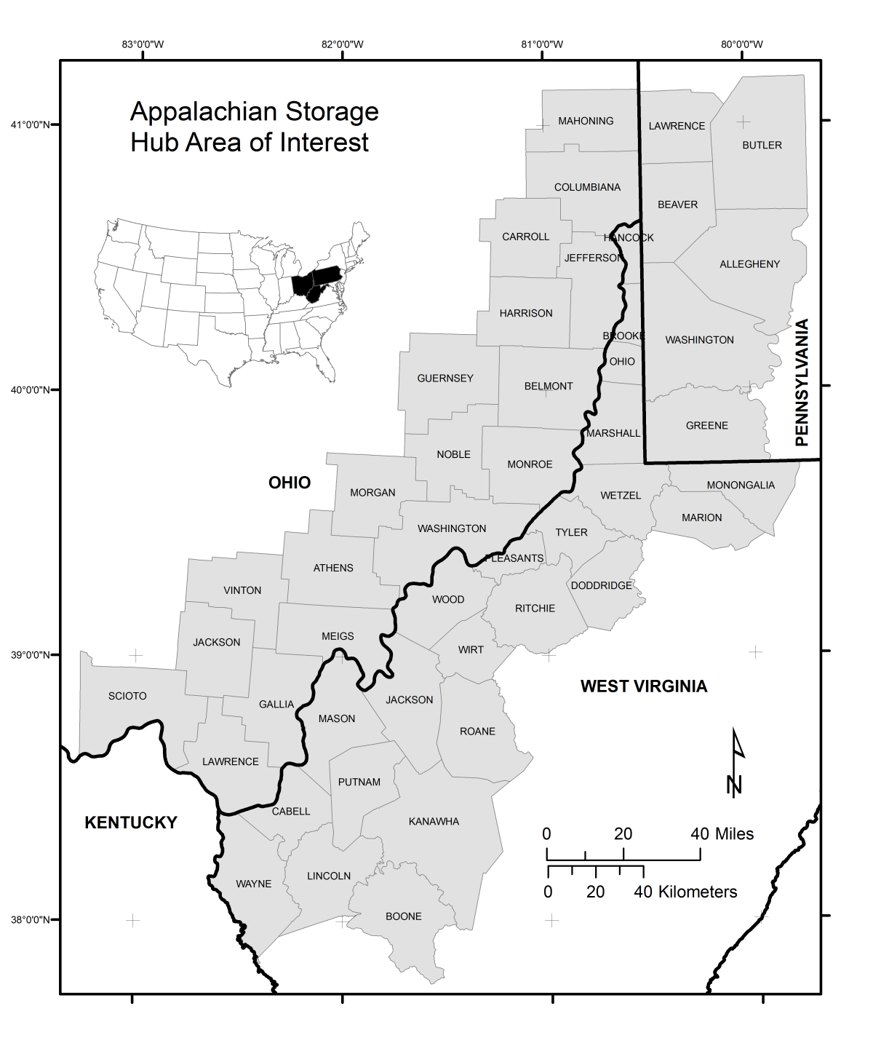
Appalachian Storage Hub Area of interest
Focused on Ohio River Valley
Incorporates W. Virginia, Pennsylvania, and Ohio
46 counties in AOI
20,107 mi²

Slide 3
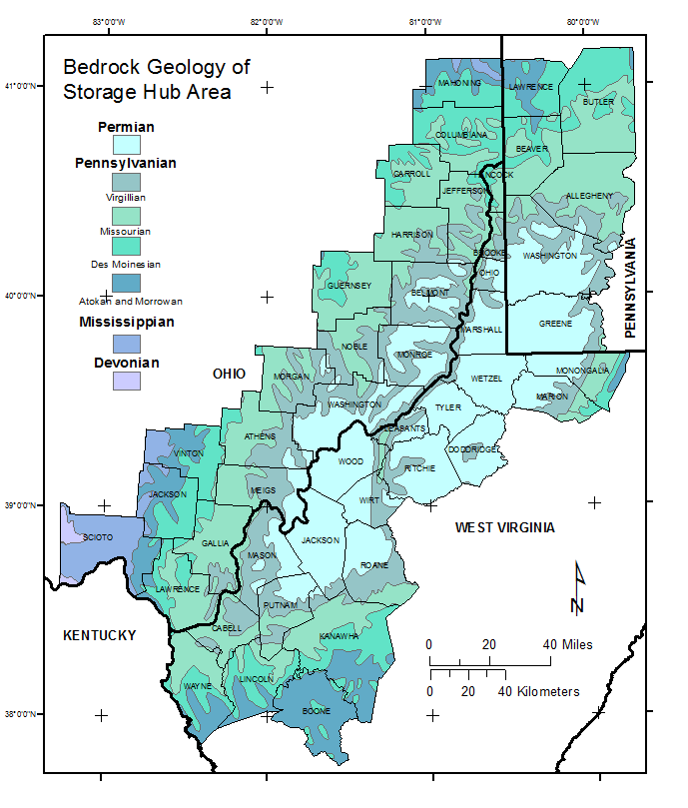
Geologic Map of Area of interest
The AOI is in the Appalachian Basin
Bedrock map outcrops: Permian, Mississippian, Pennsylvanian, Devonian
Older units, subsurface: Silurian, Ordovician, Cambrian
Modified from Wickstrom and others (2005)

Slide 4
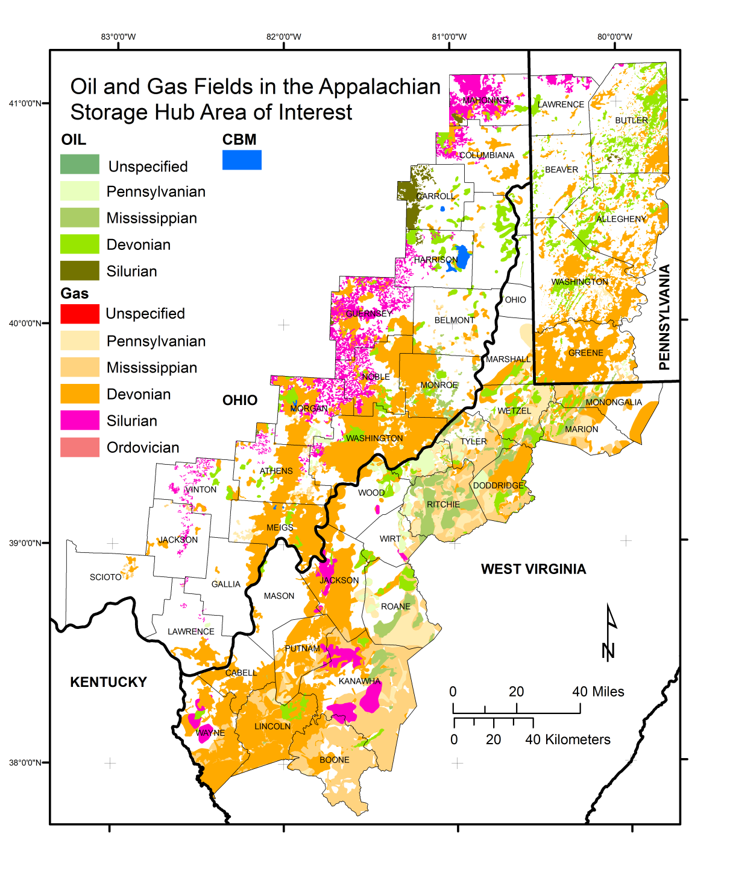
Oil and gas fields of the aoi (area of interest)
Active and depleted oil and gas fields
Modified from Wickstrom and others (2005)

Slide 5
Potential geologic formations of Ohio for ngl storage
Oriskany Sandstone
Salina Group salt
Clinton /Tuscarora Sandstone
Rose Run Sandstone

Slide 6
Cambrian Rose run sandstone
~100 ft thick sandstone
Studies:
Riley and others, 1993
Baranoski and others, 1996
Wickstrom and others 2005
Wickstrom and others (2011)
Others
Wickstrom and others (2011)

Slide 7
Rose run sand Structure & isopach maps
Subsea depth range:
-1,500ft to -16,000ft
Average thickness: 120ft
RPSEA(2015)

Slide 8
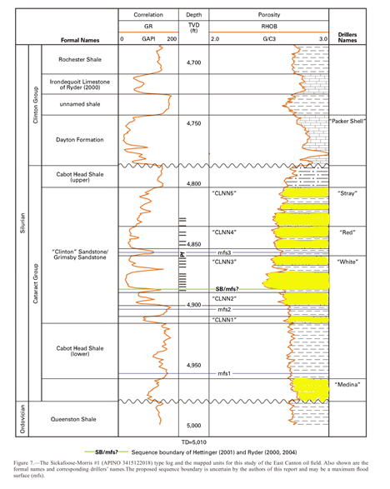
Silurian Medina/Cataract Group (“Clinton”) interval
100-300ft of interbedded sandstone and shale
Studies:
McCormac and others, 1996
Carter and others, 2010
Riley and others, 2010
Others
Riley and others (2010)

Slide 9
Medina/Cataract Group “Clinton” interval
Subsea depth range:
Sea level to - 9,000ft
Average thickness: 300ft
RPSEA(2015)

Slide 10
Tuscarora / Clinton sandstone outcrop
Seneca Rocks, West Virginia

Slide 11
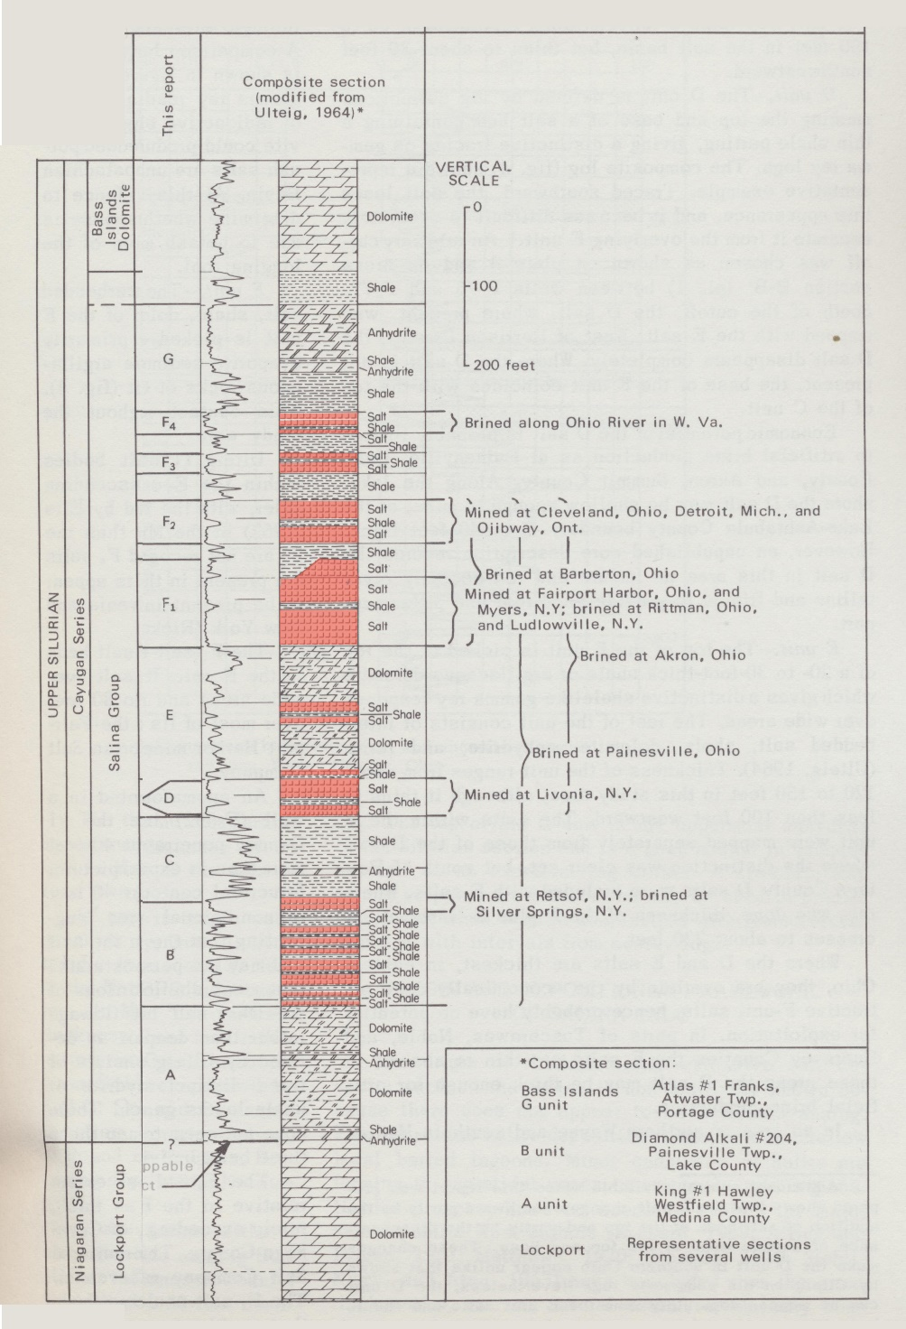
Silurian Salina Group, Salt-bearing units
Salina salt units in AOI
B: numerous thin salt beds < 10ft thick
D: ~40ft thick
E: 2 beds each ~20ft thick; locally, 1 bed > 100ft thick
F₁: 2-3 beds total ~80ft thick; pinchout to the south
F₂: 2 beds ~20ft thick; pinchout to the south
F₃: 2 beds ~20ft thick; pinchout to the south
F₄:1-3 beds > 100ft thick along the Ohio River Valley
Studies:
Stehli and others1963
Ulteig, 1964
Clifford, 1973
(Clifford, 1973)

Slide 12
Salina f4 salt, Belmont county
34013205860000
FEGENCO #1
F₄ salt > 100ft
along Ohio River
Valley
G
F
F₄
90ft
F₃
(Clifford, 1973)

Slide 13
Silurian Salina group
Salt deposition in the Michigan and Appalachian Basins
Salt thickness vary in the AOI; however net salt thickness is > 200ft along the Ohio River Valley
(Clifford, 1973)

Slide 14
Silurian Salina salt F1 member
Cargill Underground salt mine, Cleveland, Ohio

Slide 15
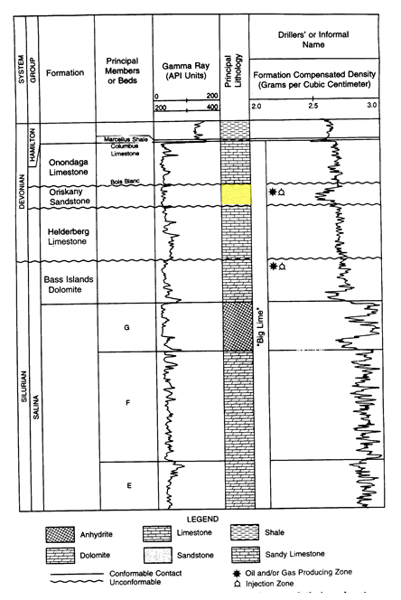
Devonian Oriskany Sandstone
0-100ft of sandstone
Studies:
Harper and Patchen, 1996
Opritza, 1996
Patchen and Harper, 1996
Kostelnik and Carter, 2009
Carter and others, 2010
Others
Opritza (1996)

Slide 16
Oriskany sandstone
Subsea depth range:
-1,000 to - 6,500ft
Thickness range: 0 - 150ft
RPSEA(2015)

Slide 17
references
Baranoski, M.T., Riley, R.A., and Wolfe, M.E., 1996, Cambrian-Ordovician Knox Group unconformity play, in Roen, J.B., and Walker, B.J., eds., The atlas of major Appalachian basin gas plays: West Virginia Geological and Economic Survey Publication v. 25, p. 145-150.
Carter, K. M., Kostelnik, J. J., Laughrey, C. D., Harper, J. A., Barnes, D. A., Harrison, W. B., III, Venteris, E. R., McDonald, James, Wells, J. G., Wickstrom, L. H., Perry, C. J., Avary, K. L., Lewis, J. E., Hohn, M. E., Stolorow, A., Slater, B. E., and Greb, S. F., 2010, Characterization of geologic sequestration opportunities in the MRCSP region, Middle Devonian–Middle Silurian formations—MRCSP phase II topical report October 2005–October 2010: Midwest Regional Carbon Sequestration Partnership report submitted to Battelle Memorial Institute and U.S. Department of Energy, Cooperative Agreement No. DE-FC26-05NT42589, 150 p.
Clifford, M.J., 1973, Silurian rock salt of Ohio: Ohio Division of Geologic Survey, Department of Natural Resources, Columbus Ohio, Report of Investigations No. 90, 42 p., 4 plates.
Harper, J.A. and Patchen, D.G., 1996, Lower Devonian Oriskany Sandstone structural play, in Roen, J.B., and Walker, B.J., eds., The atlas of major Appalachian basin gas plays: West Virginia Geological and Economic Survey Publication v. 25, p. 109-117.
Kostelnik, J., and Carter, K.M. 2009a. The Oriskany Sandstone updip permeability pinchout: A Recipe for Gas Production in Northwestern Pennsylvania: Pennsylvania Geology, v.39, no.4, p. 19-24.
Kostelnik, J., and Carter, K.M. 2009b. Unraveling the stratigraphy of the Oriskany Sandstone: A necessity in assessing its site-specific carbon sequestration potential: Environmental Geosciences, v. 16, no.4, p. 187-200.
Opritza, S.T., 1996, Lower Devonian Oriskany Sandstone updip permeability pinchout, in Roen, J.B., and Walker, B.J., eds., The atlas of major Appalachian basin gas plays: West Virginia Geological and Economic Survey Publication v. 25, p. 126-129.
Patchen, D.G. and Harper, J.A., 1996, The Lower Devonian Oriskany Sandstone combination traps play, in Roen, J.B., and Walker, B.J., eds., The atlas of major Appalachian basin gas plays: West Virginia Geological and Economic Survey Publication v. 25, p. 118-125.
Reasearch Partnership to Secure Energy for America (RPSEA), 2015, Development of subsurface brine disposal framework in the northern Appalachian Basin: Battelle Memorial Institute, Columbus Ohio, 411 p.
Riley, R. A., Harper, J. A., Baranoski, M. T., Laughrey, C. D., and Carlton, R. W., 1993, Measuring and predicting reservoir heterogeneity in complex deposystems: The Late Cambrian Rose Run sandstone of eastern Ohio and western Pennsylvania. Appalachian Oil and Natural Gas Research Consortium, West Virginia University, Morgantown, WV, U.S. Depart­ment of Energy, contract no. DE-AC22-90BC14657, 257 p.
Riley, R.A., Wicks, J.L., and Perry, C.J., 2010, Silurian “Clinton” sandstone reservoir characterization for evaluation of CO₂-EOR potential in the East Canton Oil Field, Ohio: Ohio Division of Geologic Survey, Department of Natural Resources, Columbus Ohio, Open File Report 2011-2, 31p. 4 plates.
Stehli, F.G., Namy, J.N., and Aten, M.D., 1963, Evaporite facies in northeastern Ohio, in Symposium on salt, Cleveland: Northern Ohio Geological Society, Cleveland, Ohio, p. 31-46.
Wickstrom, L.H., Venteris, E.R., Harper, J.A., McDonald, James, Slucher, E.R., Carter, K.M, Greb, S.F., Wells, J.G., Harrison, W.B., III, Nuttall, B.C., Riley, R.A., Drahovzal, J.A., Rupp, J.A., Avary, K.L., Lanham, Sacha, Barnes, D.A., Gupta, Neeraj, Baranoski, M.T., Radhakkrishnan, Premkrishnan, Solis, M.P. Baum, G.R., Powers, Donovan, Hohn, M.E., Parris, M.P., McCoy, Karen, Grammer, Michael, Pool, Susan, Luckhardt, Catherine, Kish, Patrick, 2005, Characterization of Geologic Sequestration Opportunities in the MRCSP Region—Phase I task report October 2003—September 2005: Midwest Regional Carbon Sequestration Partnership report submitted to Battelle Memorial Institue and U.S., Department of Energy, Cooperative Agreement No. DE-PS2605NT42255, 152 p.
Wickstrom, L.H., Riley, R.A., Spane, F.A., McDonald, James, Slucher, E.R., Zody, S.P., Wells, J.G., and Howat, Erica, 2011, Geologic assessment of the Ohio Geological Survey CO₂ No. 1 well in Tuscarawas County and surrounding vicinity: Ohio Division of Geologic Survey, Department of Natural Resources, Columbus Ohio, Open File Report 2011-3, 81 p.
Ulteig, J.R., 1964, Upper Niagaram and Cayugan stratigraphy of northeastern Ohio and adjacent areas: Ohio Division of Geologic Survey, Department of Natural Resources, Columbus Ohio, Report of Investigations No. 51, 48 p.

