Slide 1
Appalachian storage Hub (ASH) project
Semi-Annual Meeting
March 14, 2017
WVU Erickson Alumni Center

Slide 2
Strategy 2: stratigraphic correlation
Kyle Metz – Energy Resources Group, Ohio Department of Natural Resources – Division of Geological Survey
Michael Solis - ODNR
Gary Daft - WVGES
Eric Lewis - WVGES
Kristin Carter – PAGS

Slide 3
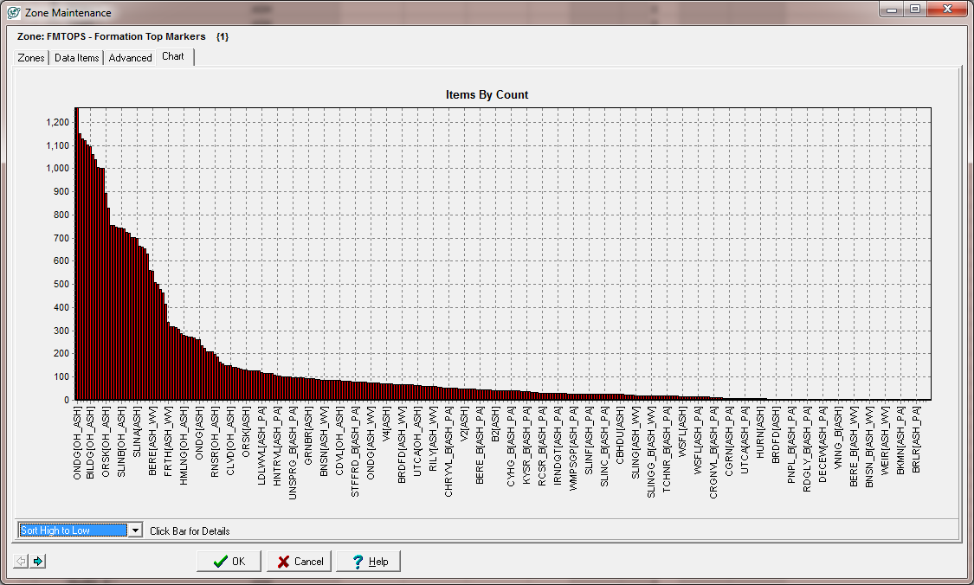
ASH Project
Strategy 2 – Stratigraphic Correlation of Key Units
Formation top distribution input into study
Number of wells with Formation Picked
Formations
Challenge – over 200 individual named formations. Need to alias formations and correct for state-line ‘faults’ / jumped correlations to provide a consistent set of maps for the nine intervals of interest within the AOI.
Identify formations of value and their lateral equivalents.
Extend correlations into areas where well logs are present but tops are missing.
Formation top distribution after aliasing/regional correlations
3907 wells with tops
Number of wells with Formation Picked
Formations

Slide 4
Strategy 2 – stratigraphic correlation
Mississippian – Devonian : (Greenbrier, Keener to Berea, Upper Devonian Sands)
W
E
W
Greenbriar – 218 wells
Big Injun – 1170 wells
Berea – 1169 wells
E
Venango – 543 wells
Bradford – 477 wells
Elk – 531 wells
Greenbrier/Big Injun is difficult to correlate and map in OH due to unconformities and lack of logs over interval
Berea is more well developed into OH
Venango, Bradford, and Elk are more well developed in PA & WV due to proximity to catskill delta

Slide 5
Strategy 2 – stratigraphic correlation
Mississippian – Devonian : Greenbrier
From Rice & Schwietering, 1988
Greenbrier subcrop sub parallel to Ohio River. Some erosional remnants complicate contour mapping of interval.
From Rice & Schwietering, 1988

Slide 6
Strategy 2 – stratigraphic correlation
Mississippian – Devonian : Big Injun
From Roen et al., 1996
From Roen et al., 1996
Most productive Lower Miss sandstone in basin.
Discovered in 1886.
Fluvial channel to distributary/delta front environment of deposition.
From Roen et al., 1996

Slide 7
Strategy 2 – stratigraphic correlation
Mississippian – Devonian : Berea
From Roen et al., 1996
From Roen et al., 1996
From Roen et al., 1996
First discovered in 1860.
Diverse depositional environments from fluvial-deltaic to shallow marine and barrier beach settings.
Some stacked reservoir potential

Slide 8
Strategy 2 – stratigraphic correlation
Mississippian – Devonian : Venango, Bradford, Elk sands
From Roen et al., 1996
From Roen et al., 1996
First discovered in 1859.
Fluvial-deltaic environment of deposition in Catskill delta complex.
Sediments shed from the Acadian Orogeny.
Multiple stacked sandstone reservoirs.
From Roen et al., 1996

Slide 9
Strategy 2 – stratigraphic correlation
Devonian - Silurian: (Oriskany, Salina, Newburg, Cataract Group)
S
N
N
Oriskany is bound by unconformities on both top and base, so presence is spotty where thin.
Salina salt basin is centered along West Virginia panhandle.
Salina F4 salt bound on top by Salina G anhydrite (~100’ thick).
Newburg developed in southwestern WV.
Cataract Group (Clinton/Medina) is present throughout area.
S
Oriskany– 1033 wells
Salina F– 825 wells
Newburg– 271 wells
Cataract Group– 1052 wells

Slide 10
Strategy 2 – stratigraphic correlation
Devonian - Silurian: Oriskany
From Roen et al., 1996
From Roen et al., 1996
First discovered in 1887.
High-energy marine, nearshore environment of deposition.
Single clean sandstone reservoir.
From Roen et al., 1996

Slide 11
Strategy 2 – stratigraphic correlation
Devonian - Silurian: Newburg
From Roen et al., 1996
From Roen et al., 1996
First discovered in 1939, play kicked off in 1964.
Supra-to-intertidal environment with storm influence.
Single clean sandstone reservoir.
From Roen et al., 1996

Slide 12
Strategy 2 – stratigraphic correlation
Devonian - Silurian: Cataract Group
First discovered accidentally in 1920s.
Upper ‘Clinton’ sands are shallow marine – deltaic.
Lower ‘Medina’ sands are transgressive marine sands.
Generally low porosity. Production enhanced by fractures.
From Roen et al., 1996
Multiple stacked laterally continuous sandstone reservoirs
From Roen et al., 1996
From Roen et al., 1996

Slide 13
Strategy 2 – stratigraphic correlation
Ordovician – Rose Run
Rose Run is part of the Knox unconformity play.
Has complex mineralogy (feldspar) causing GR to read high.
Best discriminator for reservoir is porosity log.
Rose Run / Gatesburg is prohibitively deep and poorly defined in WV/PA.
Rose Run – 665 wells

Slide 14
Strategy 2 – stratigraphic correlation
Ordovician - Cambrian: Rose Run
From Roen et al., 1996
First discovered in 1961.
Interpreted to represent lowstand sands that were reworked during sealevel transgression.
Single Laterally continuous sandstone reservoir.
From Roen et al., 1996

Slide 15
Strategy 3: Mapping
Kyle Metz – Energy Resources Group, Ohio Department of Natural Resources – Division of Geological Survey
Michael Solis - ODNR
Mohammad Fakhari - ODNR
Gary Daft- WVGES
Kristin Carter – PAGS

Slide 16
Strategy 3 – Mapping of Key Intervals
Greenbrier
Structure Map
TVDss
CI = 100 ft
Gross Isopach Map
Apparent thickness
CI = 10 ft
Structure map from WV combined with well control to generate high-resolution map that honors preexisting structure maps and newest well tops.
Data in Ohio is questionable due to drilling/logging practices and Greenbrier subcrop location.

Slide 17
Strategy 3 – Mapping of Key Intervals
Keener to Berea
Structure Map
TVDss
CI = 100 ft
Gross Isopach Map
Apparent thickness
CI = 25 ft
Used Greenbrier structure map and isopached down to Keener-Berea top, then recontoured with well control.
Assumes concordant folding with Greebrier Limestone.
Keener/Big Injun data is questionable in Ohio due to drilling/logging practices.
Gross isopach, NOT net sand

Slide 18
Strategy 3 – Mapping of Key Intervals
Venango
Structure Map
TVDss
CI = 100 ft
Gross Isopach Map
Apparent thickness
CI = 25 ft
Used Greenbrier structure map and isopached down to Venango top, then recontoured with well control.
Assumes concordant folding with Greebrier Limestone.
Gross isopach, NOT net sand

Slide 19
Strategy 3 – Mapping of Key Intervals
Bradford
Structure Map
TVDss
CI = 100 ft
Gross Isopach Map
Apparent thickness
CI = 25 ft
Used Greenbrier structure map and isopached down to Bradford top, then recontoured with well control.
Assumes concordant folding with Greebrier Limestone.
Gross isopach, NOT net sand

Slide 20
Strategy 3 – Mapping of Key Intervals
Elk
Structure Map
TVDss
CI = 100 ft
Gross Isopach Map
Apparent thickness
CI = 25 ft
Used Greenbrier structure map and isopached down to Elk top, then recontoured with well control.
Assumes concordant folding with Greebrier Limestone.
Gross isopach, NOT net sand

Slide 21
Strategy 3 – Mapping of Key Intervals
Oriskany
Structure Map
TVDss
CI = 100 ft
Gross Isopach Map
Apparent thickness
CI = 10 ft
Combined contours from RPSEA subsurface brine injection project with latest well tops.
Combined contours from RPSEA subsurface brine injection project with latest well tops.

Slide 22
Strategy 3 – Mapping of Key Intervals
Salina ‘F4’ Salt
Structure Map
TVDss
CI = 100 ft
Net Isopach Map
Net Salt thickness
CI = 10 ft
Salina ‘F’ salt and stratigraphic equivalent top.
Net Salina ‘F4’ salt basin is centered along WV panhandle/Ohio River.
F4 salt thickness exceeds 100 feet in basin center.
F3 salt ~20 feet below could add an extra 25 – 50 feet of salt.

Slide 23
Strategy 3 – Mapping of Key Intervals
Cataract Group
Structure Map
TVDss
CI = 100 ft
Gross Isopach Map
Apparent thickness
CI = 5 ft
Combined contours from RPSEA subsurface brine injection project with latest well tops.
Combined contours from RPSEA subsurface brine injection project with latest well tops.

Slide 24
Strategy 3 – Mapping of Key Intervals
Rose Run
Structure Map
TVDss
CI = 250 ft
Gross Isopach Map
Apparent thickness
CI = 25 ft
Combined contours from RPSEA subsurface brine injection project with latest well tops.
Little-to-no well control in deeper part of basin.
Combined contours from RPSEA subsurface brine injection project with latest well tops.
Little-to-no well control in deeper part of basin.

Slide 25
References and Acknowledgements
Rice, C.L. and Schwietering, J.F., 1988, Fluvial Deposition in the Central Appalachian During the Early Pennsylvanian, U.S. Geological Survey Bulletin: Evolution of sedimentary basins – Appalachian Basin, QE75.B9 no. 1829A-D, pp. B1-B10.
Roen, John B., Walker, Brian J., and others, 1996, The Atlas of Major Appalachian Gas Plays: West Virginia Geological and Economic Survey, Publication V-25.
I would like to thank the ASH research team for their assistance. I would also like the thank the industry partners for their support with this project.

