Slide 1
Appalachian storage Hub (ASH) project
Jessica Pierson Moore
West Virginia Geological and Economic Survey

Slide 2
Database construction
Flexible, iterative process that can be modified depending on project needs
Uses format and template derived from previous work
Database will be built to ensure maximum efficiency of technology transfer

Slide 3
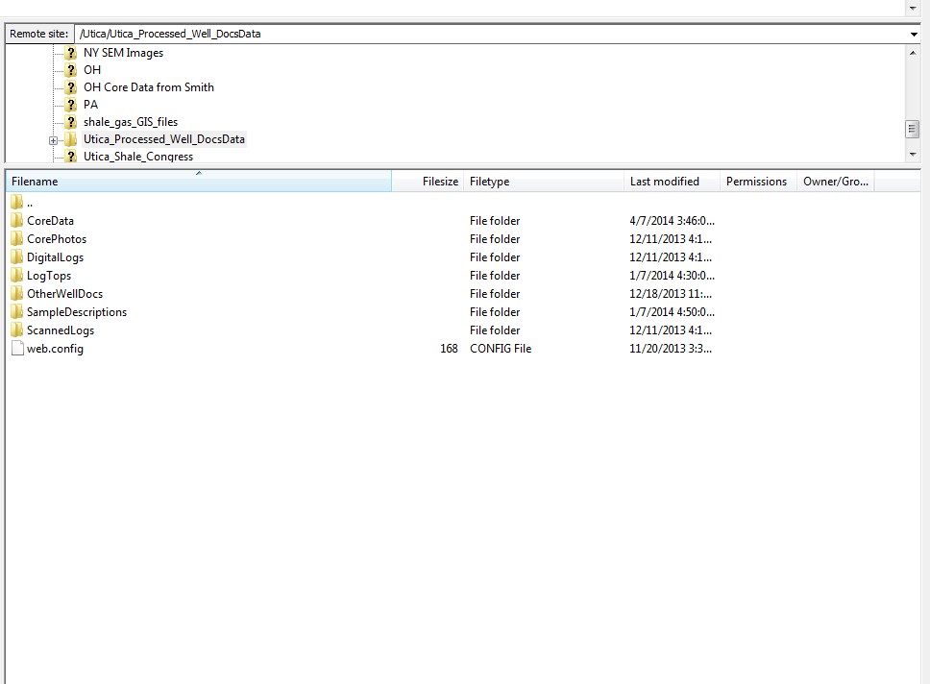
FTP/Dropbox Site
Researchers will submit information as it is gathered/interpreted
Each folder organized by state
Linked to online searchable database

Slide 4
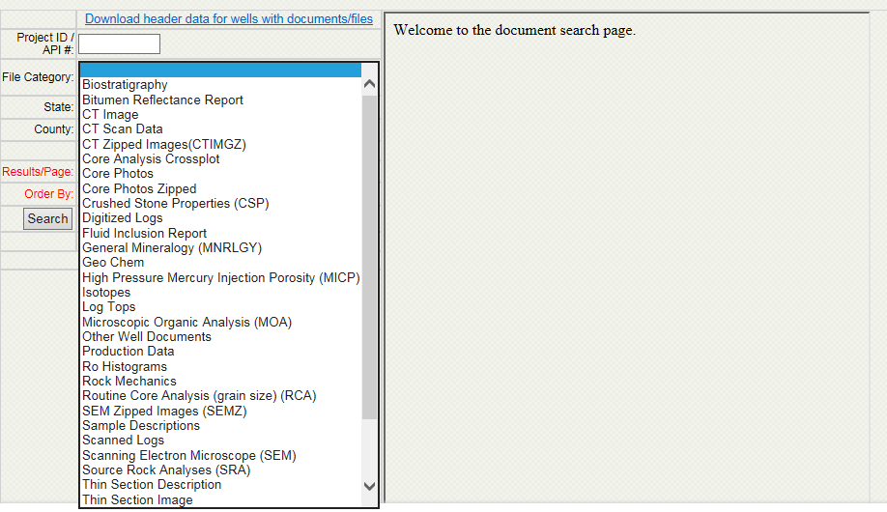
Well File Document Search
Linked to root file on FTP server
Creates customized searches on multiple criteria

Slide 5
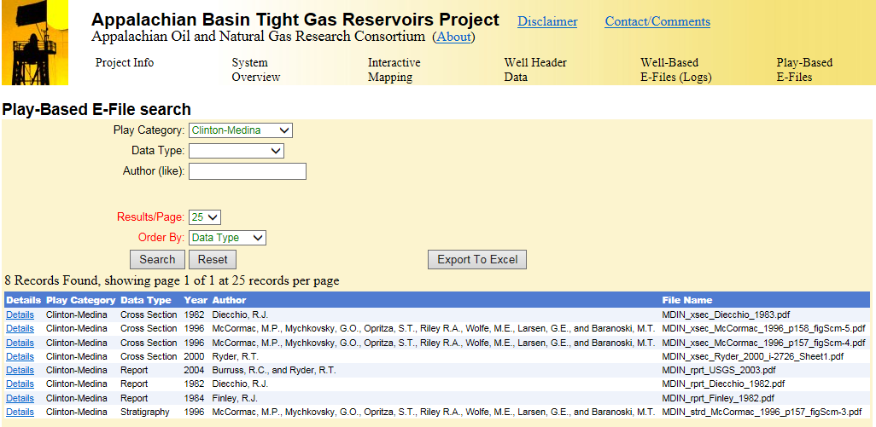
Legacy Projects
http://www.wvgs.wvnet.edu/atg/ProjectInfo.aspx

Slide 6
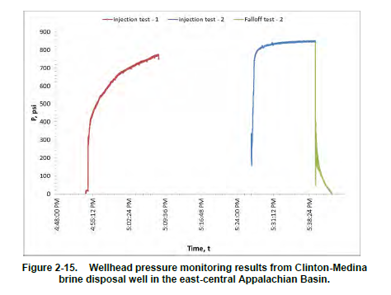
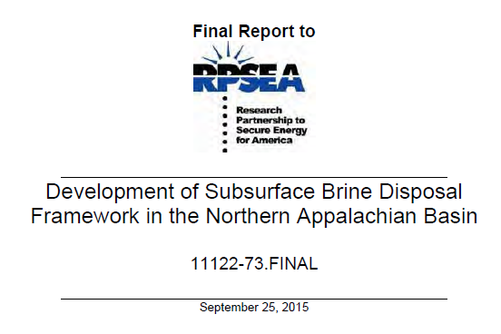
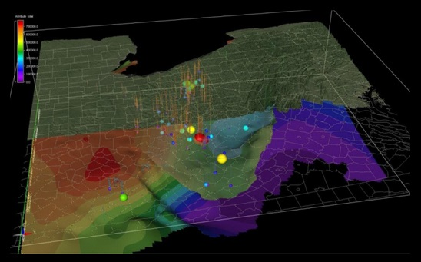
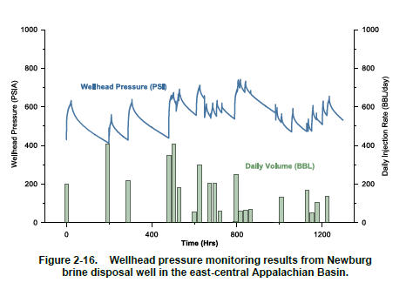
Legacy Projects
http://www.rpsea.org/projects/11122-73/

Slide 7
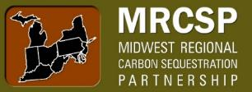
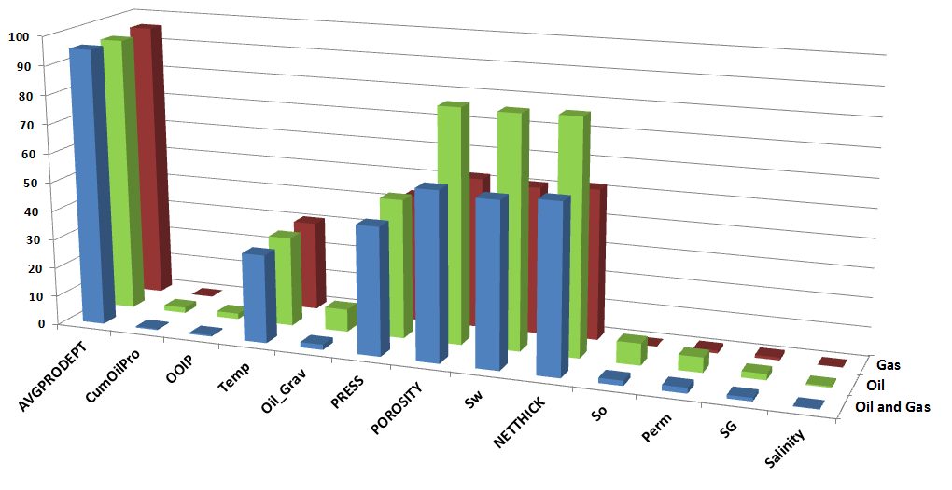
Legacy Projects
Midwest Regional Carbon Sequestration Partnership (MRCSP)
Ongoing, collaborative research encompassing a ten-state region
Project managed by Battelle Memorial Laboratory
Includes detailed reservoir data and regional cross-sections
http://www.mrcsp.org/
The United States of America
MRCSP Study Area
Fields Data Attributes
MRCSP
Western Extent
%

Slide 8
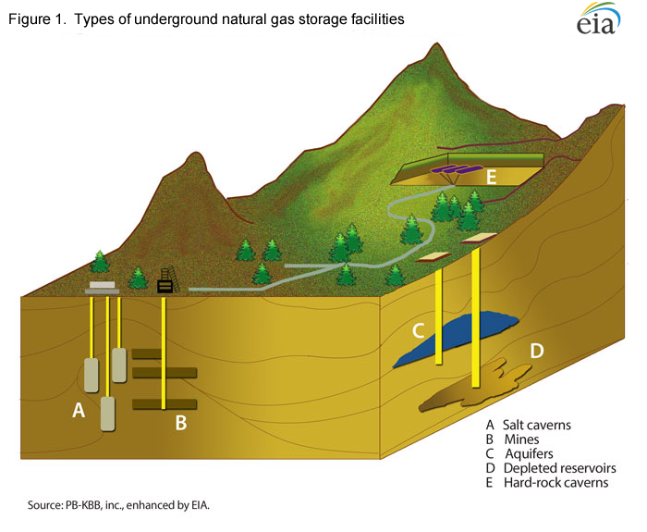

Slide 9
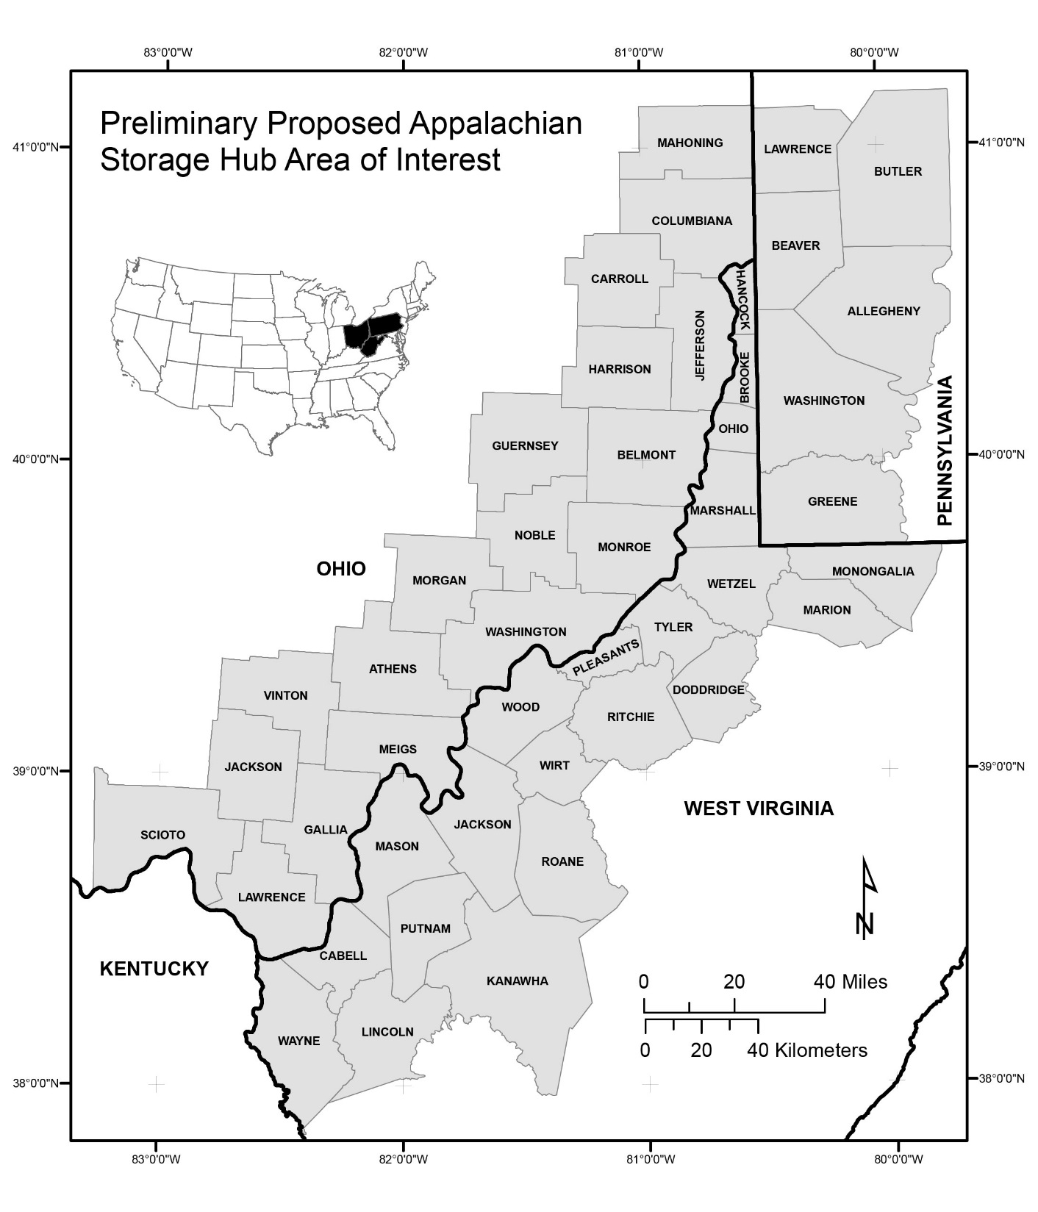
Multiple Options

Slide 10
Appalachian storage Hub
SOLUTION MINING

Slide 11
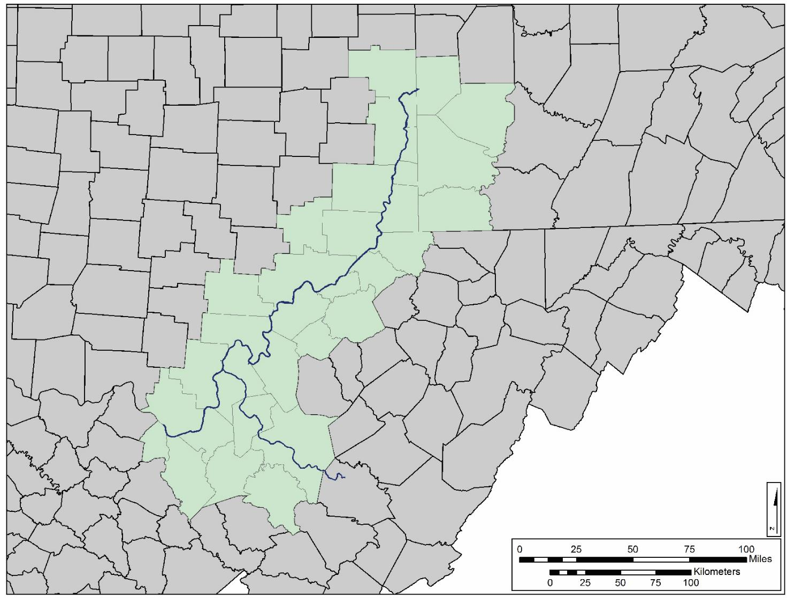
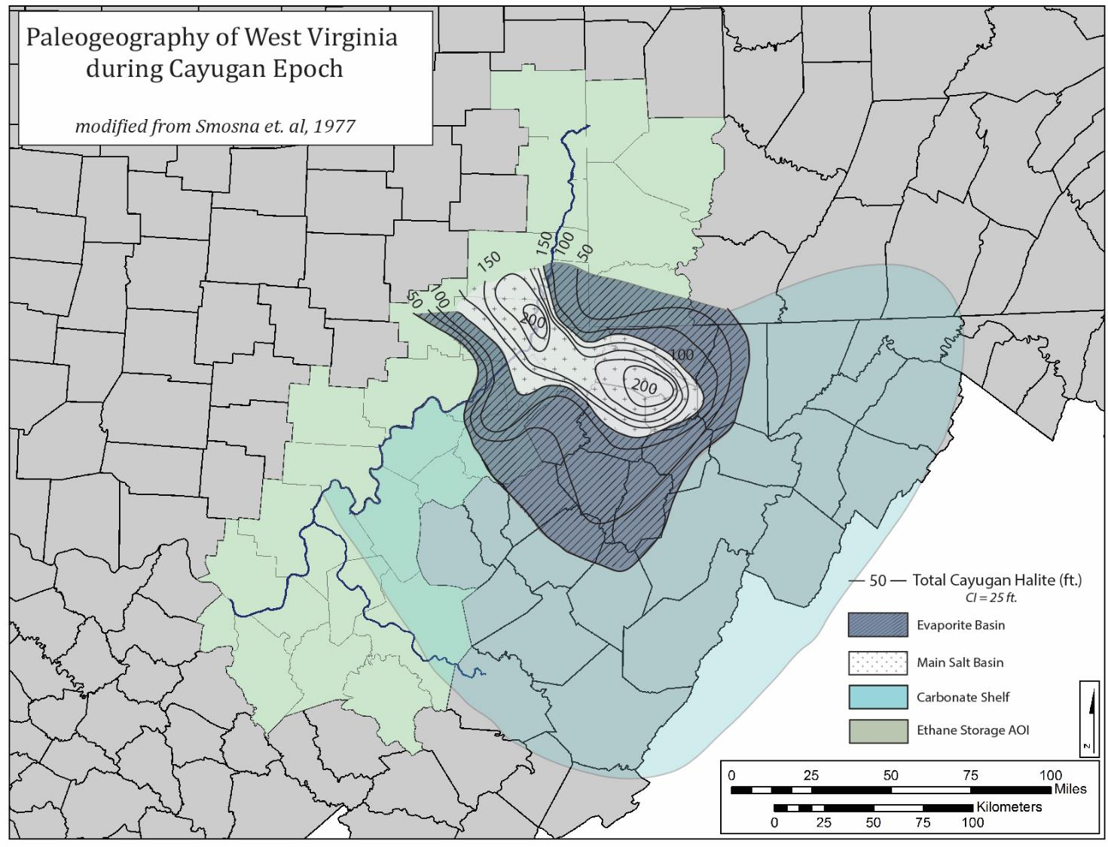

Slide 12
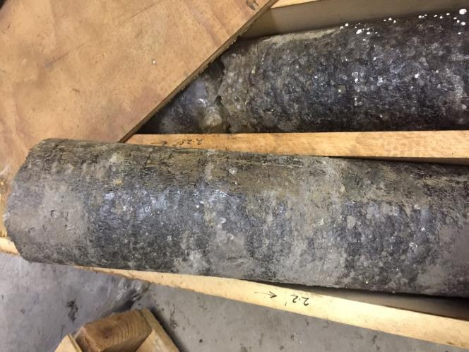
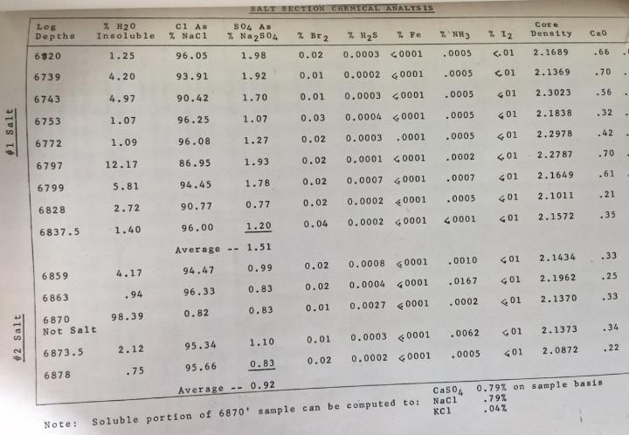
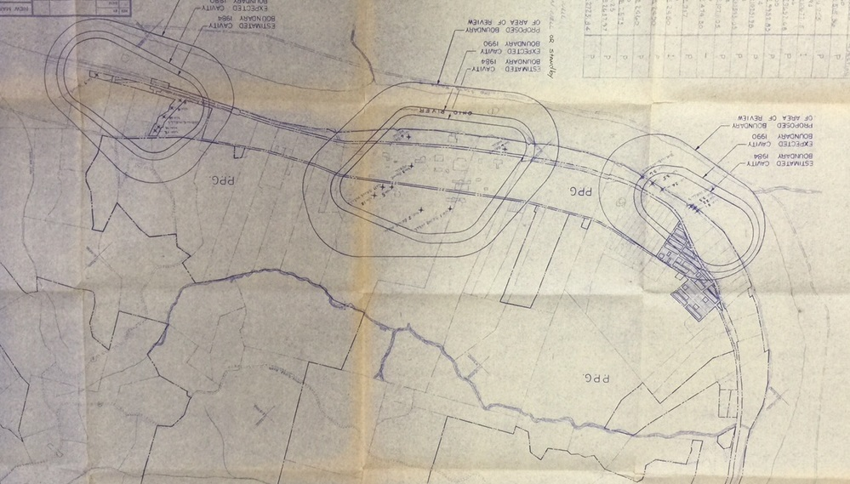
PPG Industries--Natrium, WV
Cavern Maps and Analyses
4” diameter core
Chemical analyses and maps from UIC permit applications

Slide 13
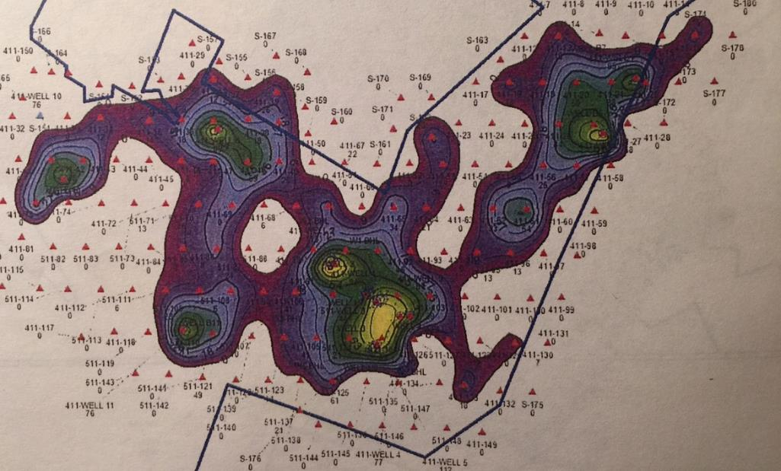
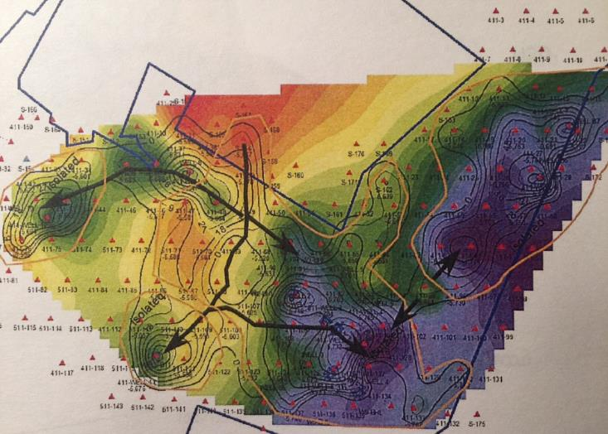
Bens Run Salt Brine Caverns

Slide 14
Appalachian storage Hub PROJECT
MINED ROCK CAVERNS

Slide 15
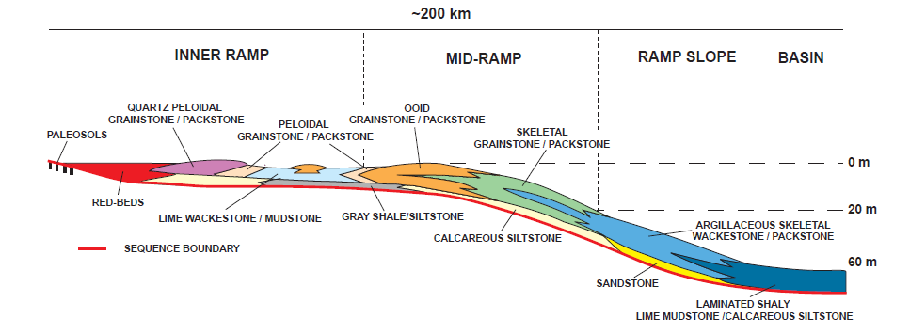
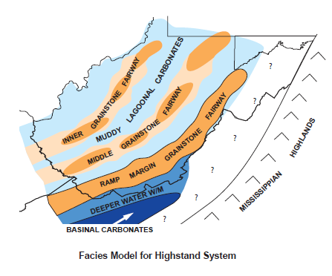
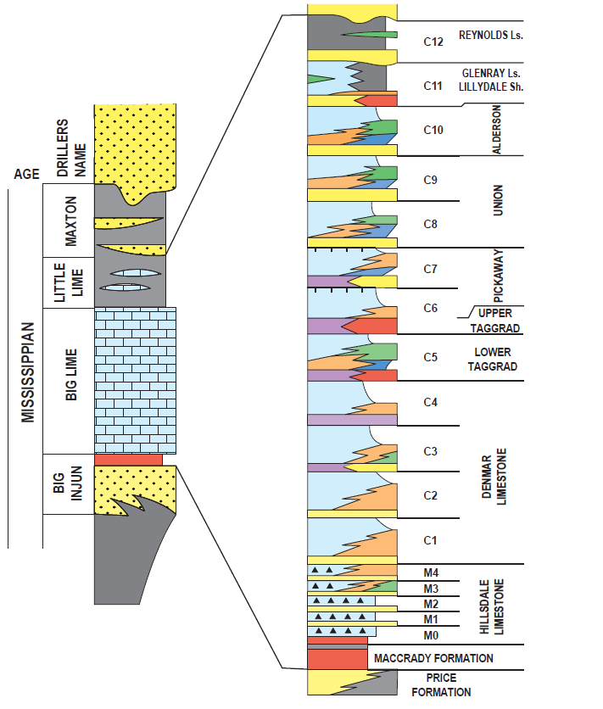
Wynn, 2003
Wynn, 2003

Slide 16
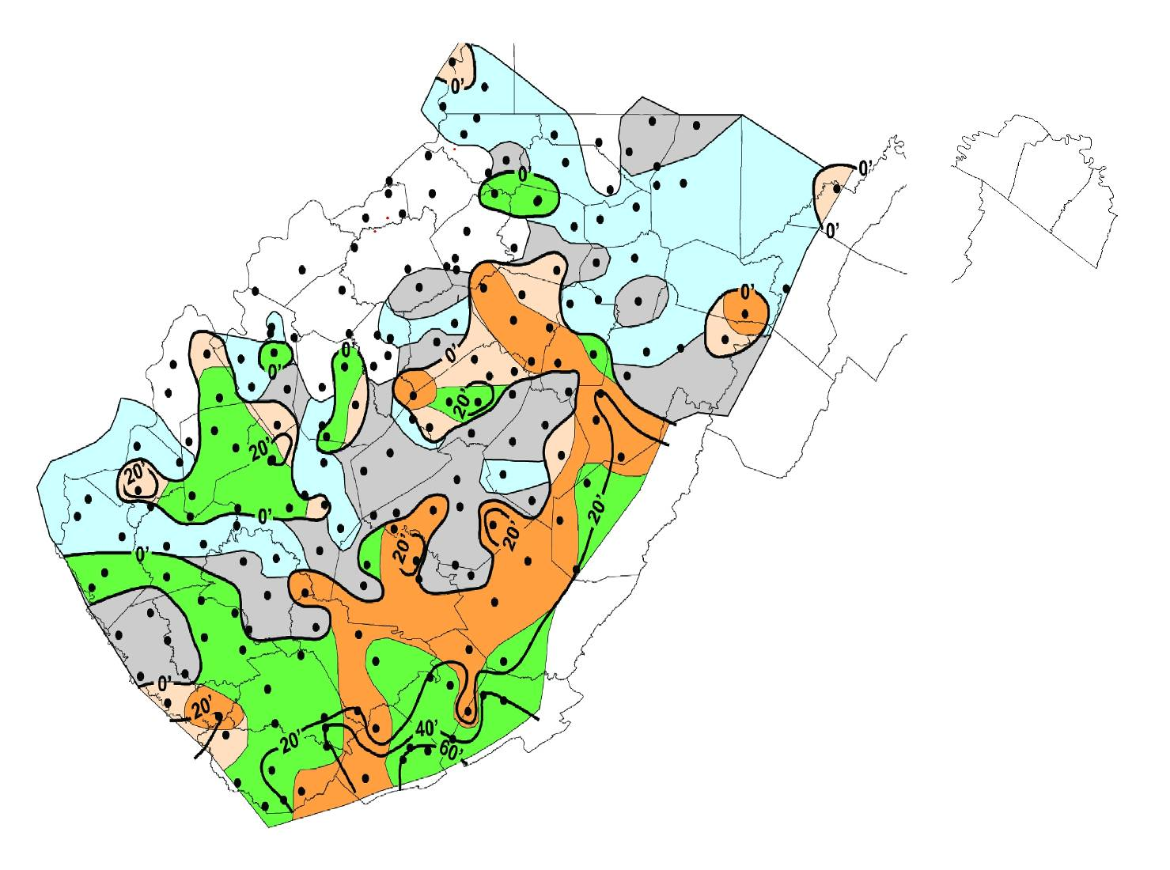
CARBONATE RESERVOIR HETEROGENEITY
Wynn, 2003

Slide 17
Appalachian storage Hub project
DEPLETED GAS RESERVOIRS

Slide 18
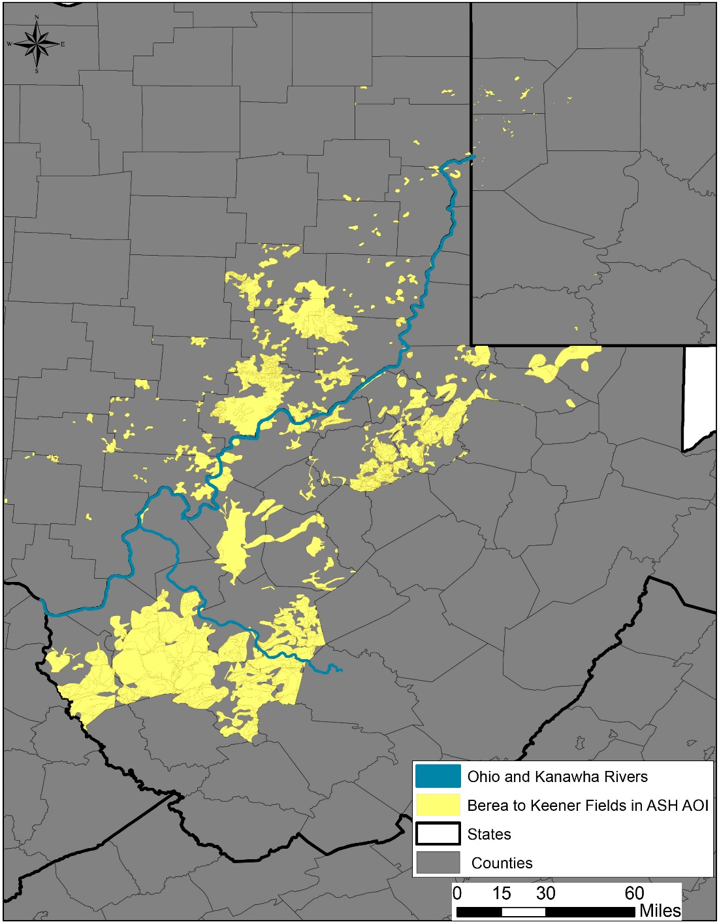
Berea to Keener Interval
Includes conventional drillers’ targets such as the “Big Injun”, “Squaw”, and “Weir” sands
Many small fields within the larger, regional trends

Slide 19
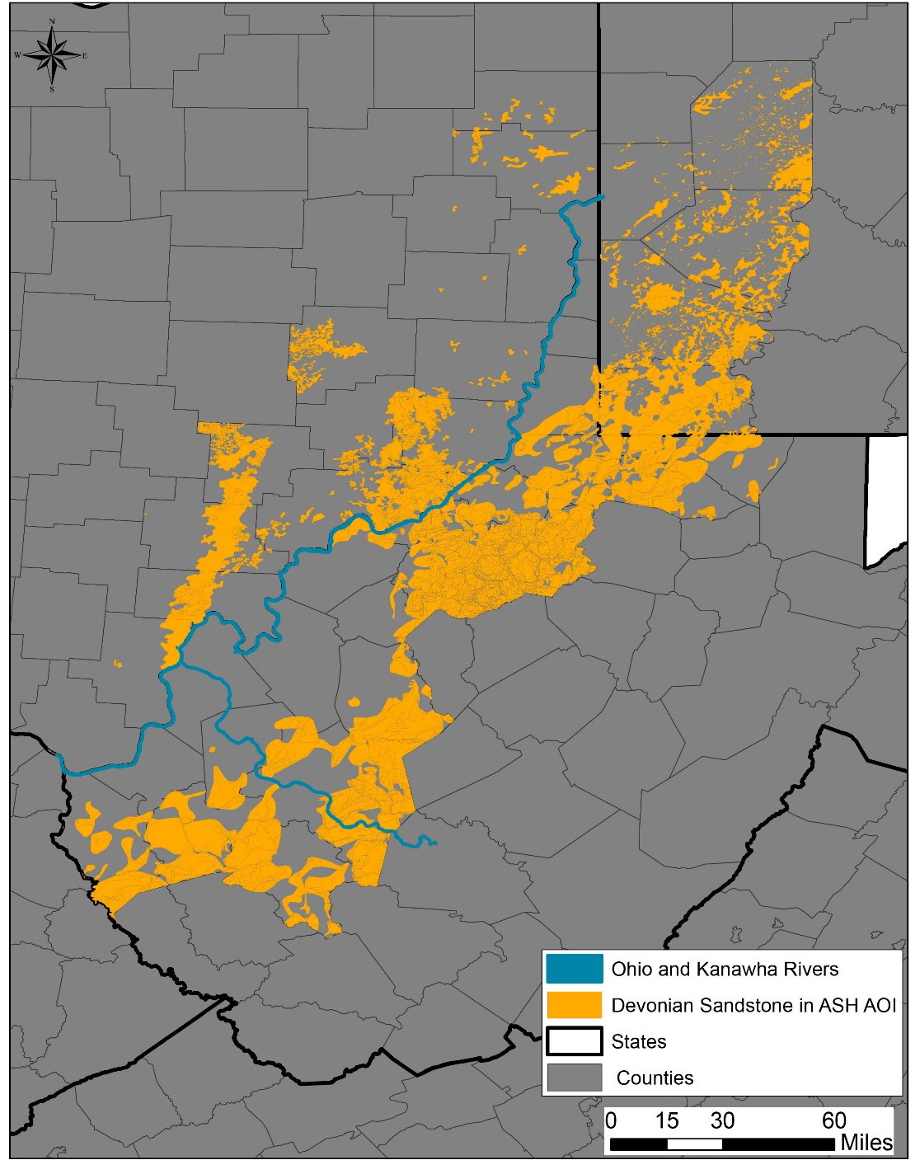
Devonian Sandstone Interval
Historical drilling targets in northern WV and SW PA
Sand bodies become more discontinuous to west
Shales replace siliciclastics to west and south

Slide 20
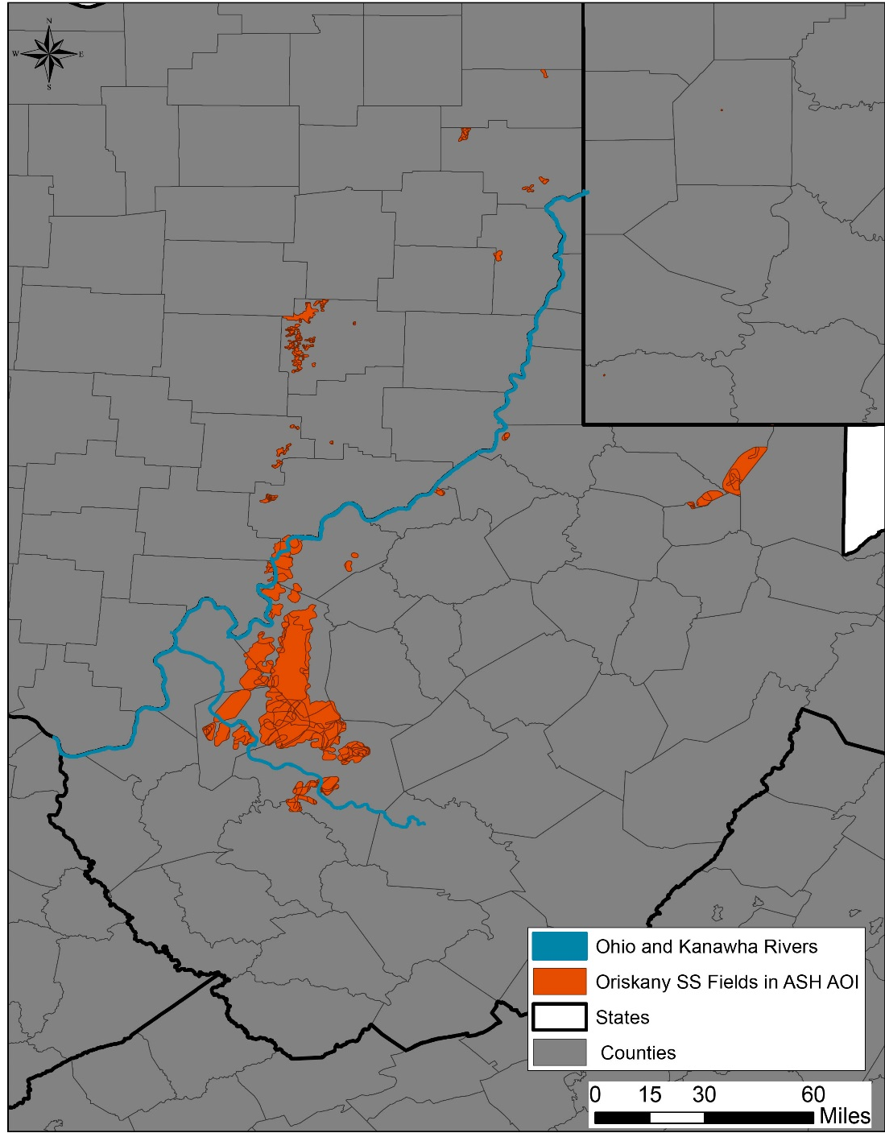
Oriskany Sandstone
Some pools/fields demonstrate excellent porosity and permeability
Variable reservoir composition and quality
Becomes highly fractured to east

Slide 21
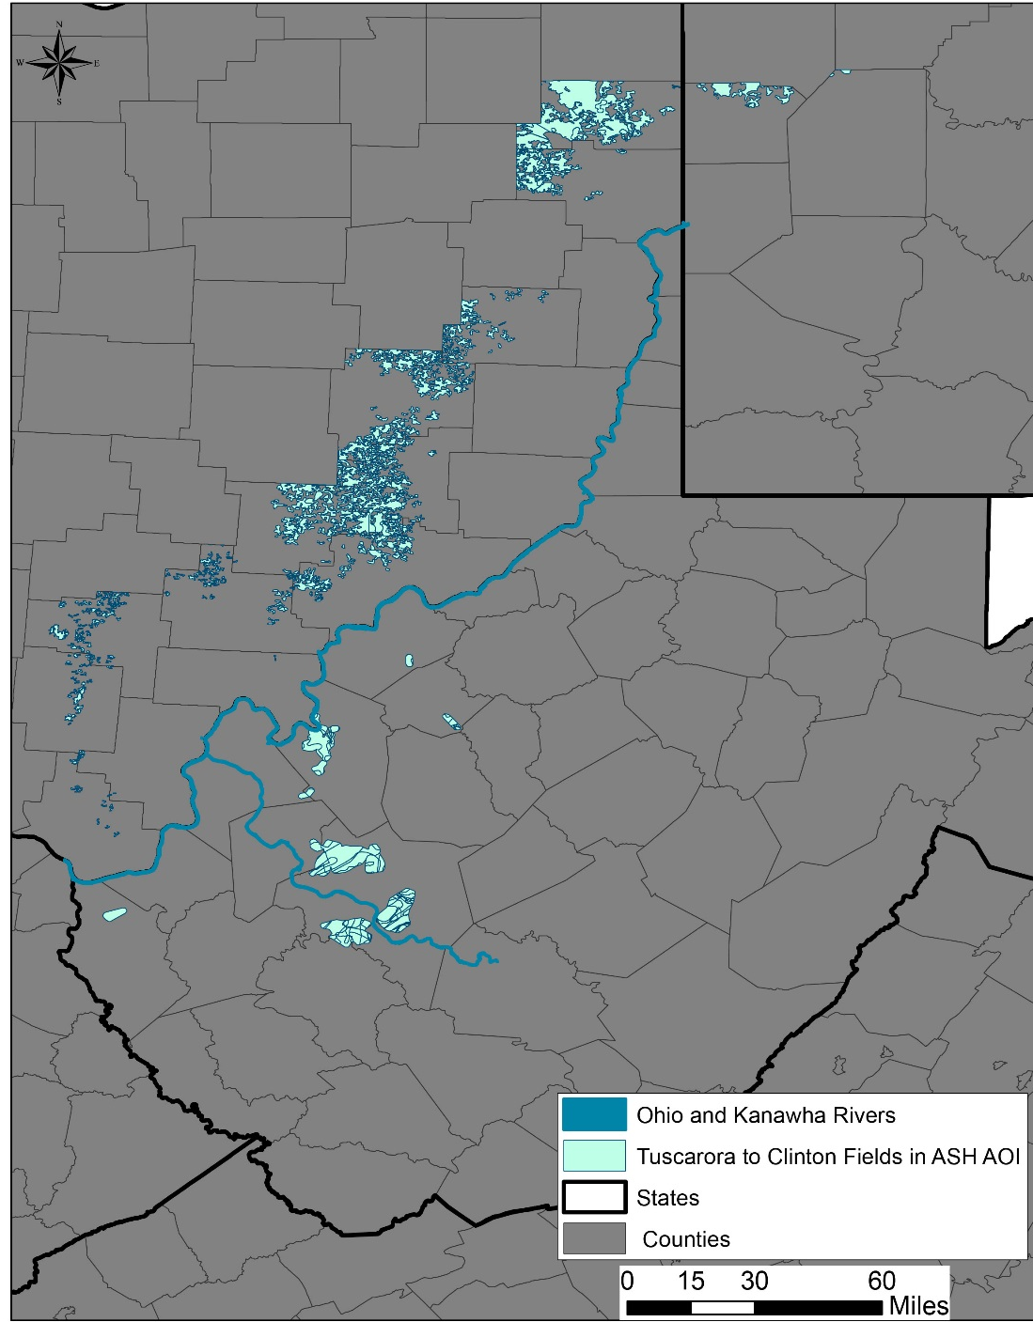
Tuscarora to Clinton Interval
Excellent production history in Ohio
Deeper, and less frequently targeted, in eastern portions of the basin
Food-grade CO₂ produced from Indian Creek field (Kanawha County, WV)

Slide 22
SUMMARY
Database construction has begun, and database will continue to be populated as project moves forward
Robust legacy dataset available
Variable geographic footprint
Variable lithologic character within and between reservoirs

Slide 23
THANK YOU!

