Slide 1

Appalachian storage Hub (ASH) project
Strategy 1: Data collection
Jessica Pierson Moore
West Virginia Geological and Economic Survey

Slide 2
Data collection
Flexible, iterative process that can be modified depending on project needs
Uses format and template derived from previous work
Database will be built to ensure maximum efficiency of technology transfers
3 Main Tasks:
  Identify and assemble well log and core data
  Identify previous studies of interest
  Create a project database

Slide 3

File sharing
Researchers submit information as it is gathered/interpreted
Each folder organized by state
Linked to online searchable database
REPLACE WITH ASH SCREENCAP

Slide 4
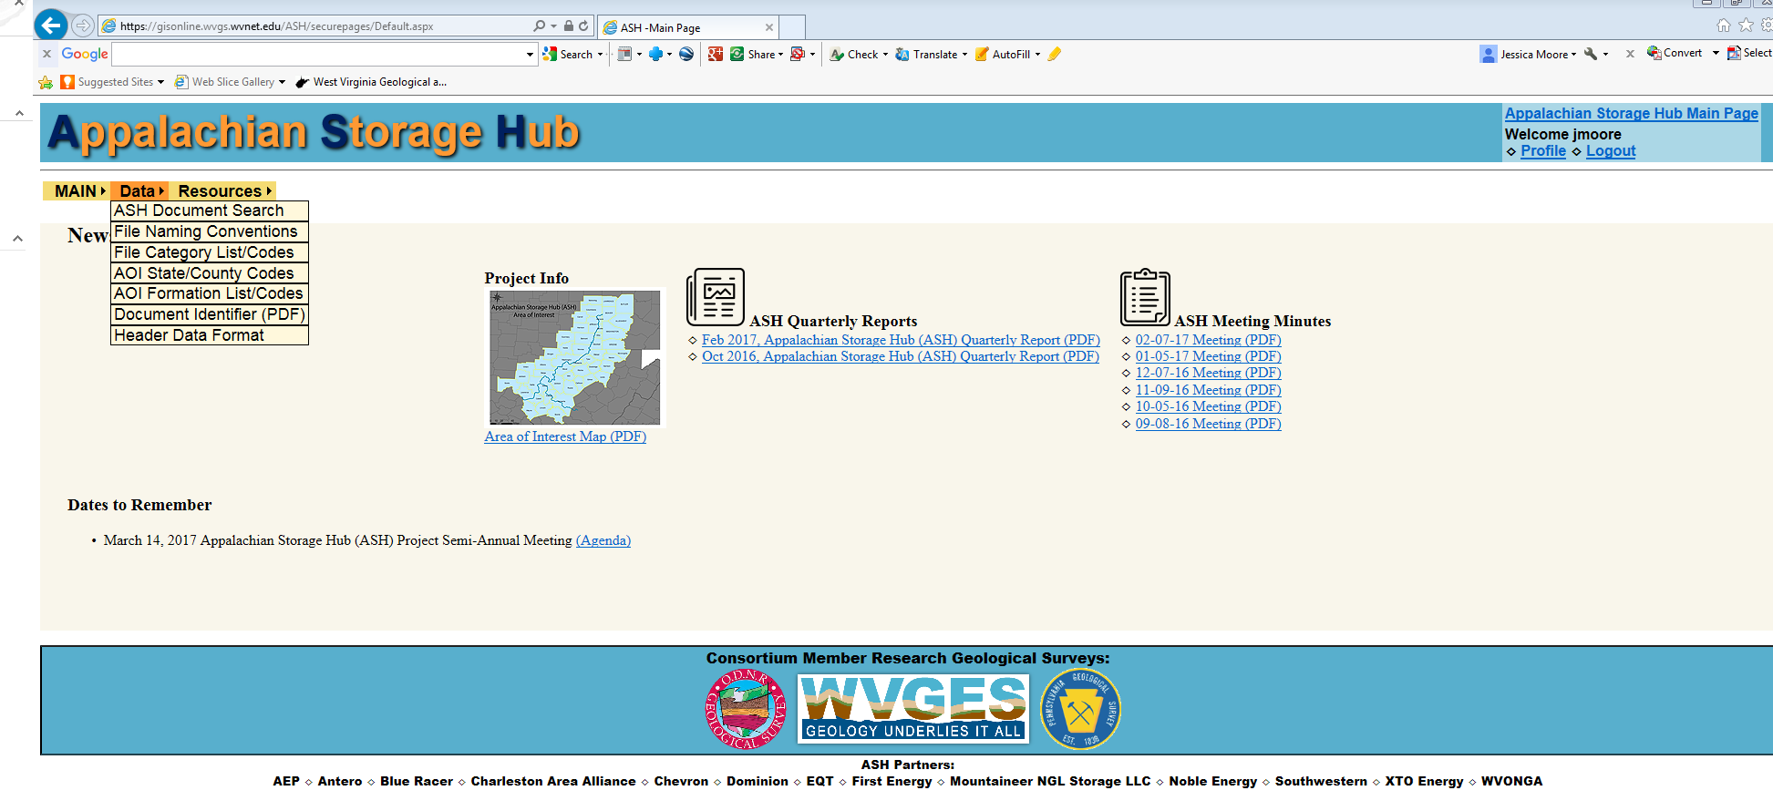
Project website
https://gisonline.wvgs.wvnet.edu/ASH/

Slide 5
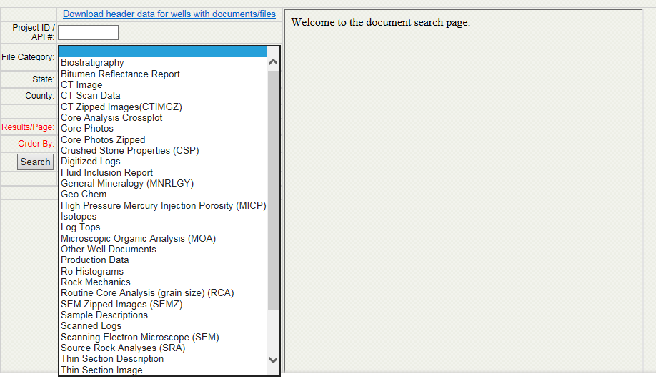
Well File Document Search
Linked to root file on FTP server
Creates customized searches on multiple criteria

Slide 6
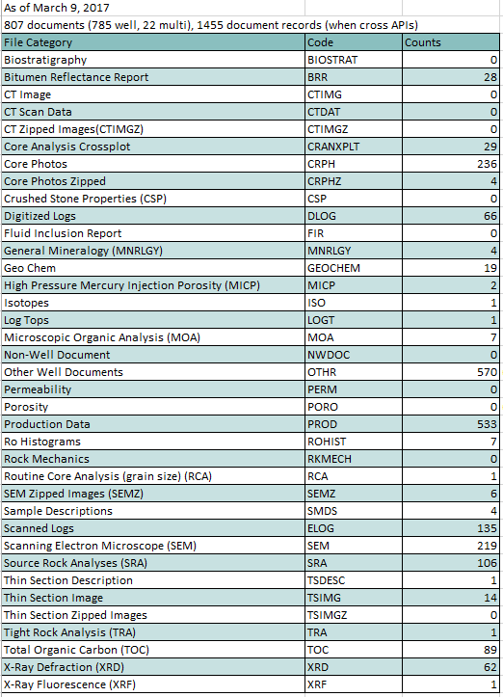
ASH Document
File Counts as of
March 9, 2017
File number will increase as Mapping and Reservoir Characterization
strategies proceed

Slide 7
Bibliography, Completed Projects, and links to publications
Annotated bibliography is being compiled to enable keyword searches of pertinent literature
Robust legacy dataset available, including many completed projects
Publications usually reserved for purchase will also be made available

Slide 8

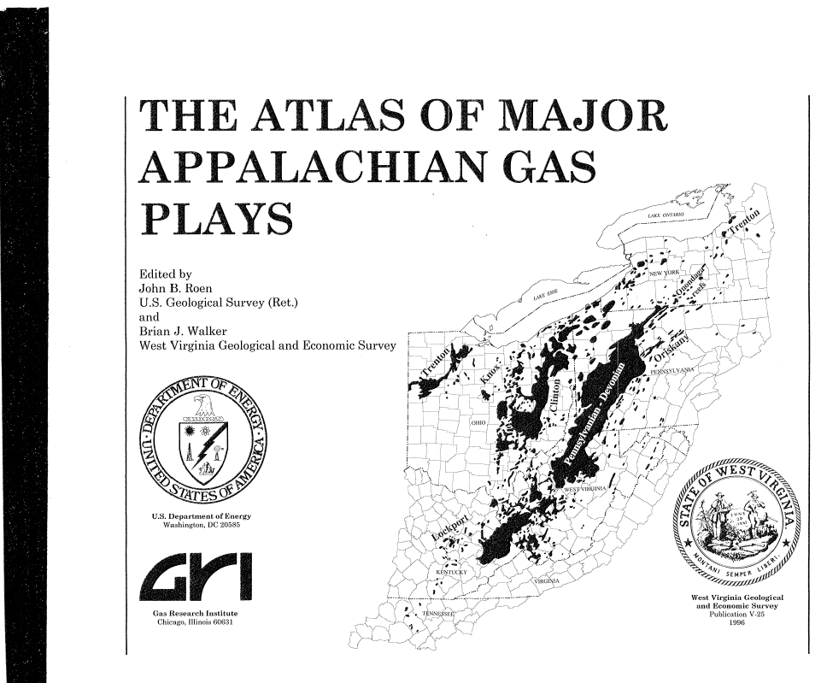
Also available:
Oil and Gas Bulletins for selected counties within the ASH area of interest

Slide 9
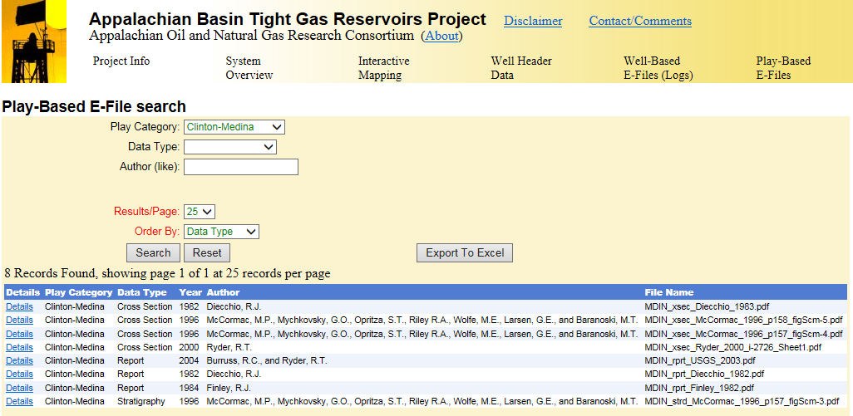
TIGHT GAS SANDS
http://www.wvgs.wvnet.edu/atg/ProjectInfo.aspx

Slide 10
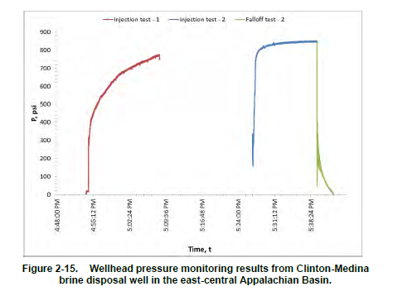
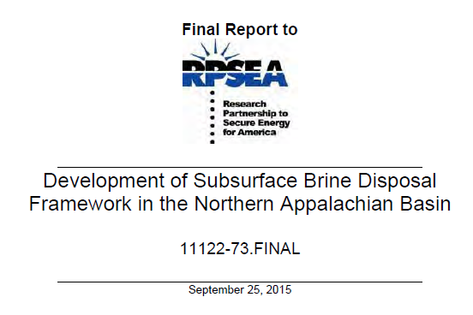
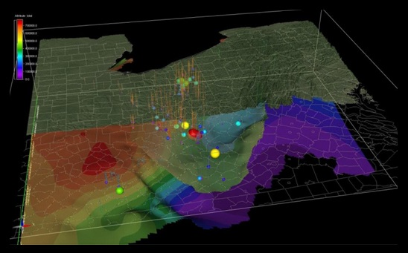
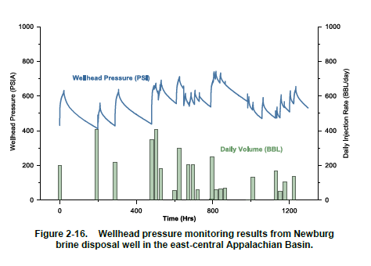
BRINE DISPOSAL FRAMEWORK
http://www.rpsea.org/projects/11122-73/

Slide 11
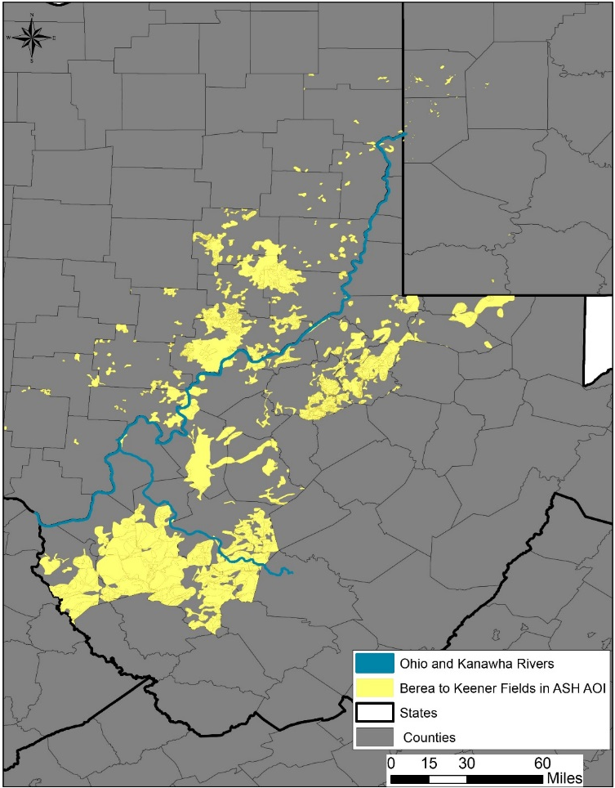
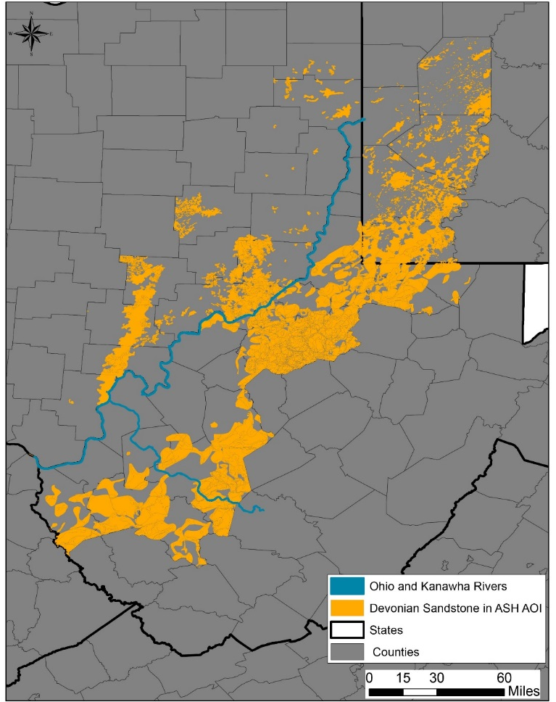
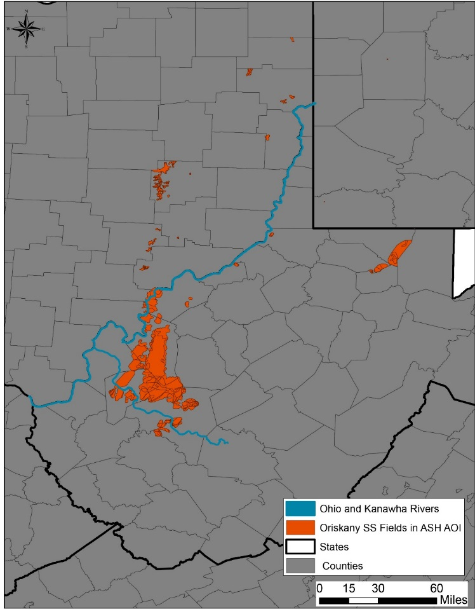
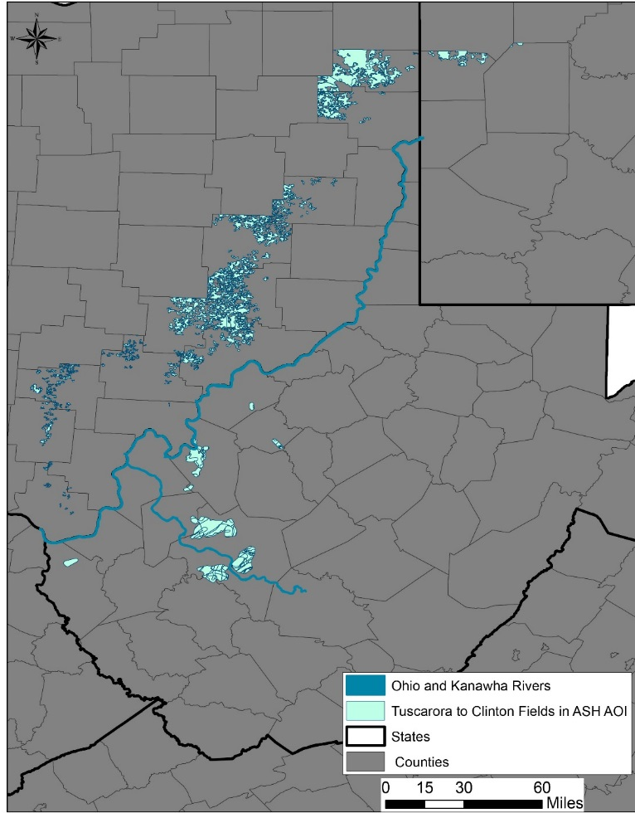
CARBON STORAGE
Midwest Regional Carbon Sequestration Partnership
Ongoing, collaborative research encompassing a ten-state region
Includes detailed reservoir data at the field level as well as regional cross-sections

Slide 12
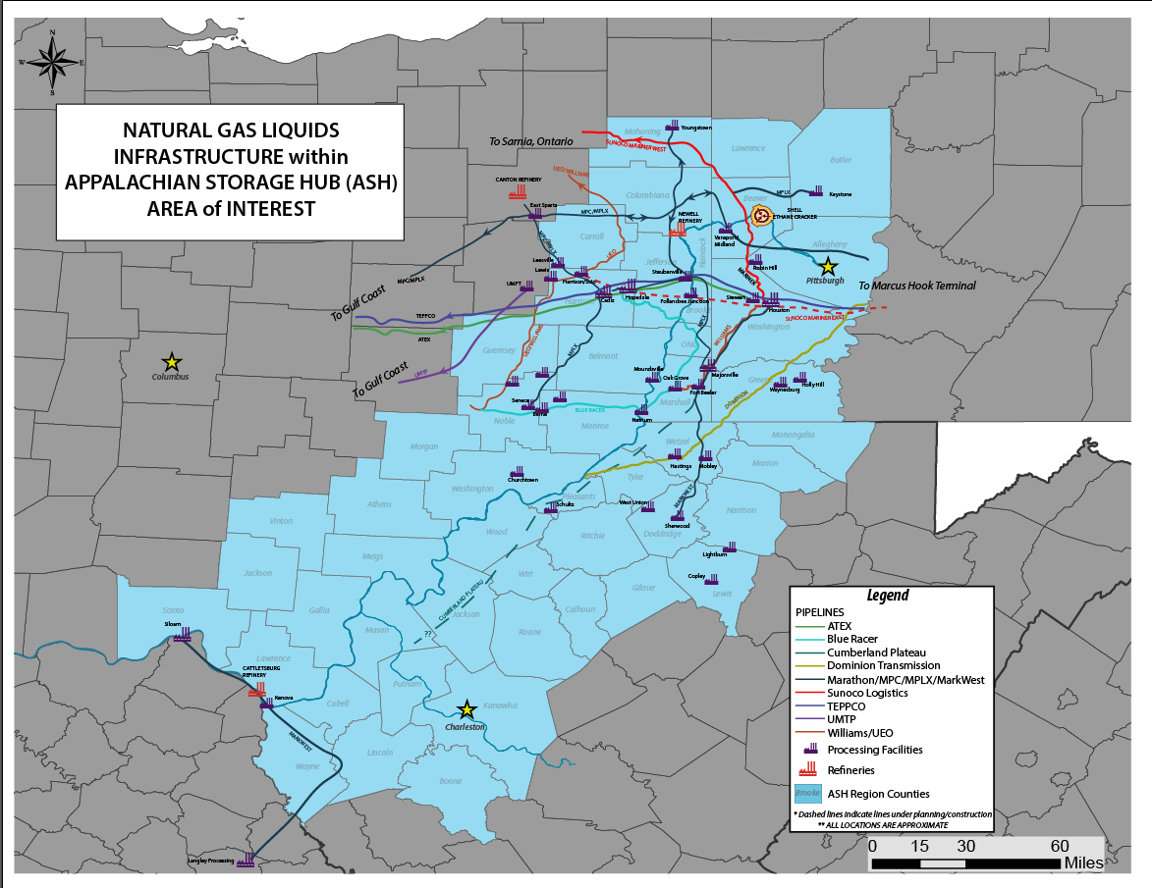
Static maps and mapping files
Master Petra project file; .las files and header data will be exported periodically and made available via data search
Static maps: NGL Infrastructure, production, horizontal well locations
Final maps of selected targets

Slide 13
Appalachian storage Hub (ASH) project
The Role of Petroleum Geology and Salt
Production on Manufacturing and Development in the Appalachian Basin

Slide 14
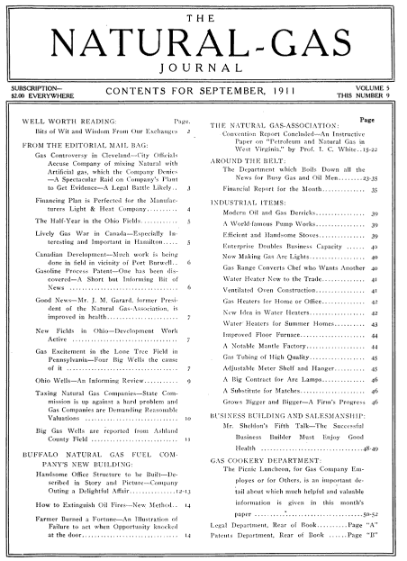
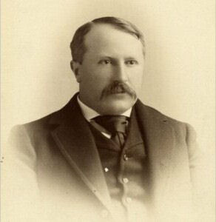
Dr. Israel Charles (I.C.) White, circa 1898
Notes:
I can think of no better narrator for the first part of this slideshow than I.C. White, the first State Geologist of West Virginia. I’ve included a copy of a similar article published in 1911 in the Natural Gas Journal, but will read from a copy dated 1917, found at WVGES headquarters, entitled “The Romance of Petroleum and Natural Gas in West Virginia”
Photo Credit:
I.C. White Photo:
https://en.wikipedia.org/wiki/Israel_C._White
Natural Gas Journal:
https://books.google.com/books?id=N3xBAQAAMAAJ&printsec=frontcover#v=onepage&q&f=false

Slide 15
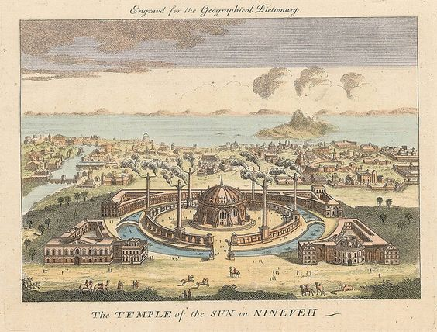
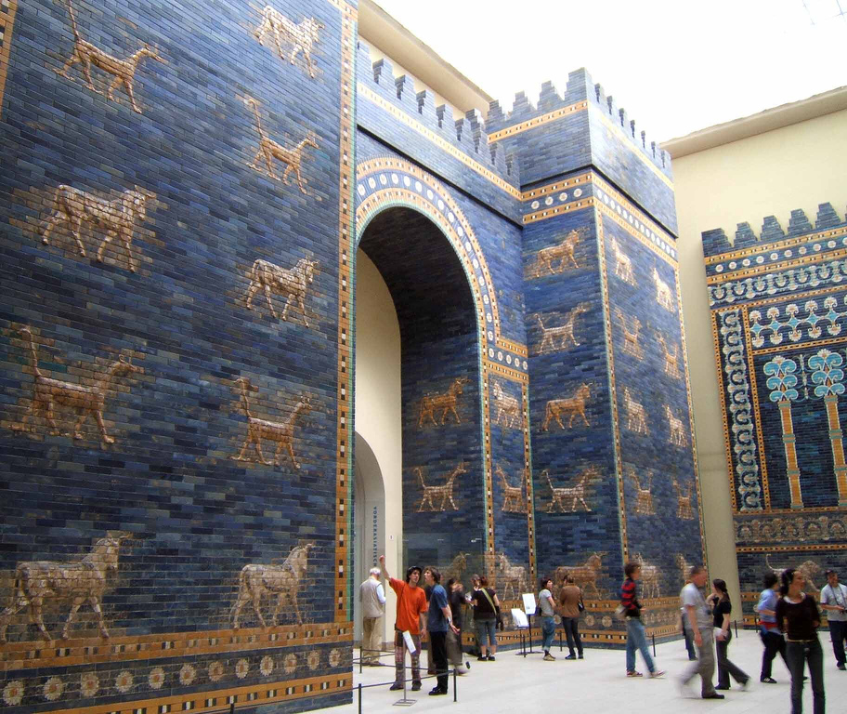
Notes:
“The date of the first use of petroleum or its residual products, pitch and asphaltum, precedes authentic history. Probably the first recorded utilization is that of the eleventh chapter of Genesis in which it is stated that the soft or semi-fluid bitumen found in the valley of the Euphrates and translated “slime”, was used as a mortar in the building of Babylon, more than forty centuries ago. Erastosthenes, a celebrated Grecian writer who lived in the third century B.C., has described this bitumen from the Springs of Hit, on the Euphrates, and has also told of its use in the construction of mosaics, pavements, etc., in the beautiful palaces and temples of ancient Nineveh and Babylon.”
Photo Credits:
Temple of the Sun:
http://www.flickriver.com/photos/bibliodyssey/2824285420/
Ishtar Gate:
https://en.wikipedia.org/wiki/Ishtar_Gate

Slide 16
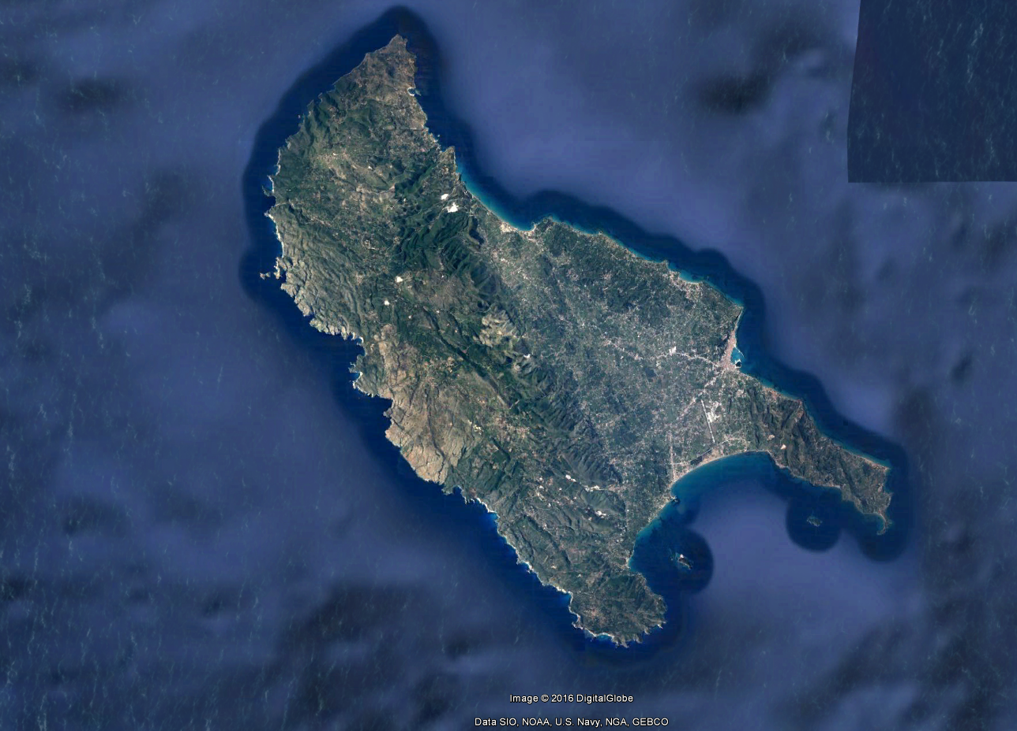
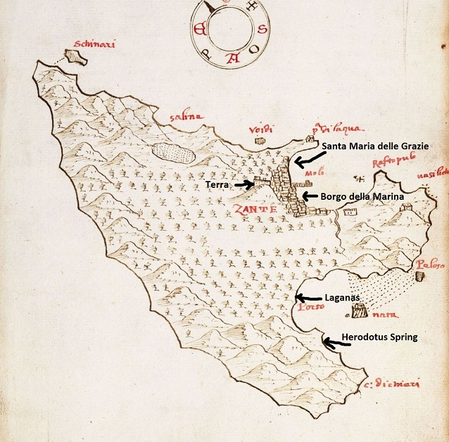
Notes:
“Herodotus, the Father of History, who lived in the fifth century B.C., or nearly twenty-four hundred years ago, has told us in his inimitable style how asphaltic oil was procured in his day from a lake on the Island of Zante, in the Mediterranean, off the coast of Greece, by swabbing it up with a branch of myrtle, very much like the early settlers of the Allegheny and Little Kanawha valleys of Pennsylvania and West Virginia collected petroleum from the surface of water with woolen cloths, so that in the primitive methods of procuring mineral oil there is apparently “nothing new under the sun”. Aristotle, who lived in the fourth century B.C., describes the deposits of bitumen in Albania, along the eastern shores of the Adriatic sea, while Pliny and Dioscorides, who lived in the first century of the Christian era, have given account of the oil springs of the island of Sicily, and the use of petroleum in lamps under the name of “Sicilian oil”. Many ancient writers and travelers like Plutarch, Strabo, Marco Polo, and others, have recorded the use of “rock oil” and pitch in Arabia, Persia, India, and elsewhere from the earliest historic periods.”
Photo Credits:
Herodotus Spring on Zante Island Map:
http://pampalaia.blogspot.com/2012/03/causes-of-enigmatic-death-of-vesalius.html
Aerial Photo:
https://www.google.com/maps/@37.77661,20.803,116232m/data=!3m1!1e3

Slide 17
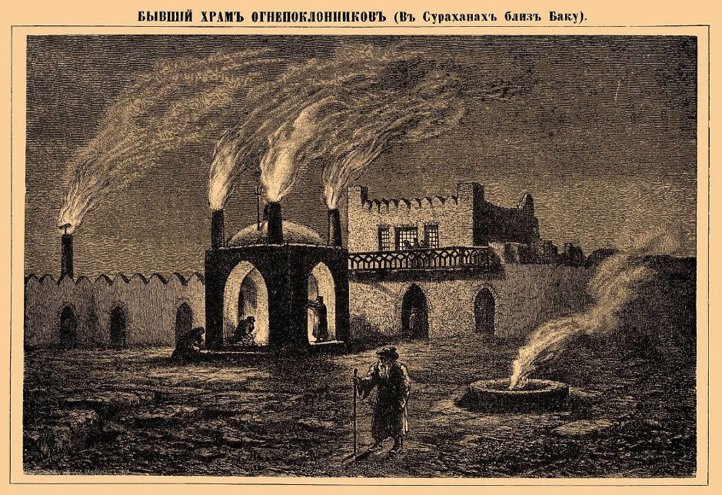
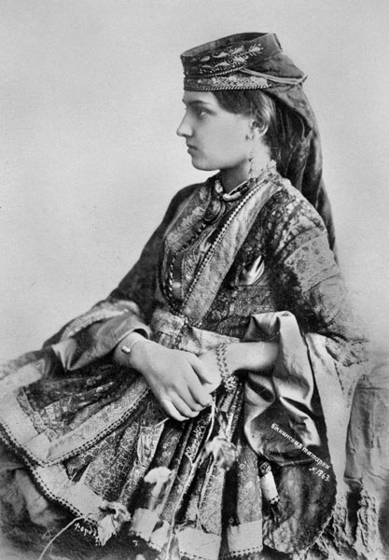
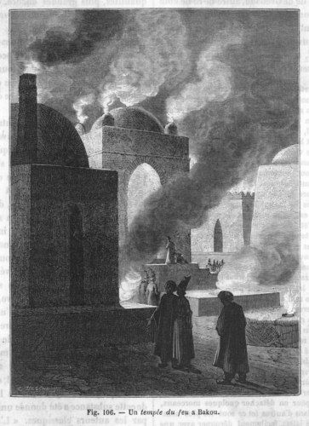
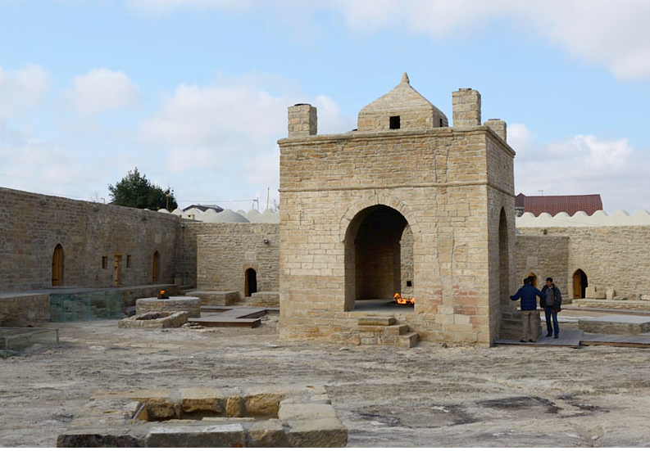
Notes:
“One of the nearly extinct religious cults, that of the Fire Worshipers, or Parsees, was founded upon the mystery which the priesthood of that religion threw around the perpetual fire maintained on the altars of their temples with natural gas. When the writer [Dr. White] visited Baku on the shores of the Caspian Sea in 1897, he saw the ruins of one of these mystic shrines the last of whose priests had disappeared only twenty off years before. In dismantling the altar of this ancient structure, it was discovered that it had been built over a fissure from which natural gas issued, and that a secret pipe conducted the gas from the fissure to the altar, where its lambent flames had inspired the Fire Worshipers with a belief in the supernatural powers of the priests of Zoroaster. It is possible that similar tricks of deception have imposed upon the credulity of mankind during the childhood of the race in the establishment of other primitive religious beliefs. In China—that great empire whose civilization has remained practically unchanged for so many centuries, crude methods of using natural gas were practiced more than two thousand years ago, while the Japanese have also collected and utilized mineral oil for many hundreds of years.”
Photo Credits:
Baku Black and White
www.tipsimages.it (via Pinterest)
Temple of Eternal Fire (modern):
http://www.advantour.com/azerbaijan/baku/ateshgah-temple.htm
Illustration from Brockhaus and Efron Encyclopedic Dictionary (1890—1907)
https://en.wikipedia.org/wiki/Ateshgah_of_Baku#/media/File:Brockhaus_and_Efron_Encyclopedic_Dictionary_b4_738-0.jpg
Female from Baku:
https://commons.wikimedia.org/wiki/File:Azeri_Female_from_Baku_1897.jpg

Slide 18


Notes:
“Hence we find that the oil and natural gas seepings welling up through the fissures in the earth’s stratified crust were both observed and used by primitive peoples of most every country. The earliest written account of the occurrence of petroleum in America is apparently that of a Jesuit missionary who came from Canada into New York in 1629, and wrote a letter concerning it which was published in Sagard’s “History of Canada” in 1632.”
Photo Credits:
Sagard’s History of Canada
https://www.williamreesecompany.com/pages/books/WRCAM32324/gabriel-sagard-theodat/le-grand-voyage-du-pays-des-hurons-situe-en-lamerique-vers-la-mer-douce-es-derniers-confins-de-la
Titusville Oil Seep
http://www.geoexpro.com/articles/2009/03/the-birth-of-the-modern-oil-industry

Slide 19
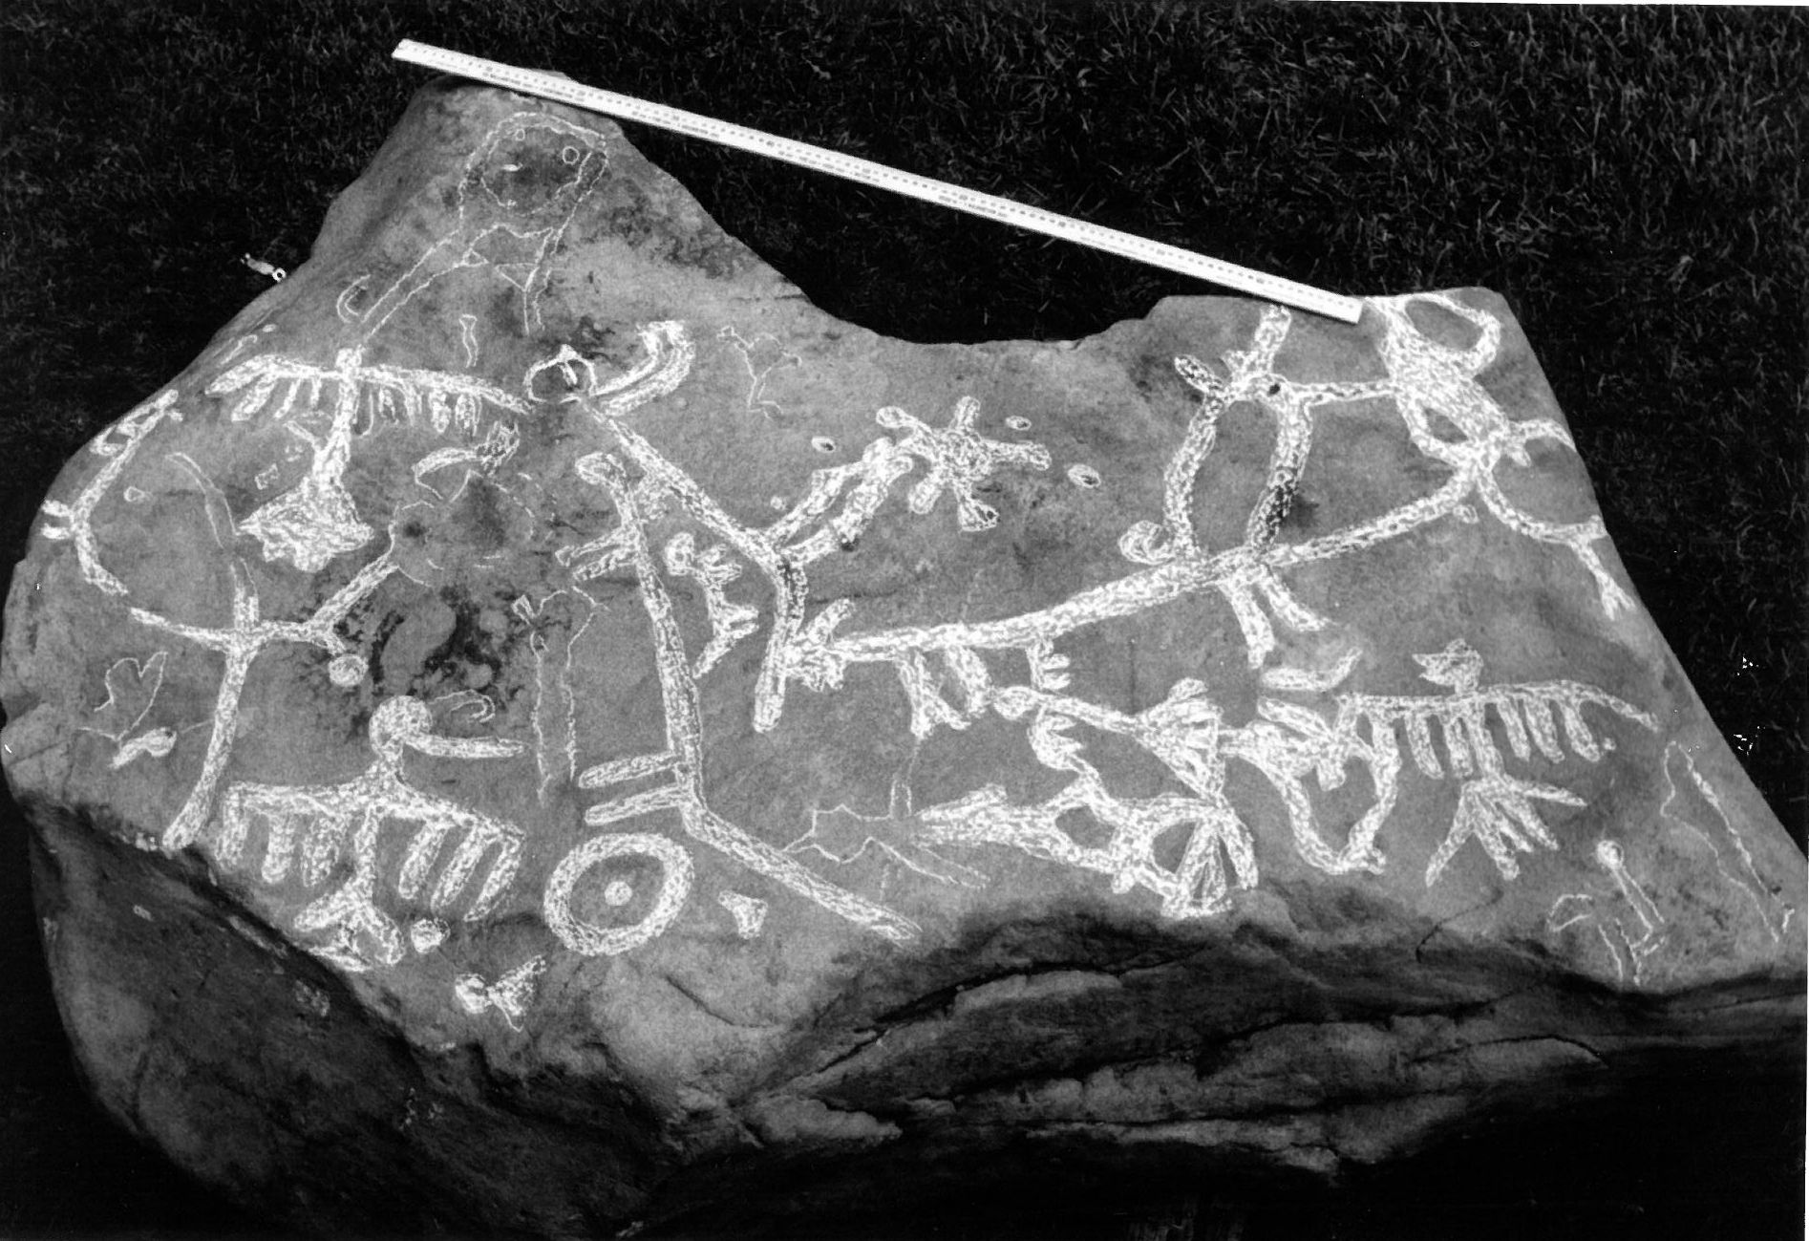
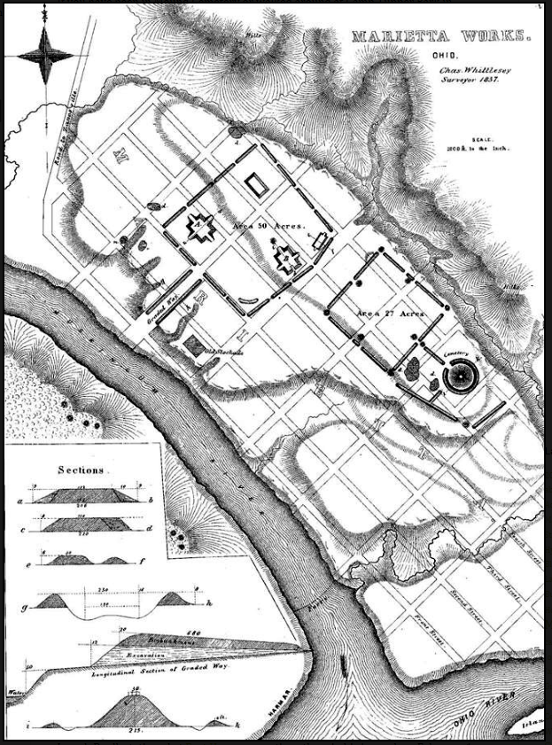
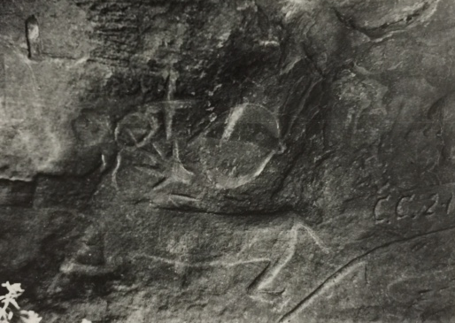
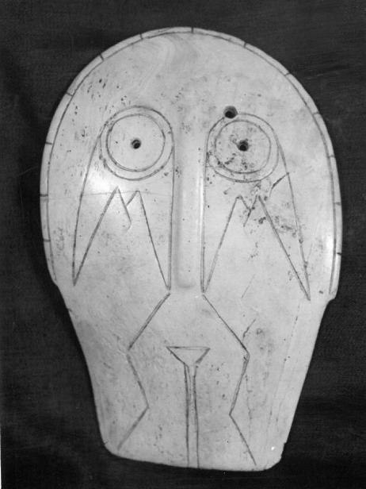
Notes:
“The Petroleum seepings in Oil Creek in Pennsylvania, and on Hughes and Little Kanawha Rivers, in what is now West Virginia, were doubtless known and used by Indians long before white men visited the regions or Columbus landed in America. The earliest published account of the oil springs near Titusville, Pennsylvania, appears to be that of a Swedish traveler, one Peter Kalm, about 1750, while those of Wirt and Ritchie Counties of West Virginia, as well as similar seepings on the Big and Little Muskingum Rivers of Ohio, were first described by Dr. S.P. Hildreth, of Marietta, Ohio, in an article published in “The American Journal of Science and Arts, New Haven, Connecticut, in February, 1826.”
Photo Credits:
Marietta Mounds:
http://earlymarietta.blogspot.com/2016_02_01_archive.html
Muskingum River Map:
http://earlymarietta.blogspot.com/2016_02_01_archive.html
Petroglyphs: WVGES Collection

Slide 20
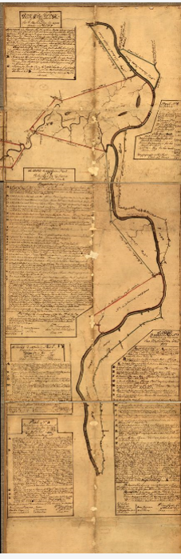
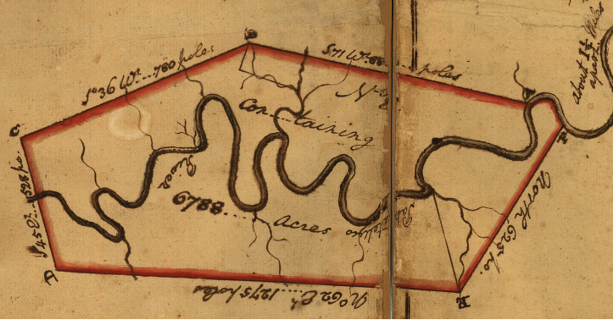
Notes:
“In discovering and utilizing natural gas, West Virginia clearly has precedence over Pennsylvania, for probably the first recorded reference to this valuable fluid in the United States was made as early as 1775, by General Washington, who preempted the land around the “burning springs” nine miles above Charleston, in the Great Kanawha Valley, which he described as “a bituminous spring of so inflammable a nature as to burst forth” (take fire) “as freely as spirits and is nearly as difficult to extinguish”. It is also well known that the first use of natural gas for manufacturing purposes was by Mr. William Tomkins, in the same Kanawha Valley, who in 1841 struck a large flow of gas in boring a salt well only a few hundred feet from the “burning spring” that Washington had noticed sixty-six years before, and piping the gas to his salt works, used it instead of coal in boiling down the brines, thus displacing several hundred bushels of coal daily.”
Photo Credits:
Washington Survey tract, Kanawha Valley:
https://www.loc.gov/resource/g3892k.ct000363/

Slide 21
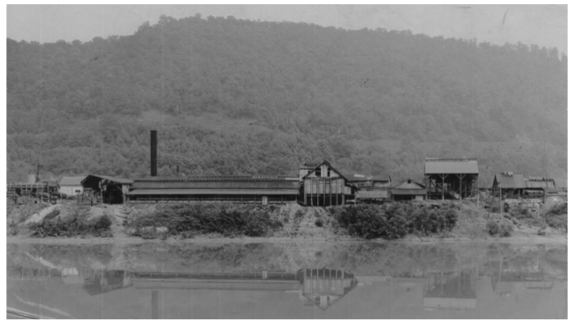
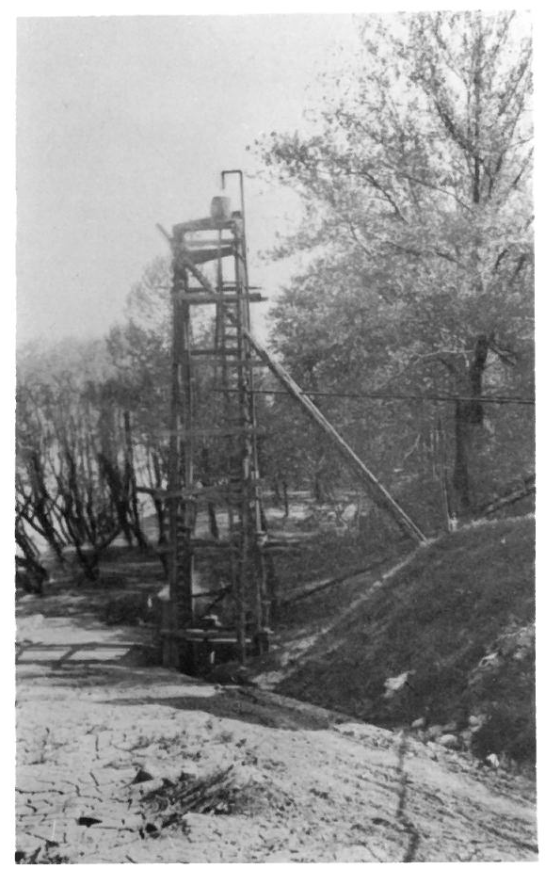
Notes:
“In 1843, Messrs. Dickinson and Shrewsberry, boring a few rods below, tapped at about 1,000 feet in depth, nature’s great gas reservoir of this region. So great was the pressure of this gas, and the force with which it vented through this bore-hole, that the auger, consisting of a heavy iron sinker, weighing some 500 pounds, and several hundred feet more of auger poles, weighing in all, perhaps 1,000 pounds, was shot up out of the well like an arrow out of a cross-bow. With it came a column of salt water, which stood probably 100 feet high. The roaring of this gas and water, as they issued, could be heard under favorable conditions for several miles.
It would have been difficult to estimate with any approach to accuracy, the quantity of gas vented by this well, and no attempt was made to measure it. It was roughly estimated as being enough to light London and Paris, with, perhaps, enough left to supply a few such villages as New York and Philadelphia. But as this was a salt well, and also a gas well, it is suggested that the gas estimates be taken, cum grano salis.” (End transcript of I.C. White address)
This area, dubbed the Kanawha Salines, was now the nexus of salt manufacturing in the United States
Photo Credit:
Salt Manufacturing, Dickinson Family:
http://www.jqdsalt.com/our-story/
Salt Well: WVGES Collection

Slide 22
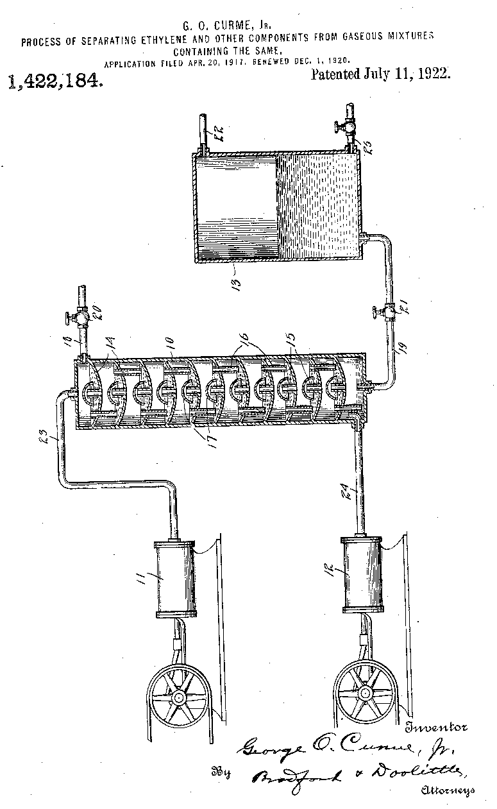
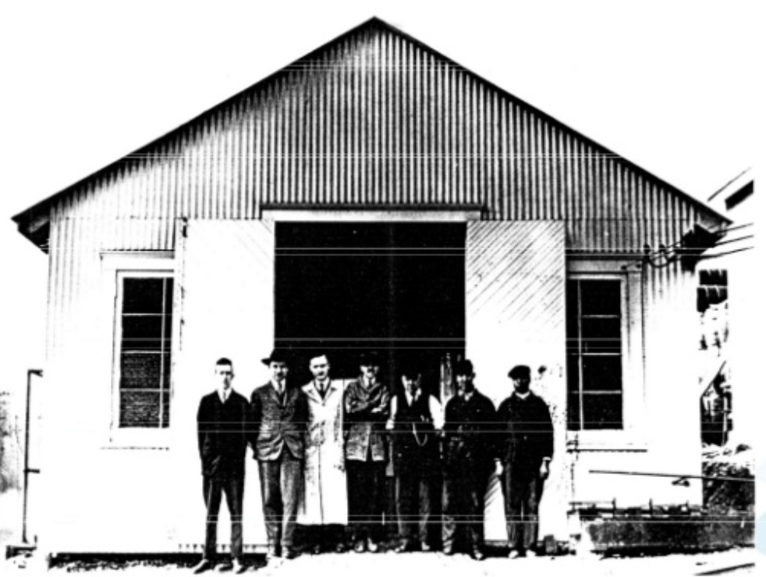
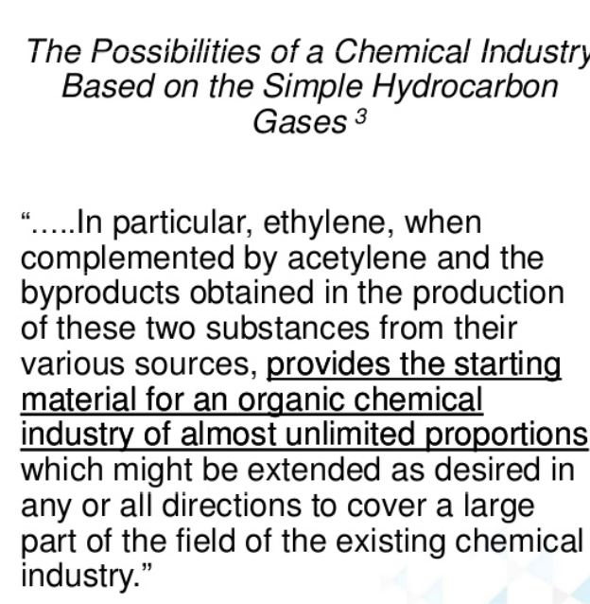
Notes:
In the 1800s it was discovered that by electrolysis of the brine, chlorine, caustic soda, and hydrogen could be created. This discovery set off a new flurry of manufacturing activity. The Belle Alkali Company was built in Belle in 1915. In South Charleston, the Rollin Chemical Company produced barium peroxide and salts and E.C. Klipstein produced sulfur dyes and tear gas. Both companies were eventually purchased by Union Carbide
In 1920, the Union Carbide Company bought a small refinery near Clendenin. Concurrently, a researcher from the Mellon Institute in Pittsburgh was conducting experiments to produce acetylene in the lab. The researcher, George Curme, developed a technique to produce acetylene from petroleum at high temperatures, with ethylene as a by-product. His process was further developed by Carbide engineers at the Clendenin site, conveniently located near ethane-rich natural gas
Photo Credit:
George Curme quote and Carnegie Mellon photo of “the Shack”:
https://www.slideshare.net/raunaqjamal/technical-david-bronikowski-sadara-chemical-companyethylene-full-cycle
Curme patent:
https://www.google.com/patents/US1422184

Slide 23
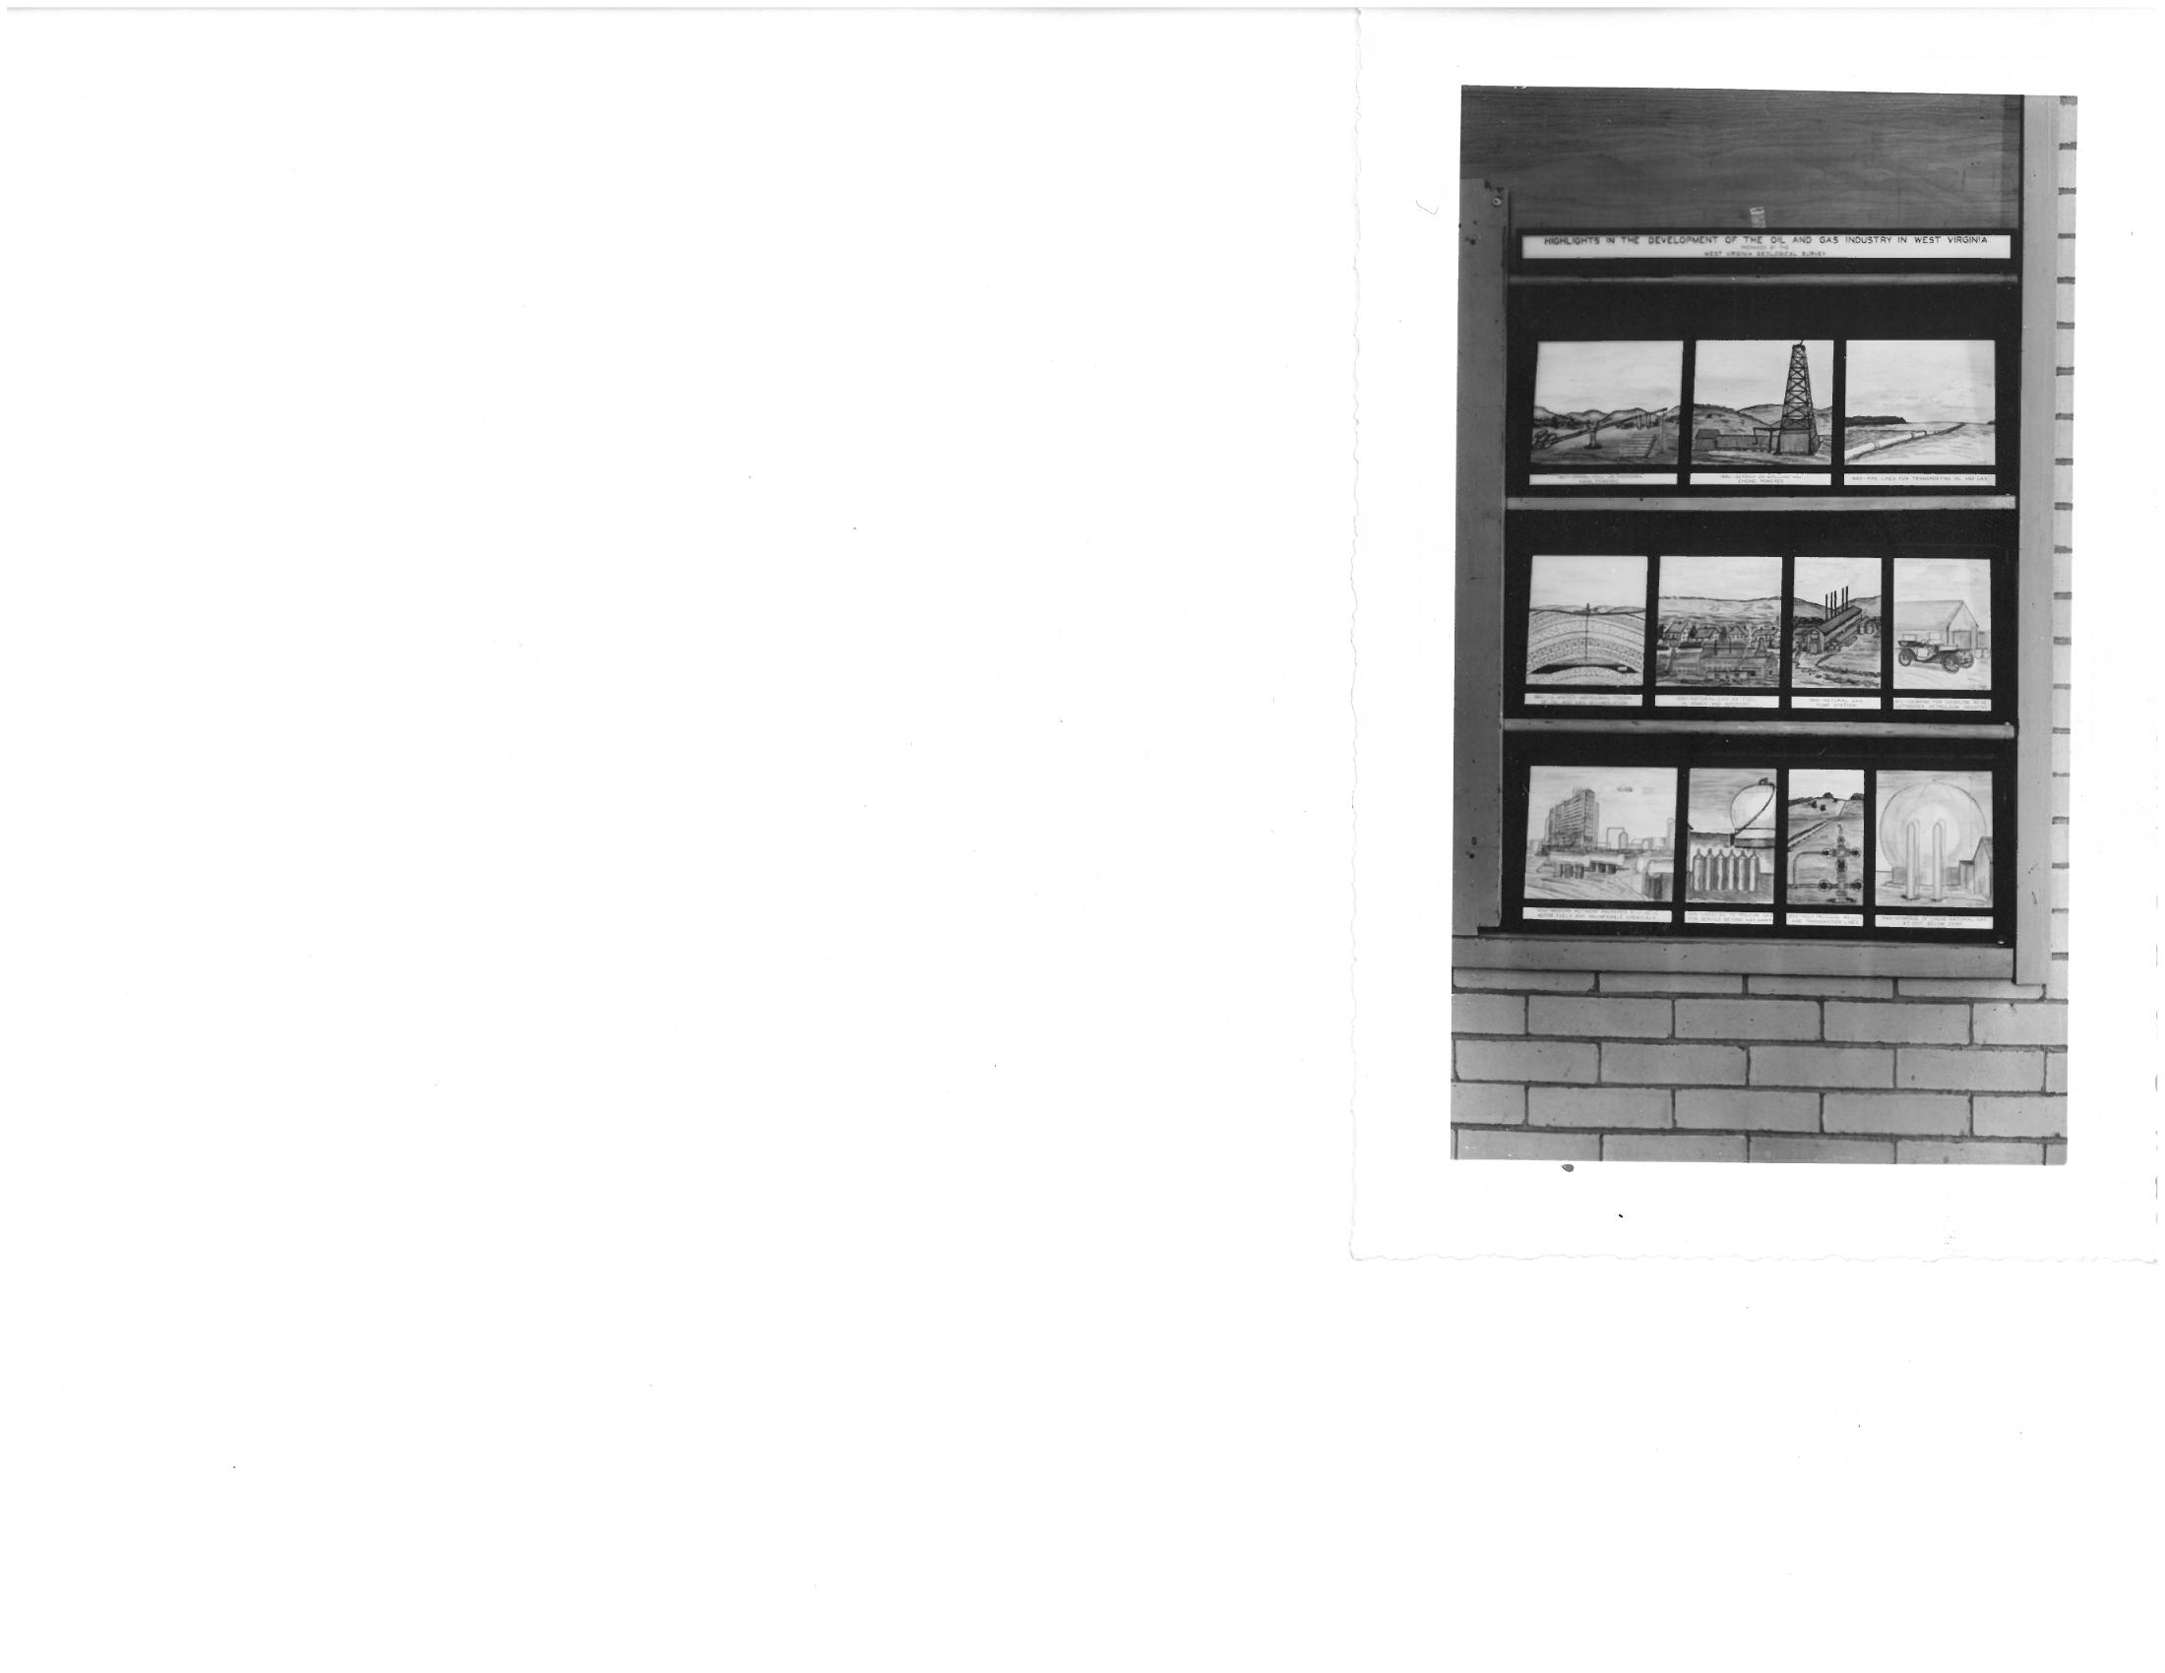
Notes:
This display from 1940 shows industry highlights and the bright future ahead. Most notably, the final, futuristic, image shows storage of natural gas liquids at minus 250 degrees. These bright visions for the future were put on hold, however…
Photo Credit: WVGES Collection

Slide 24

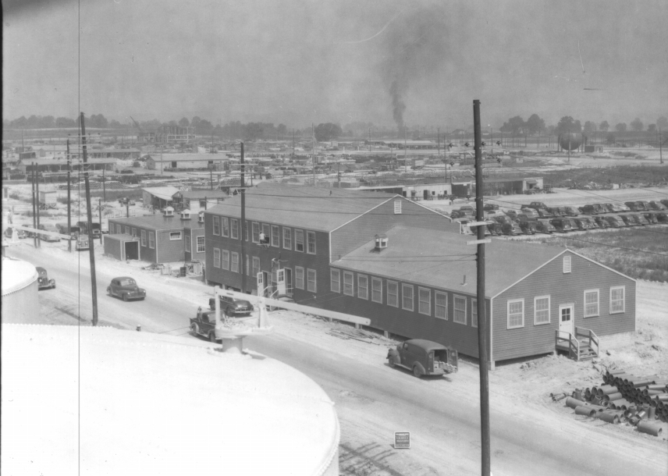
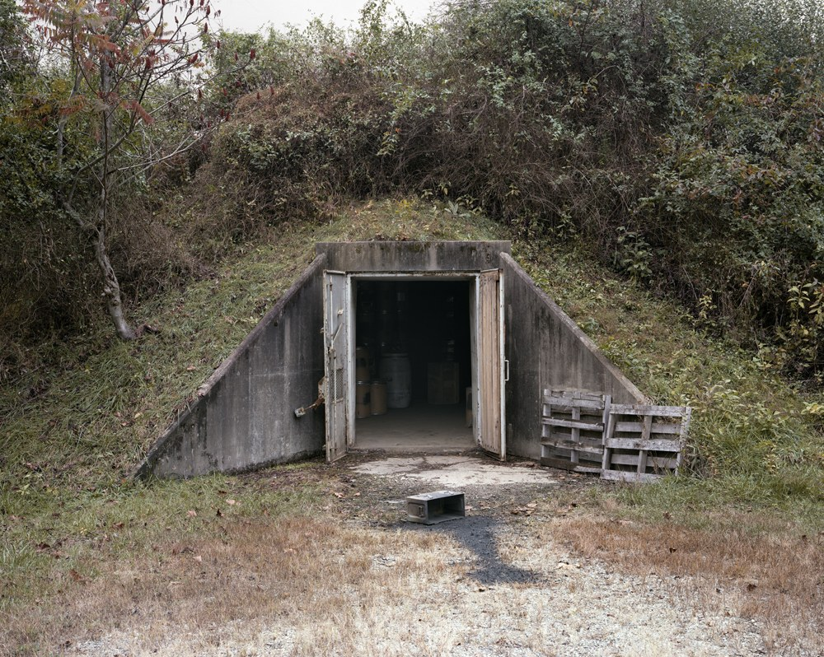
Notes:
…as manufacturing and production efforts shifted to support of WWII. The area continued to produce myriad products including nylon for stockings and parachutes, Buna S synthetic rubber, barium nitrate for incendiaries, and hexachloroethane for smoke screens. The photo at left shows the Laboratory, Supervisor’s office, and Acid Area at the West Virginia Ordnance Works in Point Pleasant. To this day, a bunker holds unspent TNT manufactured at the facility
Photo Credit:
Ordnance works:
https://en.wikipedia.org/wiki/West_Virginia_Ordnance_Works#/media/File:Laboratory_and_Supervisors_Office_Acid_Area_West_Virginia_Ordnance_Works.jpg
Chute the Works:
http://www.wvcommerce.org/info/west-virginia-edge/wv-edge-issue1-2012/modern_life_made_possible/default.aspx
TNT Bunker Storage, Point Pleasant WV
https://www.wired.com/2014/03/joshua-dudley-greer-tnt-storage/

Slide 25
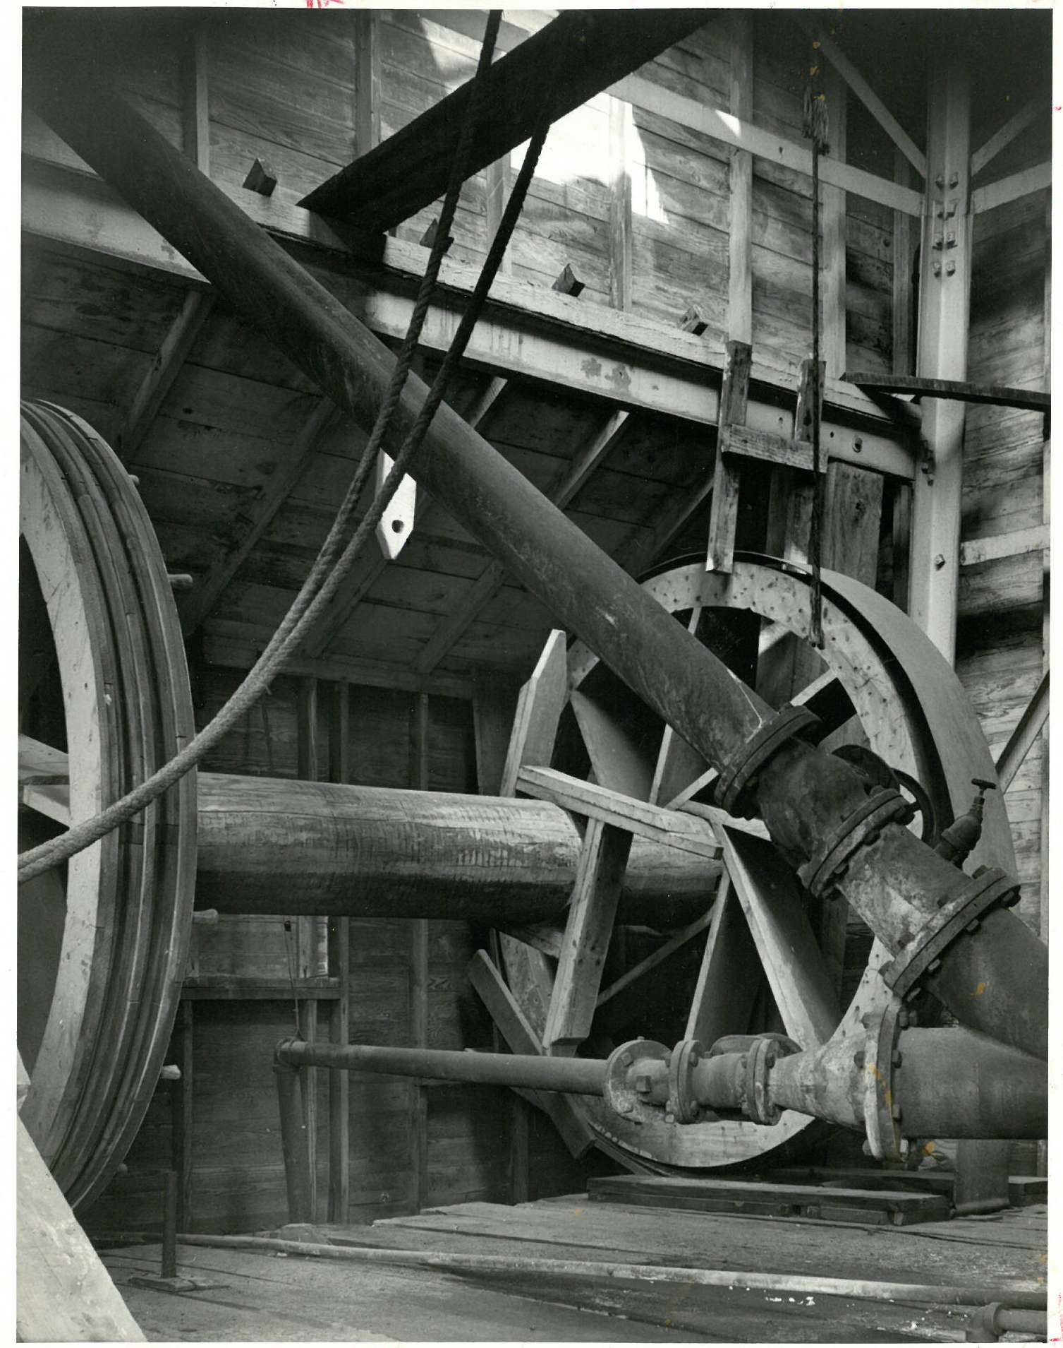
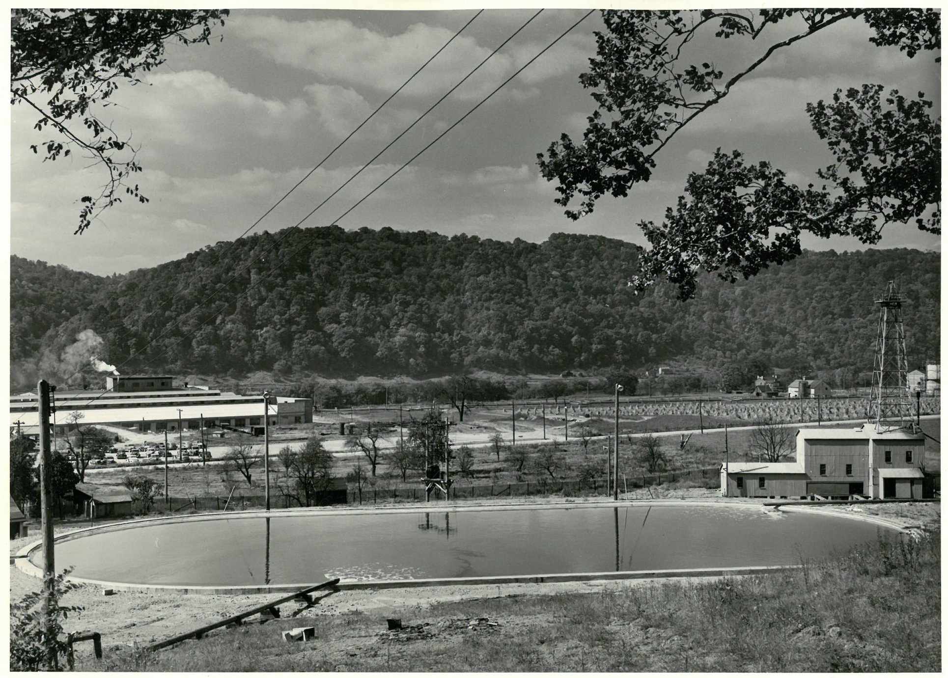
Notes:
In 1942, the Defense Plant Corporation built an electrolytic caustic soda plant at Natrium in Marshall County. Here, water is sent down the wells to Silurian salt deposits at depths of greater than 7,000 ft. The fresh water dissolves the salt, leaving behind a void or cavity as the super-saturated solution is pumped back to the surface
Photo Credit: WVGES Collection

Slide 26
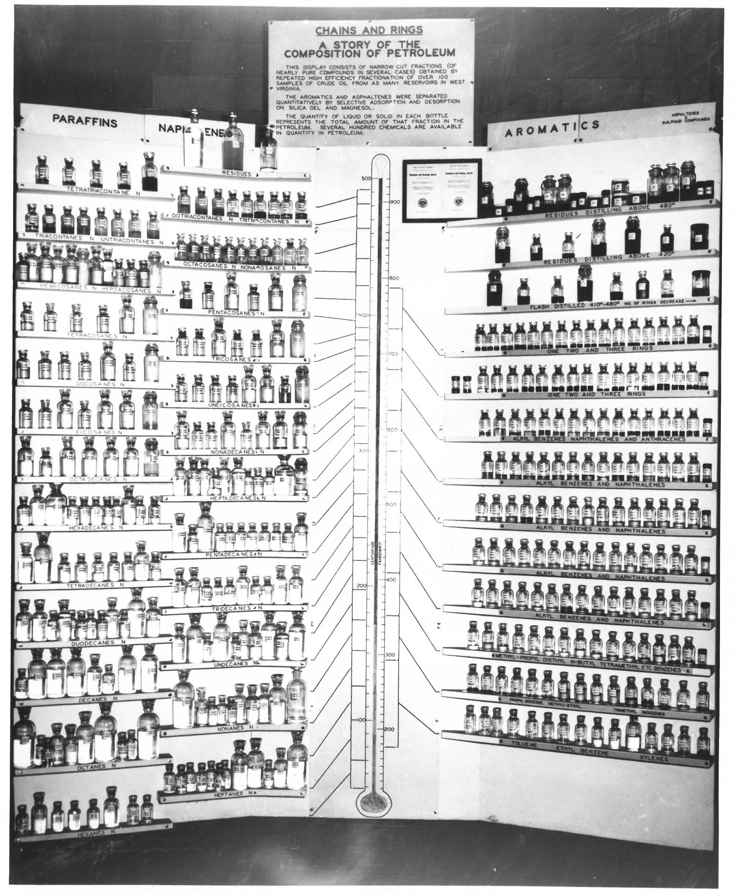
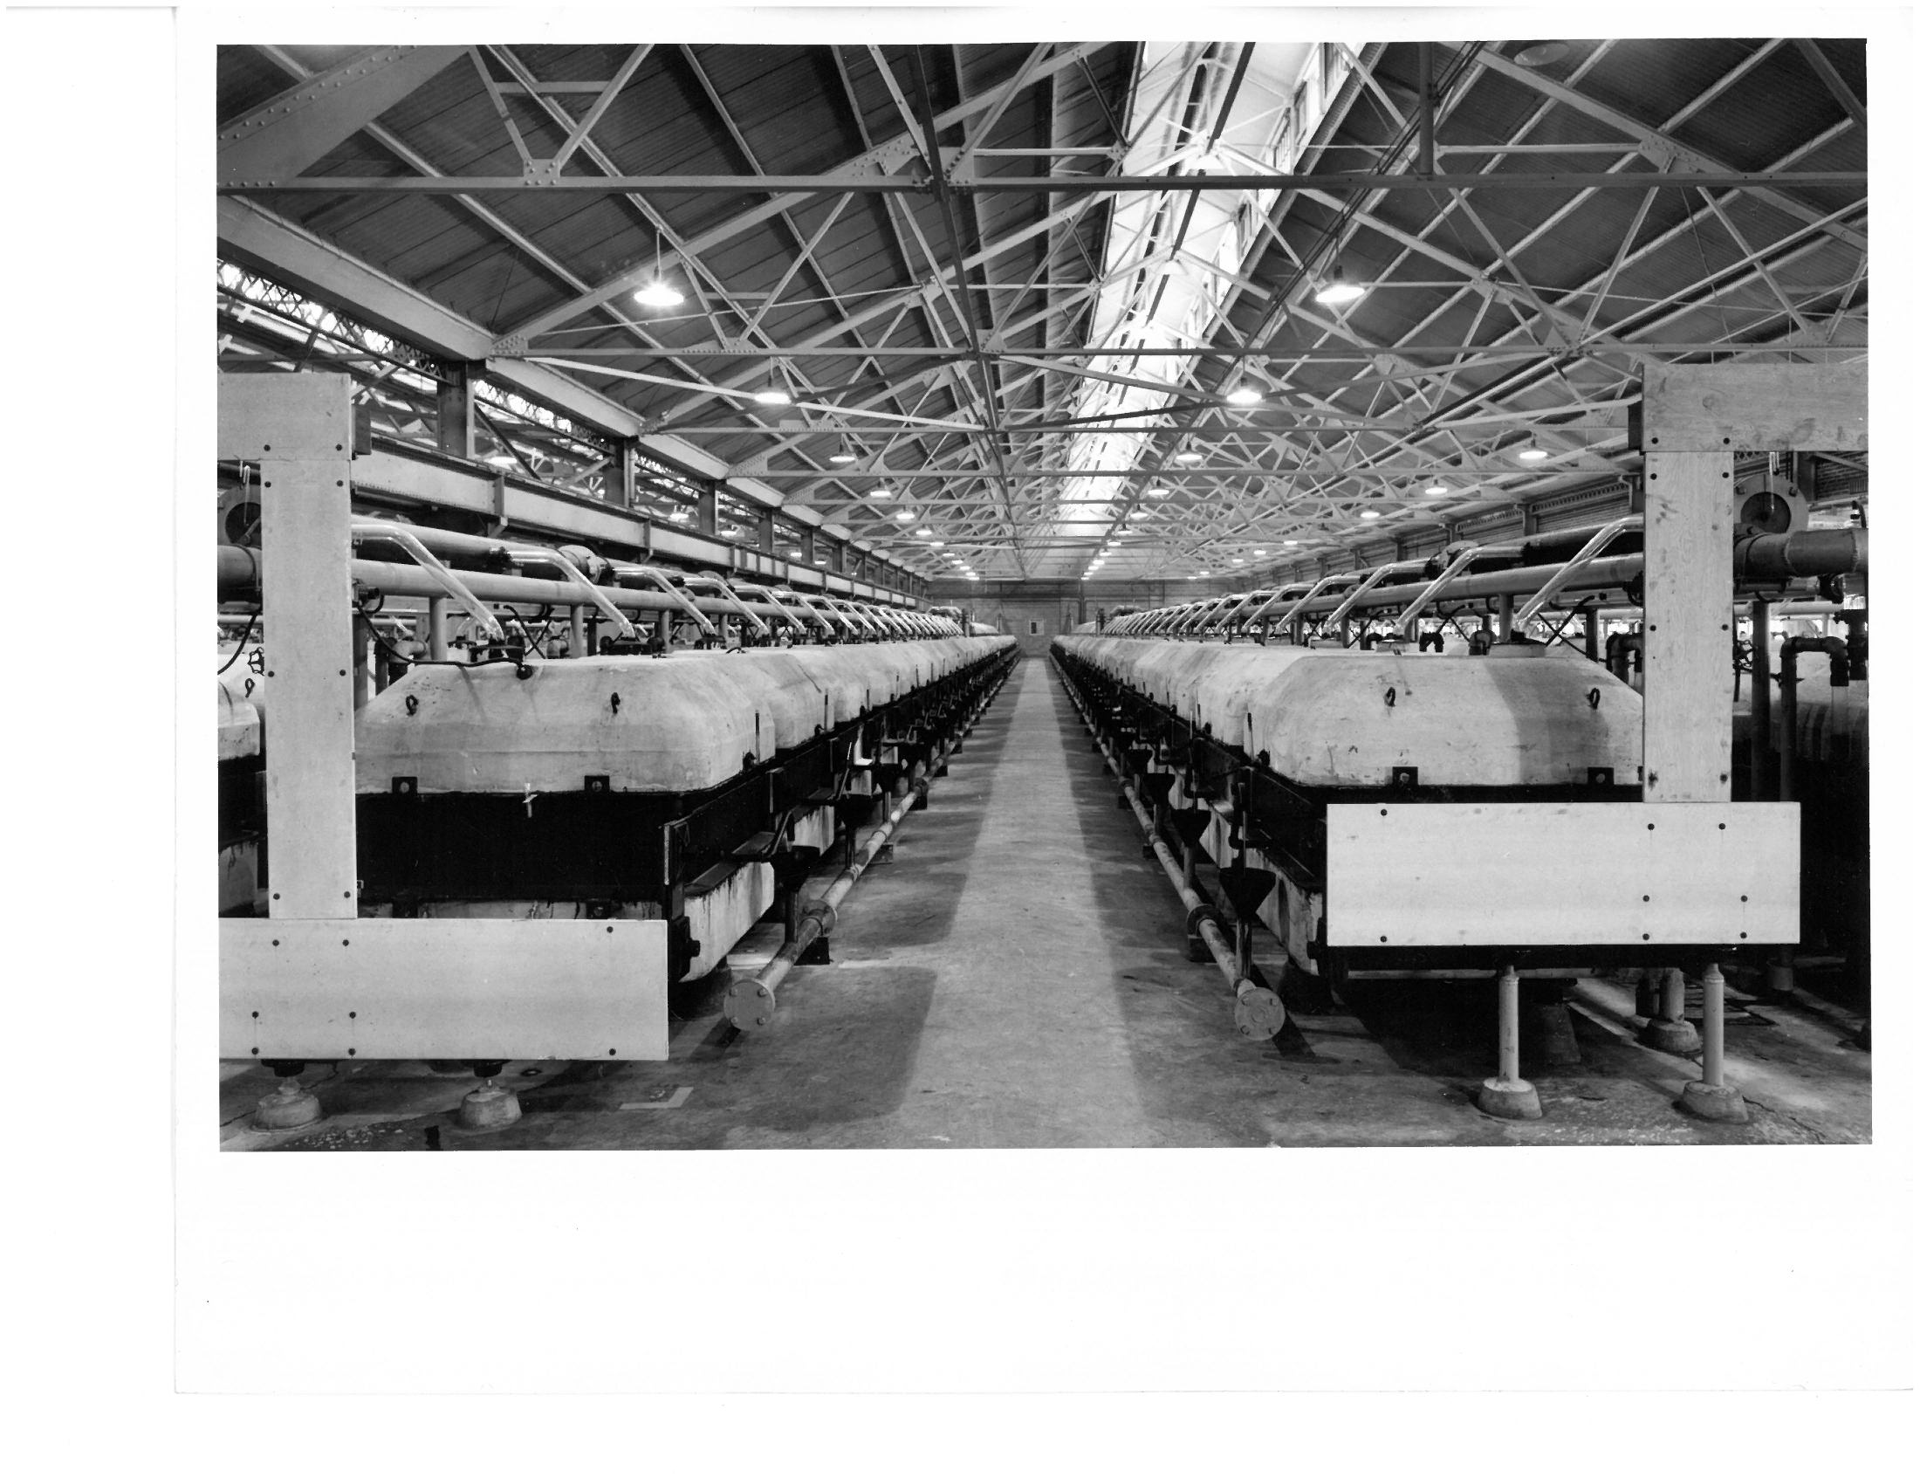
Notes:
Post-war, the knowledge gained from the previous 50 years of research and development ushered in a new age of consumer chemicals.
Photo Credit: WVGES collection

Slide 27
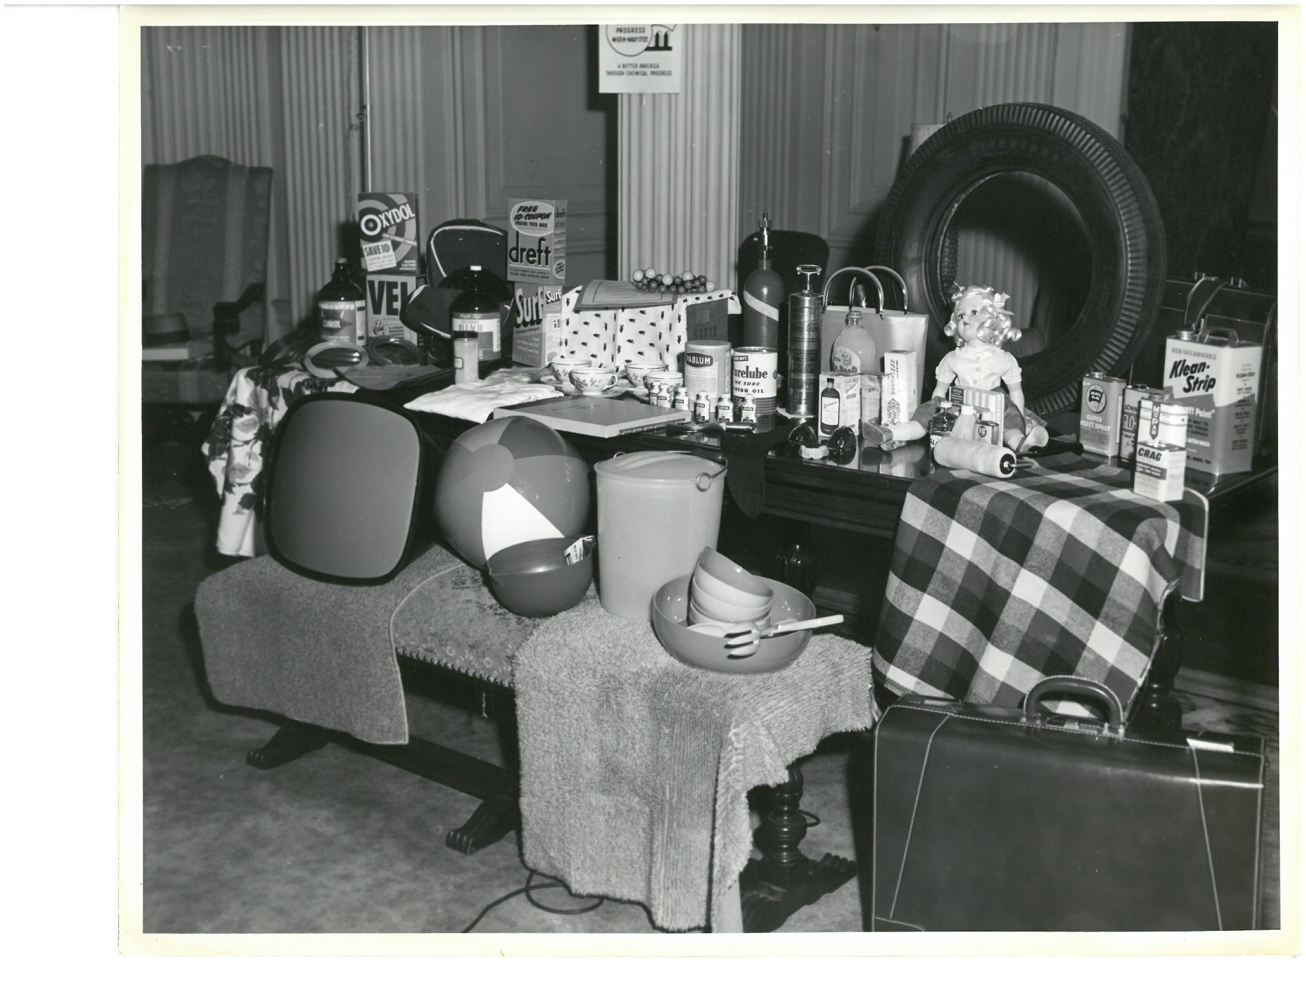
Notes:
In the 1940s and 50s the Union Carbide Tech Center in South Charleston generated more than 30,000 patents. More than half of the world’s top 500 chemicals were developed there, including the products that would go on to be marketed as Glad trash bags, Eveready batteries, or Prestone antifreeze (Source: WV Dept Commerce).
Photo Credit: WVGES Collection

Slide 28

Notes:
Demand for commodity chemicals outgrew the production limits of the Kanawha Valley, and manufacturing shifted to larger facilities in the Gulf Coast region. As a result, the local industry began declining after reaching peak employment around 1950. Flash Gordon, Plastics representative of the outer worlds, as featured in a four-page promotional comic book by Al Williamson, commissioned by Union Carbide (Source: WV Dept Commerce)
Photo Credit:
Flash Gordon:
http://www.wvcommerce.org/info/west-virginia-edge/wv-edge-issue1-2012/modern_life_made_possible/default.aspx

Slide 29
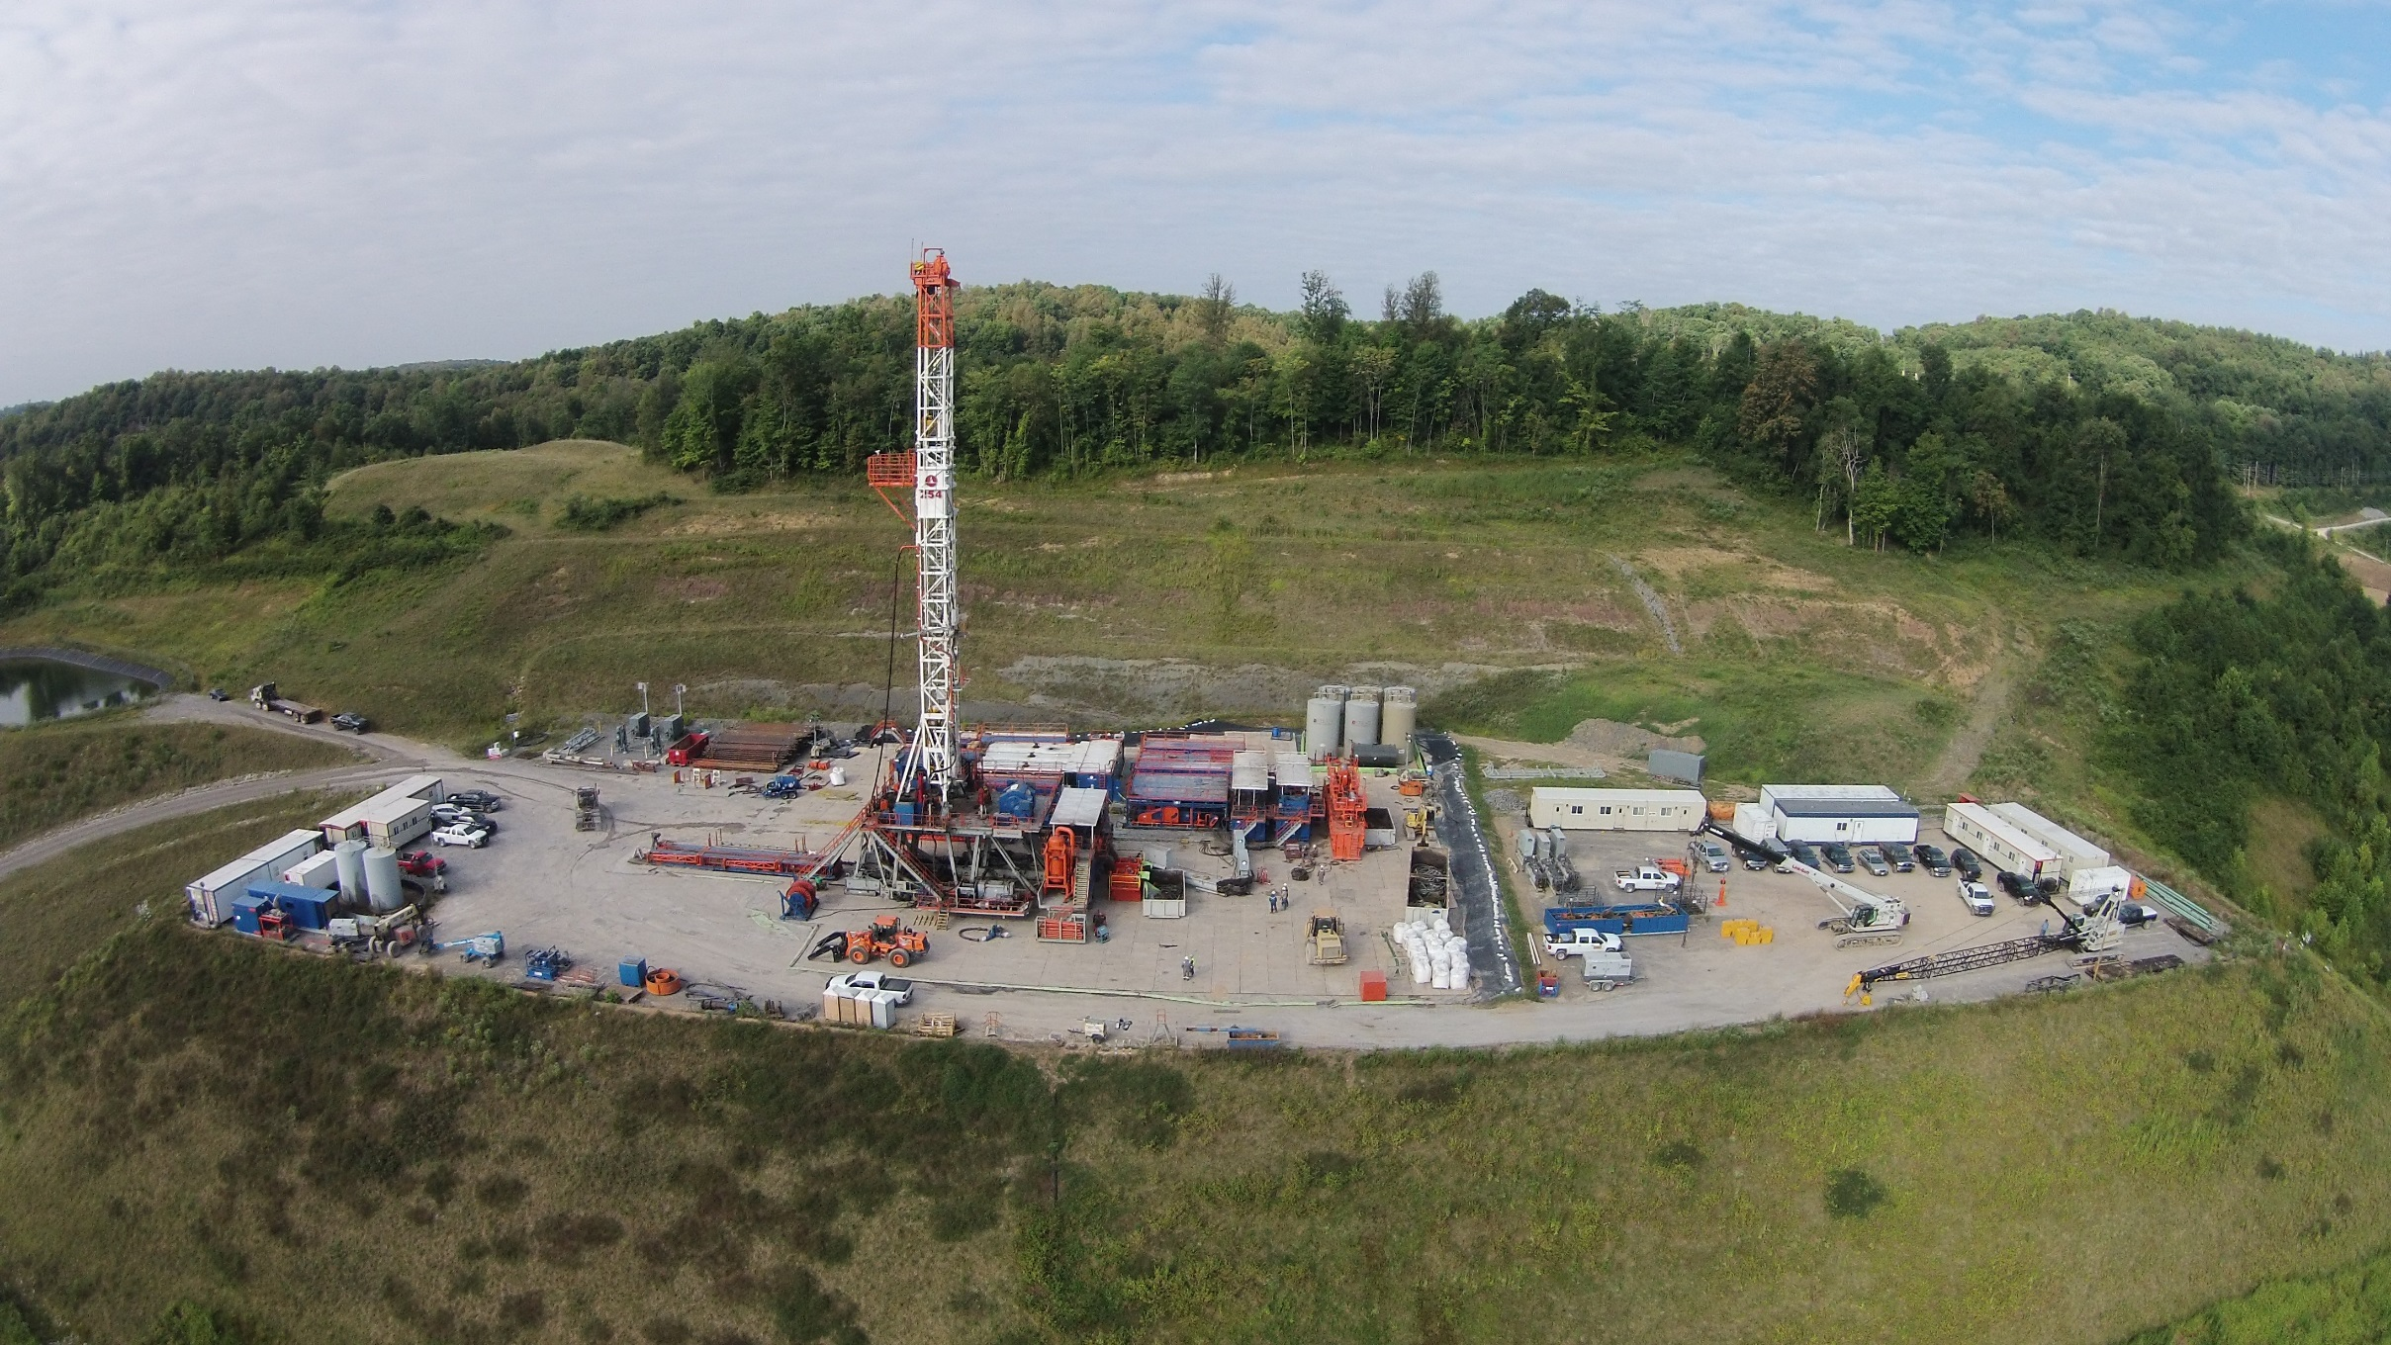
Notes:
Flash forward to the 21st Century: New developments in drilling and completion practices enable extraction of tremendous volumes of natural gas from organic-rich shales. The gas, rich in ethane, spurs a new generation of development in the region.
Photo Credit:
MSEEL well:
http://mseel.org/

Slide 30
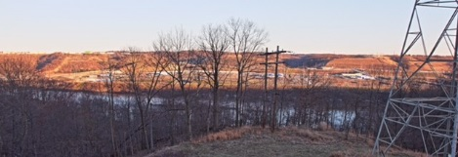
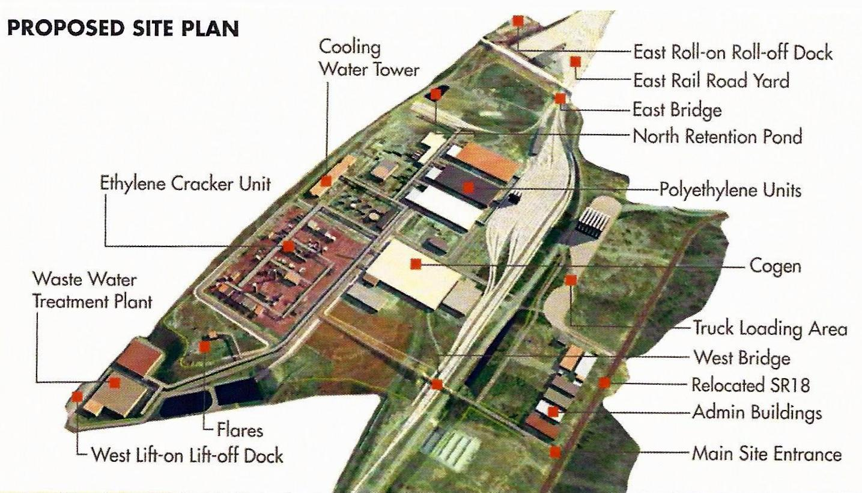
…in particular, ethylene, when complemented by acetylene and the byproducts obtained in the production of these two substances from their various sources, provides the starting material for an organic chemical industry of almost unlimited proportions which might be extended as desired in any or all directions to cover a large part of the field of the existing chemical industry
-- George O. Curme, Jr.
Notes:
As Appalachia awaits Shell’s construction of an ethylene cracker in Beaver County, PA, the Appalachian Storage Hub researchers work to characterize subsurface storage opportunities, including areas where natural gas and salt have been extracted and developed for hundreds of years. The identification of storage opportunities is critical to ensuring that natural gas liquids are both extracted and utilized in the tri-state area.
Photo Credit:
Shell Cracker:
http://marcellusdrilling.com/2016/05/more-progress-at-shells-pa-ethane-cracker-plant-site/
Panoramic of Cracker Site:
Howard Swint, WV Regional Technology Park

Slide 31
THANK YOU!

