Slide 1
Appalachian storage Hub (ASH) project
Reservoir Characterization Studies
Pennsylvania Geological Survey (Pittsburgh, PA)
1
Notes:
Thank you, it’s a pleasure to be here.

Slide 2
Geologic INTERVALS of interest
Mined-rock caverns
Greenbrier Limestone (>40 ft thick at depths in excess of 1,800 ft; suitable for mining)
Salina Group salts (>100-ft thick preferred; suitable for solution mining)
Keener sandstone to Berea Sandstone
Upper Devonian sandstones
Oriskany Sandstone
Clinton-Medina Group through Tuscarora Sandstone
Rose Run and Upper Sandy Member of the Gatesburg Formation
Salt caverns
Gas reservoirs
2
Notes:
As a reminder, and for those who may be joining us for the first time, we have three categories of geologic intervals that are part of this project’s scope:
mined-rock caverns, salt caverns and depleted/depleting gas reservoirs
The characterization of these intervals as potential storage reservoirs, therefore, will vary a bit.

Slide 3
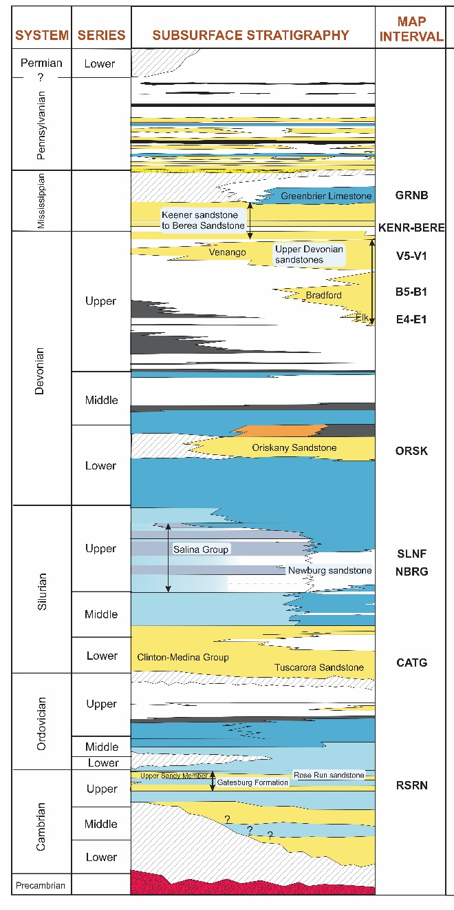
Evaluating our Prospects
Mined-rock cavern
depth, thickness, extent (facies changes)
Salt cavern
location, thickness, extent
create your storage container
F salt ~100 ft thick in Ohio River Valley corridor
Manage produced brine
Gas reservoirs
multiple sandstone reservoirs at various depths in AOI
porosity/permeability characteristics are important
productivity gives insight into potential storage potential
stacked storage opportunities
Notes:
So, we must evaluate our prospects by tailoring our characterization work to the type of geologic interval.
For mined-rock caverns, we need to look at (read slide)
For salt caverns, we need to consider (read slide)
For gas reservoir rocks, we know (read slide)

Slide 4
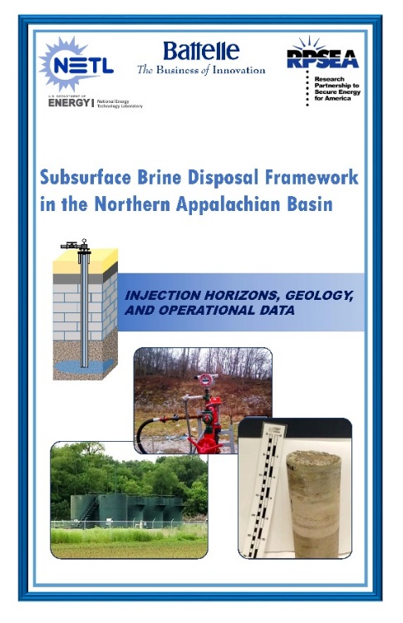
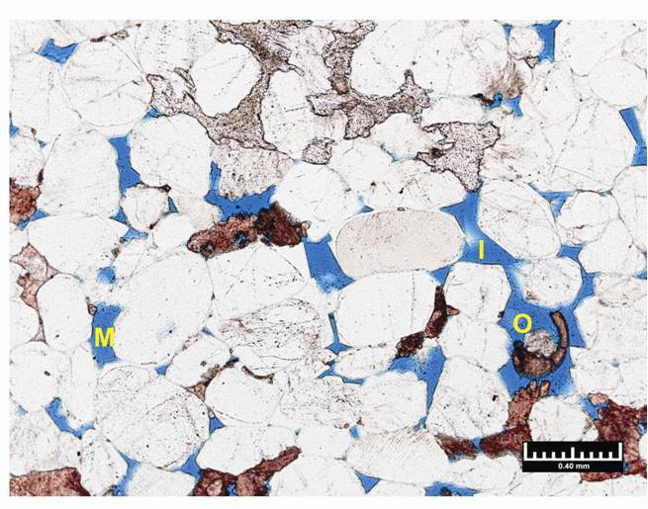
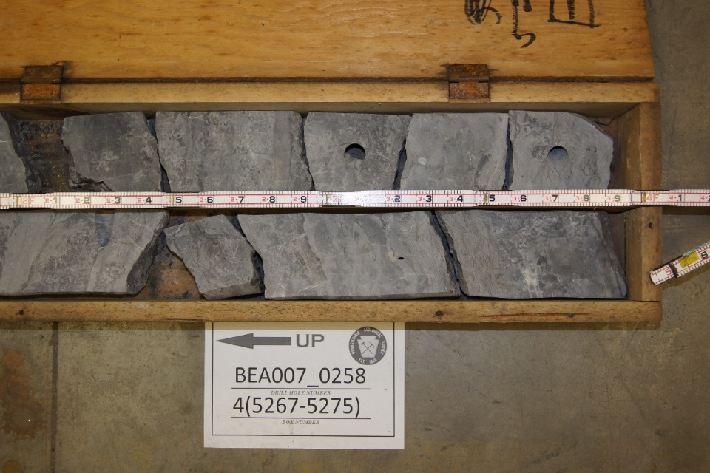
Reservoir characterization Efforts
Legacy data compilation
Mapping and petrophysical calculations
Qualitative thin section analyses
4
Notes:
Pennsylvania’s work under Strategy 4 – Reservoir Characterization Studies – has three parts (read slide).
Let’s talk about legacy data first.
Legacy data will largely come from the group’s recent brine injection study (2015) and our 14+ years’ worth of regional subsurface mapping under the DOE’s Midwest Carbon Sequestration Partnership (2003 – now).
Projects such as these, along with other research consortia we’ve participated in over the years (most notably, the Gas Atlas, Trenton Black River, and Utica Shale efforts) provide the backbone for our current work in terms of regional correlation, subsurface geologic mapping, understanding of structural controls, and reservoir and seal properties.
Given the ‘desktop study’ nature of the ASH Project, the research team is culling these works for the best quality, most applicable data for this study’s geologic intervals of interest.

Slide 5
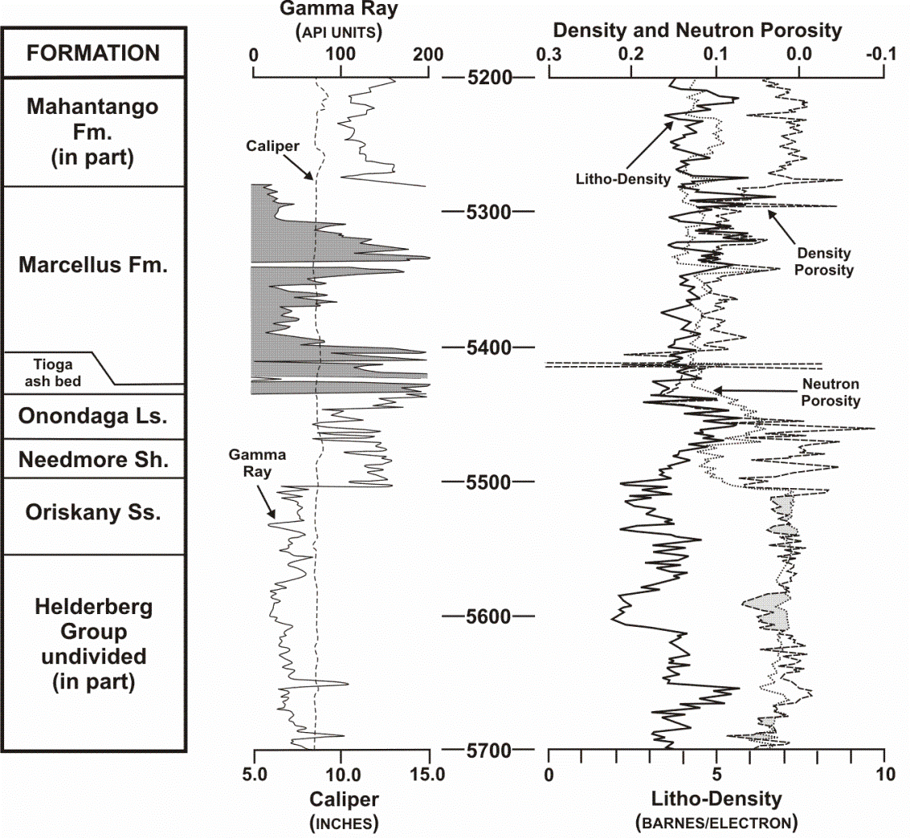
Reservoir characterization Efforts
Mapping and petrophysical calculations
Pick tops
Map surfaces
Select cutoff criteria (for ‘net sand’)
Compute reservoir parameters
Oriskany Sandstone
5
Notes:
Mapping and petrophysical calculations require various types of technical information, such as geophysical logs, core-derived data, oil and gas well records, etc.
For our part on this project, here’s the general workflow of how we come up with reservoir parameters (read slide).
In this example of the Oriskany Sandstone, we have a geophysical log with various curves – we use them to pick the top and bottom of the unit, and that data can be used in mapping the unit regionally. What’s more, our software allows us to designate cutoff criteria (what we refer to as the ‘net sand’), which demarcates ‘clean’ Oriskany Ss vs. less desirable sandstone.
Given this criteria, we compute reservoir parameters, including average porosity, gross and net thicknesses, and porosity-feet.

Slide 6
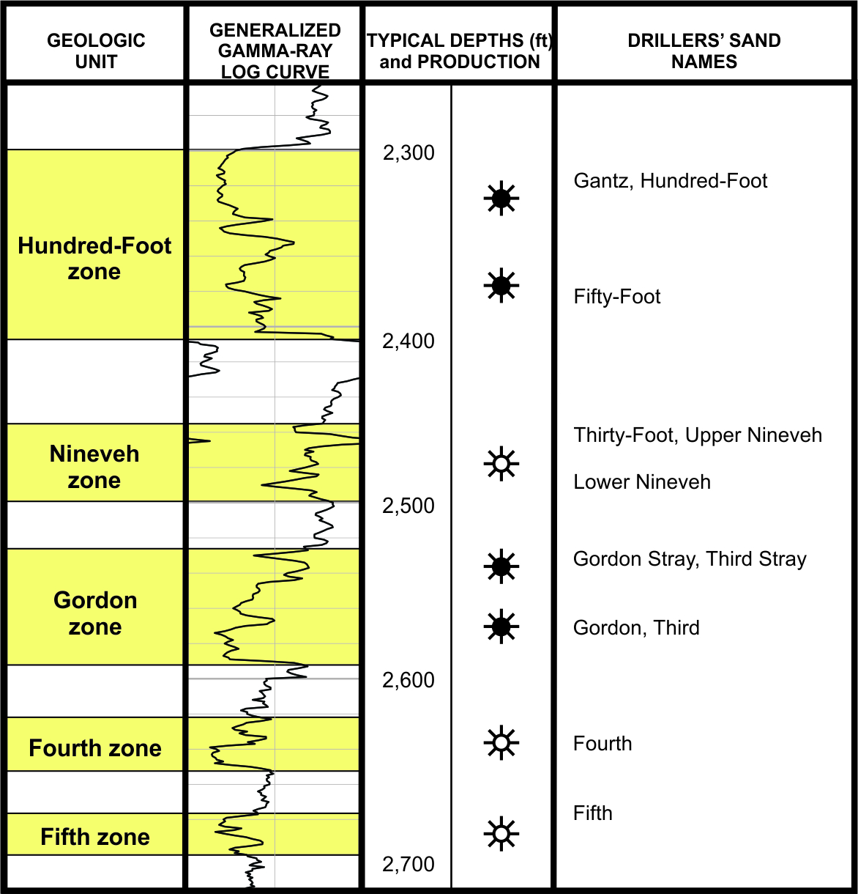
Reservoir characterization Efforts
Mapping and petrophysical calculations
Pick tops (group, formation, member, ‘drillers sands’)
Map surfaces
Select cutoff criteria (for ‘net sand’)
Compute reservoir parameters
Upper Devonian sandstones
Notes:
Using our Upper Devonian sandstones as another example:
Here, we’ve picked tops more specifically than just at the group (‘Venango’) level, because the sands are distinct, and over the years, drillers have come up with informal sand names for them.
You’ll note that in this case, the net sand cutoff is pretty important, as these sandstones have silty and shaly layers in between them. This means that there will be a notable difference in gross vs. net sand thickness (isopach) values.
The variability in lithology seen here generally reflects depositional controls during Devonian time when these sediments were laid down.

Slide 7
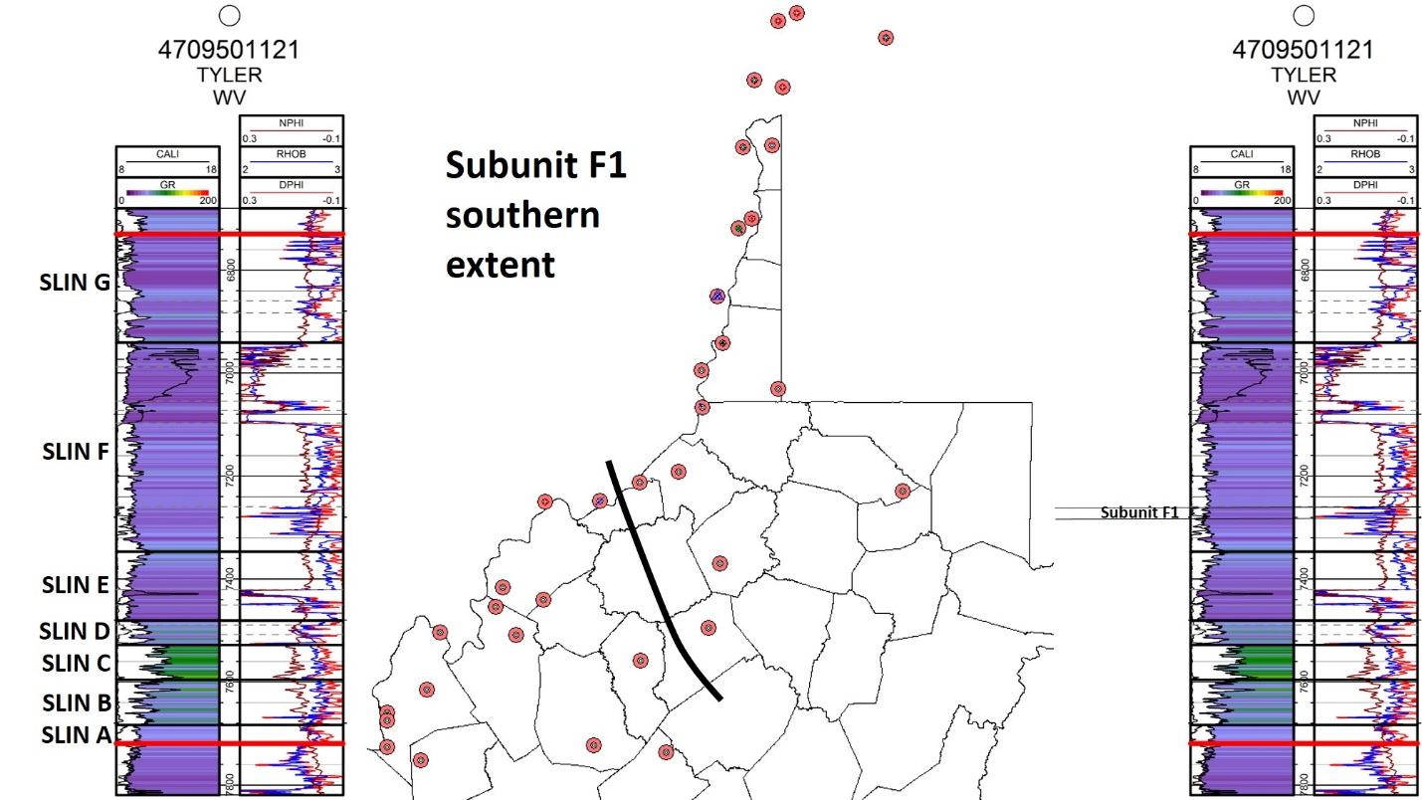
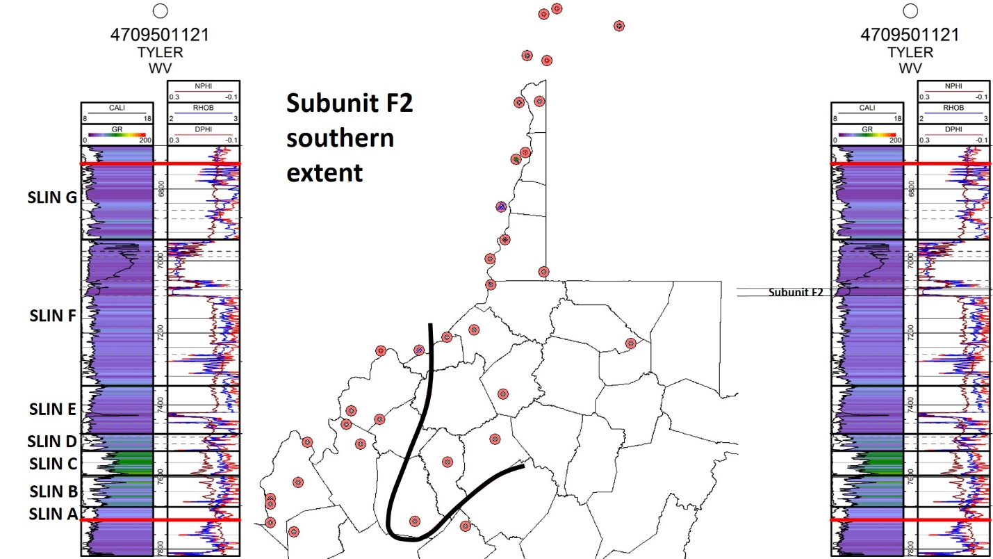
Salina Group – F SALT
Location
Thickness
Extent
7
Notes:
You’ll remember I said that the way we characterize intervals of interest for this project depends on the type of potential reservoir.
In the case of the Salina Group salts, we have to be particularly precise about location, thickness and extent of individual salt units, because these characteristics will ultimately dictate whether it’s prudent to solution-mine the interval to create a storage cavern in a particular area.
In these graphics, you see how the research team has been looking at the F salt in West Virginia, using geophysical logs to define individual units proximal to the Ohio River Valley corridor, and extent (presence/absence).

Slide 8
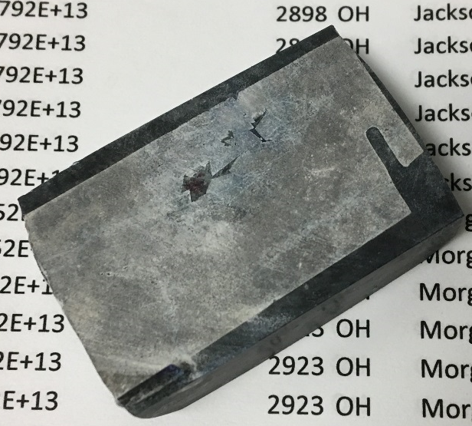
Reservoir characterization Efforts
Qualitative thin section analyses
8
Notes:
The third item that Pennsylvania is providing as part of Strategy 4 is qualitative thin section analyses.
This is a value-added item that we’re making some time for, although it’s not in the project’s official scope of work.
Thin sections are simply glass slides on which very thinly polished pieces of rock are adhered. In our case, we also impregnate the samples with blue epoxy so we can see the porosity in our samples.
On the right is an example of some thin section analysis work by Eric Lewis of the WVGES, where he studied the Newburg Sandstone as part of his graduate studies at WVU. We will be incorporating this legacy work into our reporting.

Slide 9
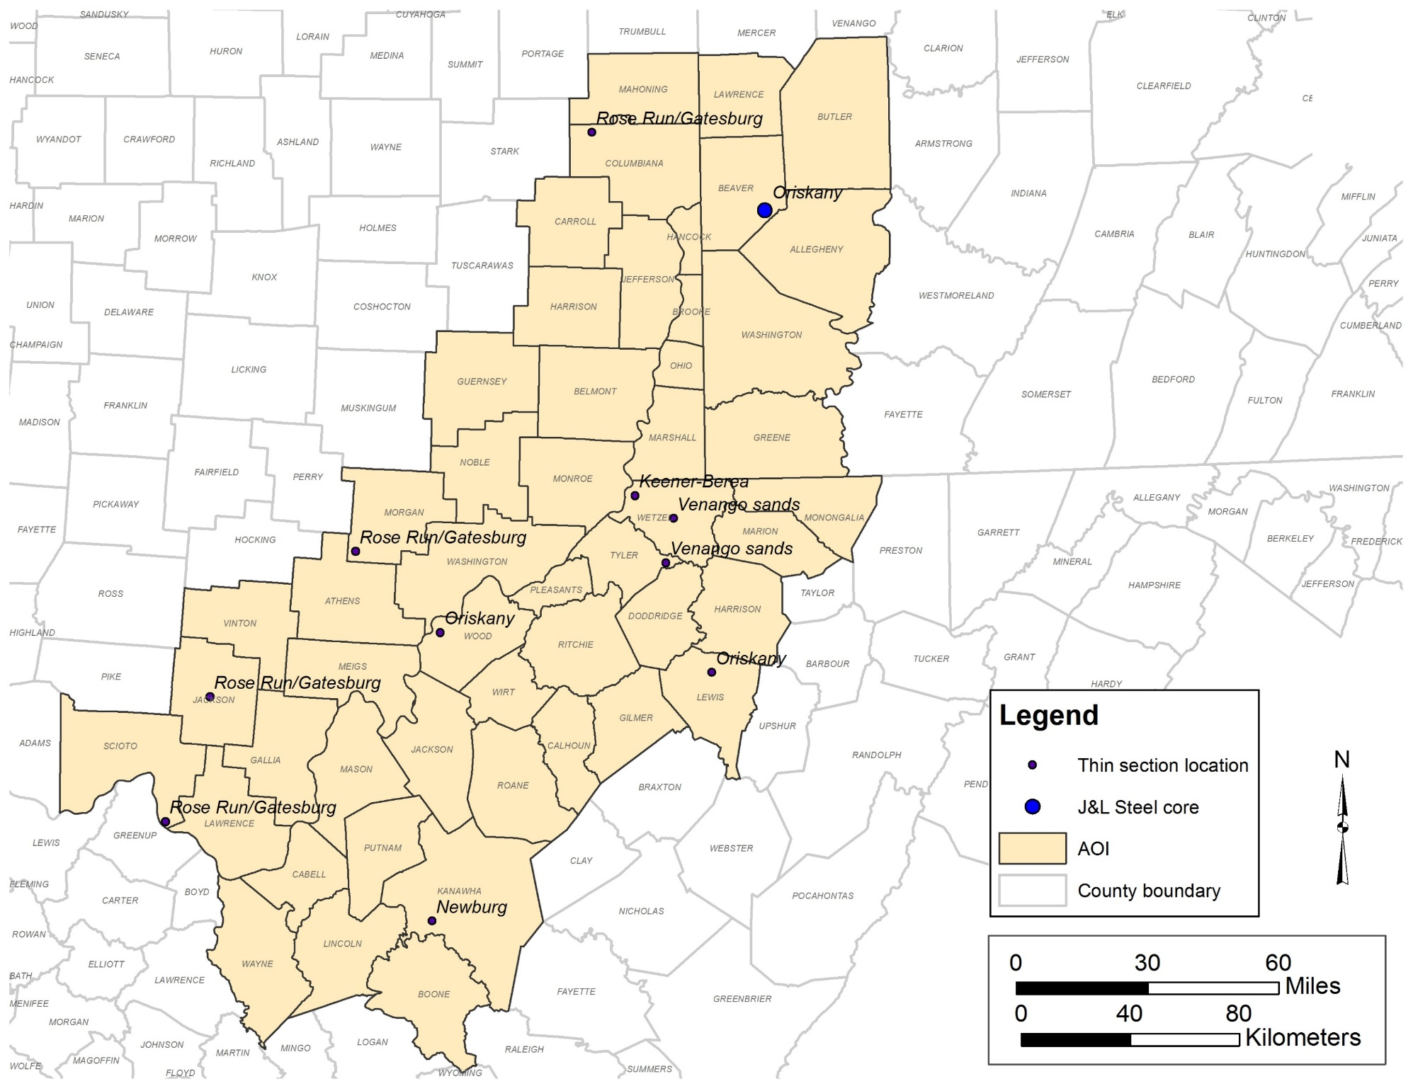
Location-specific work
Legacy core results
Existing and new thin section locations for qualitative analysis
9
Notes:
Here is a map of a couple progress items I wanted to report today – legacy core results for an Oriskany Ss well in Beaver County, PA and the locations of existing and new thin sections that we’re now evaluating for this project.
In Ohio, we have multiple locations of Rose Run/Gatesburg samples, and in West Virginia, we have locations for several geologic intervals of interest – the Keener to Berea, Venango sands, Oriskany Ss and Newburg Ss.

Slide 10
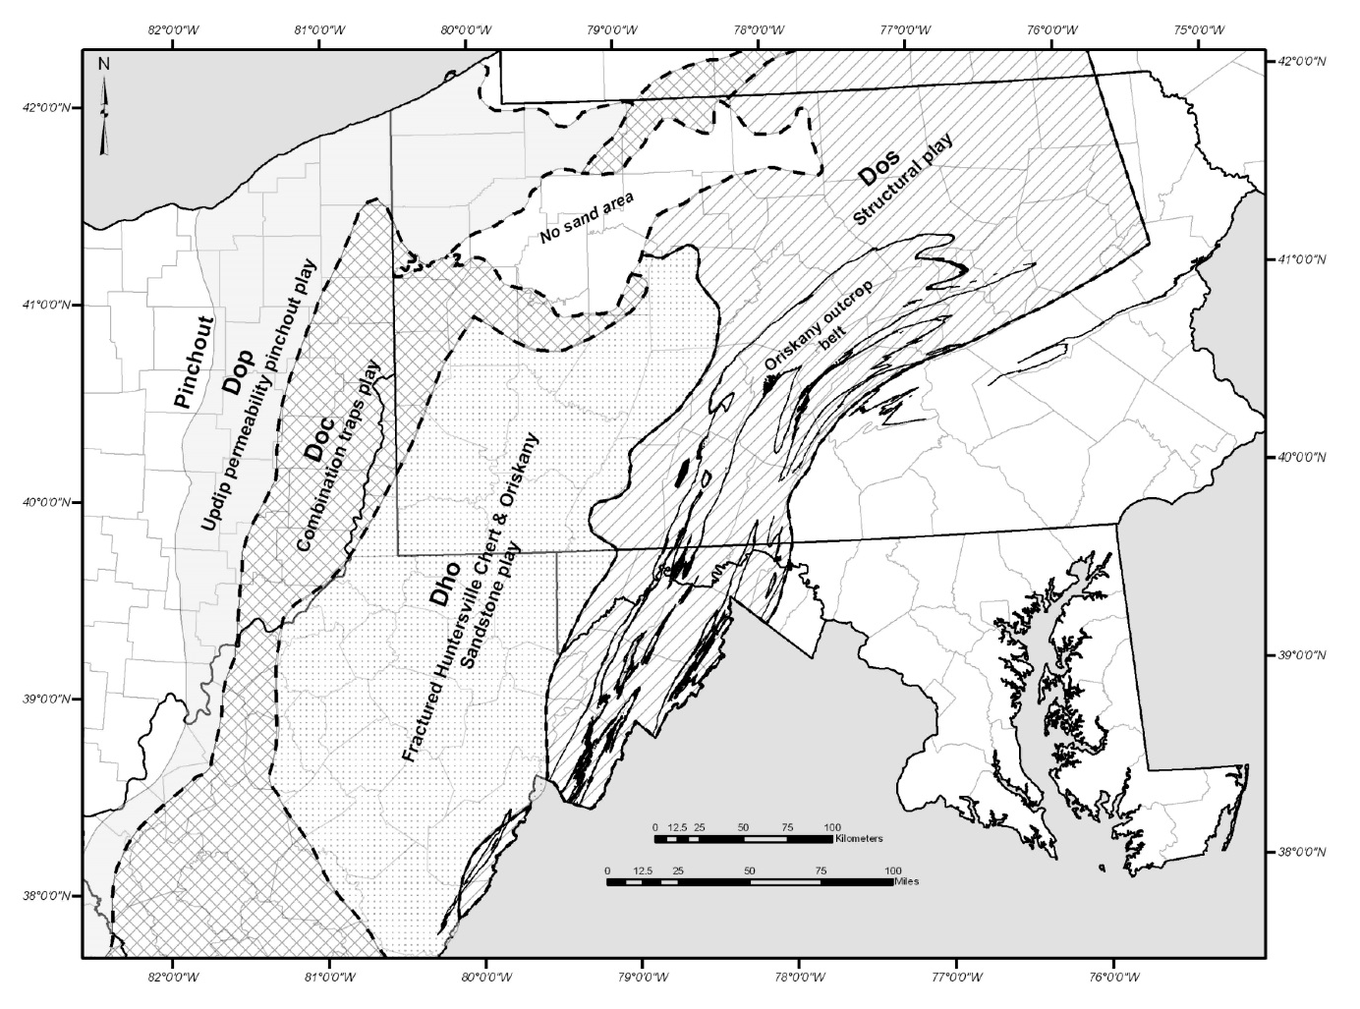
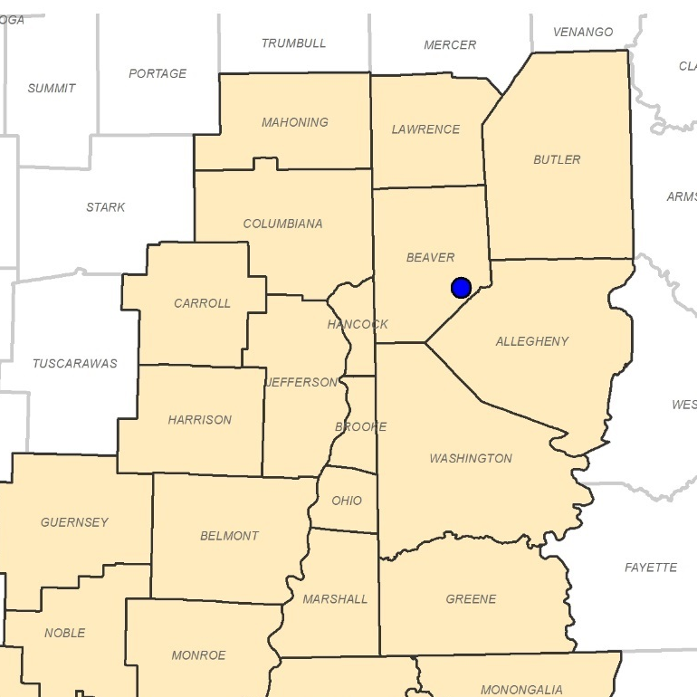
Oriskany Sandstone
Legacy data for Beaver County, PA well with rock core samples
10
Notes:
You may recall that the Oriskany is a regionally extensive sandstone that correlates across the Appalachian basin, and that in our area of interest, the unit has produced hydrocarbons through multiple processes (what we call ‘plays’).
Specifically, the DOP, DOC and DHO Oriskany plays are relevant to our area of interest, and the legacy core data from Beaver County is associated with the combination traps (DOC) play.

Slide 11
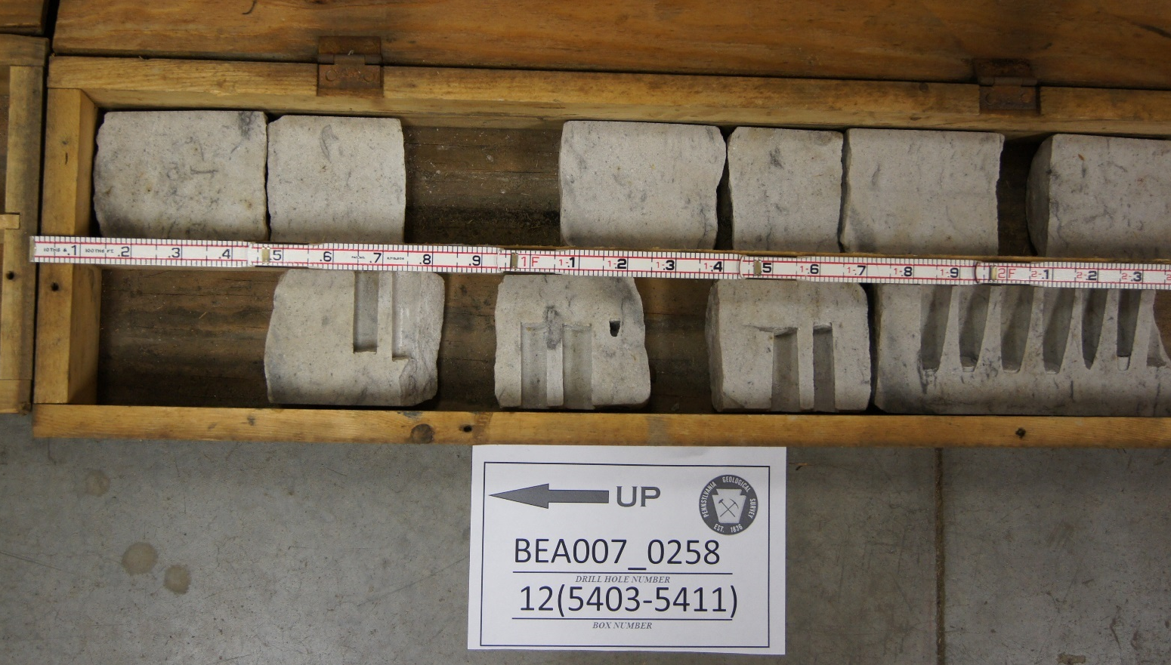
Oriskany sandstone
5,404 ft
Notes:
Here’s a photo of the section of Oriskany core from which multiple samples were taken for porosity and permeability analyses.
On the right, we show mercury injection capillary pressure (MICP) test results for the Oriskany sample taken from 5,404 ft. Porosity is 7.9 percent, and permeability is 8.35 millidarcies (in other words, pretty good for the Oriskany Ss).
The shape of this curve denotes well sorted pore throats, meaning that the void spaces in this sandstone are well-connected, and allow fluids to move through them pretty readily.

Slide 12
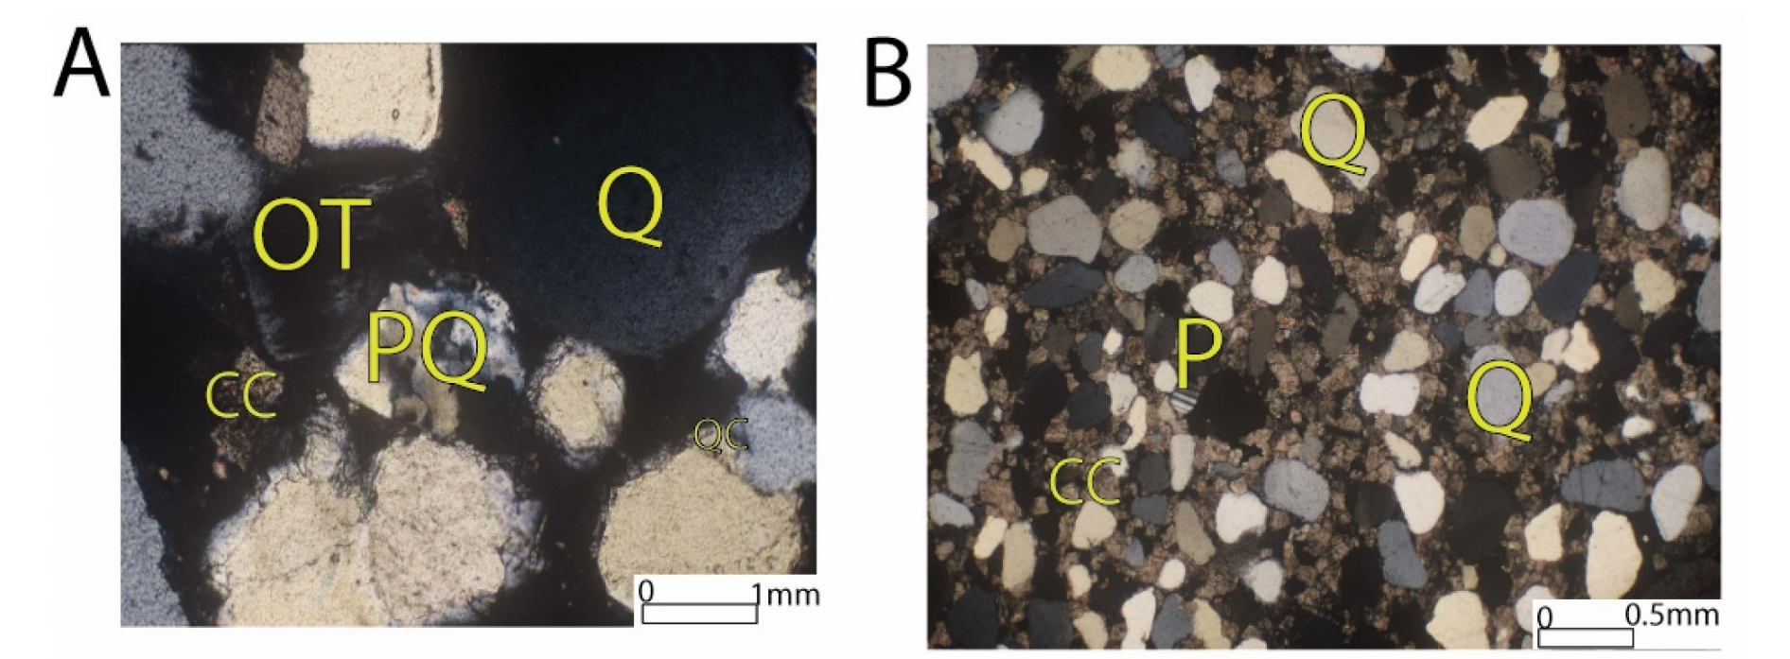
Rose Run (OH)/gatesburg (PA,WV) sandstones
Measuring and predicting reservoir heterogeneity in complex deposystems: the Late Cambrian Rose Run Sandstone of eastern Ohio and western Pennsylvania (Riley et al., 1993)
Subsurface facies analysis of the Rose Run Sandstone formation in southeastern Ohio (Chuks, 2008)
12
Notes:
As far as the Rose Run/Gatesburg sandstones go, the research team has a good bit of legacy data describing these Cambrian-age rocks – including the 1993 Rose Run study by Ron Riley and others and a Masters thesis that generated several Rose Run thin sections that the research team will be revisiting.
This graphic includes two photomicrographs of the Rose Run Ss from the Chuks Masters thesis:
calcareous quartz arenite showing carbonate cement (CC), quartz (Q), polygrystalline quartz (PQ), microcline (MC), orthoclase (OT) and quartz cement (QC);
calcareous quartz wacke showing rounded to well rounded quarts grains (Q), plagioclase (P), and carbonate cement (CC).
This is an example of the kind of deliverables that we’ll provide in the final report as far as qualitative thin section analyses go.

Slide 13
Thank you!
Kristin M. Carter, PG, CPG
Assistant State Geologist
Pennsylvania Geological Survey
Pittsburgh, Pennsylvania
krcarter@pa.gov
13
Notes:
That’s it for me!
Thank you for your time and interest today.

