Slide 1
Appalachian storage Hub (ASH) project
Reservoir Characterization Studies
Pennsylvania Geological Survey (Pittsburgh, PA)

Slide 2
A geologic study of the potential to build an Appalachian storage hub
Data collection and project database development
Stratigraphic correlation of key units
Mapping thickness and structure of key units
Studies of reservoir character
Develop ranking criteria
Recommendations
Project Management and Technology Transfer

Slide 3
Geologic INTERVALS of interest
Mined-rock caverns
Greenbrier Limestone (>40 ft thick at depths in excess of 1,800 ft; suitable for mining)
Salina Group salts (>100-ft thick preferred; suitable for solution mining)
Keener sandstone to Berea Sandstone
Upper Devonian sandstones
Oriskany Sandstone
Clinton-Medina Group through Tuscarora Sandstone
Rose Run and Upper Sandy Member of the Gatesburg Formation
Salt caverns
Gas reservoirs

Slide 4
What is a Reservoir, and why do we need to Characterize it?
RESERVOIR – a subsurface volume of porous and permeable rock in which oil or gas has accumulated; a subsurface rock that is saturated with water
RESERVOIR CHARACTERIZATION consists of many steps, from data gathering and basic interpretation to data analysis and 3-D models of geologic stratigraphy, structure, petrophysics and fluid flow
Examples:
Lithology, depth, thickness and extent of geologic units
Contact with seals
Porosity, permeability, pressure

Slide 5
Existing published resources
The Atlas of Major Appalachian Gas Plays (1996)
Midwest Regional Carbon Sequestration Partnership Geologic Characterization Reports (2005, 2009, 2012)
Geologic Carbon Sequestration Opportunities in Pennsylvania (2009)
A Geologic Playbook of Trenton-Black River Exploration (2006)
Appalachian Basin Tight Gas Reservoirs Project (2008)
A Geologic Playbook for Utica Shale Appalachian Basin Exploration (2015)
Subsurface Brine Disposal Framework in the Northern Appalachian Basin (2015)

Slide 6
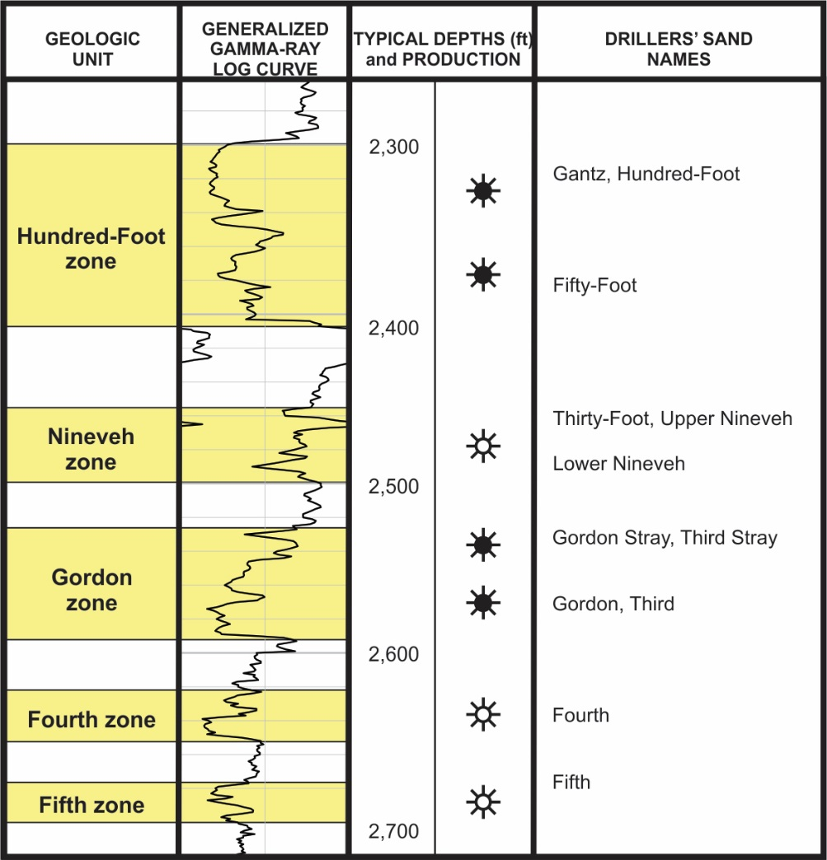
Upper Devonian Sandstones
Shallow sandstones (~2,000 – 3,000 ft deep)
Drilled by conventional operators in the Area of Interest (AOI) for more than 100 years
Multiple (stacked) gas and oil-producing zones
Individual intervals are limited in extent

Slide 7
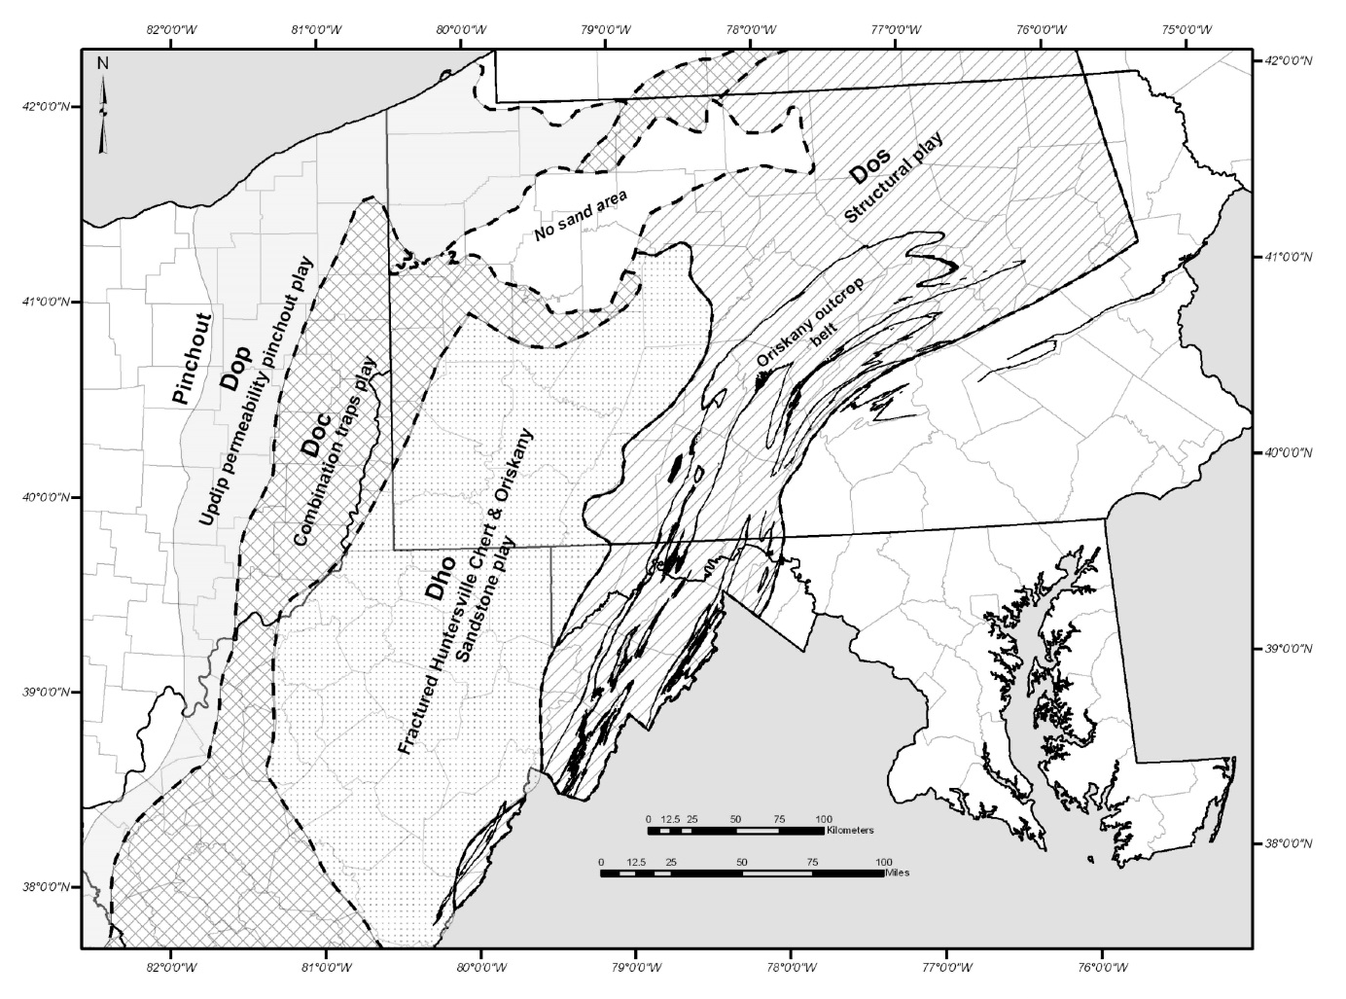
Oriskany Sandstone gas plays
Regionally extensive sandstone that correlates across the basin
Well known by operators and has been researched by many workers
Produces gas in different areas of the basin through different mechanisms
DOP, DOC and DHO Oriskany plays are relevant to our area of interest
Notes:
Next few slides will give a flavor of the kind of technical information we will be compiling for the reservoir characterization task, with specific examples from past work.

Slide 8
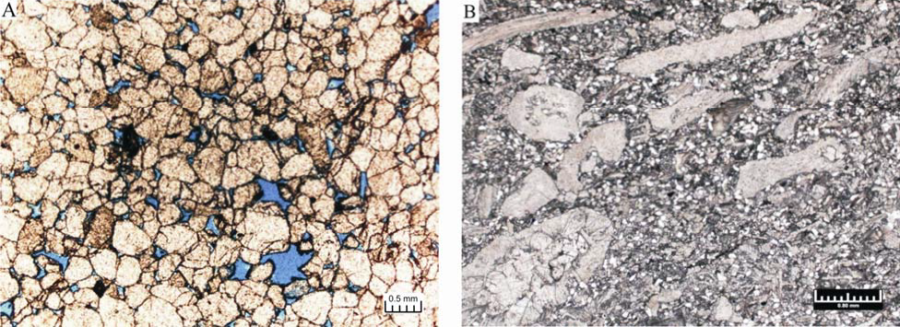
DOP – Updip Permeability pinchout Play
Left – A typical quartz arenite
Right – A sandy limestone
Both are considered “Oriskany Sandstone” but each have their own mineralogy and porosity characteristics
Moving westward (updip), connectivity of the reservoir (permeability) decreases
Notes:
Left - 1779 ft depth Ashtabula County, OH, Core #442
Right - Guernsey County, Ohio, Core #2876. Sample is from a depth of 3307.6 ft

Slide 9
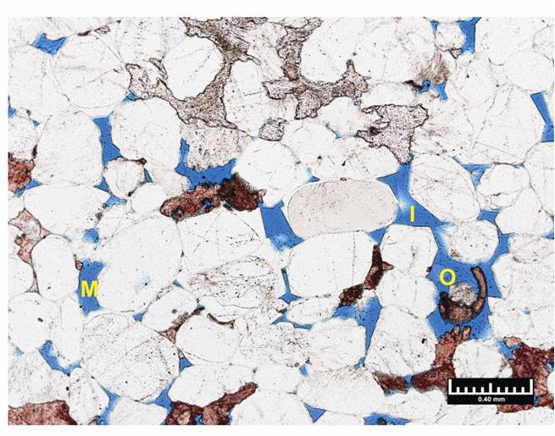
DOC – Combination Structural/Stratigraphic Traps Play
Some of the porosity in this combination play is due to structural controls, other to stratigraphic controls
Primary intergranular and secondary dissolution porosity is visible here – intergranular porosity
Porosity textures include moldic (M), oversized (O), and enlarged intergranular (I).
Notes:
Sample is from Core #2876,Guernsey County, Ohio and a depth of 3306.6 ft

Slide 10
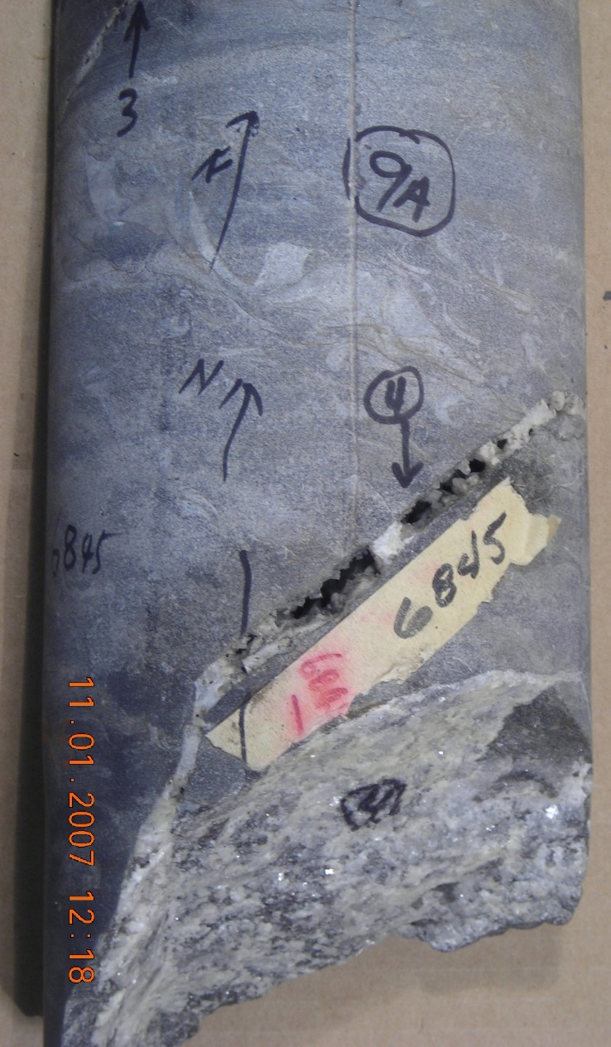
DHO – fractured Huntersville Chert and Oriskany Sandstone Play
In this play, the Oriskany Sandstone and overlying Huntersville Chert are hydraulically connected through fractures.
Right – fracture fill in core sample; fractures have been largely filled with calcite, quartz and pyrite
Left – thin section photomicrograph of medium-grained quartz arenite cemented by quartz overgrowths and calcite
Notes:
R.H. Heyn well, Fayette County, Pennsylvania (west of our AOI)

Slide 11
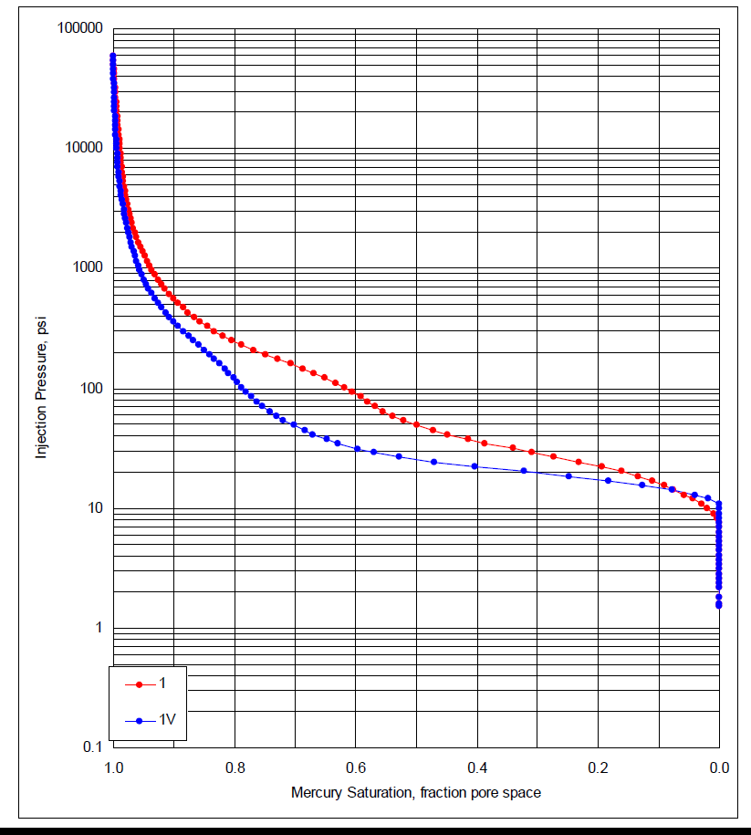
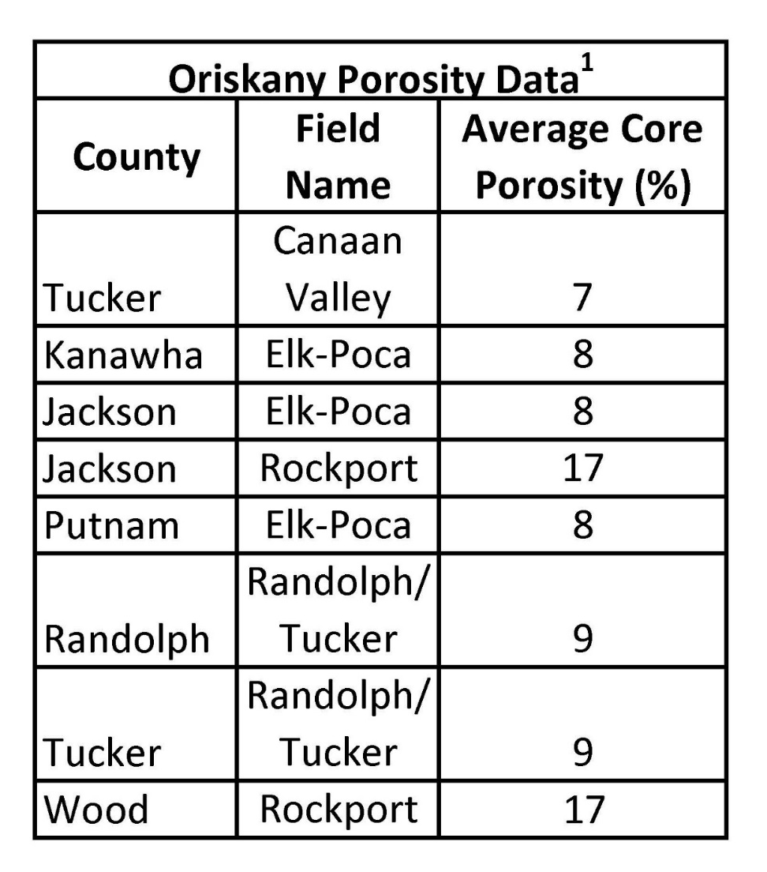
Other Examples of Reservoir data

Slide 12
Thank you!
Kristin M. Carter, PG, CPG
Assistant State Geologist Pennsylvania Geological Survey
Pittsburgh, Pennsylvania
krcarter@pa.gov

