Slide 1
LITHOSTRATIGRAPHY
Upper Ordovician Strata of the Appalachian Basin
Utica Shale Play Book Study - Canonsburg, PA - July 14, 2015
John Hickman, Cortland Eble, and David Harris
University of Kentucky – Kentucky Geological Survey
Notes:
Title slide for each presenter’s section –blue/green rectangle border at top; major and minor headings, as per workshop agenda

Slide 2
Project Area and Well Data
Geologic Quadrangles, Well Info, Well Logs, Cores & Drill Cuttings
Notes:
Title slide for each presenter’s section – major and minor headings, as per workshop agenda

Slide 3
Data Used
Project database contains location and header information on over 10,000 wells across the five member states and the bordering regions of Indiana, Michigan, and southern Ontario, Canada.
Geophysical well logs for 1,857 wells (almost 1,500 from Ordovician and deeper penetrations).

Slide 4
Data Used
Stratigraphic and lithological descriptions of relevant units from 1:24,000-scale surficial geologic maps were used to help constrain subsurface log interpretations
Information from well cuttings, core, and available strip-logs of Ordovician samples

Slide 5
Project wells

Slide 6
Upper Ordovician Units

Slide 7
Stratigraphic Interpretation
Notes:
Title slide for each presenter’s section – major and minor headings, as per workshop agenda

Slide 8
Data Interpretation
Stratigraphic correlations focused on the Upper Ordovician strata, specifically:
Kope Fm
Utica Fm
Point Pleasant
Upper Trenton/Lexington Ls
Logana Ls Mbr, Lexington Ls
Curdsville Ls Mbr, Lexington Ls
Black River Fm
Stratigraphic correlations focused on the Upper Ordovician strata, specifically:
Kope Fm
Utica Fm
Point Pleasant
Upper Trenton/Lexington Ls
Logana Ls Mbr, Lexington Ls
Curdsville Ls Mbr, Lexington Ls
Black River Fm
TOC rich units

Slide 9
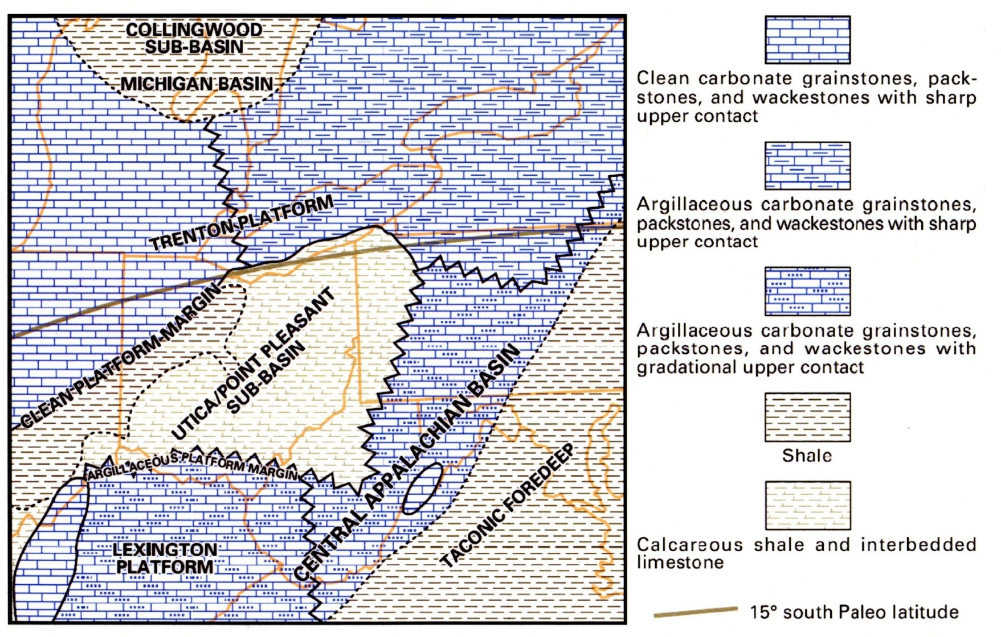
Lithofacies Map
Utica/Point Pleasant Deposition
From Riley and Baranoski, 2011

Slide 10
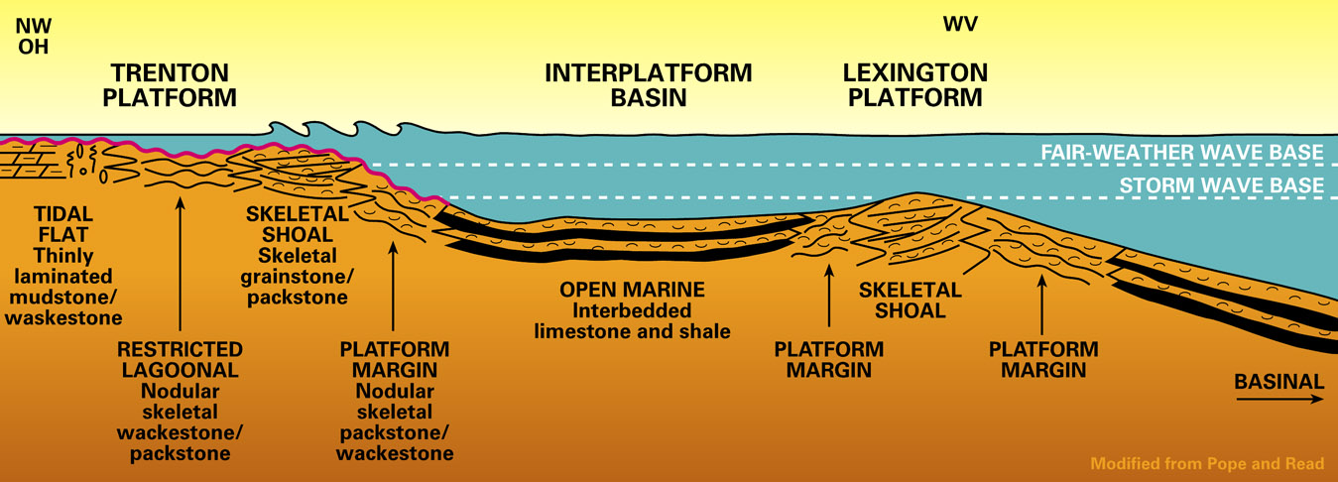
Idealized Platform & Sub-Basin Depositional Model
UTICA-POINT PLEASANT SUB-BASIN

Slide 11
Outcrop of Utica- and Pt. Pleasant-equivalent units in KY

Slide 12
Type-log – Eastern Ohio
GR
PEF
NPHI
RHOB
Cincinnatian Series
Kope Fm
Utica Sh
Point Pleasant
Upper Lexington Ls/Trenton Fm
Logana Mbr
Curdsville Mbr
Deicke K-bentonite
Black River Gp

Slide 13
Example Sections For Each Unit Studied
Notes:
Title slide for each presenter’s section – major and minor headings, as per workshop agenda

Slide 14
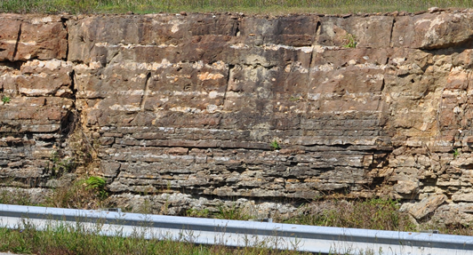
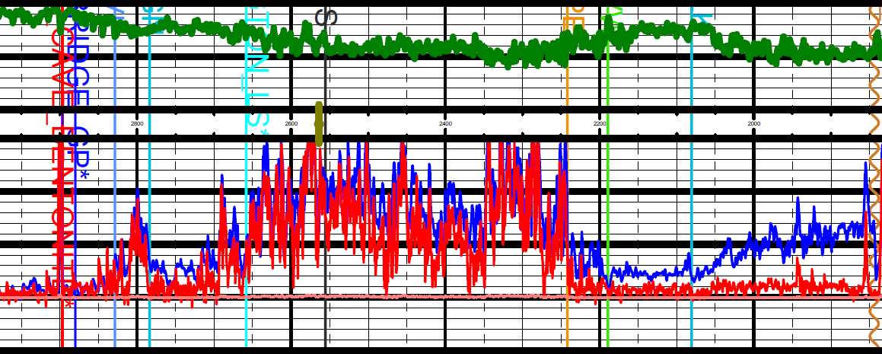
Brassfield Dol
Early Silurian Brassfield Dol
Late Ordovician Drakes Fm

Slide 15
Kope Formation
Composed of interbedded shale (about 60 to 80%), limestone (20 to 40%), and minor siltstone
Alternating 2- to 5-ft thick shales and 2- to 6-inch thick limestone beds
Mostly low TOC (< 1.0%)

Slide 16
Kope Fm
Interbedded limestone (30%) and shale (70%), Ls beds 2-6” thick

Slide 17
Utica Shale
The Utica is a laminated organic- and clay-rich shale
TOC up to 4.0% in places
Carbonate content is typically around 25%, mostly in thinly bedded limestones

Slide 18
Utica Shale
Interbedded limestone and shale (~50/50%), beds 2-6” thick

Slide 19
Point Pleasant Fm
Laminated black shale and limestone
Often appears as transitional unit between clay-rich Utica and limestone-rich Lexington/Trenton interval below
TOC up to 8% in some wells
Carbonate content typically around 50%

Slide 20
Point Pleasant Fm
Interbedded nodular limestone (50-70%) and shale

Slide 21
“Upper” Lexington Limestone
Cleaner limestone units at top of formation
Includes Millersburg, Tanglewood, and Grier Limestone Members
Nodular and irregularly bedded fossiliferous limestone
Some thin, localized “source grade” beds possible (up to 4% TOC)

Slide 22
Upper Lexington Ls (Grier Ls Mbr)
Fossiliferous calcisiltite with shale partings

Slide 23
Logana Limestone Member
High TOC zone (up to 8%) at base of section (equivalent to Flat Creek Sh in NY)
Interbedded calcisiltite, shale, and coquinoid limestone
Calcisiltite is generally in even or broadly lenticular beds 0.2- to 0.3-ft thick
High carbonate content average around 75%

Slide 24
Curdsville Limestone Member
Basal member of the Lexington/Trenton Formation
Bioclastic calcarenite
Deposited in shallow, turbulent water during the initial transgression of the Lexington sea
Up to 7% TOC

Slide 25
Logana Mbr, Lexington Ls
Interbedded calcisiltite and shale
Curdsville Mbr, Lexington Ls
Bioclastic calcarenite
Black River Gp

Slide 26
Lithostratigraphic Sampling
Notes:
Title slide for each presenter’s section – major and minor headings, as per workshop agenda

Slide 27
Lithology of source beds
The Utica-Pt. Pleasant-Trenton is a layered limestone to shale/siltstone reservoir play.
Most of these layers are thin (0.25-6”) and are therefore below downhole log resolution

Slide 28
Overcoming Sampling Biases
Organic carbon content of units is not identifiable by visual inspection (i.e.- the “darkness” of samples does not correlate to the organic richness of samples)
Because of this, potential source zones for well cuttings based TOC lab analysis are difficult to target

Slide 29
Overcoming Sampling Biases
Also, because of the interlayered Ls/Sh nature of these formations, all units have some nonorganic beds
Therefore, if only a few samples are taken per well, false negatives are common (i.e.- possibility of a low %TOC bed being sampled from what is actually an rich unit, overall)
This can lead to confusing, “bullseye” heavy maps of TOC content when contoured on raw measured values alone

Slide 30
Summary
The Curdsville through Kope stratigraphic interval represents a 1st order transgressive sequence that transitions from carbonate- to clastic-dominated (clay/siltstone).
All units contain 3rd to 4th order cycles resulting in alternating beds of limestone and shale.

Slide 31
Summary
All units appear to have been deposited at a water depth equal to or above storm-wave base.
Numerous beds are fossiliferous and/or are heavily bioturbated.
Variations in TOC richness likely derived from varied degrees of organic preservation rather than varied production rates.

