Slide 1
Core Studies:
High Resolution Core Photography & Spectral Gamma-Ray Logging
Matthew Erenpreiss
Ohio Department of Natural Resources
Division of Geological Survey
Utica Shale Play Book Study Workshop
Canonsburg, PA
July 14, 2015

Slide 2
Outline
Background
Spectral Gamma-Ray Scanner
Core Locations
Correlations
Conclusions
Notes:
White background, dark blue text, and Arial font type to be used for all slides

Slide 3
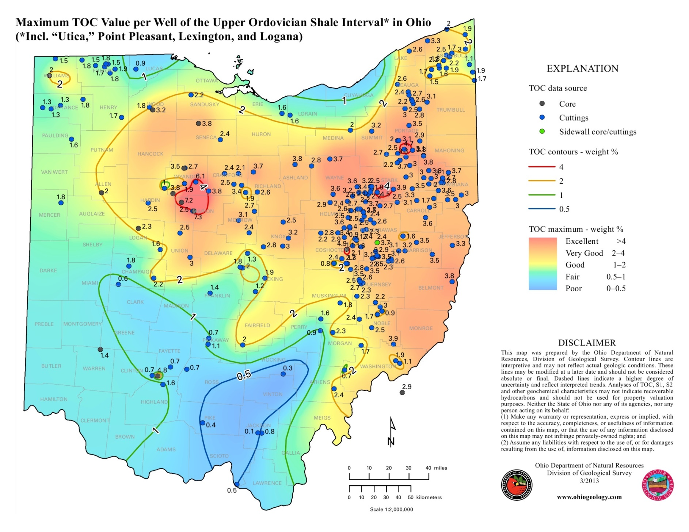
2013 TOC Map of Ohio
Notes:
White background, dark blue text, and Arial font type to be used for all slides

Slide 4
Possible TOC Proxies
Uranium/TOC Ratio
TOC=(Γ_{B}/Γ)/1.378A
Γ = Gamma-ray (Api Units)
A = Slope of Gamma-Ray – Density Crossplot
Schmoker (1981)
Density-to-TOC
TOC=(A/ρ)-B
ρ = Formation Density
A & B = Constants for a black shale facies
Schmoker (1989)
Notes:
White background, dark blue text, and Arial font type to be used for all slides

Slide 5
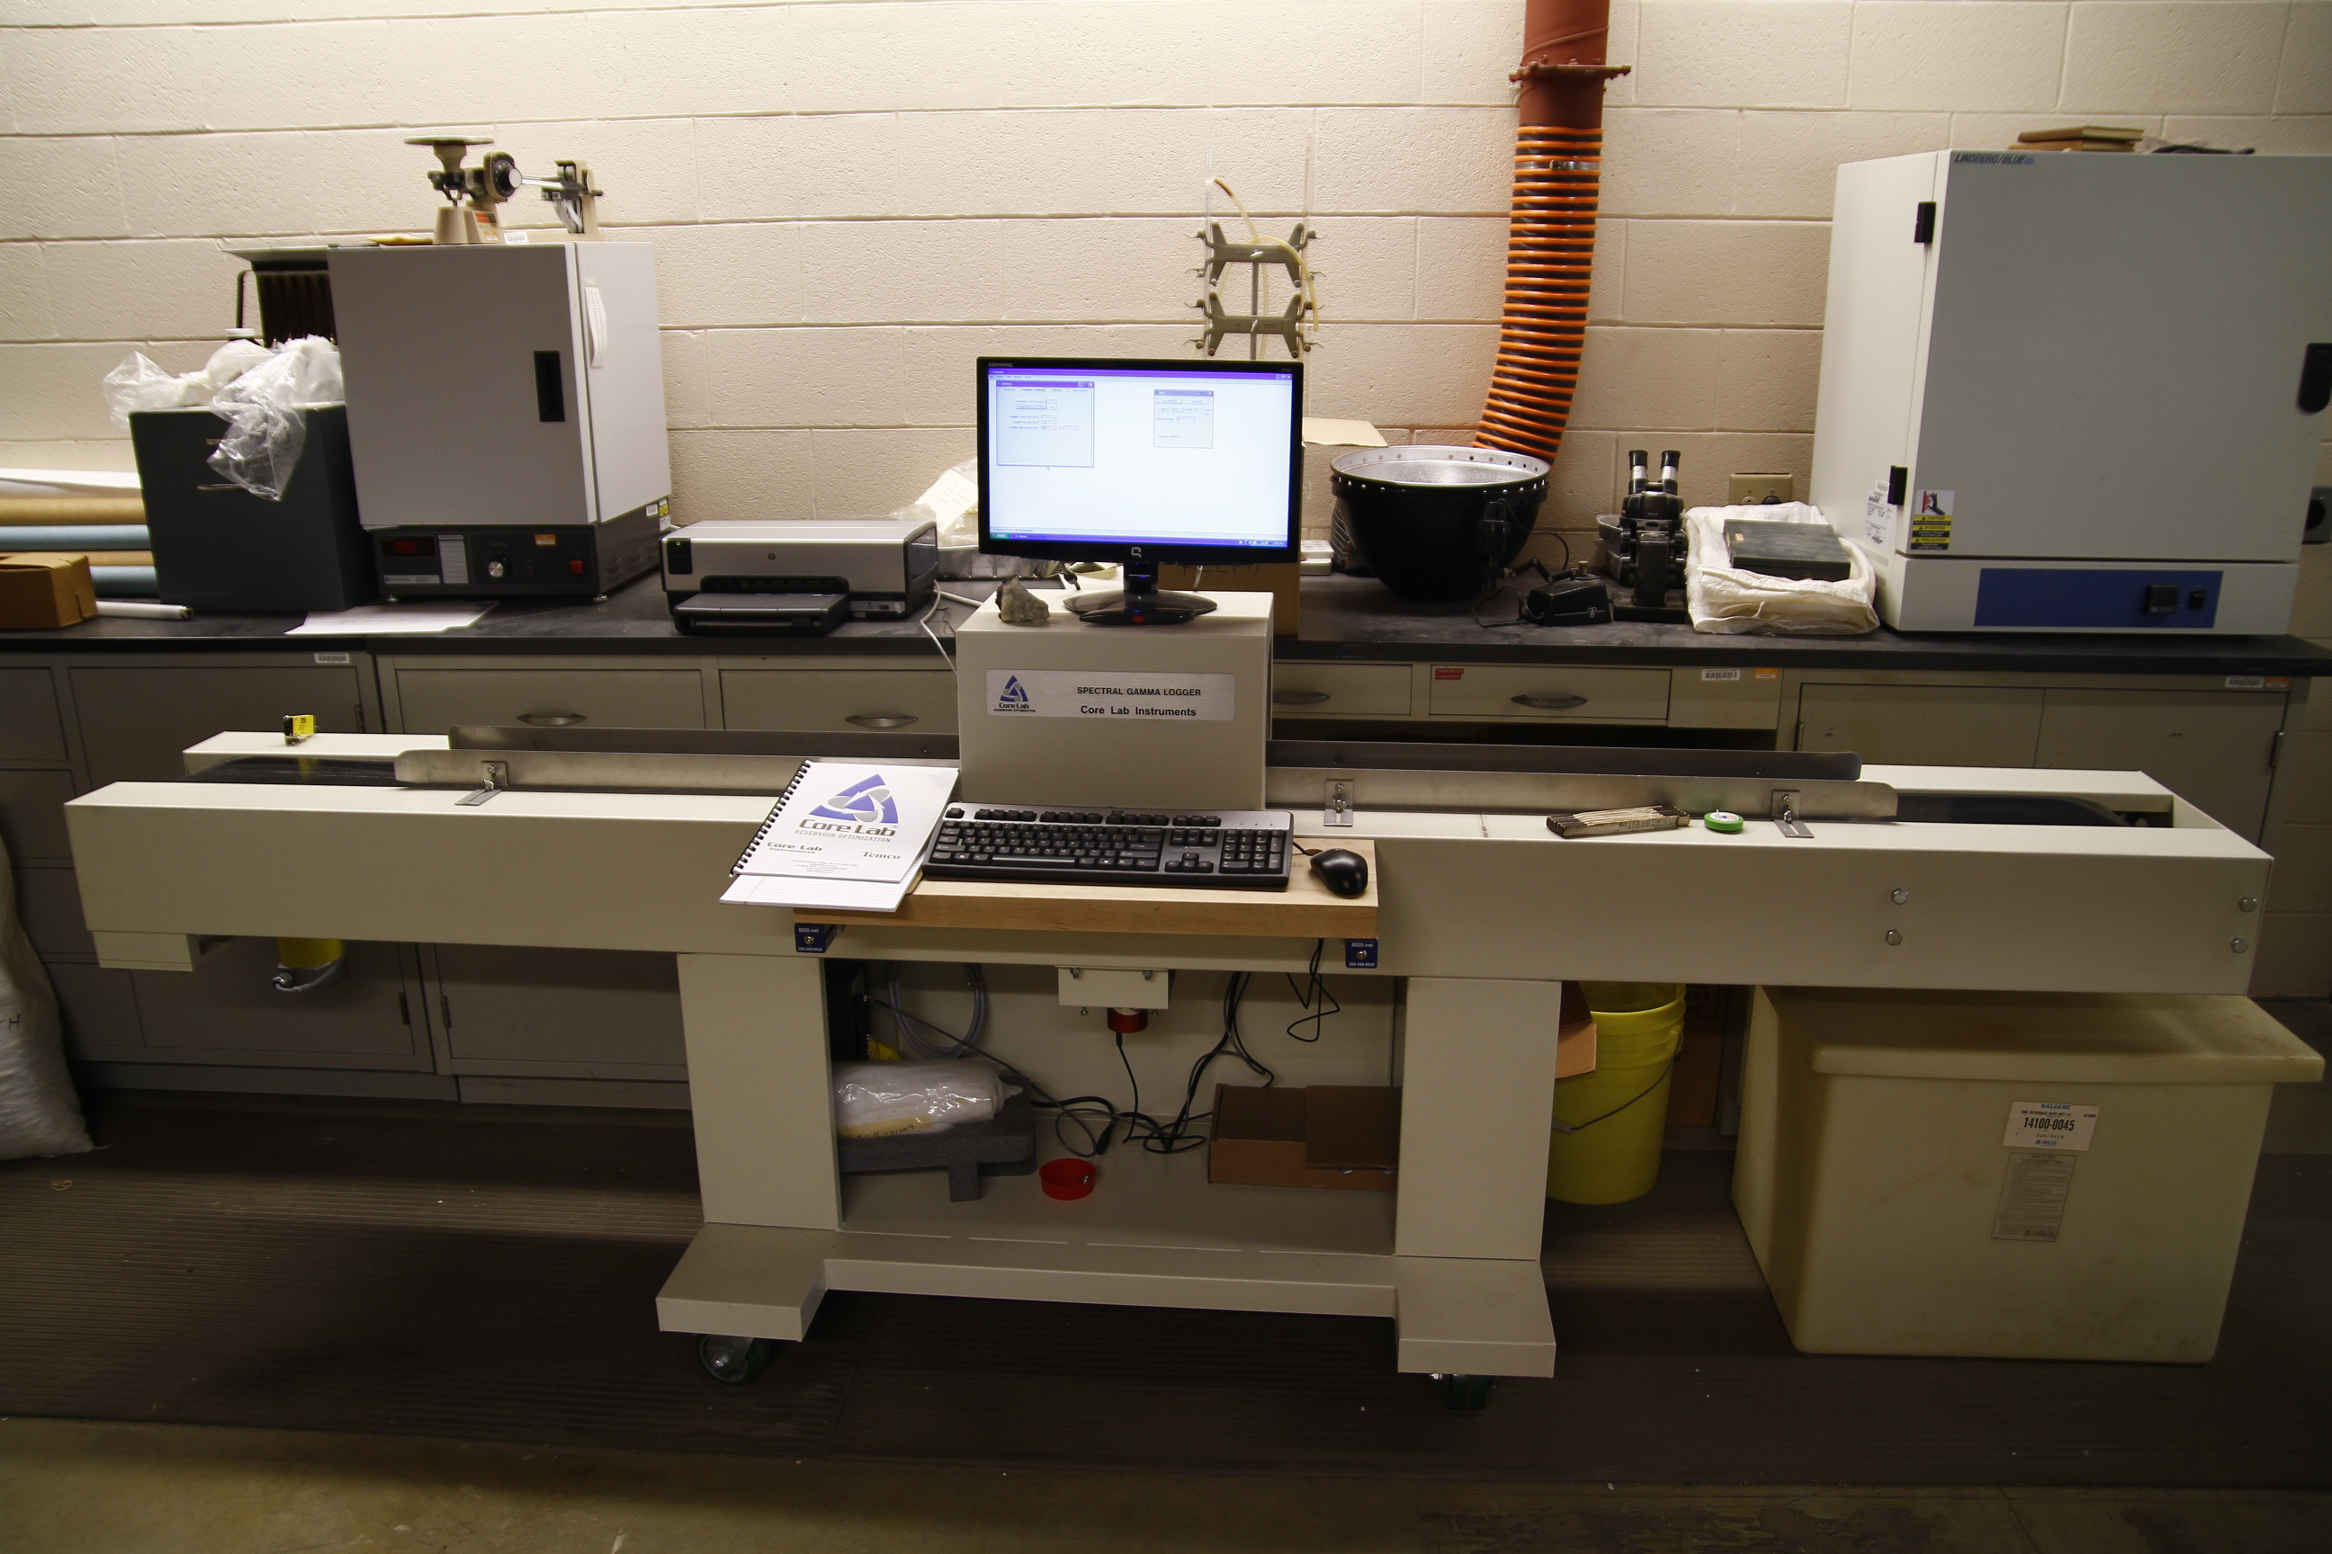
Spectral Gamma-Ray Logger
Notes:
White background, dark blue text, and Arial font type to be used for all slides

Slide 6
Downhole Spectral Gamma Ray Logs vs. SGL 300
Total Gamma Ray Curves
Downhole logs are collected by different companies using different standards that are calibrated at various gain settings.
The SGL-300 produces very consistent results
Calibrated to the same set of standards at a constant gain setting on a daily basis
Scintillator Resolution
The SGL-300 uses a high-resolution scintillator
Easily differentiates the radioactive gamma characteristics of URAN (ppm), POTA (%), and THOR (ppm)
Downhole scintillation tools are not as good at separating the unique gamma signals, resulting in “combined signals.”
Best fit of TOC data into log data
Notes:
White background, dark blue text, and Arial font type to be used for all slides

Slide 7
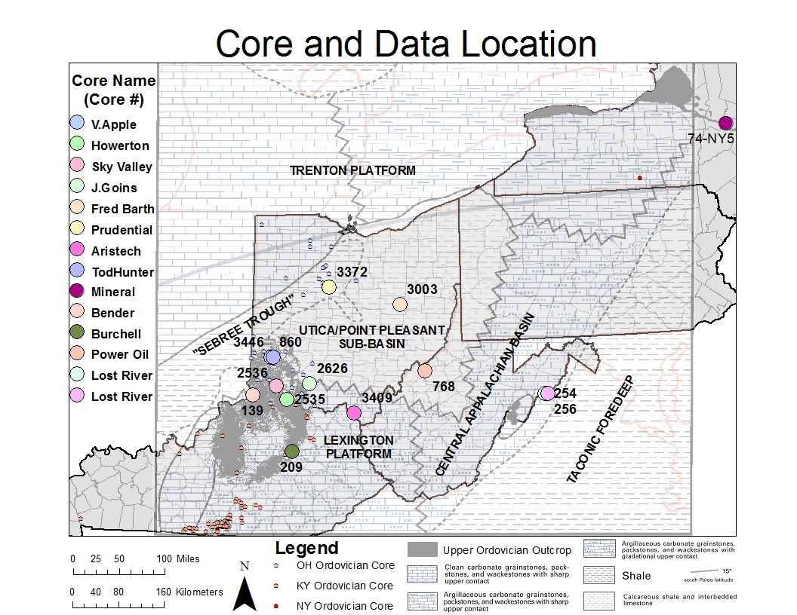
Outline
Core Locations
Notes:
White background, dark blue text, and Arial font type to be used for all slides

Slide 8
Core Data
Core # | Name | State | County | Footage | Size
3446 | Tod Hunter | OH | Butler | 27’ – 381’ | 2 ¼”; Full Diameter
860 | V. Apple | OH | Butler | 67’ – 693’ | 2 ¼”; Full Diameter/slabs
2535 | Howerton | OH | Clermont | 19’ – 349’ | 2 ¼”; Full Diameter
2536 | Sky Valley RC | OH | Clermont | 21’ – 319’ | 2 ¼”; Full Diameter
3003 | Fred T. Barth | OH | Coshocton | 5630’ – 5749’ | 3 ⅜”; Full Diameter
2626 | J. Goins | OH | Highland | 600’ – 1310’ | 2 ¼”; Full Diameter
3372 | Prudential | OH | Marion | 389’ – 1604’ | 2 ¼”; Full Diameter
3409 | Aristech | OH | Scioto | 2734’ – 3373’ | 2 ¼”; Full Diameter
254 | Lost River | WV | Hardy | 27’ – 100’ | 2 ¼”; Full Diameter
256 | Lost River | WV | Hardy | 17’ – 70’ | 2 ¼”; Full Diameter
768 | Power Oil | WV | Wood | 9417’ – 9665’ | 2 ¼”; ⅓ Slab
139 | Bender CG&E | KY | Boone | 36’ – 284’ | 2 ¼”; Full Diameter
209 | M. Burchell | KY | Montgomery | 20’ – 904’ | 2 ¼”; Full Diameter
74NY5 | Mineral Core | NY | Herkimer | 21’ – 763’ | 2 ¼”; ½ Slab
Notes:
White background, dark blue text, and Arial font type to be used for all slides

Slide 9
Individual Analysis
The following 4 wells represent results from this study:
Burchell (KY-209)
Aristech (OH-3409)
Power Oil (OH-768)
Mineral Core (74-NY-5)
Additional analysis were conducted on the following data subsets: with similar results to the 4 wells above:
All data from each facies
All data from each Formation (Utica, Point Pleasant, Lexington, Logana)
All data from each Formation in each facies
Individual wells for each formation
Notes:
White background, dark blue text, and Arial font type to be used for all slides

Slide 10
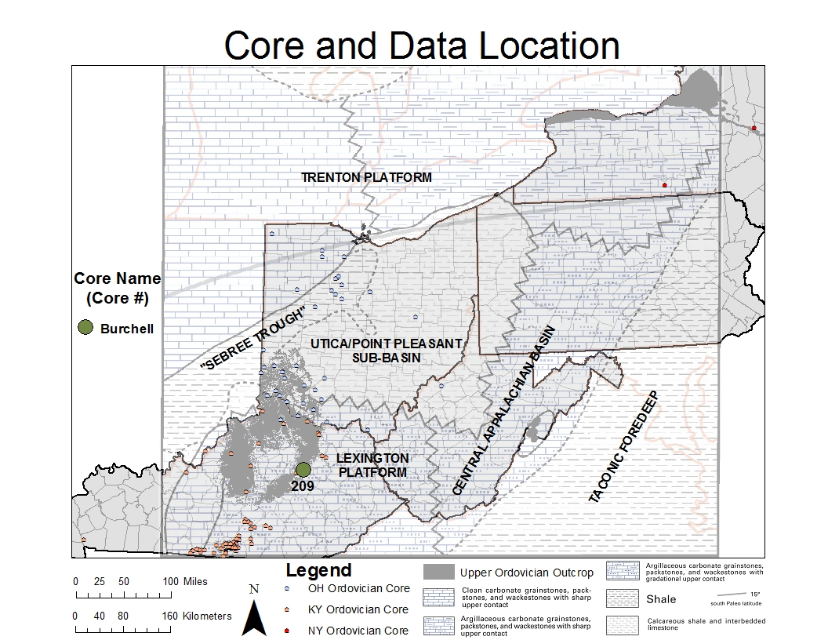
Montgomery County, Kentucky M. Burchell C-209
Notes:
White background, dark blue text, and Arial font type to be used for all slides

Slide 11
Core 209 SGL LAS File – TOC
Highest TOC (%) is in the Curdsville equivalent and Trenton
Notes:
White background, dark blue text, and Arial font type to be used for all slides

Slide 12
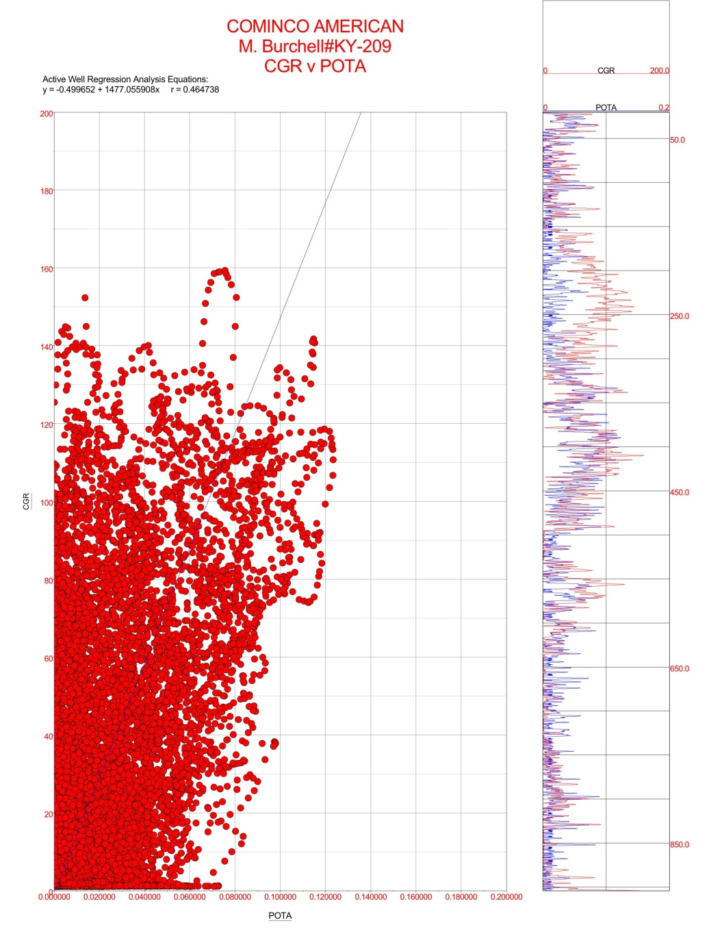
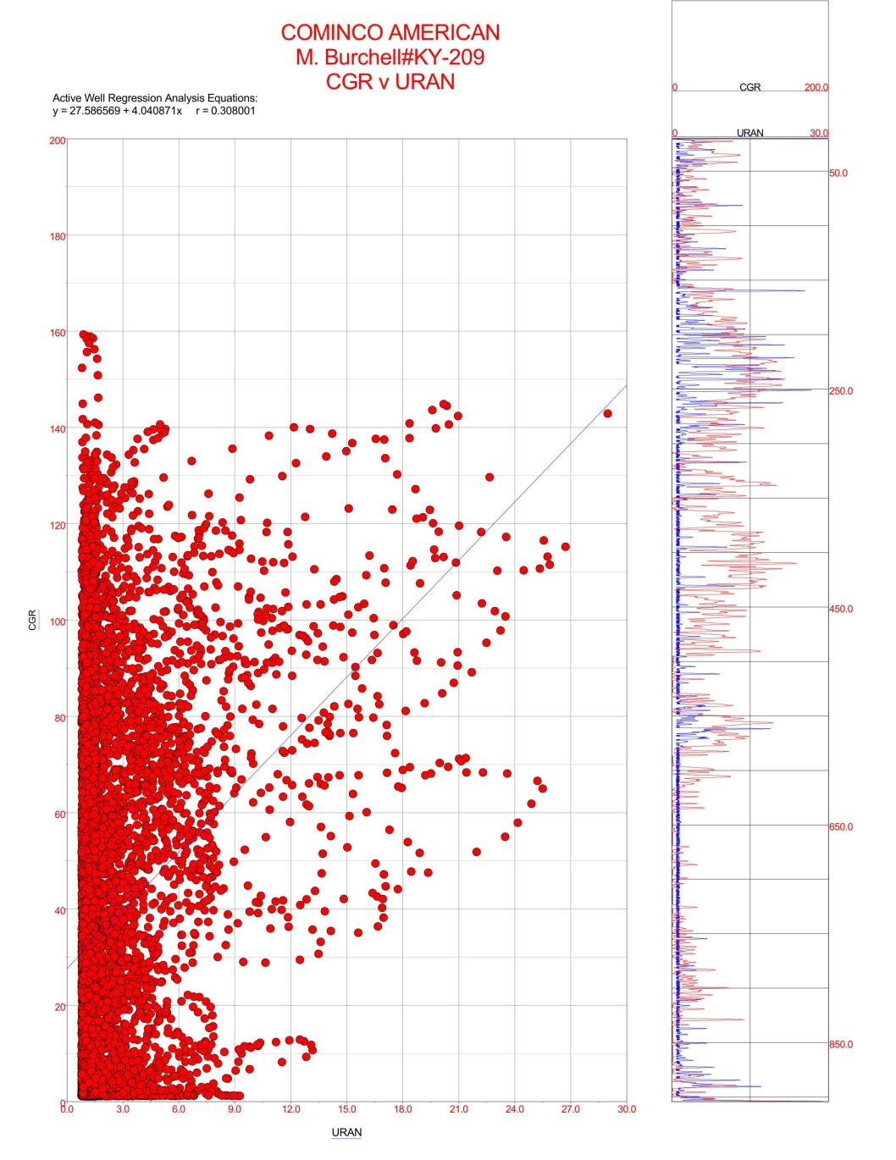
Core 209 Gamma-ray to POTA and Gamma-ray to URAN correlations
200
200
CGR (API)
CGR (API)
0
0
0
POTA (%)
20
0
URAN (ppm)
30
r = 0.464 Moderate
r = 0.308 Weak
Notes:
White background, dark blue text, and Arial font type to be used for all slides

Slide 13
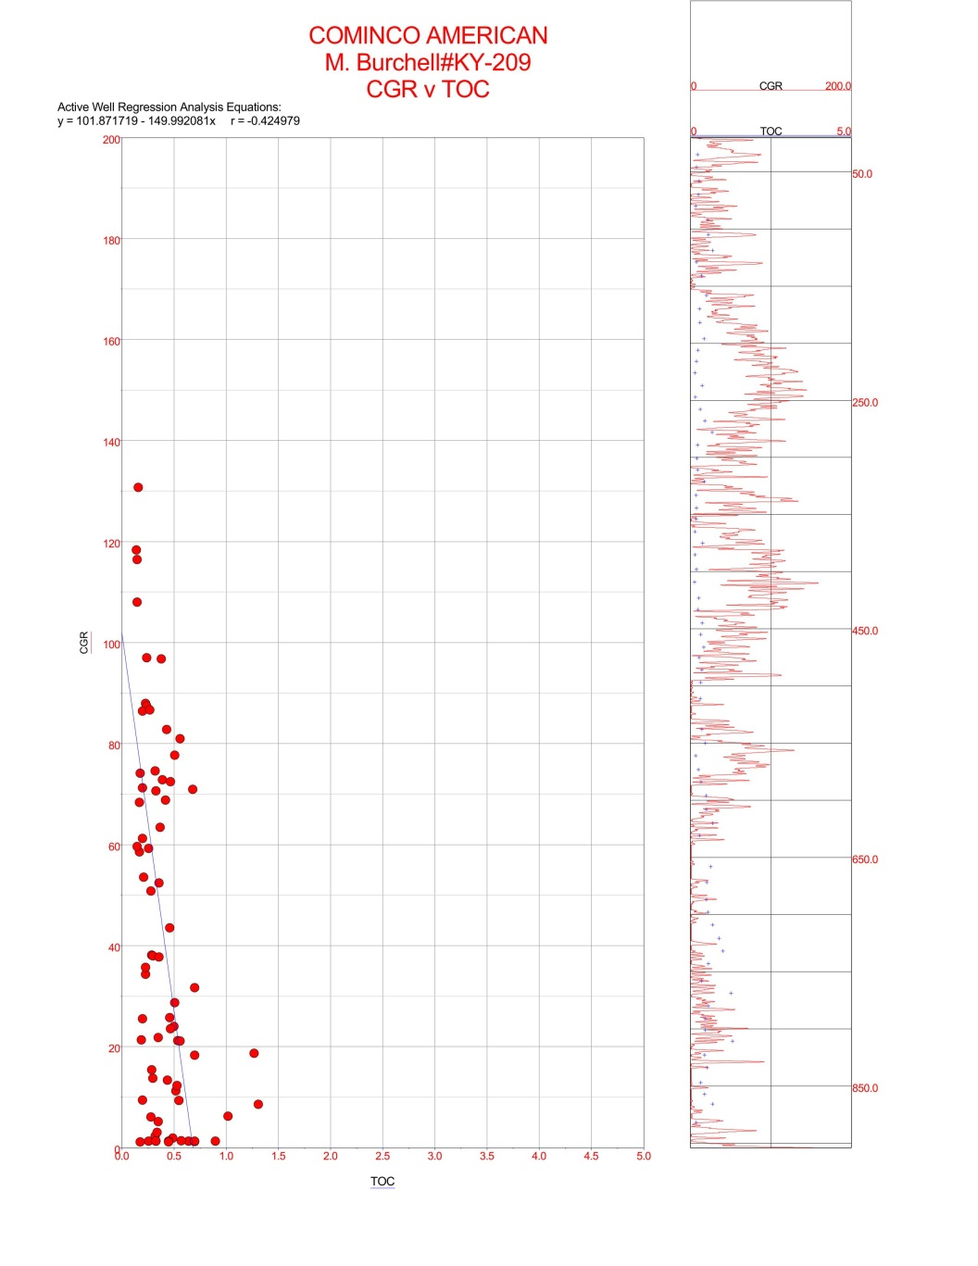
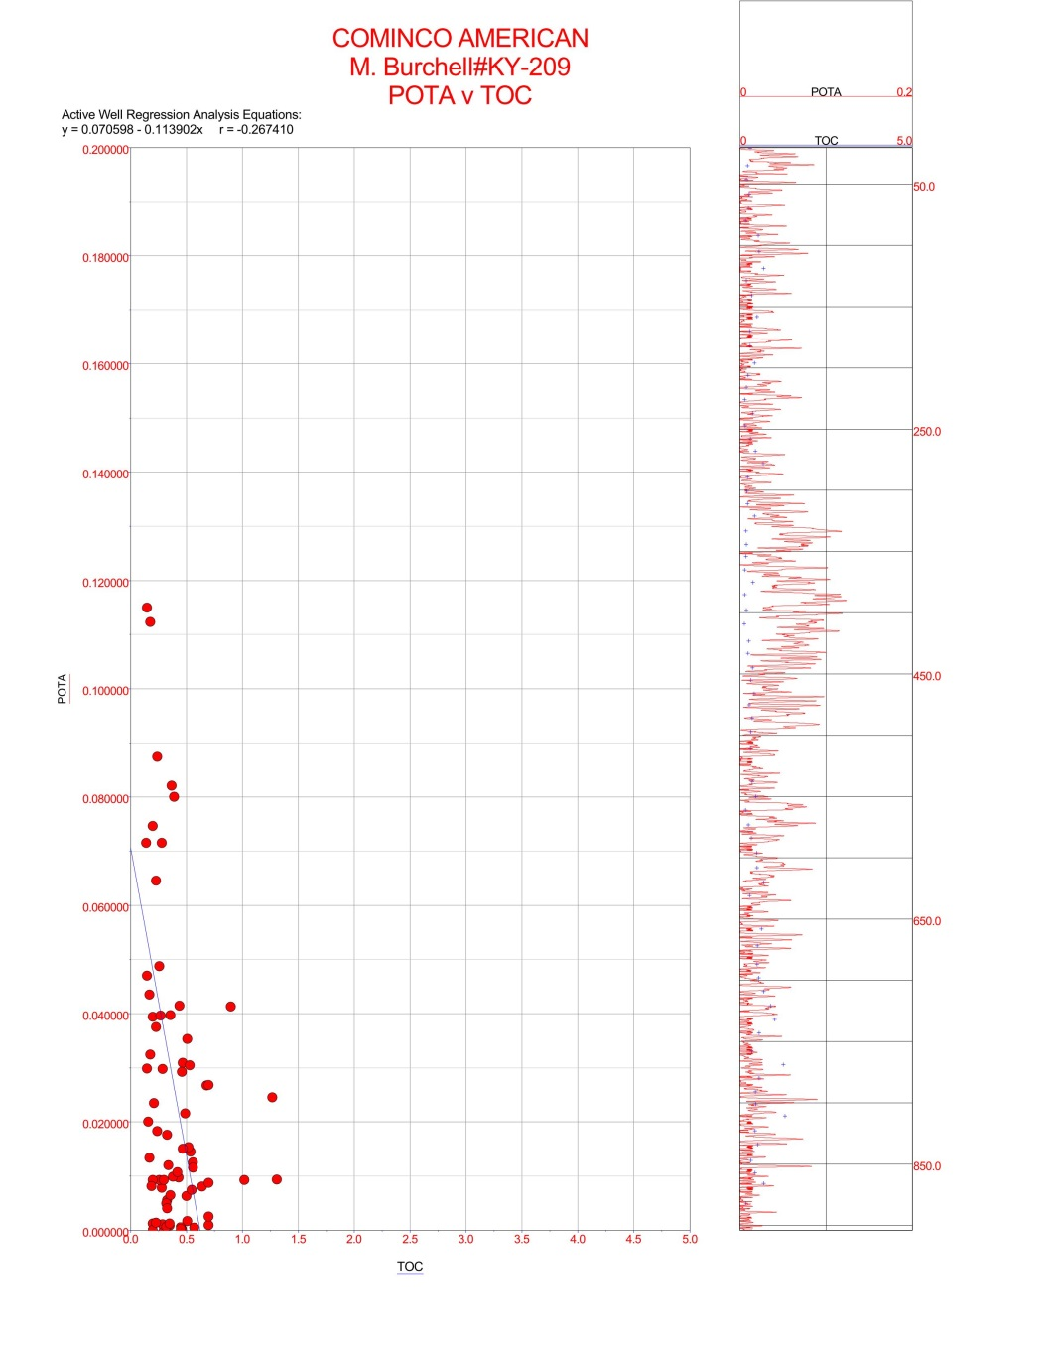
Core 209 Gamma-ray to TOC and POTA to TOC correlations
200
0.2
CGR (API)
POTA (%)
0
0
0
TOC (%)
5
0
TOC (%)
5
r = -0.424 Moderate
r = -0.267 Weak
Notes:
White background, dark blue text, and Arial font type to be used for all slides

Slide 14
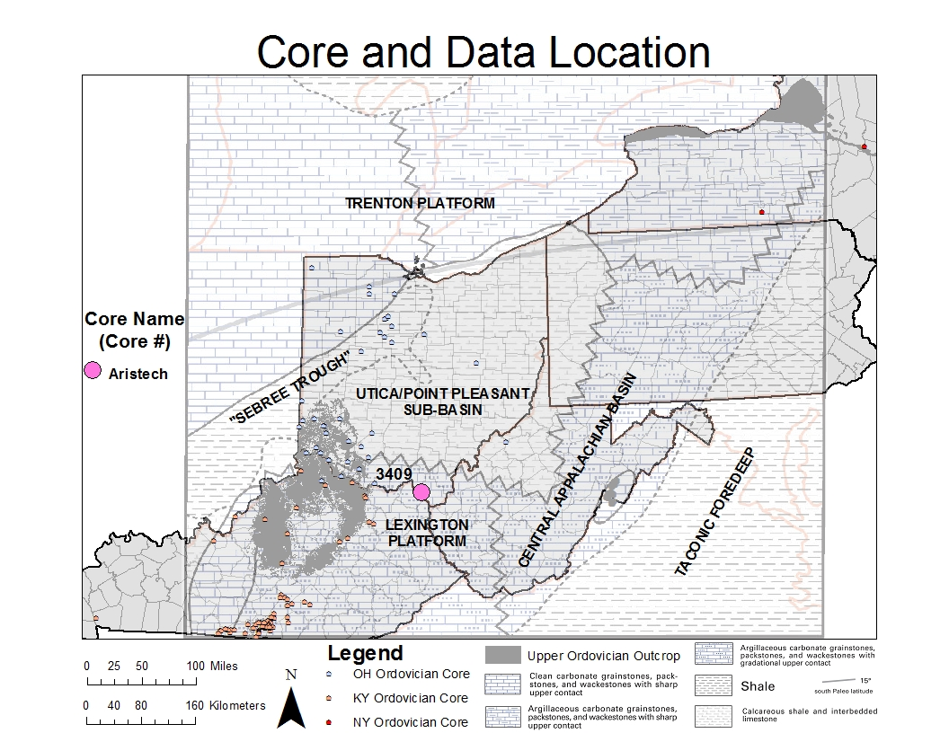
Scioto County, Aristech Well C-3409
Notes:
White background, dark blue text, and Arial font type to be used for all slides

Slide 15
Core 3409 SGL LAS, Wireline log, and TOC (%)
Highest TOC (%) is at the top of the Point Pleasant
Notes:
White background, dark blue text, and Arial font type to be used for all slides

Slide 16
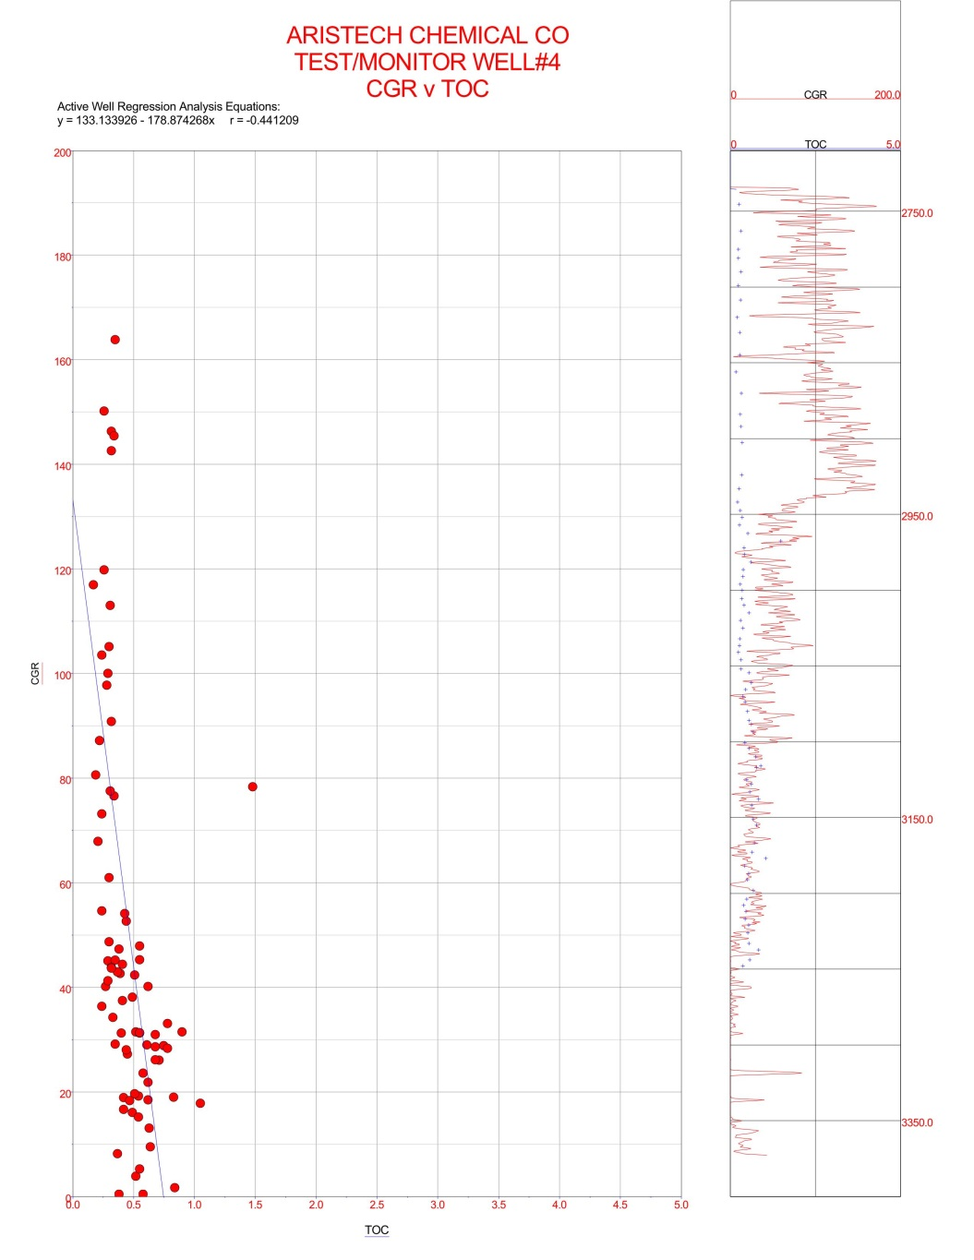
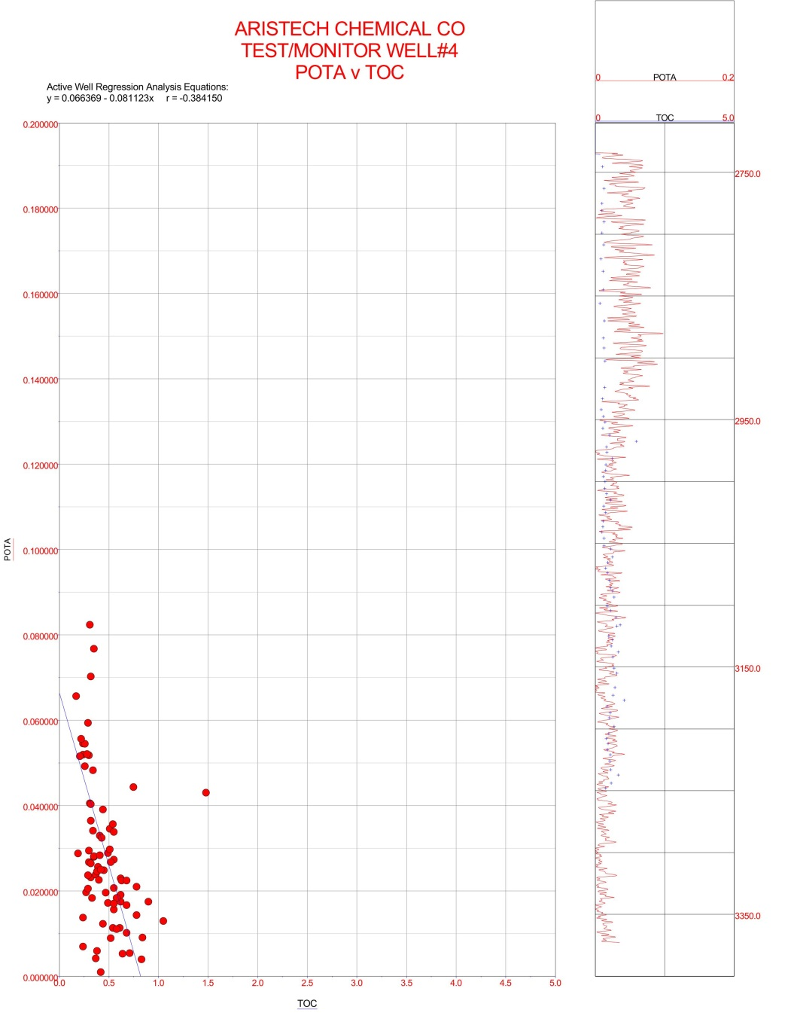
Core 3409 Gamma-ray to TOC and POTA to TOC correlations
200
0.2
CGR (API)
POTA (%)
0
0
0
TOC (%)
5
0
TOC (%)
5
r = -0.441 Moderate
r = -0.384 Weak
Notes:
White background, dark blue text, and Arial font type to be used for all slides

Slide 17
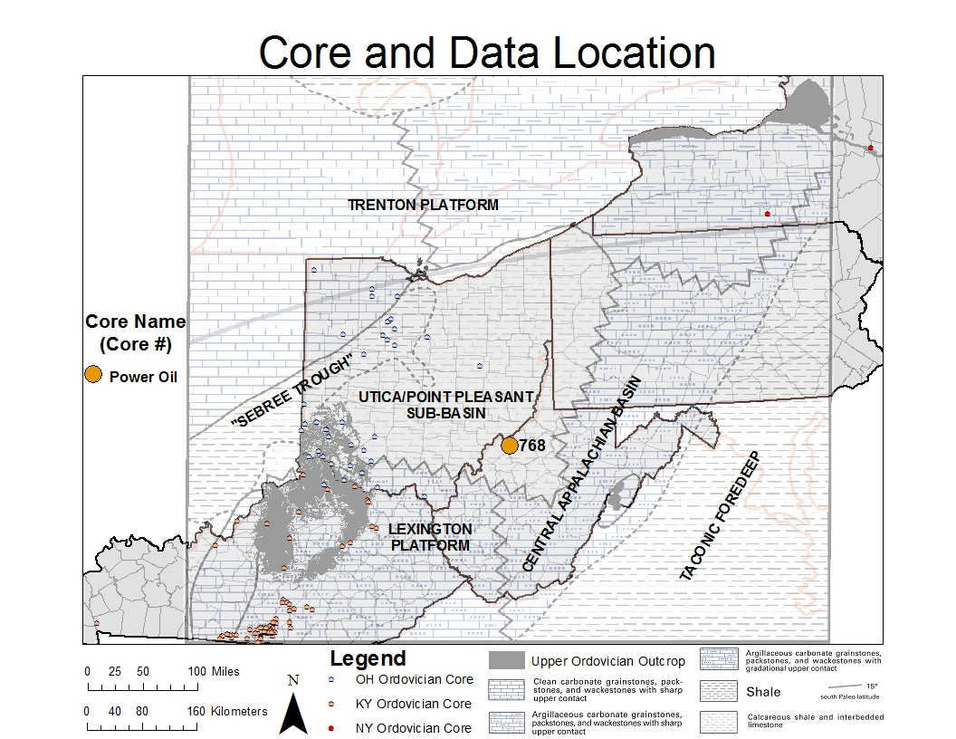
Wood Co.,WV Power Oil Co. Core -768
Notes:
White background, dark blue text, and Arial font type to be used for all slides

Slide 18
Core 768 SGL LAS, Wireline log, and TOC (%)
Highest TOC (%) is at the bottom of the Point Pleasant and Logana
Notes:
White background, dark blue text, and Arial font type to be used for all slides

Slide 19
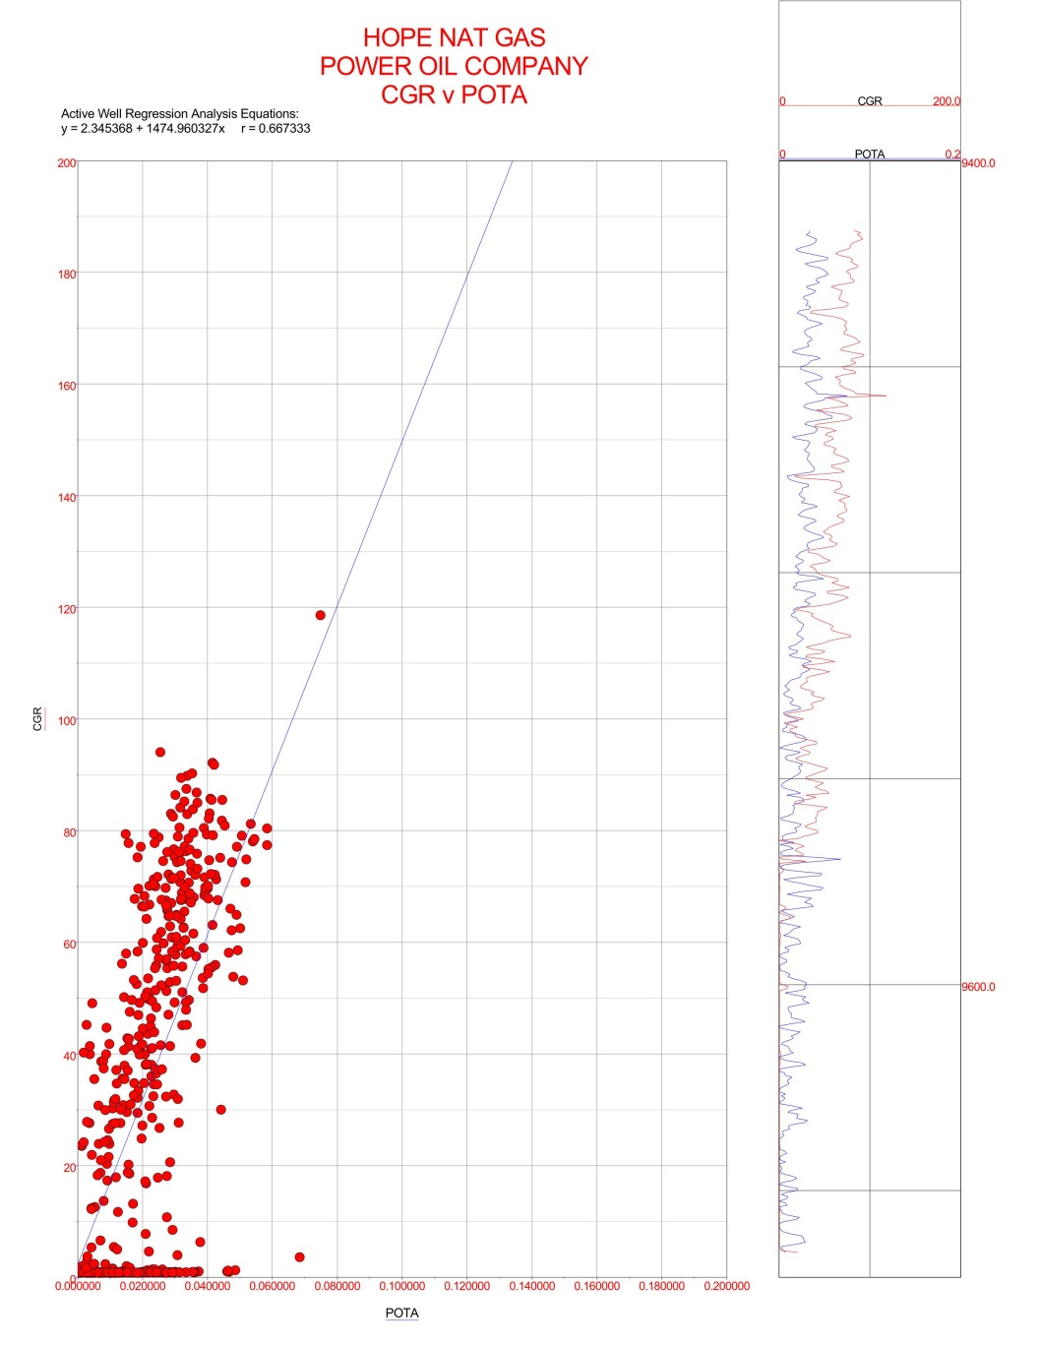
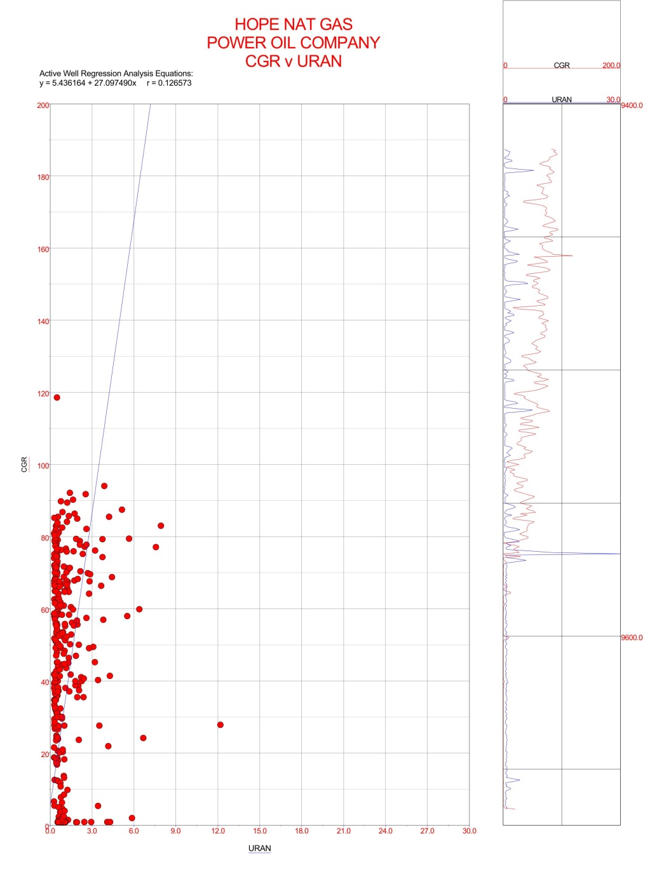
Core 768 Gamma-ray to POTA and Gamma-ray to URAN correlations
200
200
CGR (API)
CGR (API)
0
0
0
POTA (%)
0.2
0
URAN (ppm)
30
r = 0.667 Strong
r = 0.126 Weak
Notes:
White background, dark blue text, and Arial font type to be used for all slides

Slide 20
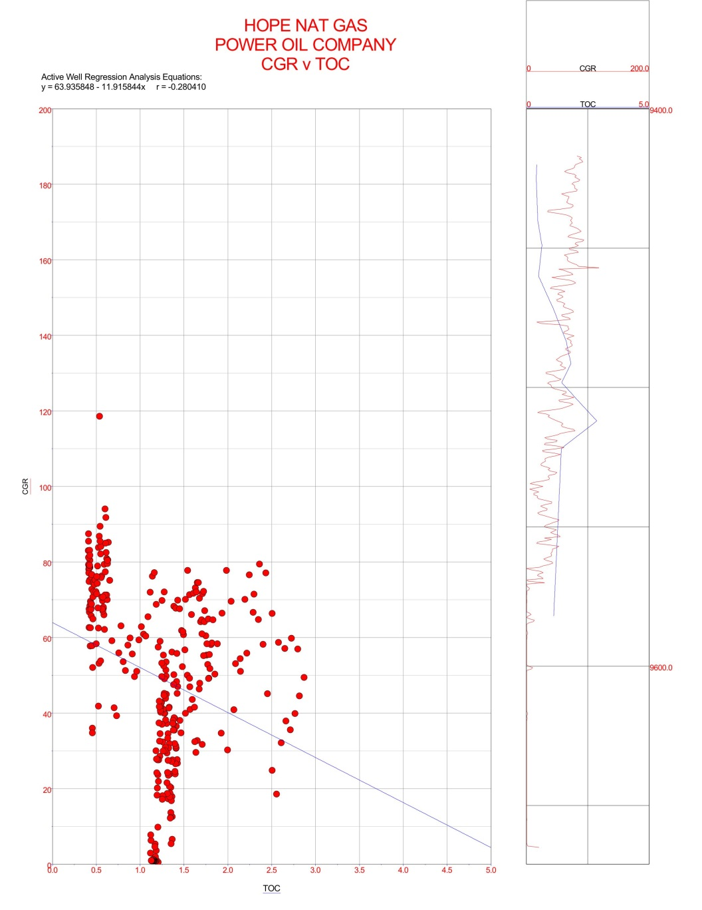
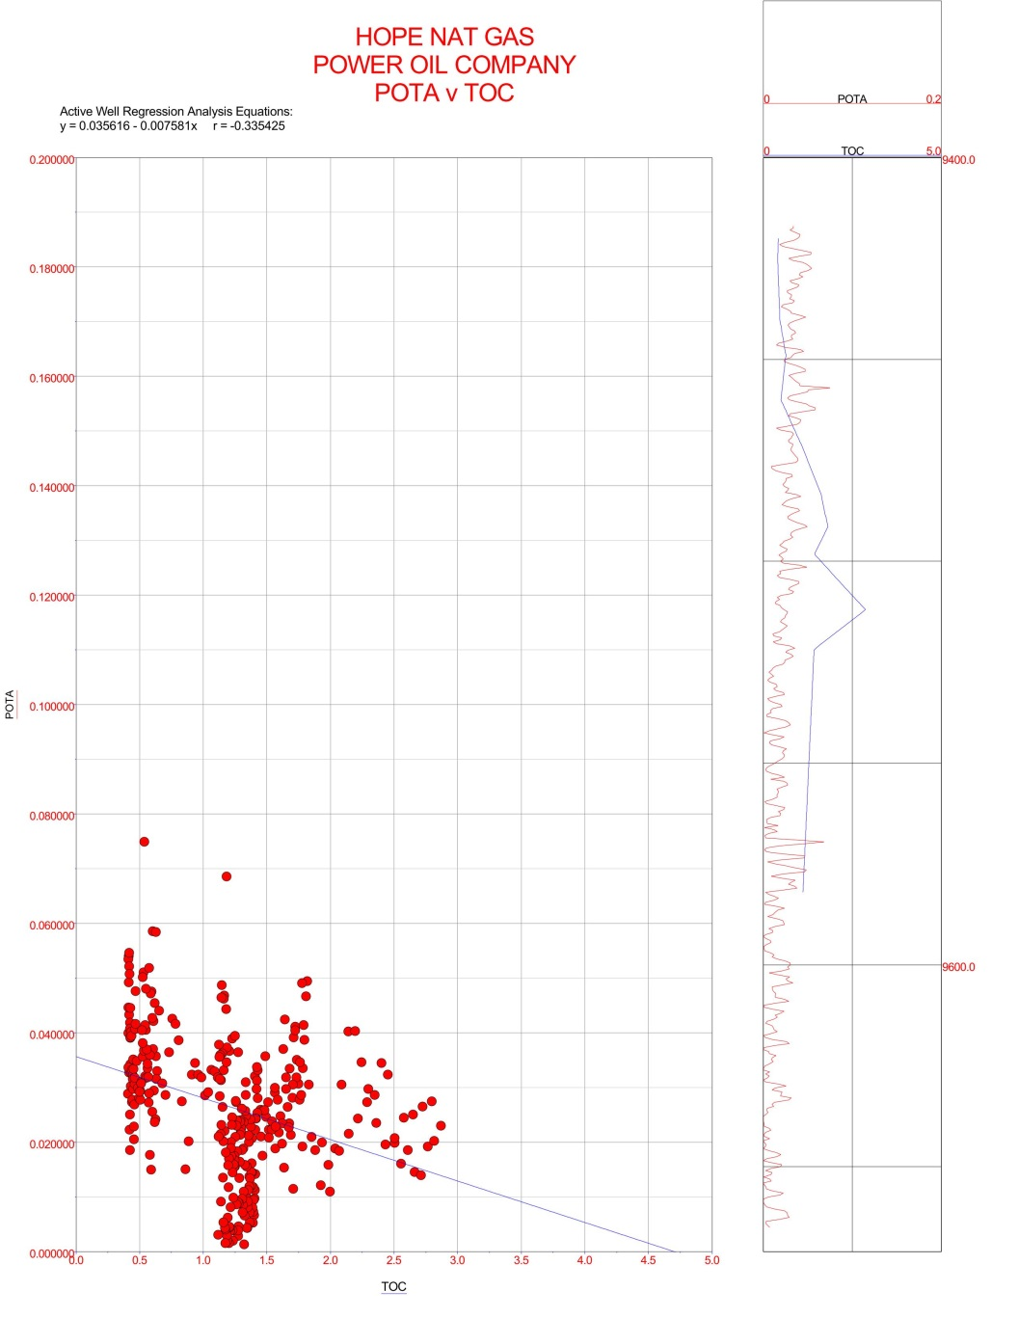
Core 768 Gamma-ray to TOC and POTA to TOC correlations
200
0.2
CGR (API)
POTA (%)
0
0
0
TOC (%)
5
0
TOC (%)
5
r = -0.280 Weak
r = -0.335 Weak
Notes:
White background, dark blue text, and Arial font type to be used for all slides

Slide 21
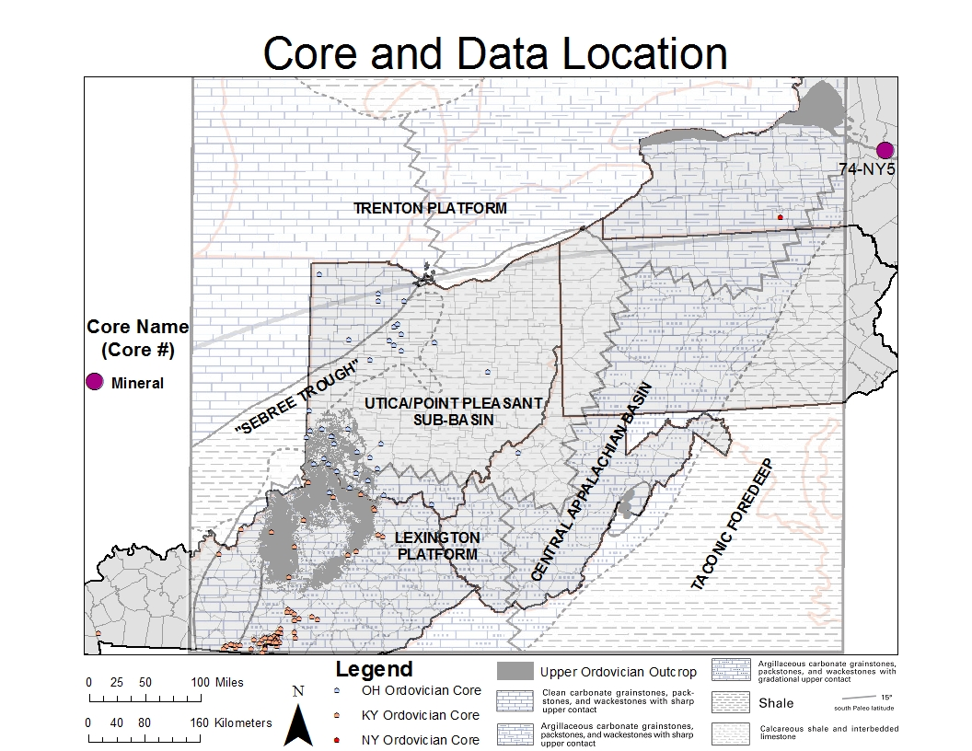
Herkimer County New York, Mineral Core 74-NY-5
Notes:
White background, dark blue text, and Arial font type to be used for all slides

Slide 22
New York 74-NY-5 SGL LAS and TOC (%)
Highest TOC (%) values are in the Flat Creek and Indian Castle
Notes:
White background, dark blue text, and Arial font type to be used for all slides

Slide 23
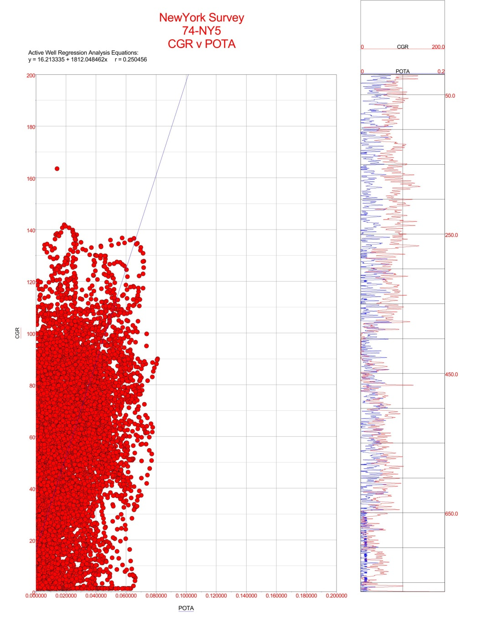
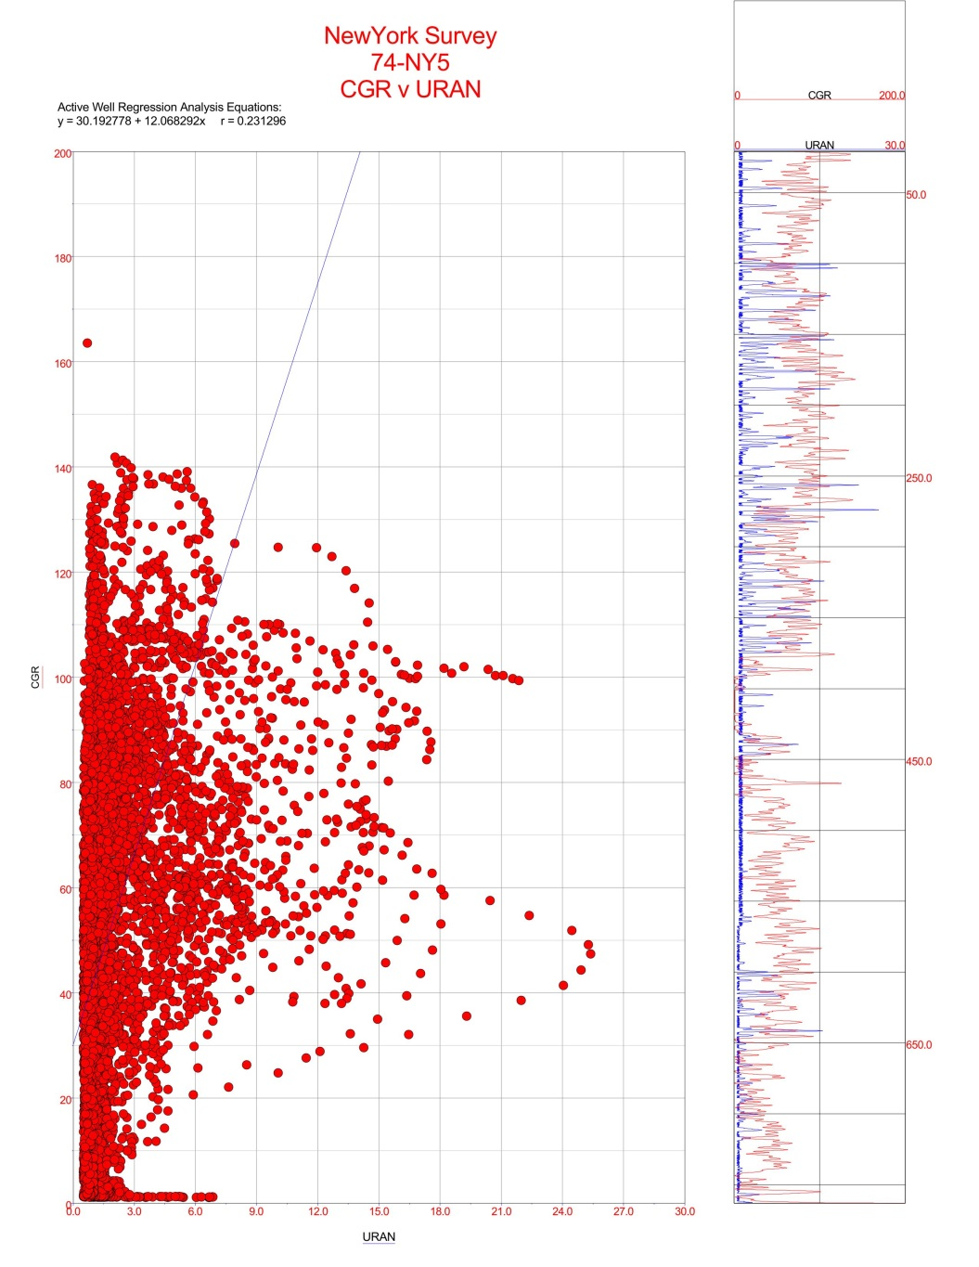
Core 74-NY-5 Gamma-ray to POTA and Gamma-ray to URAN correlations
200
200
CGR (API)
CGR (API)
0
0
30
0
POTA (%)
0.2
0
URAN (ppm)
r = 0.250 Weak
r = 0.231 Weak
Notes:
White background, dark blue text, and Arial font type to be used for all slides

Slide 24
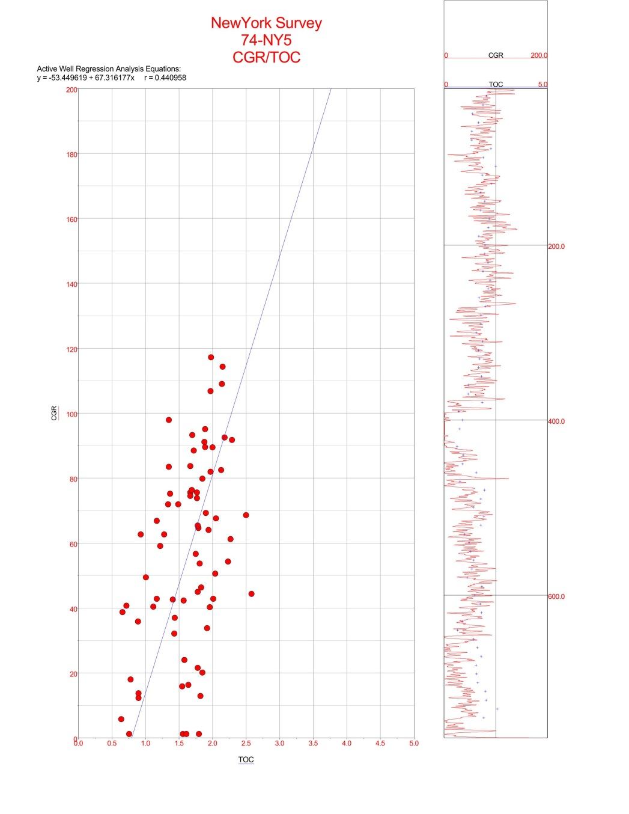
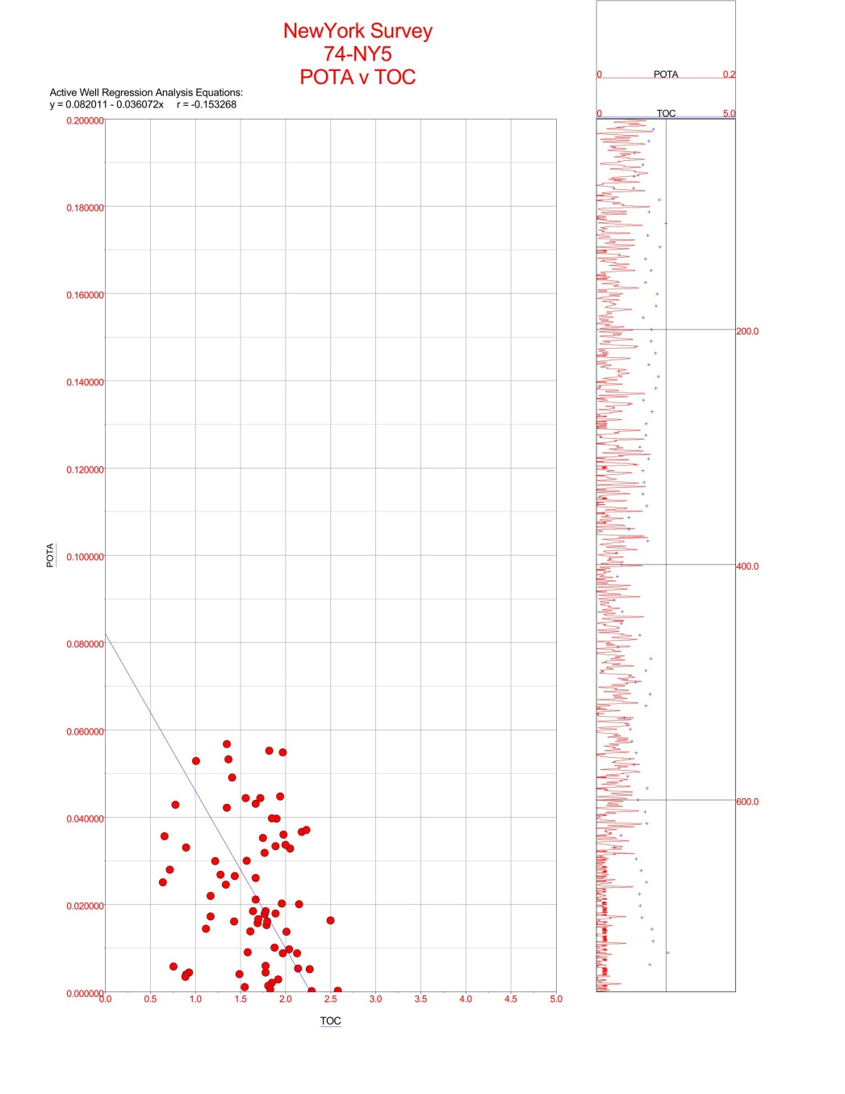
Core 74-NY-5 Gamma-ray to TOC and POTA to TOC correlations
200
0.2
CGR (API)
POTA (%)
0
0
0
TOC (%)
5
0
TOC (%)
5
r = 0.441 Moderate
r = -0.153 None
Notes:
White background, dark blue text, and Arial font type to be used for all slides

Slide 25
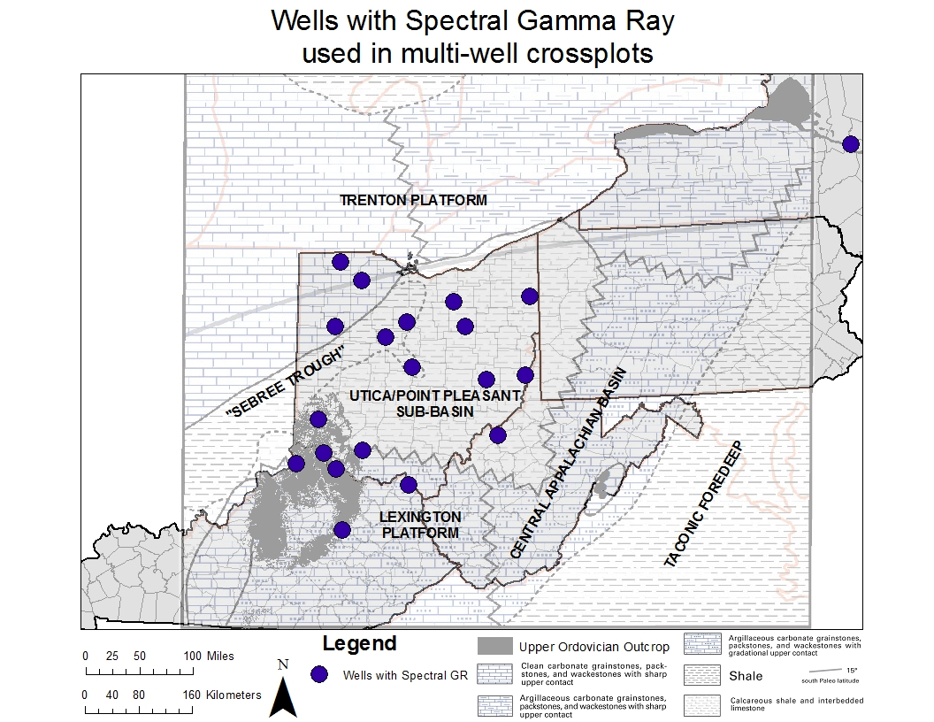
Outline
All wells in Study with Spectral Gamma-ray used in multi-well crossplots
Notes:
White background, dark blue text, and Arial font type to be used for all slides

Slide 26
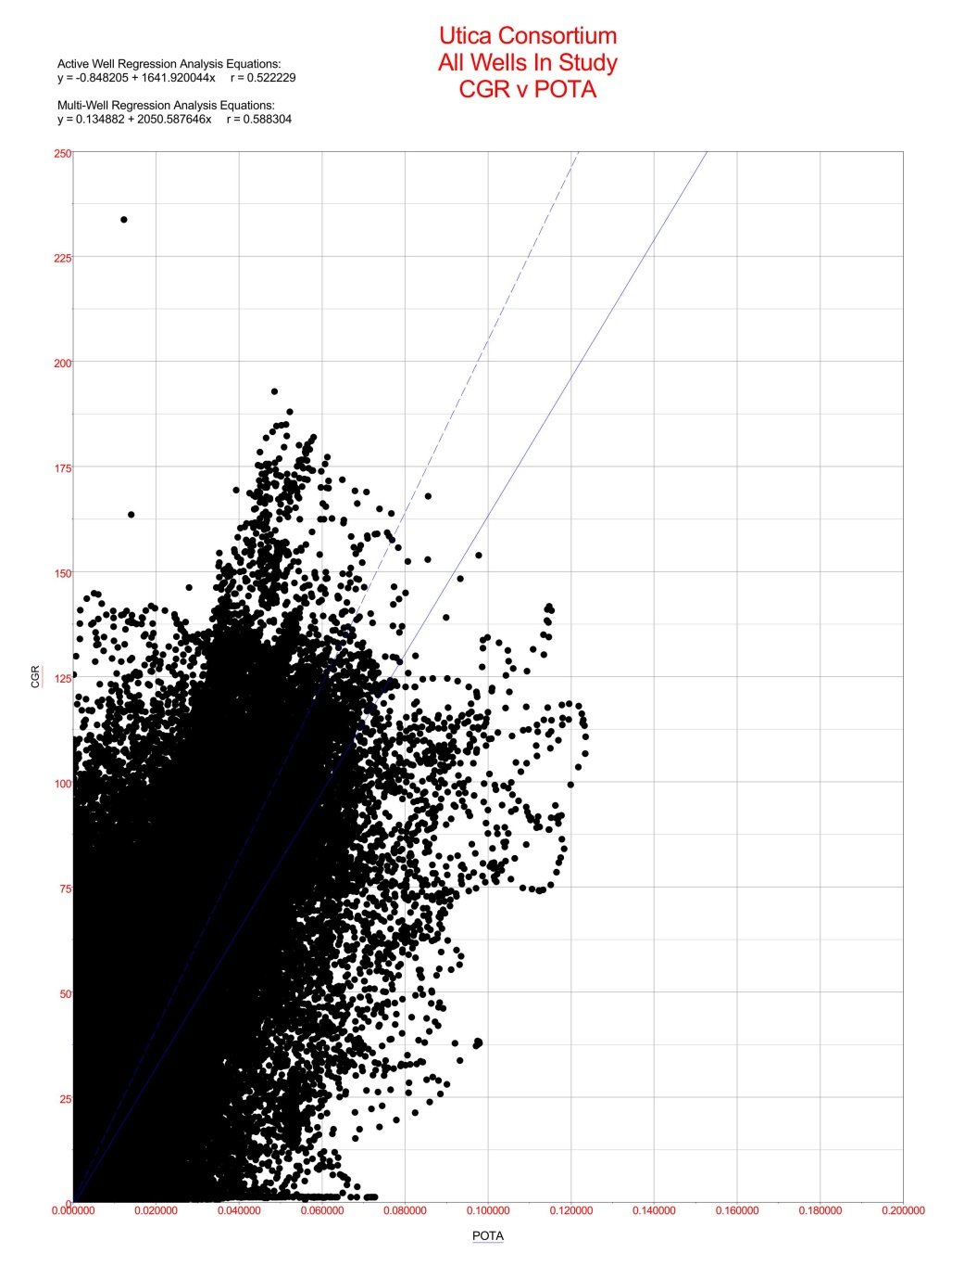
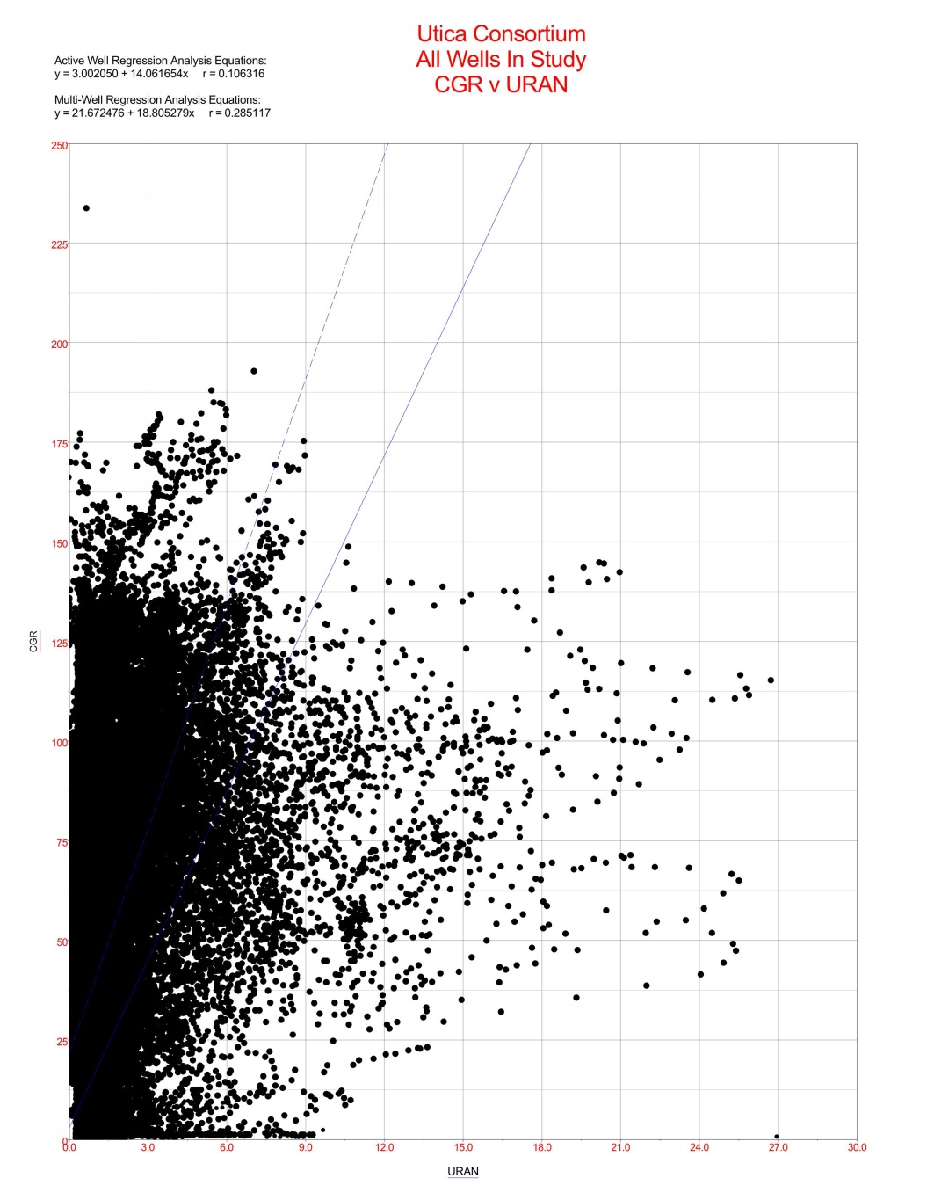
All Wells in Study Gamma-ray to POTA and Gamma-ray to URAN correlations
250
250
CGR (API)
CGR (API)
0
0
0
POTA (%)
0.2
0
URAN (ppm)
30
r = 0.588 Moderate
r = 0.285 Weak
Notes:
White background, dark blue text, and Arial font type to be used for all slides

Slide 27
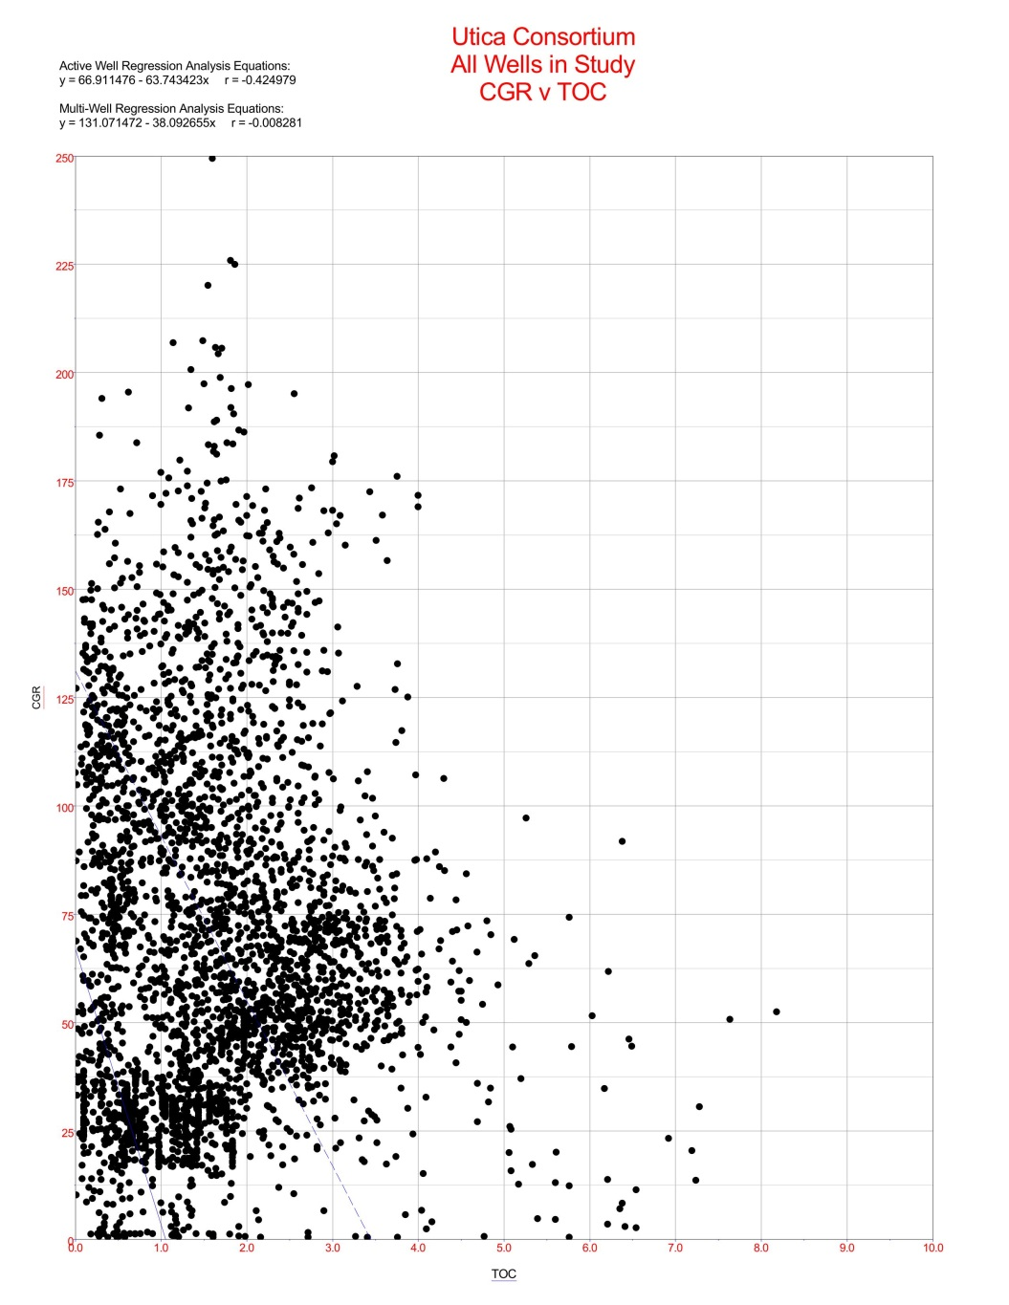
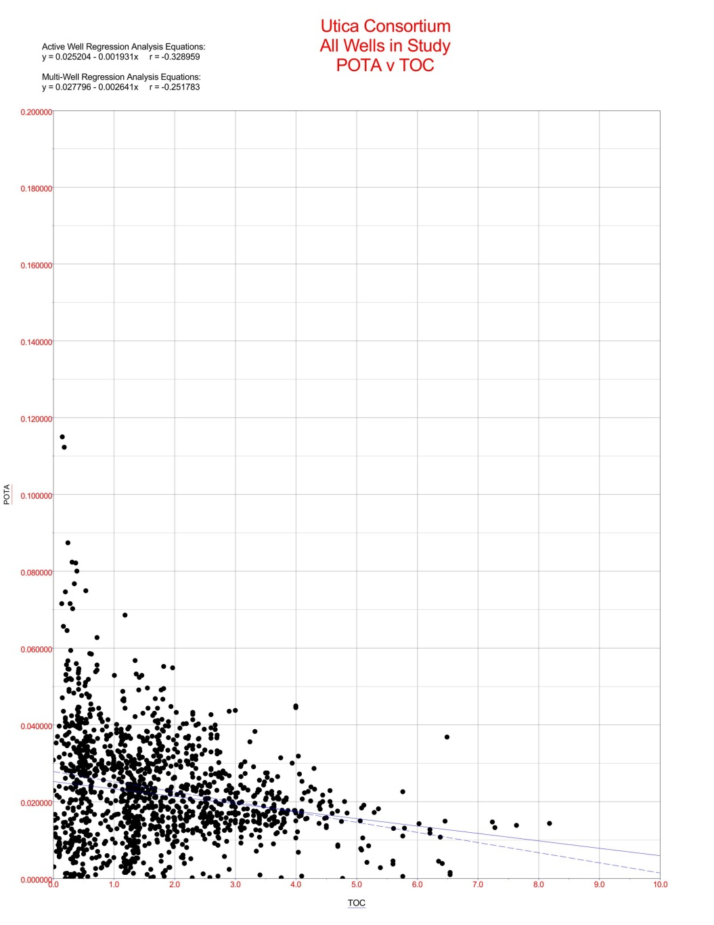
All Wells in Study Area Gamma-ray to TOC and POTA to TOC correlations
250
0.2
CGR (API)
POTA (%)
0
0
0
TOC (%)
10
0
TOC (%)
10
r = -0.008 None
r = -0.251 Weak
Notes:
White background, dark blue text, and Arial font type to be used for all slides

Slide 28
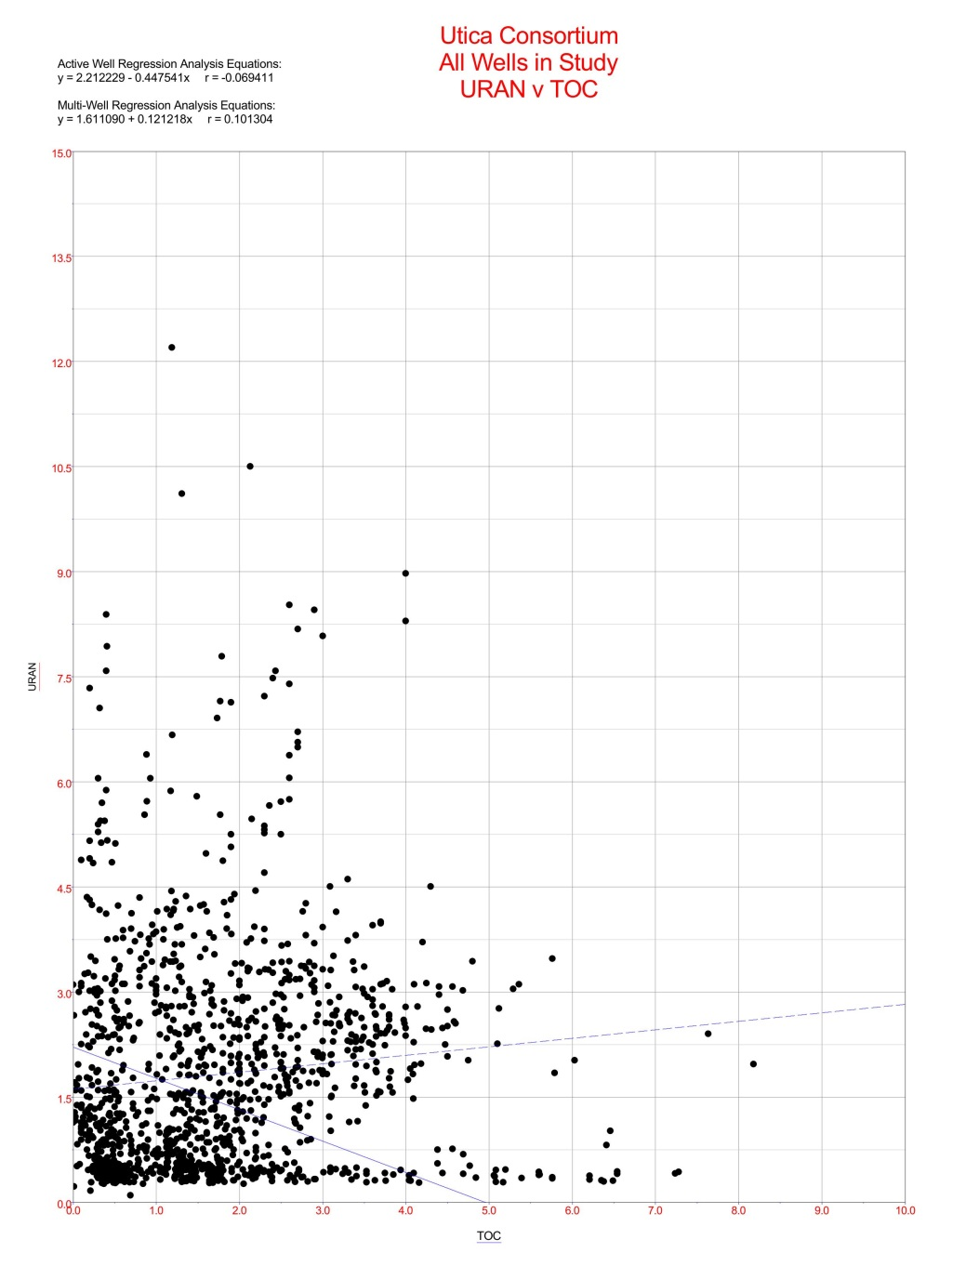
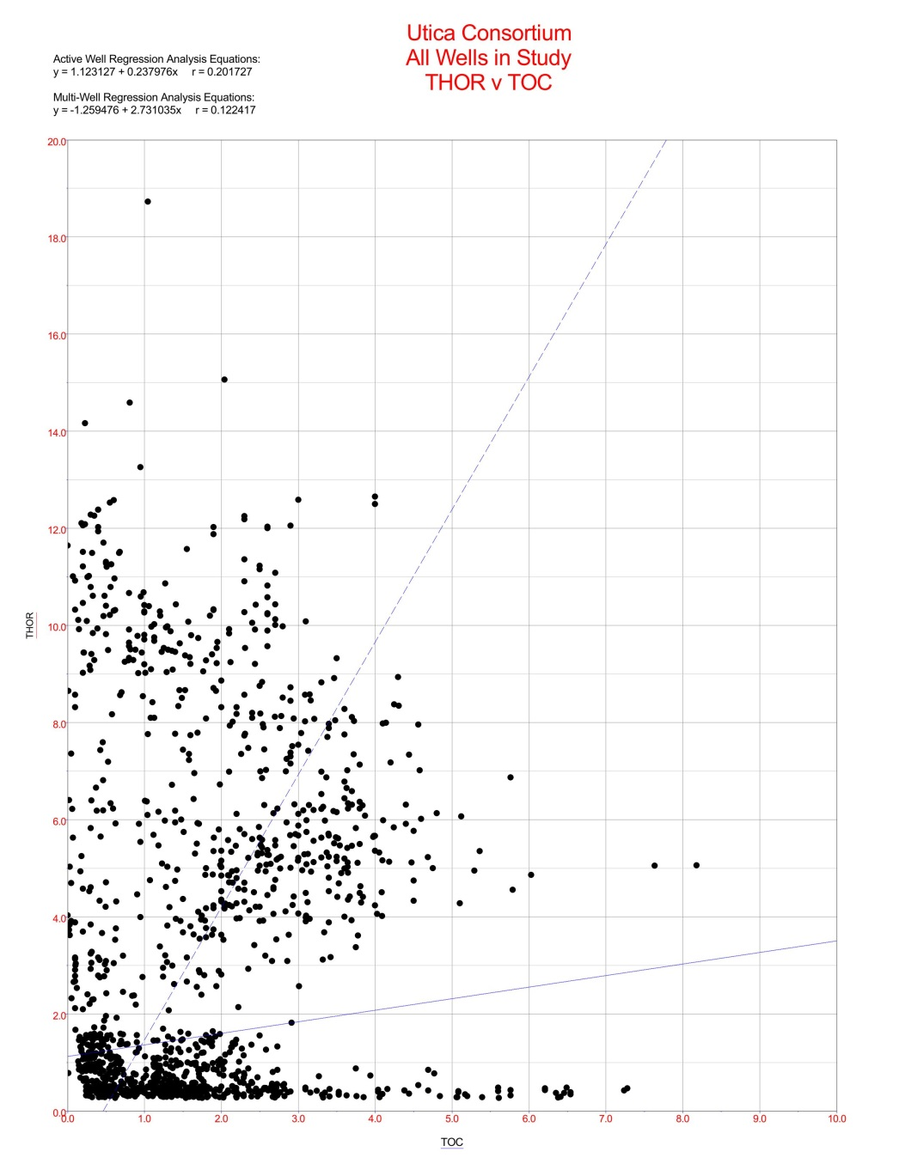
All Wells in Study Area URAN to TOC and THOR to TOC correlations
30
20
URAN (ppm)
THOR (ppm)
0
0
0
TOC (%)
0
TOC (%)
10
r = 0.101 None
r = 0.122 None
Notes:
White background, dark blue text, and Arial font type to be used for all slides

Slide 29
Bulk Density and TOC (%)
Grain Density
The grain density of organic matter can range from 0.95 to 1.6 (g/cm3)
Typical mineral grain densities can range from 2.5 to 3.0 (g/cm3)
TOC (%) can look much like porosity on a density log.
Note:
The relationship is not constant and can vary greatly with organic type (Type II vs. Type III) and with maturity (Cluff and Holmes, 2013). Other variables that need to be considered are amounts of pyrite, quartz influx, real porosity, and TOC (%) units (Schmoker, 1989).
The following are examples gathered in this study to show both the possibility and inconsistency, illustrating the localized analysis that needs to be done when predicting TOC (%).
Notes:
White background, dark blue text, and Arial font type to be used for all slides

Slide 30
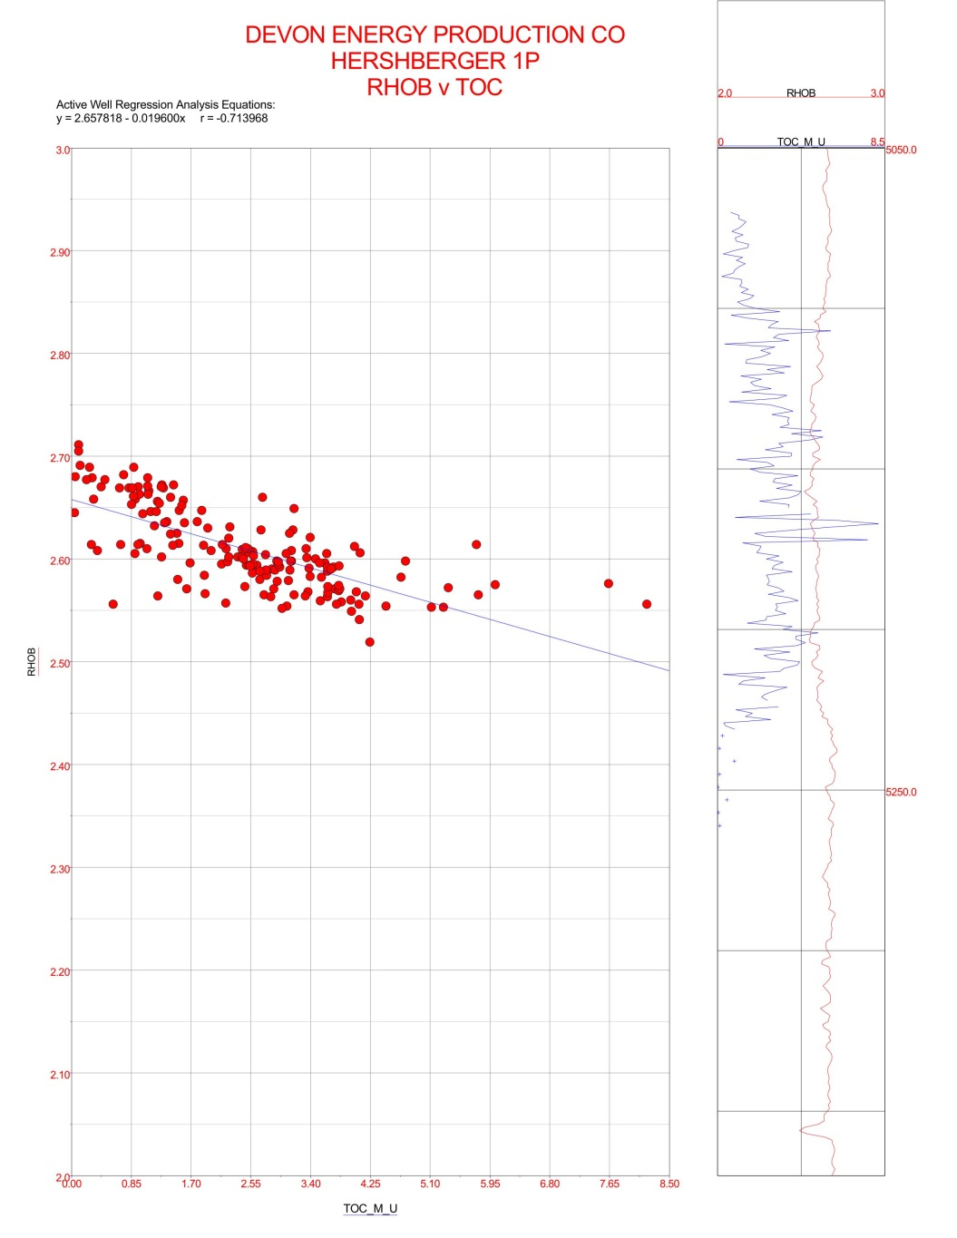
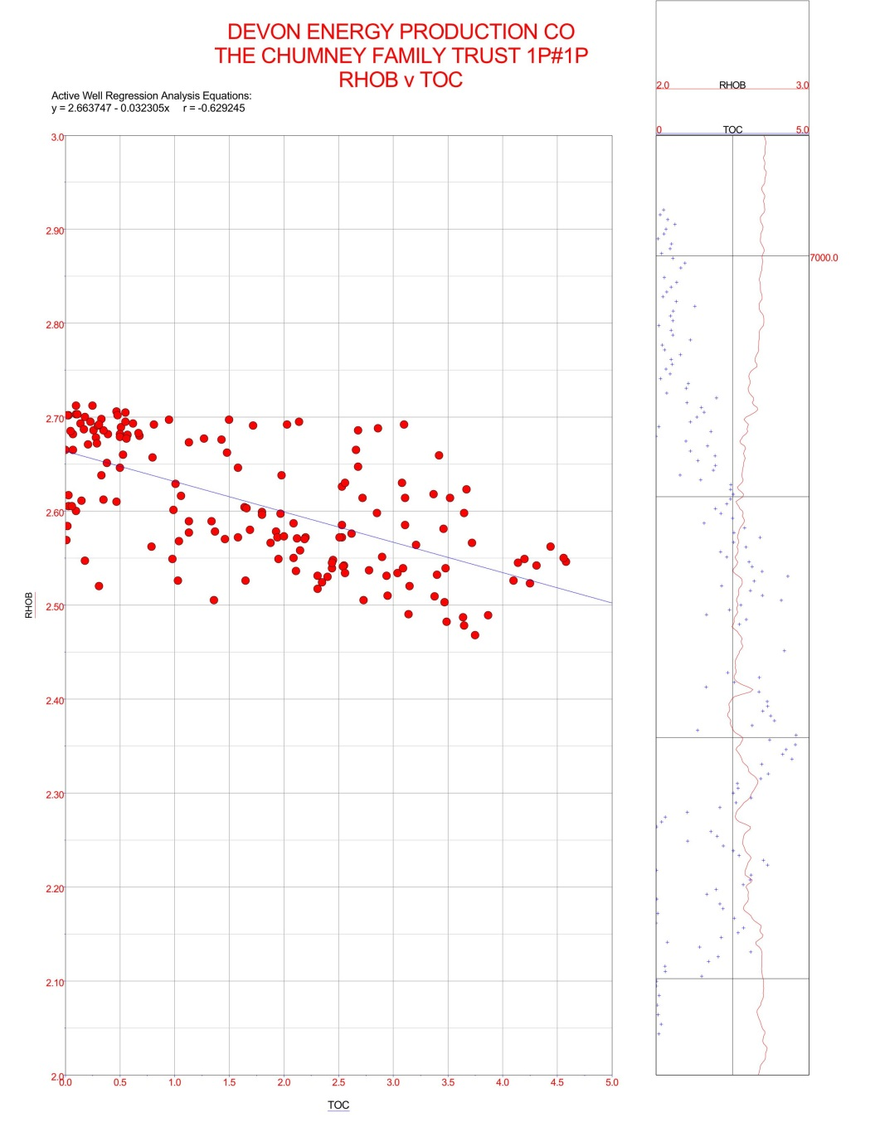
RHOB Vs TOC (%)
3
3
RHOB
RHOB
2
2
0
TOC (%)
8
0
TOC (%)
5
r = -0.714 Strong
r = -0.629 Strong
Notes:
White background, dark blue text, and Arial font type to be used for all slides

Slide 31
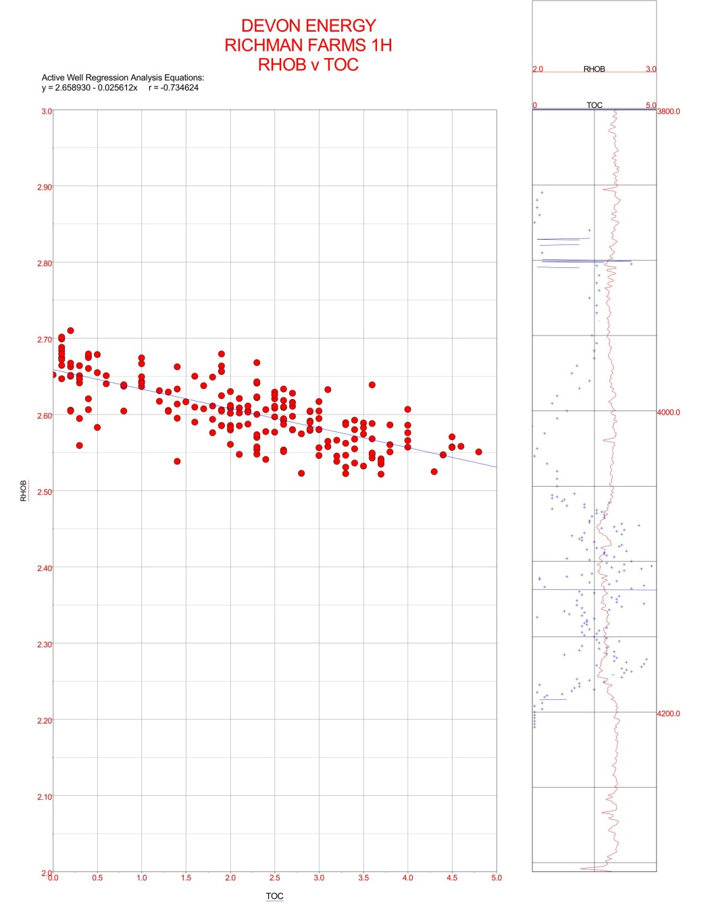
RHOB Vs TOC (%)
3
RHOB
2
0
TOC (%)
5
r = -0.734 Strong
Notes:
White background, dark blue text, and Arial font type to be used for all slides

Slide 32
Conclusions
SGL-300 produces much Higher-Resolution Spectral Gamma Logs than downhole
Differentiates radioactive gamma energy signatures much better
Potassium is the most abundant radioactive element
TOC (%) does not directly correlate to any radioactive element in the Upper Ordovician Utica-Point Pleasant shale interval in the Appalachian Basin.
Influx of Carbonate Material
Lack of available Uranium in the seawaters
Amount of oxygen in the system.
NOTE: The Devonian Marcellus shale is a good example in which a good correlation exists between the GR or URAN (ppm) signature and TOC (%) measurements (Cluff and Holmes, 2013).
Notes:
White background, dark blue text, and Arial font type to be used for all slides

Slide 33
Conclusion cont…
RHOB vs TOC (%) shows a Strong correlation on a single well analysis
RHOB vs TOC (%) shows a weak correlation when using multi-well analysis
Formation Density may be a much better proxy for predicting TOC

Slide 34
References
Boggs, S., Jr, 2006, Principals of sedimentology and stratigraphy (4th ed.): Pearson Education, Inc., 662 p.
Bohacs, K.M., 1998, Contrasting expressions of depositional sequences in mudrocks from marine to non marine environs, in Schieber, J., Zimmerle, W., and Sethi, P., eds., Shales and mudstones, vol. 1—Basin studies, sedimentology, and paleontology: Stuttgart, E. Schweizerbart'sche Verlagsbuchhandlung, p. 33–78.
Cluff, R., and Holmes, M., 2013, Petrophysics of unconventional resources [course handbook]: PTTC Technology Connections, Rocky Mountain Region [workshop], Colorado School of Mines, January 31–February 1, 2013.
Herron, S.L, 1991, In situ evaluation of potential source rocks by wireline logs, in Merrill, R.K.,ed., source and migration processes and evaluation techniques: AAPG Treatise of Petroleum Geology, Handbook of Petroleum Geology,p.127–134.
Lunig, S., Kolonic, S., 2003, URAN (ppm) spectral gamma ray response as a proxy for organic richness in black shales— Applications and limitations: Journal of Petroleum Geology, v. 26, no. 2, p. 153–174.
Meyer, B.L., and Nederlof, M.H., 1984, Identification of source rocks on wireline logs by density/resistivity and sonic transit time/resistivity cross plots: AAPG Bulletin, v. 68, no. 2, p. 121–129.
Passey, Q.R., Creaney, S., Kulla, J.B., Moretti, F.J., and Stroud, J.D., 1990, A practical model for organic richness from porosity and resistivity logs: AAPG Bulletin, v. 74, no. 12, p. 1,777–1,794.
Patchen, D.G., and 17 others, 2006, A geologic play book for Trenton-Black River Appalachian Basin exploration: U.S. Department of Energy, Final Report, Contract No. DE-FC26-03NT41856, 582 p.
Schlumberger, 1997, Logging tool response in sedimentary minerals, Appendix B in Log interpretation charts: Houston, Schlumberger Wireline and Testing, p. B-5–B-6.
Schmoker, J.W., 1981, Determination of organic matter content of Appalachian Devonian shales from gamma-ray logs: AAPG Bulletin, v.65/7 p. 1285 - 1298.
Schmoker, J.W., 1989, Formation resistivity as an indicator of the onset of oil generation in the Woodford shale, Anadarko Basin Oklahoma, Oklahoma Geological Survey, Anadarko Basin symposium Circular 90.
Schmoker, J.W., 1993, Use of formation-density logs to determine organic-carbon content in Devonian shales of the western Appalachian Basin and an additional example based on the Bakken Formation of the Williston Basin.
Kepferle, R.C., eds., Petroleum geology of the Devonian and Mississippian black shale of eastern North America: U.S. Geological Survey Bulletin 1909, p. J1–J14.
Schumacher, G.A., Mott, B.E., Angle, M.P., 2013, Ohio’s geology in core and outcrop—A field guide for citizens and environmental and geotechnical investigators: Ohio Department of Natural Resources, Division of Geological Survey Information Circular 63, p. 182–186.
Swanson, V.E., 1960, Oil yield and URAN (ppm) content of black shales: U.S. Geological Survey Professional Paper 356-A, 44 p.
Notes:
White background, dark blue text, and Arial font type to be used for all slides

Slide 35
Questions?
Notes:
White background, dark blue text, and Arial font type to be used for all slides

