Slide 1
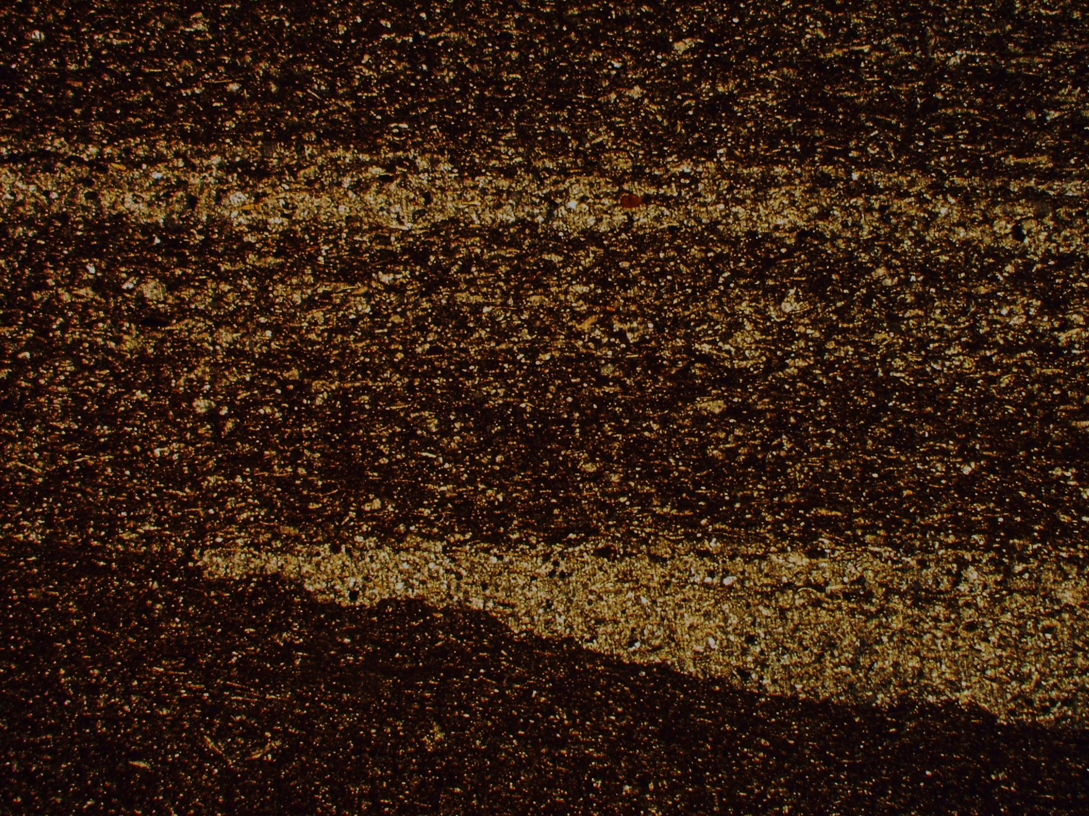

Core Description, Petrography, Stratigraphy
Taury Smith
Smith Stratigraphic LLC

Slide 2
5-Core Study
Thanks to Devon Energy for allowing me to present this data
Studied 5 long cores
First described thin sections semi-quantitatively
Used core photos plus thin sections plus visual inspection of core to describe cores in detail down to cm-scale
High-resolution TOC and carbonate content analysis

Slide 3
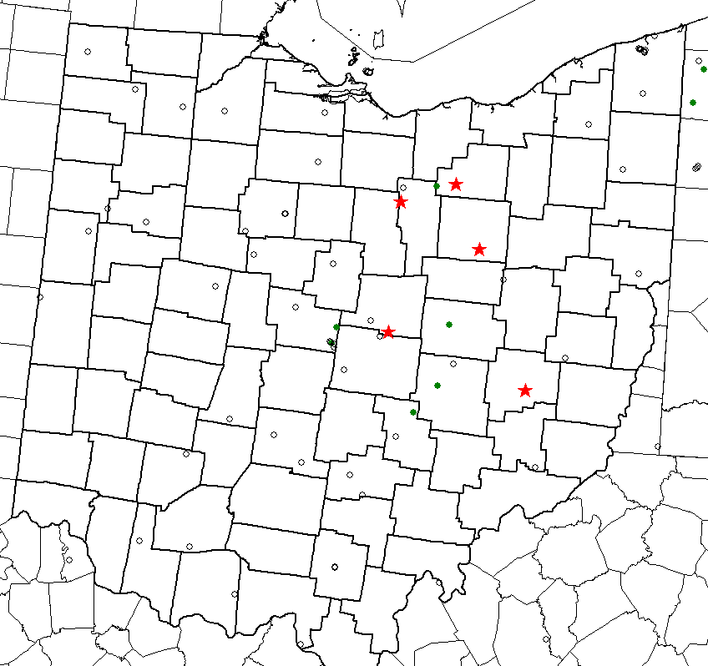
Five Continuous Cores
Richman Farms Core – 355 ft (Medina County)
Eichelberger Core – 356 ft
(Ashland County)
Hershberger Core – 241 ft
(Guernsey County)
Harstine Trust Core – 373 ft
(Knox County)
Chumney Trust Core – 185 ft
(Wayne County)
Richman Farms
Eichelberger
Hershberger
Harstine Trust
Chumney Family Trust

Slide 4
Four cores were located in the oil window and did not flow
Chumney Family Trust well was buried deeper and may be in more productive area
All have good TOC, but Harstine Trust is lower than the others
Harstine Trust has significantly more limestone than wells to north
Chumney Family Trust more organic-rich than Harstine Trust even though it is further south
Richman Farms
Eichelberger
Hershberger
Harstine Trust
Chumney Family Trust

Slide 5
Core Studies
For each core, the following was done and the data is included on the ftp site
Described all thin sections in a semi-quantitative manner
Described core in detail
Sampled and analyzed hundreds of samples for TOC and carbonate content (at a resolution of 1 per foot in reservoir interval)
Created posters and PowerPoint presentations capturing all data

Slide 6
Thin Section Description
Thin sections were described semi-quantitatively using a petrographic microscope and Microsoft Excel
The relative abundance of rock constituents and skeletal grain types were visually estimated and entered into a spreadsheet
These can then be plotted in a log program or versus other rock properties to identify trends

Slide 7
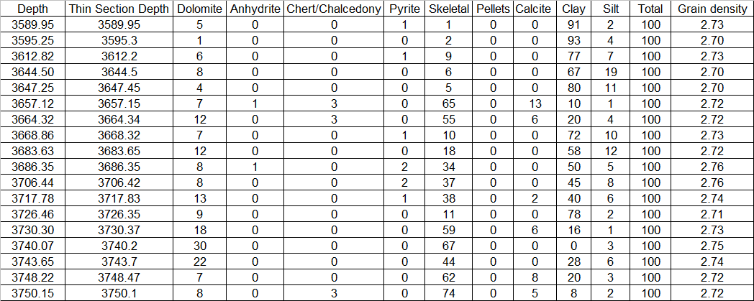
Main Constituents
Spreadsheet example of main constituents of the Harstine Trust core in the Utica-Point Pleaseant-Trenton section
There were different depths on the samples and thin sections
Diagenetic minerals include dolomite, anhydrite, chert and pyrite, skeletal grains include all fossils and fossil debris, Pellets are rare, calcite cements grainstones, clay and silt are common and detrital – Grain density calculated relative abundance

Slide 8
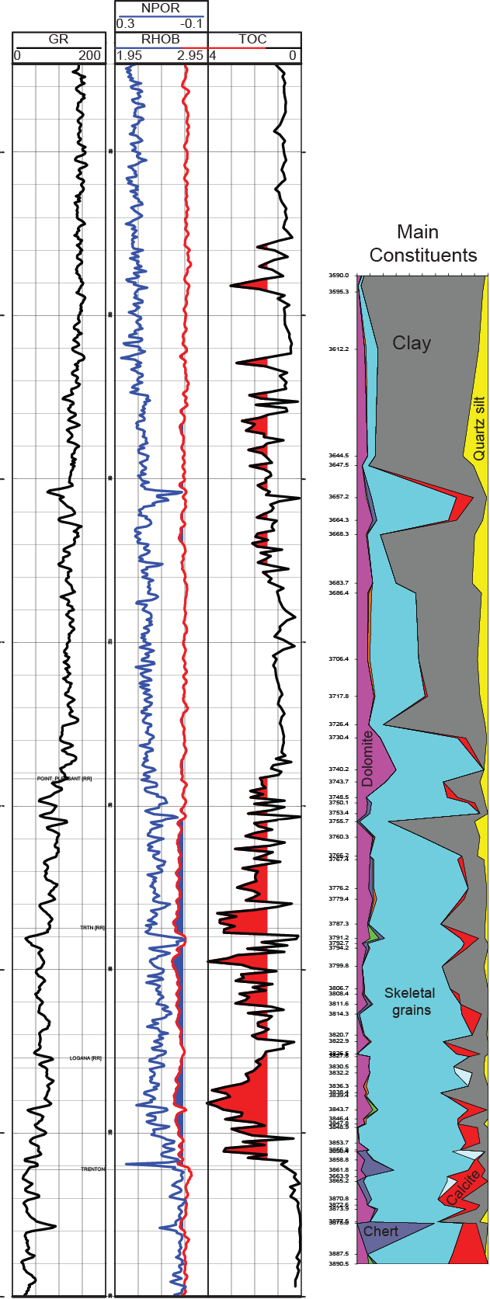
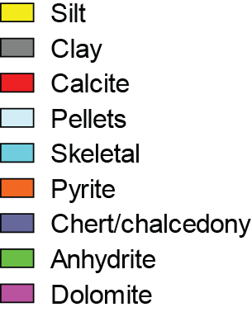
Constituents and Logs
TOC log is shaded red above 1.5% TOC to highlight most organic-rich intervals
Highest TOC is in Lexington and Point Pleasant with some higher TOC strata in Upper Utica and upper part of Lower Utica
The Point Pleasant and Lexington are more carbonate rich than one would guess looking at the core
Red on constituent display shows where grainstones occur – note that highest TOC
L. Utica
Point Pleasant (PK)
Lexington (PK)
“shales” mainly occur just below and above grainstones and are less common away from grainstones
Trenton (PK)

Slide 9
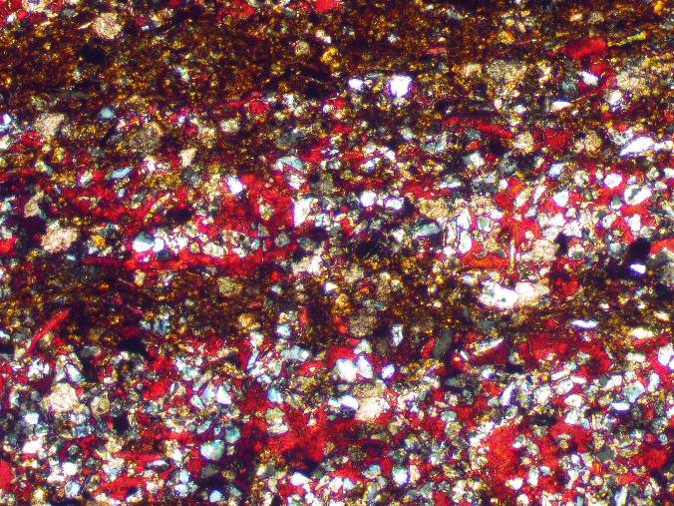
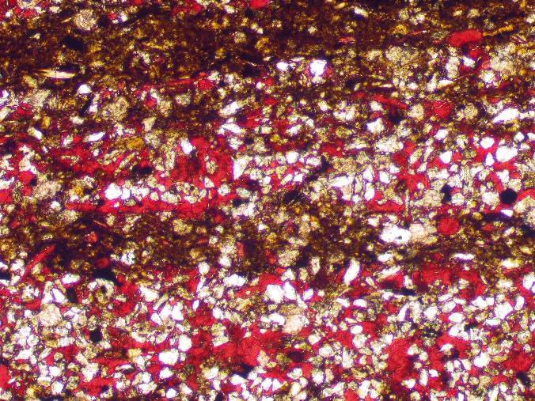
Silt and Clay
L.Utica
Qtz silt
P.Pleasant
Lexington
Quartz silt (white/gray in slide above) is common in the Utica and Point Pleasant, much less common below that – it positively correlates with clay
Trenton

Slide 10
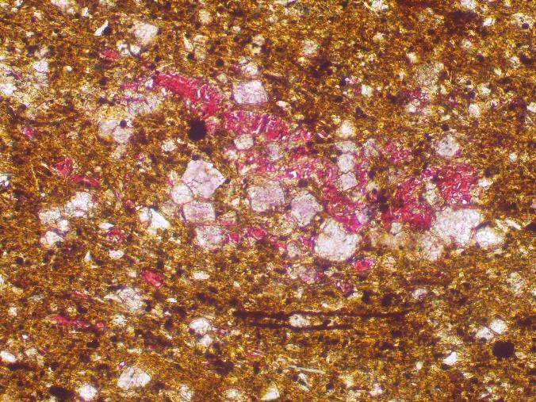
Fine Dolomite
L.Utica
P.Pleasant
Lexington
Fine dolomite is found in most of the thin sections and averages about 7.5% - most of it is fine, early dolomite that formed on or just below sea floor
Trenton

Slide 11
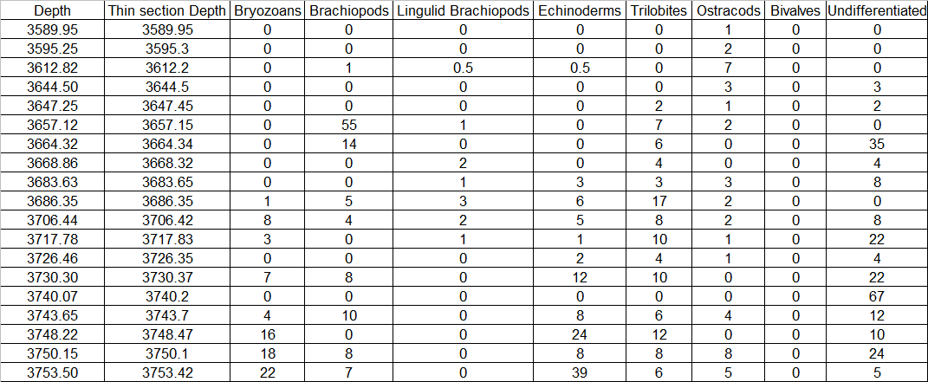
Skeletal Grain Abundance
Main fossils found are bryozoans, brachiopods,lingulid brachiopods, echinoderms, trilobites, ostracods,bivalves and undifferentiated skeletal debris
Undifferentiated consists of skeletal material that is broken into tiny silt sized pieces of indeterminate origin – much of the organic-rich “shale” in the Point Pleasant and lower actually consists of this undifferentiated skelelal debris with lesser clay

Slide 12
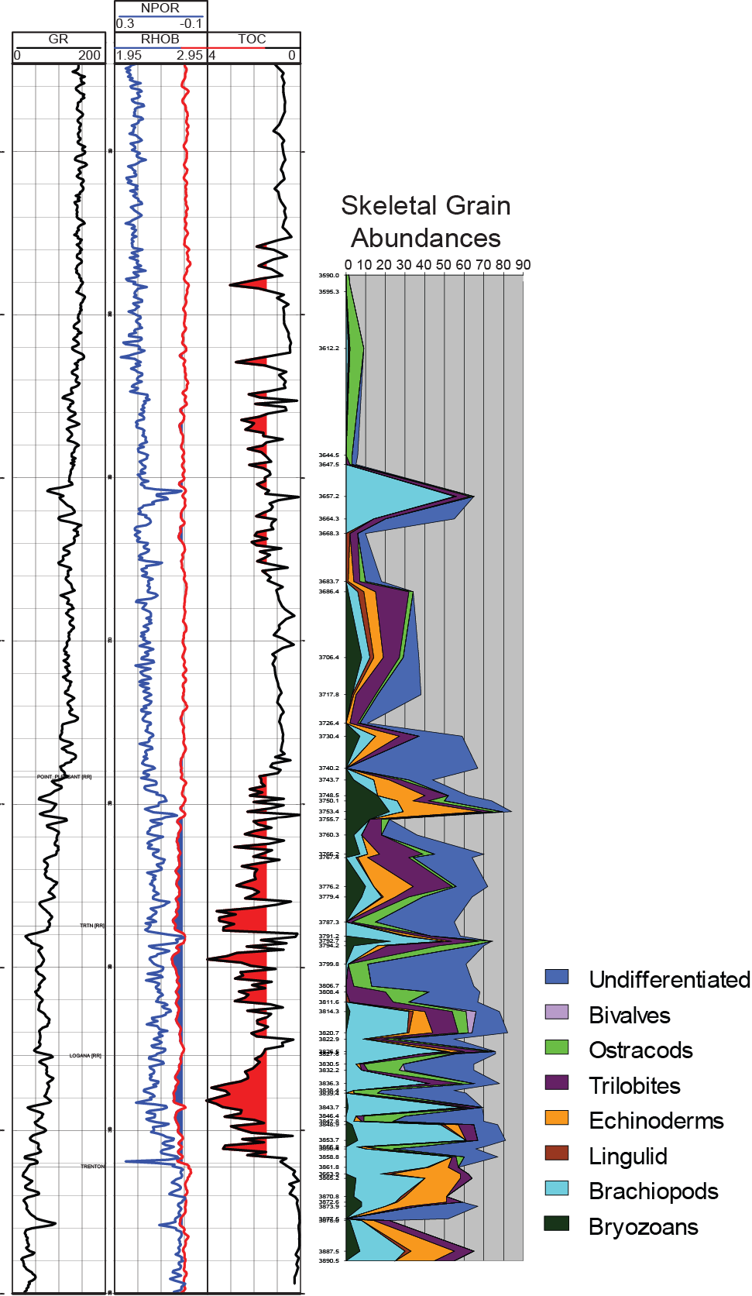
Harstine Trust skeletal grains and Logs
Sampling is non-random and disproportionately includes limestones
The limestone at the top of the Lower Utica is similar to those found in the basal Lexington (brachiopod-rich)
The limestone in the Point Pleasant and basal Lower Utica has more bryozoans
Organic-rich facies has mainly ostracods and
Utica
L. Utica
Point Pleasant
undifferentiated skeletal debris
For the most part, the same skeletal grains that are common in the Trenton also occur in the overlying strata
Lexington
Logana
Curdsville

Slide 13
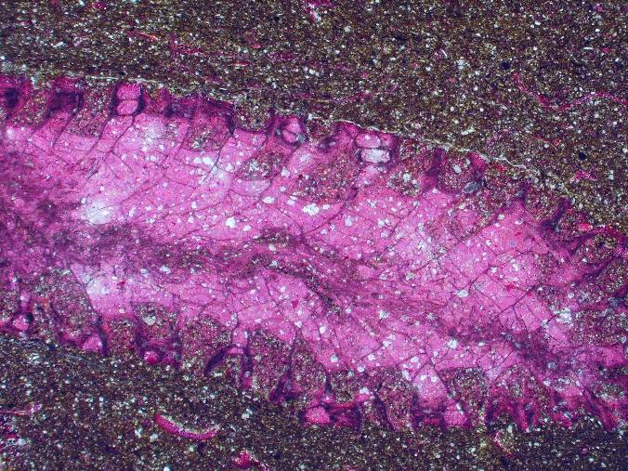
Bryozoans
L.Utica
P.Pleasant
Lexington
Bryozoans (mainly Prasapora) are common to abundant in the Point Pleasant, common in the Trenton and rare in the Utica and the shale below the Point Pleasant
Trenton

Slide 14
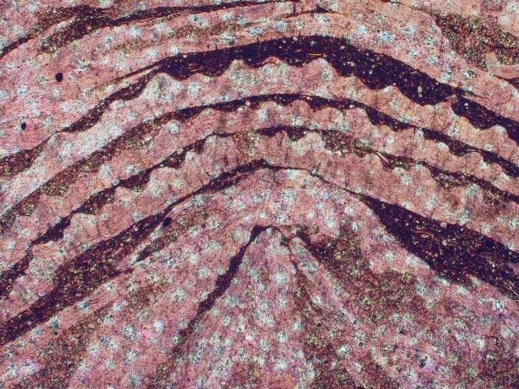
Brachiopods
L.Utica
P.Pleasant
Lexington
Brachiopods are common to abundant through much of the section, especially in the Trenton and Lexington where there are multiple cycles with brachiopod rudstone and organic-rich shale
Trenton

Slide 15
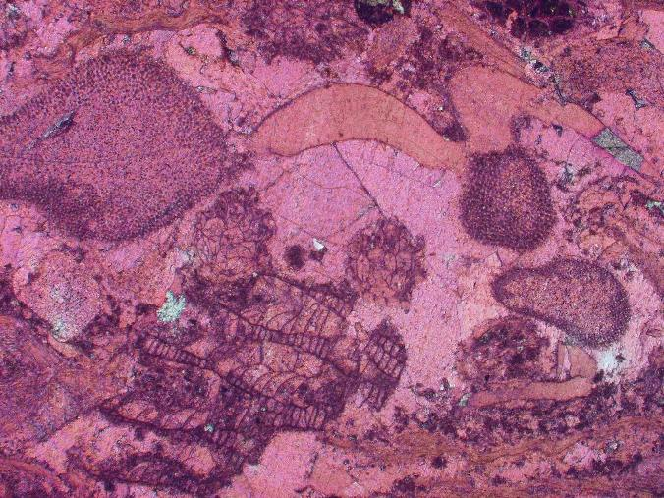
Echinoderms
L.Utica
Ech
Ech
P.Pleasant
Lexington
Echinoderms occur throughout most of the core and are abundant in the Trenton and at the limstone at the top of the Point Pleasant
Trenton

Slide 16
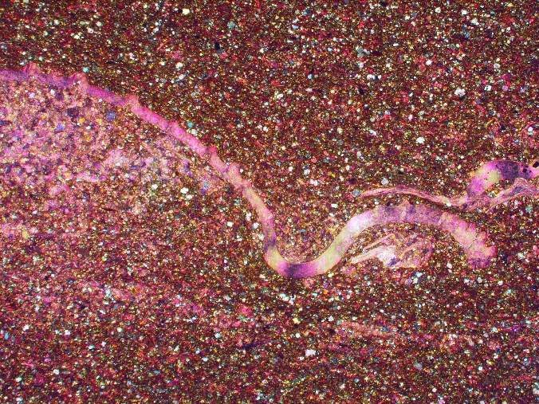
Trilobites
L.Utica
P.Pleasant
Lexington
Trilobites are common throughout the well and abundant in the Lower Utica and Point Pleasant – trilobites are arthropods which have sweeping extinction in cross-polarized light
Trenton

Slide 17
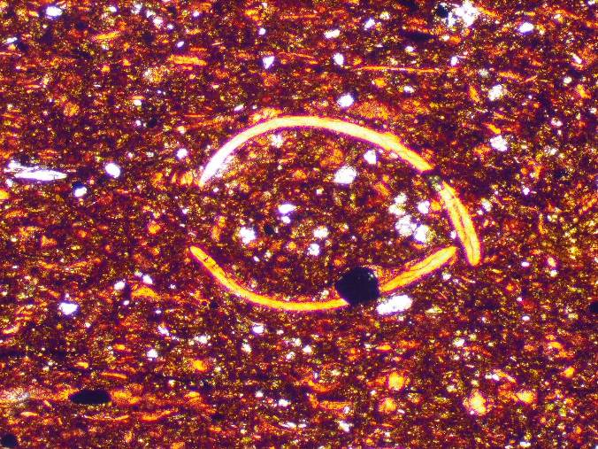
Ostracods
L.Utica
P.Pleasant
Lexington
Ostracods are common throughout everything but the Trenton and are abundant in the organic-rich Lexington – they are articulated in some places – this strongly suggests that these formed here
Trenton

Slide 18
L.Utica
TOC
P.Pleasant
Ostracods
Lexington
Trenton
Ostracod abundance positively correlates with TOC % – the ostracods thrived in the low oxygen environment – but it was not a no oxygen environment for any extended period

Slide 19
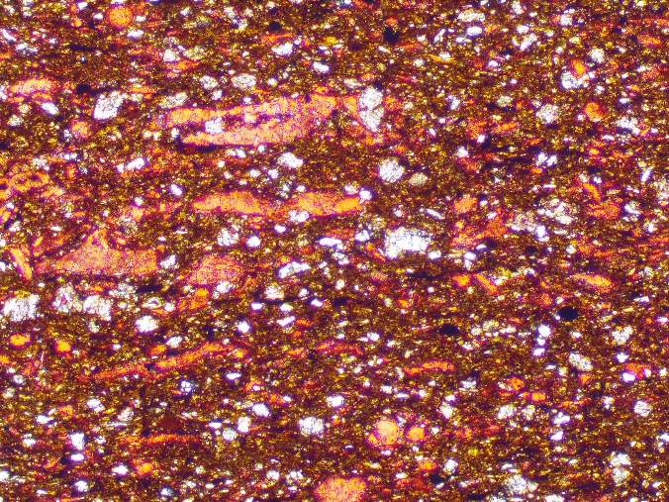
L.Utica
P.Pleasant
Lexington
0.125mm
Much of the organic-rich section is composed of argillaceous limestone that has a high component of silt-sized skeletal debris of indeterminate origin - this is common in the Lower Utica, Point Pleasant and Lexington
Trenton

Slide 20
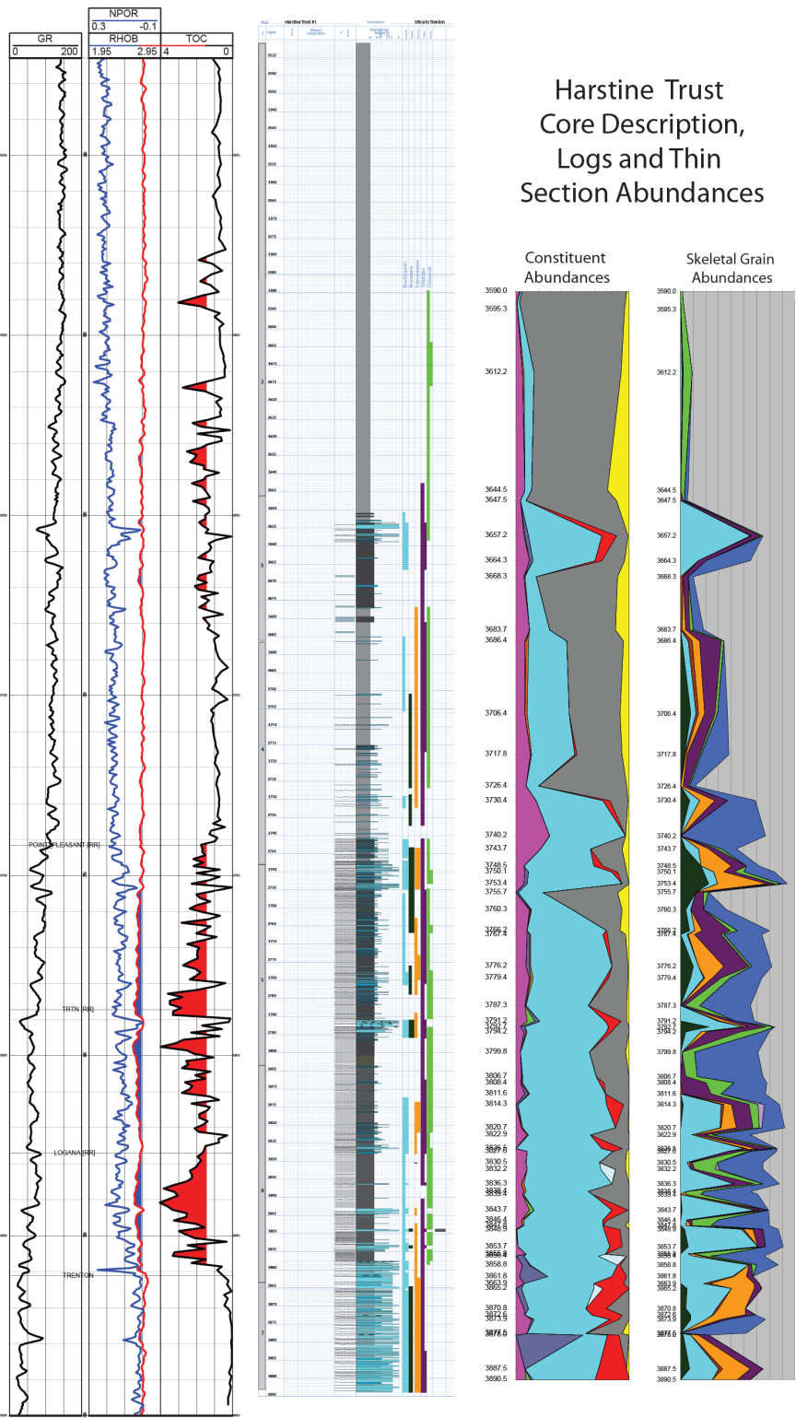
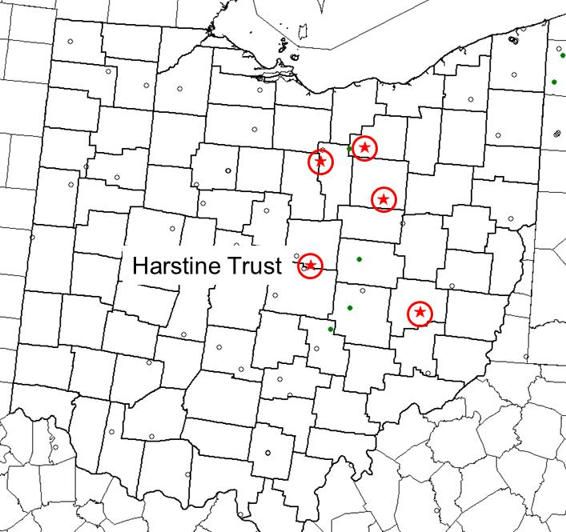
Harstine Trust Well
Gamma ray, NPHI and RHOB logs with RHOB shaded blue where it is <2.65 g/cc
High-resolution TOC log shaded red where >1.5%
Core description done using Dunham classification of carbonate rocks
373 feet
Knox County

Slide 21
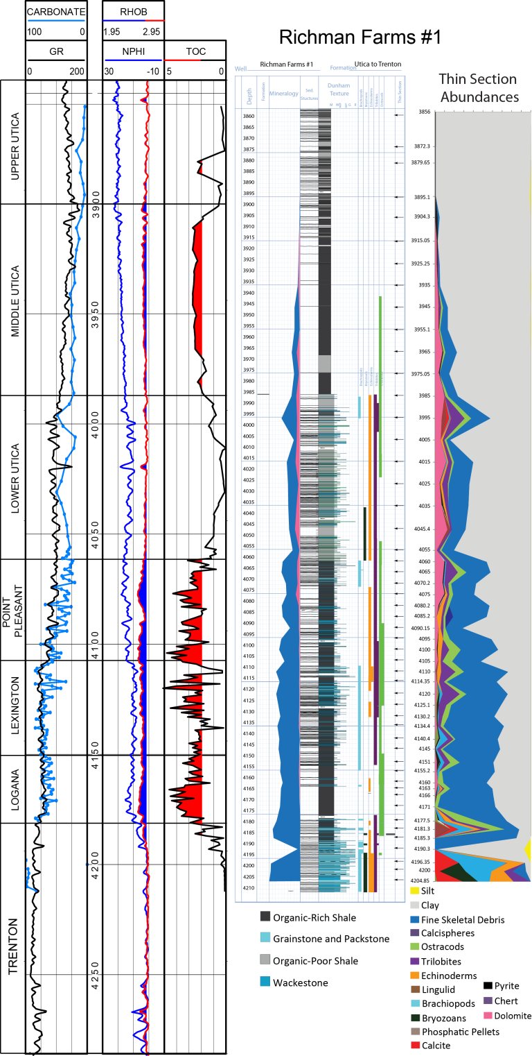
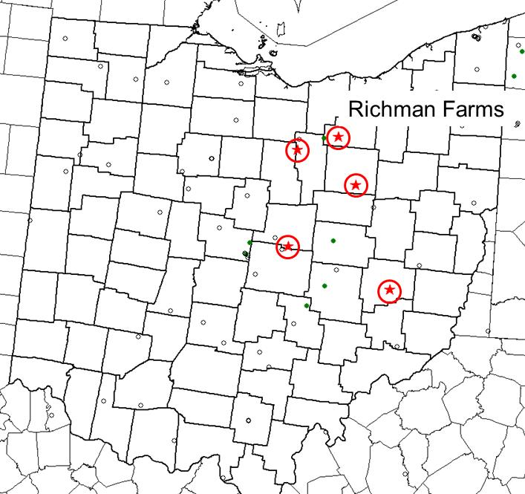
Richman Farms Core
This well and all the others have carbonate content log in the same track with the gamma ray
GR tracks carbonate
Lower carbonate content in this well than in Harstine Trust
355 ft
Medina County

Slide 22
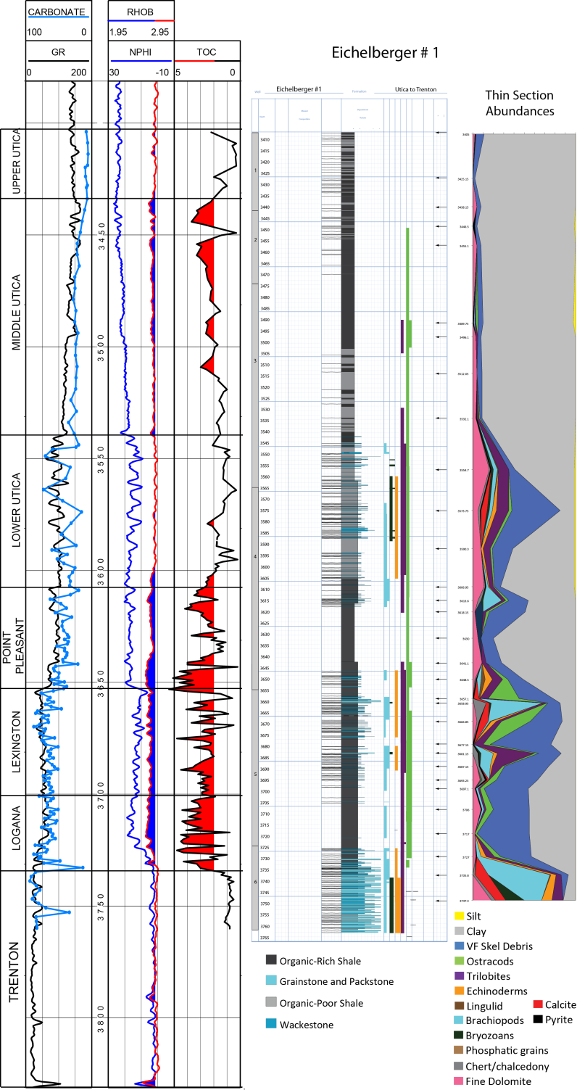
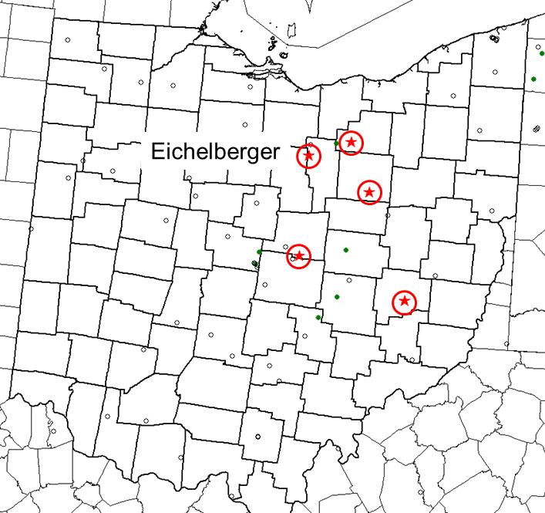
Eichelberger Core
Formations picked on displays slightly different (Devon terminology)
Literally hundreds of scour surfaces
356 feet
Ashland County

Slide 23
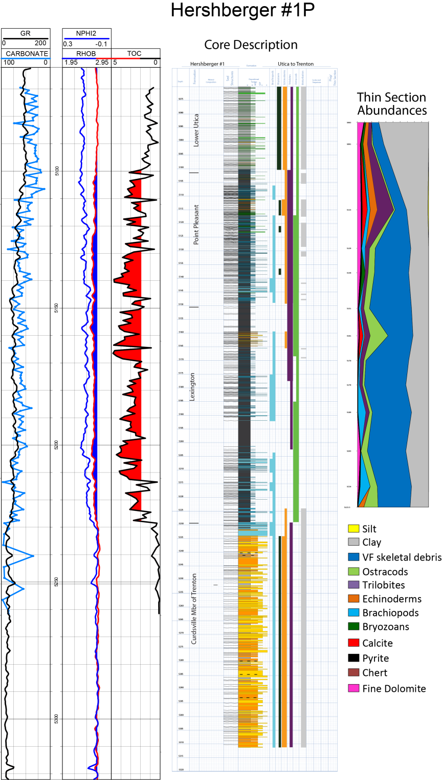
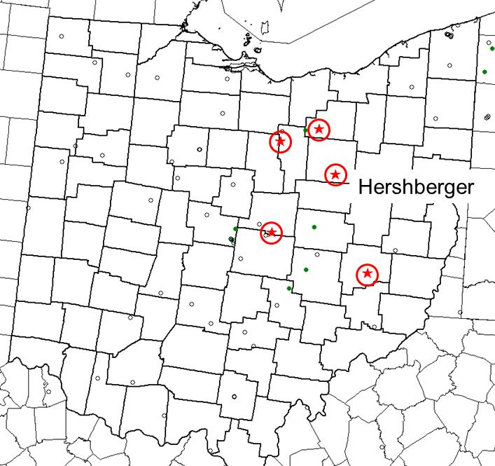
Hershberger Core
Shorter core does not include organic-rich Utica
Thicker section of Curdsville – they were looking for HTD potential (there was none)
More carbonate-rich than wells to north
241 feet
Guernsey County

Slide 24
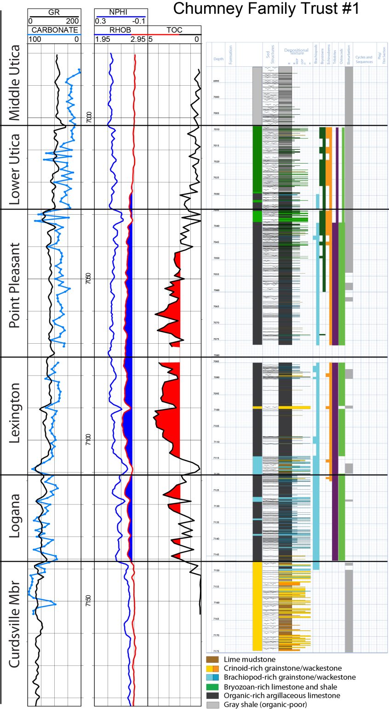
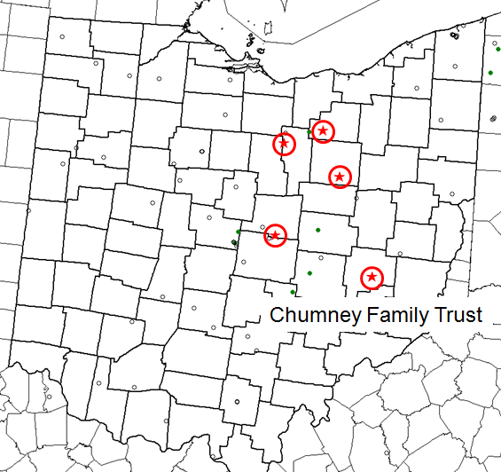
Chumney Family Trust Core
This well is the deepest and farthest to the east
It has a different look and is more clay-rich than the other wells
The Logana and basal Lexington are more carb-rich
185 ft
Wayne County

Slide 25
In fact there may be several disconformities within the section marked by sharp surfaces on the GR and in some cases by increases in TOC just above the surface
The one at the top of the Lower Utica is the only one with obvious relief
Top Lexington, Top Point Pleasant, Top Lower Utica and two within the Middle Utica

Slide 26
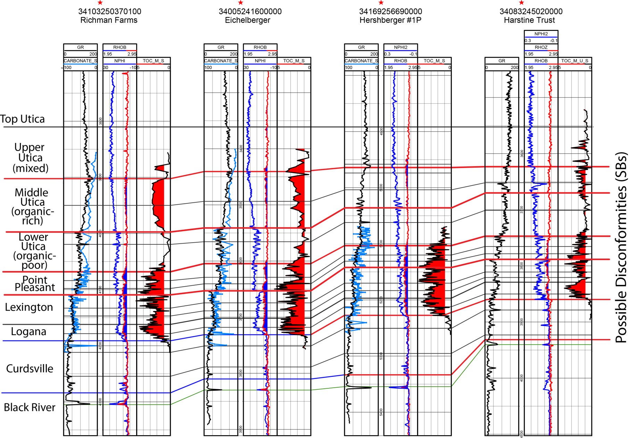

Slide 27
Upper Utica/Kope
The uppermost part of three of the cores consists of interbedded black and gray shale
There is a sharp boundary at the base of each gray interval and a gradational, burrowed contact at the top of the gray and bottom of the black intevals
This correlates with what is called Utica or Upper Indian Castle in western New York

Slide 29
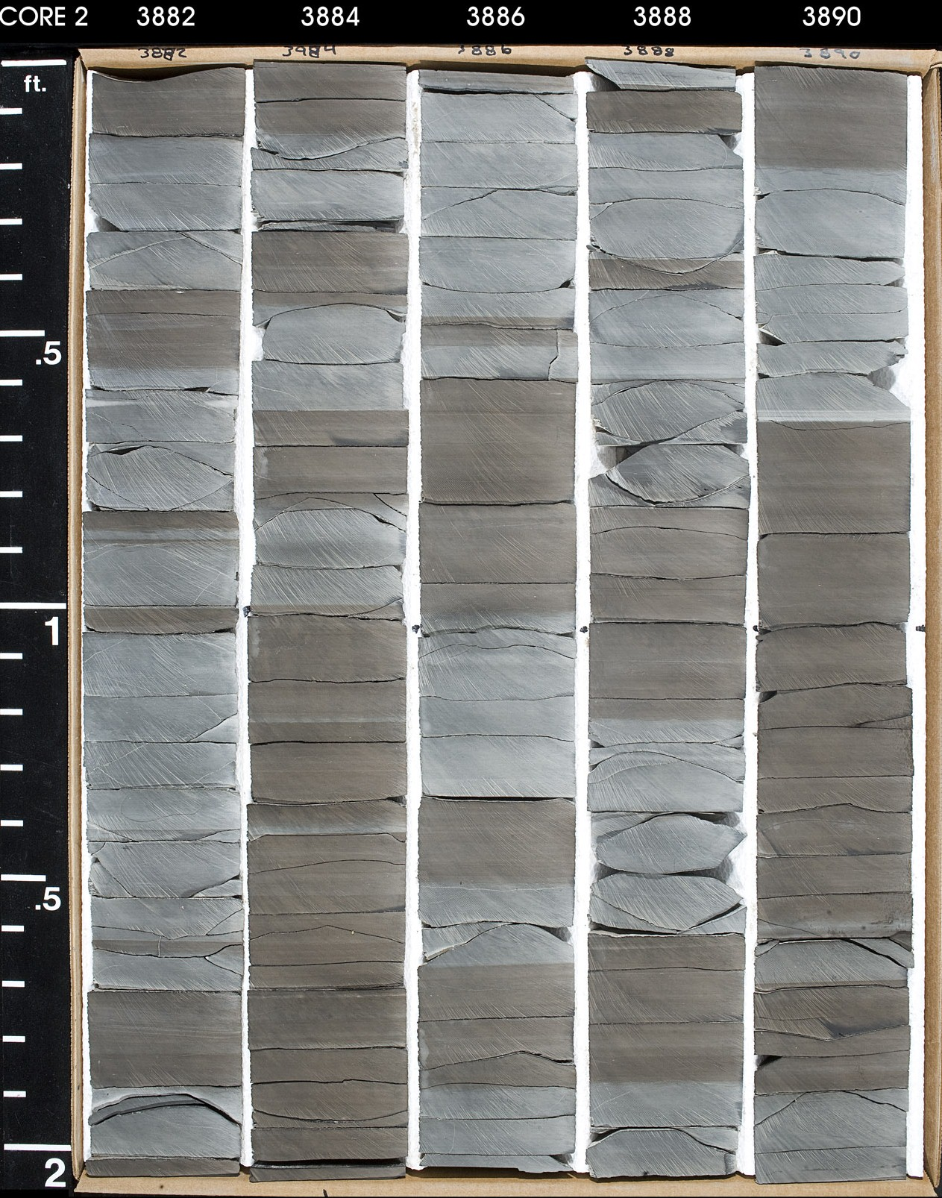

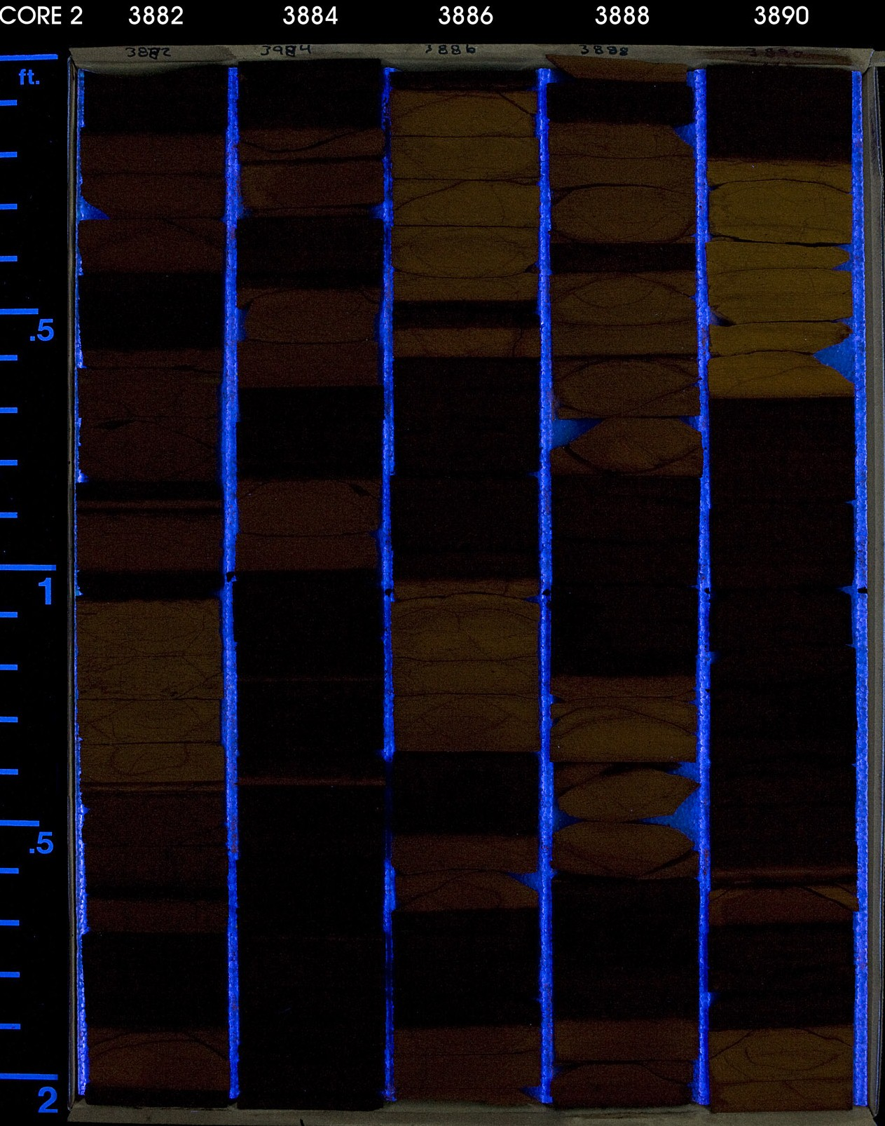
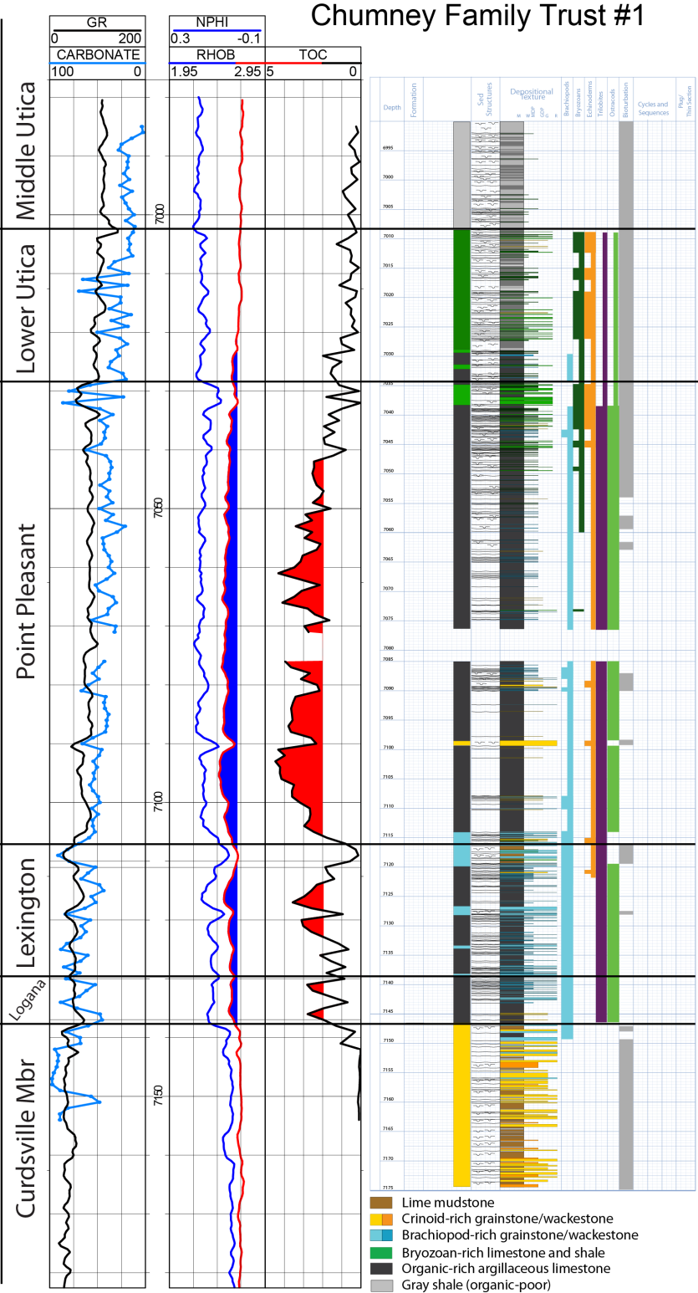
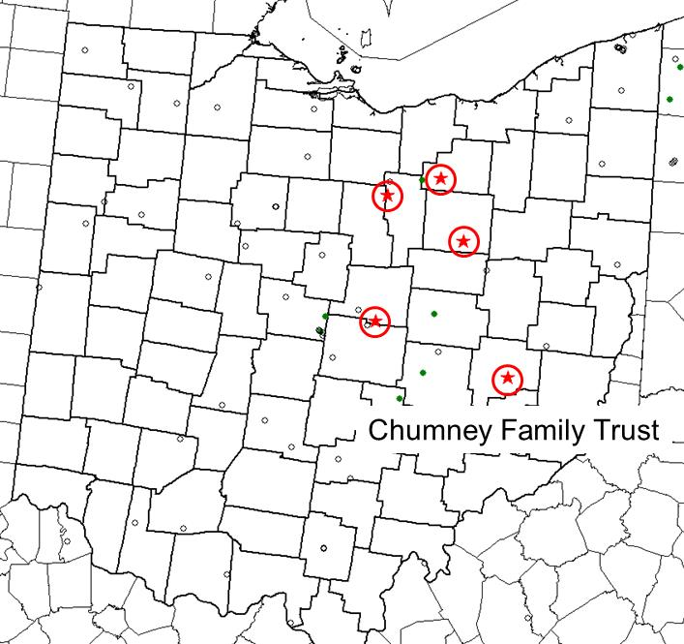
Chumney Family Trust Well
This well was farther to east and more deeply buried
More continuous organic-rich section in Point Pleasant, does not look as good in Logana and Lexington
6.7
0.3
6.1
0.2
13
1.9
11
2.3
15
2.3

Slide 30
Middle Utica
The “Middle” Utica is a laminated organic- and clay-rich shale
This interval is what the Ohio Survey calls Utica
TOC up to 4% in places
Carbonate content is typically around 25%
Some thin limestone beds at base in southern cored wells but not many visible fossils other than that

Slide 32
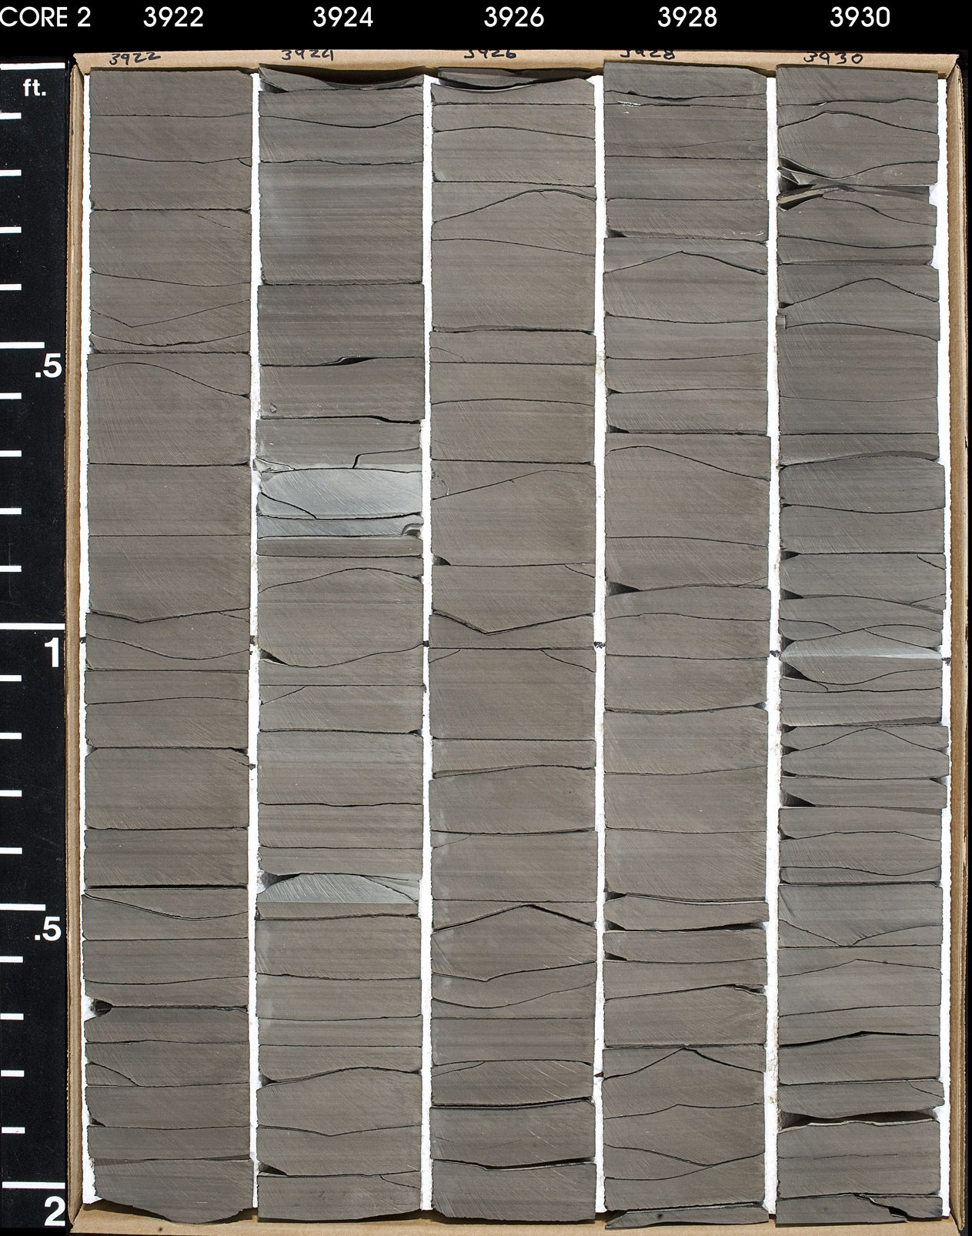
21
2.6
20
2.3
TS

Slide 33
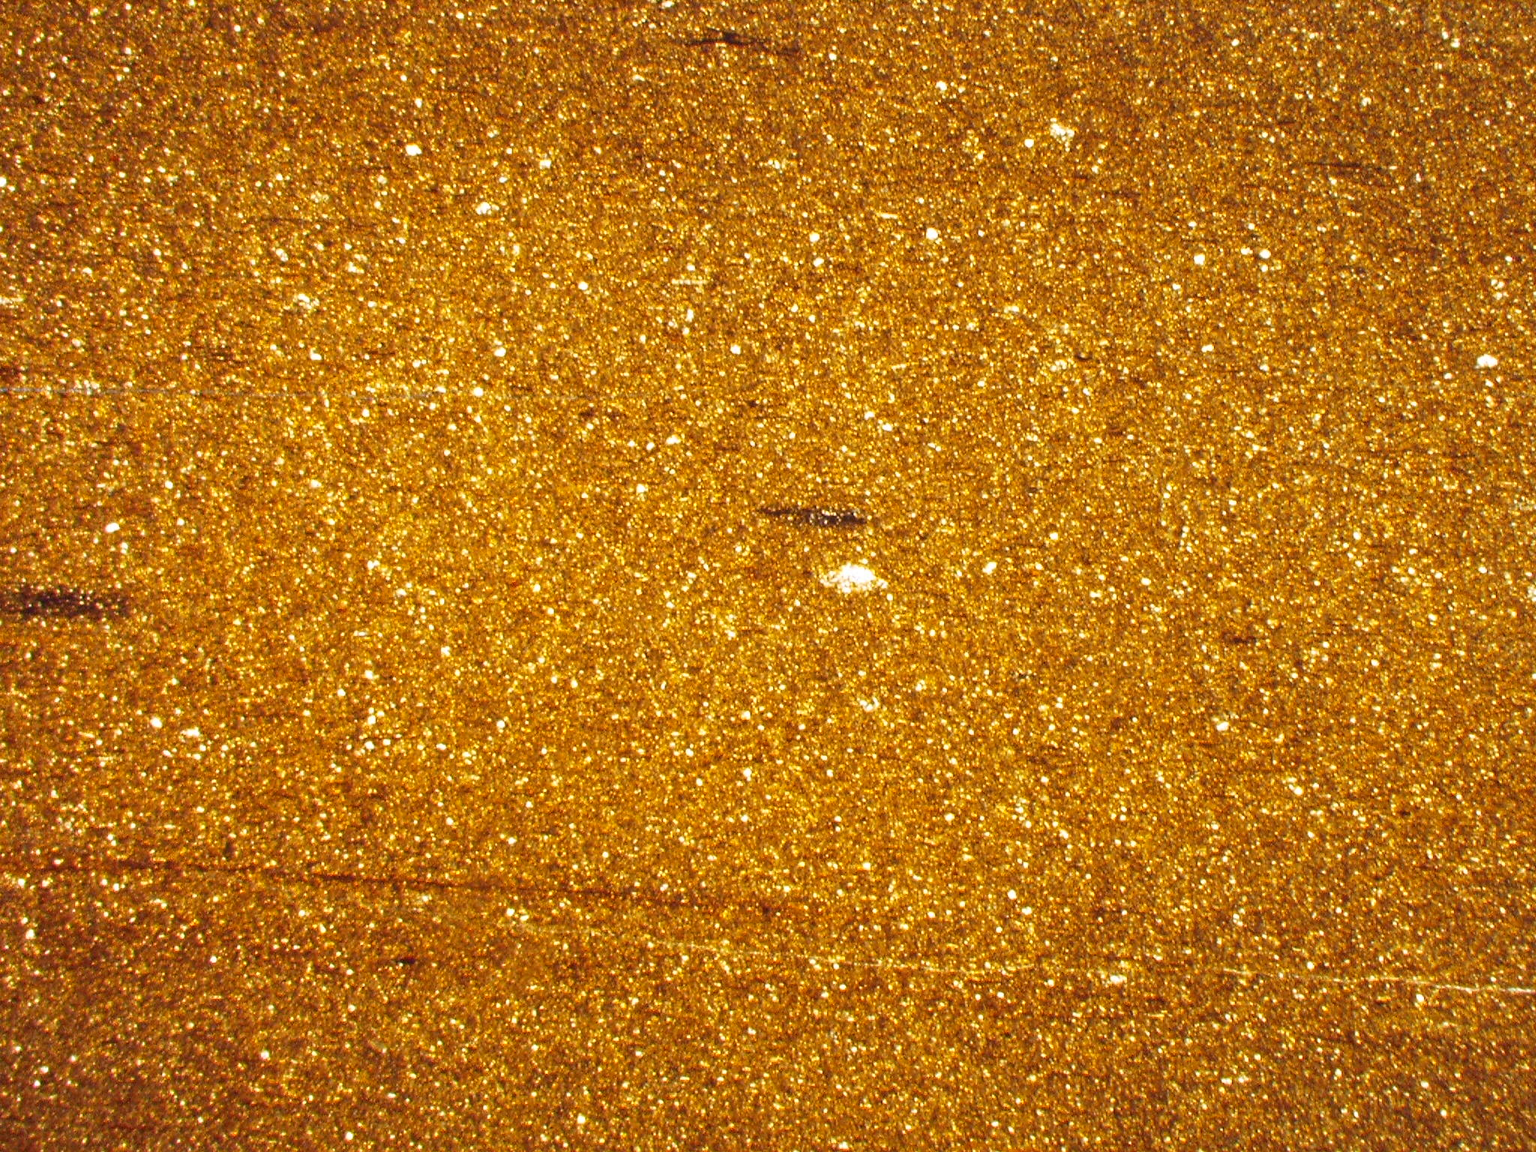
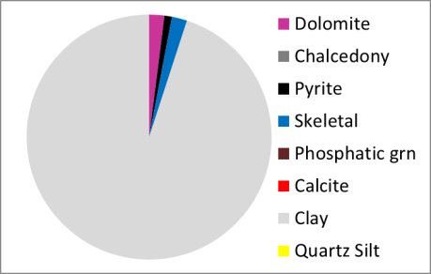
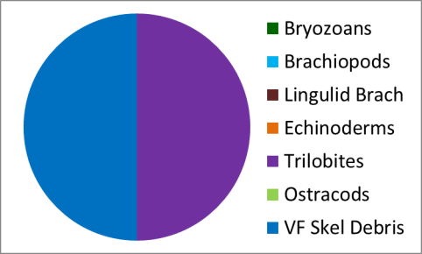
20
2.3
TS
1 mm
3925.25-Laminated organic-rich shale with some dolomite and first trilobite – carbonate percentage (20%) is higher than what one can see visually (4%)

Slide 34
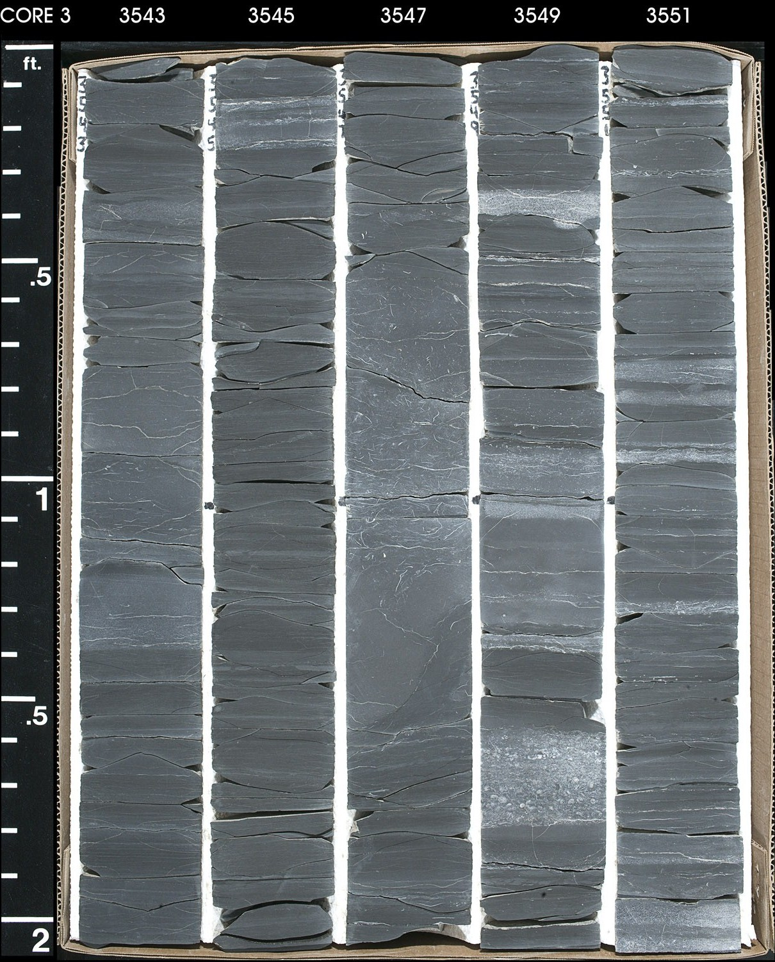
26
1.6
20
2.1
60
0.8
70
0.8

Slide 35
Top of Lower Utica is an erosion surface that could be a disconformity
Disconformity?
This surface also occurs in the Harstine Trust well at the top of the Lower Utica

Slide 36
Lower Utica
This interval is mostly organic-poor and has common thin beds of limestone
Prasapora bryozoans very common, especially to south
Sometimes called Point Pleasant because of limestone content, but Point Pleasant here picked at top of organic-rich interval

Slide 38
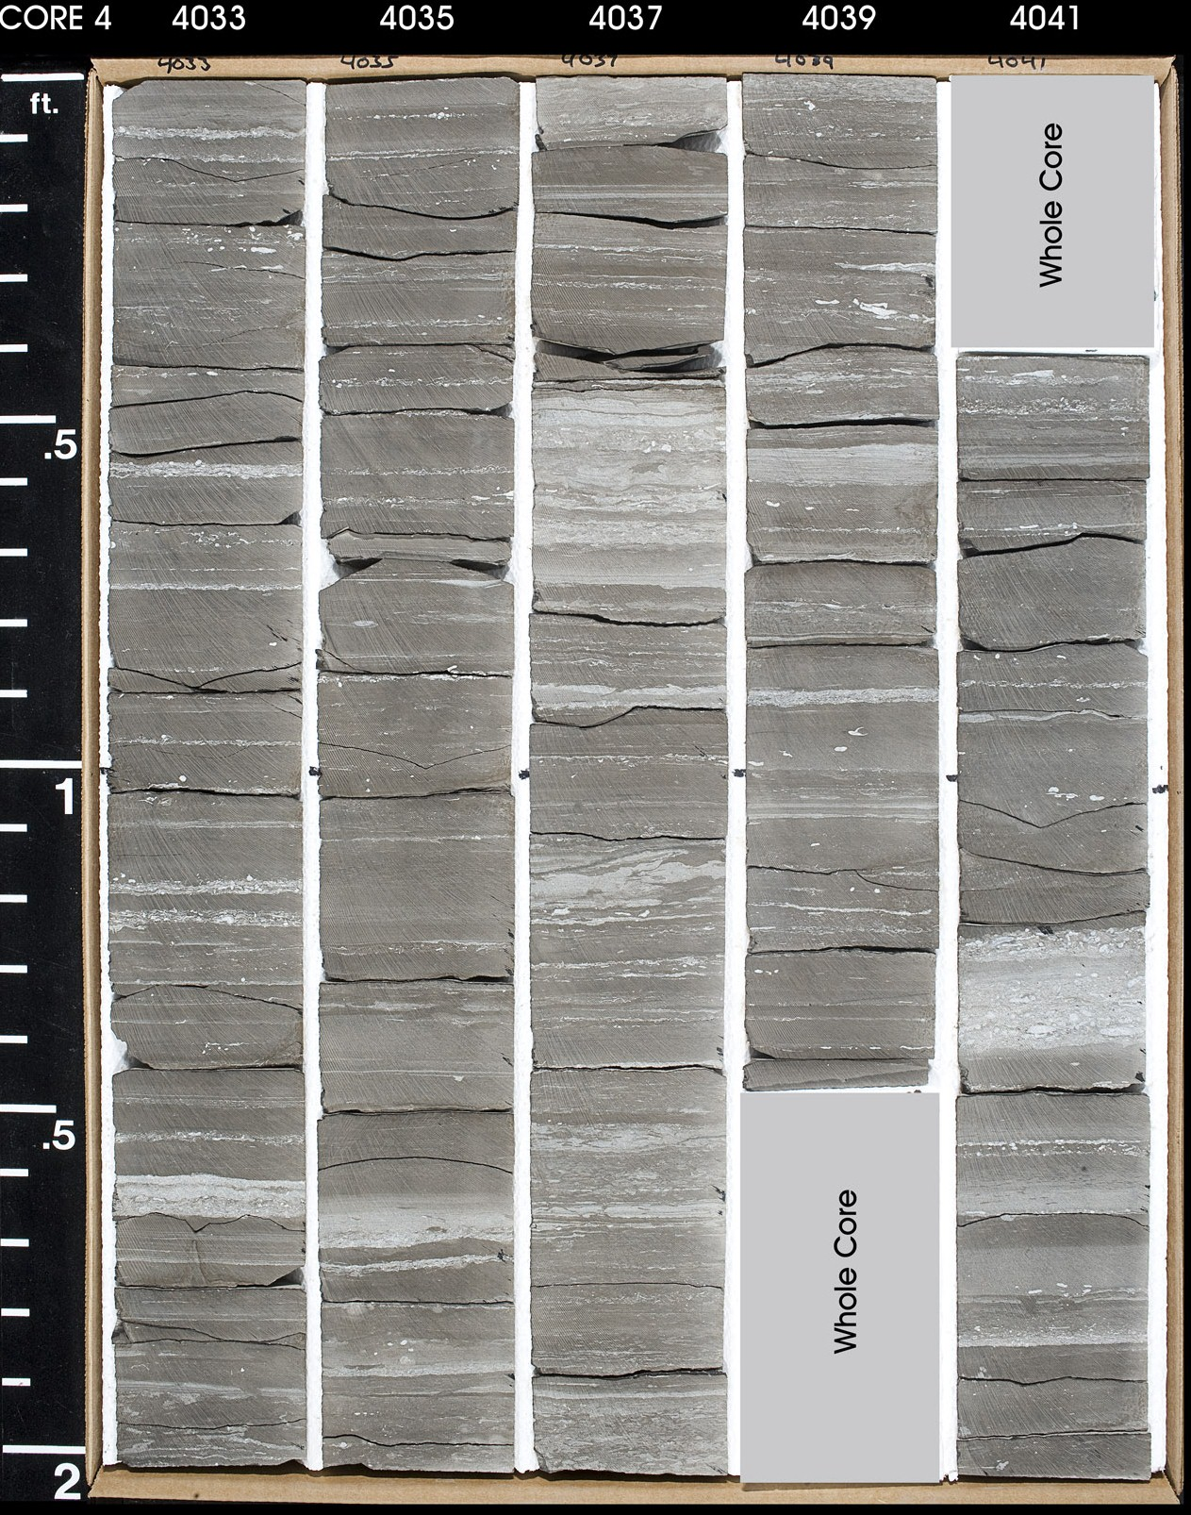
42
0.6
TS
37
1.0

Slide 39
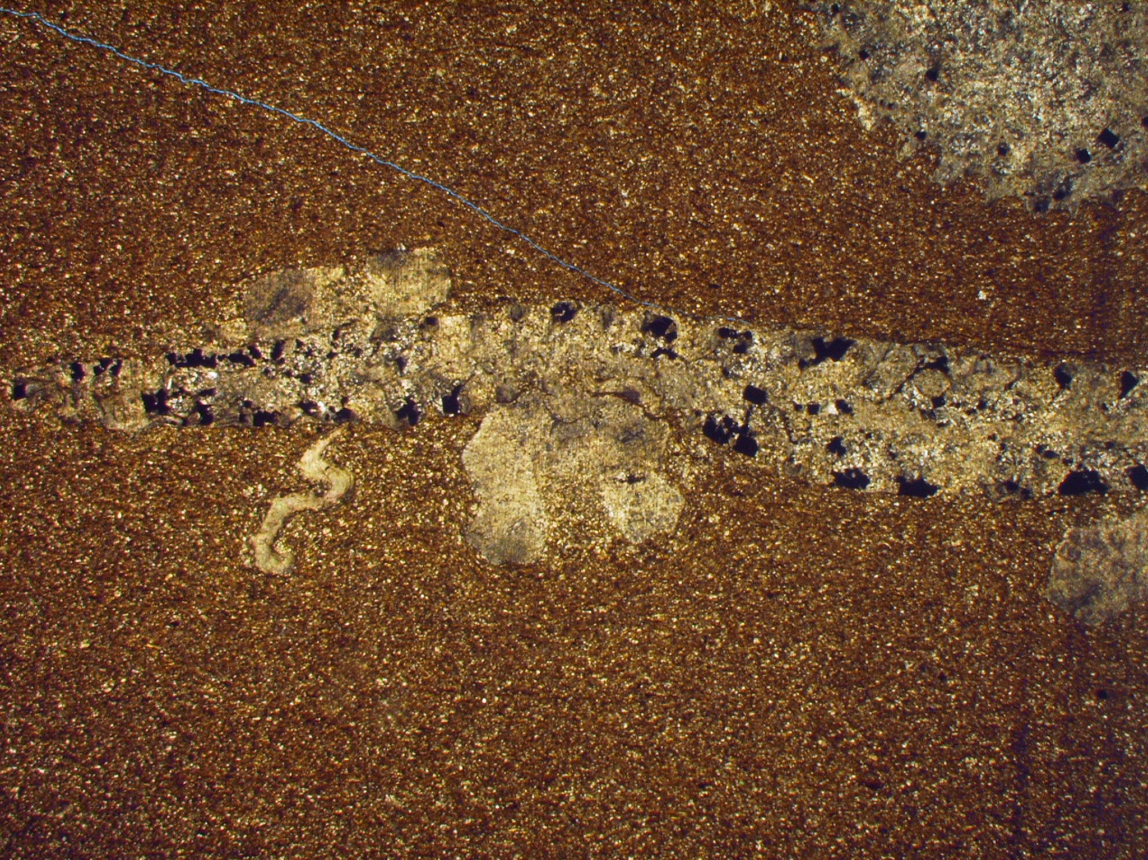
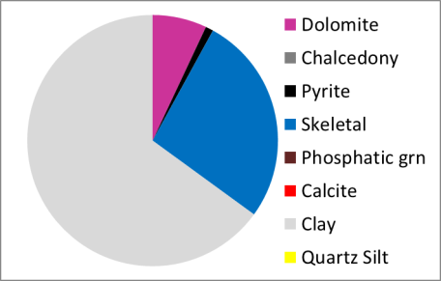
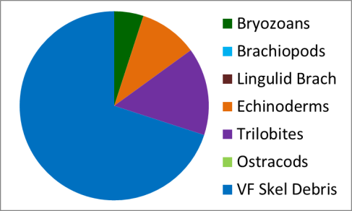
42
0.6
TS
1 mm
4035-Bryozoan in laminated organic-poor calcareous shale

Slide 40
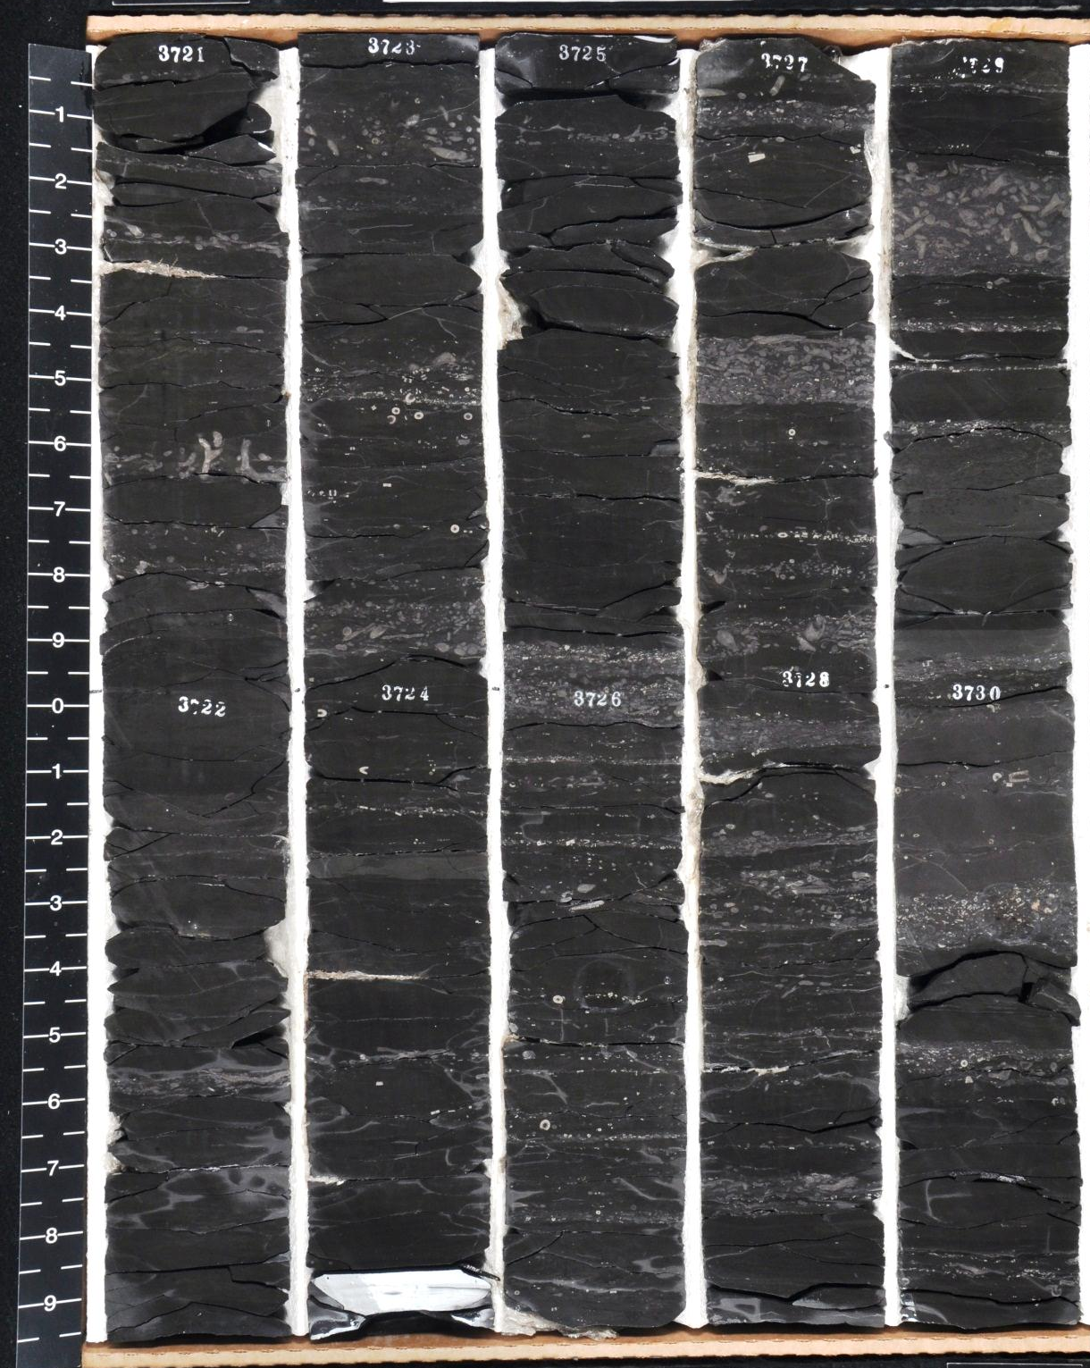

0.9
0.7
0.7
0.6
0.9

Slide 41
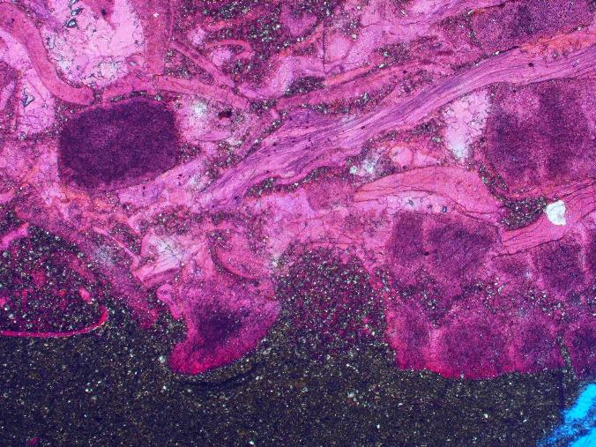
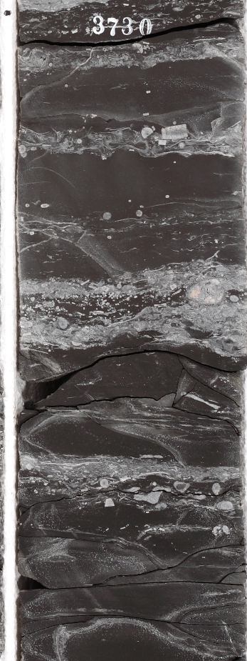
0.6
0.5mm
3730.37 Skeletal packstone and organic-poor shale - packstone consists of echinoderms, brachiopods and trilobites 2.5x 0.6% TOC

Slide 42
Point Pleasant
Storm-bedded and laminated black shale and limestone
TOC up to 5% in some wells
Carbonate content typically around 50%
This is the upper part of the main reservoir interval

Slide 43
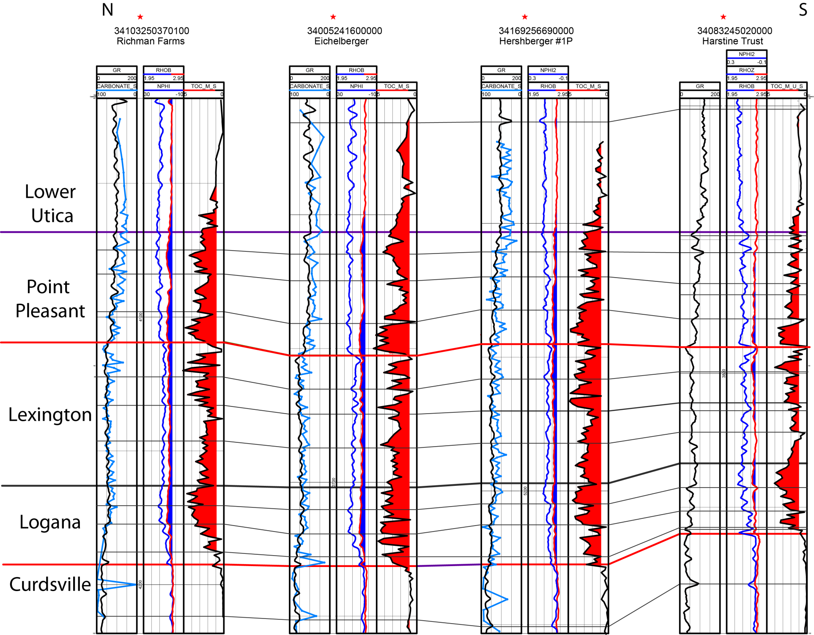

Slide 44
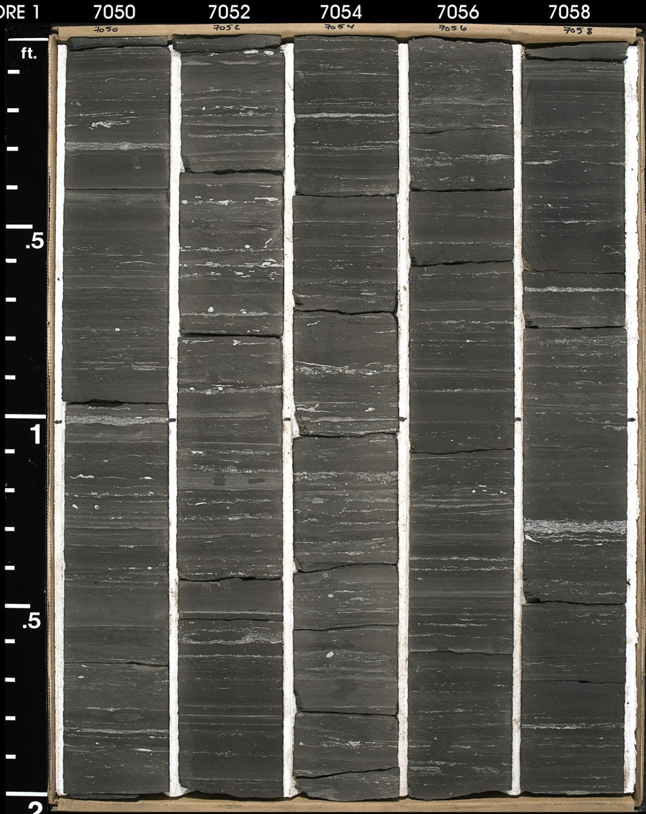
38
2.4
38
2.0
34
2.5
34
2.9
21
3.4
47
2.3
40
2.1
48
1.6
41
2.6
30
2.5

Slide 45
Lower down in Point Pleasant most coarse grains are gone
Carbonate content is pretty low – in the 20-50% range
TOC increases downward as coarse bryozoans and crinoids become rare then absent
Still some common bioturbation
Reservoir quality is moderate – TOC getting higher but carbonate content probably too low
38
2.4
38
2.0
34
2.5
34
2.9
21
3.4
burrows
47
2.3
40
2.1
48
1.6
41
2.6
30
2.5
burrow

Slide 46
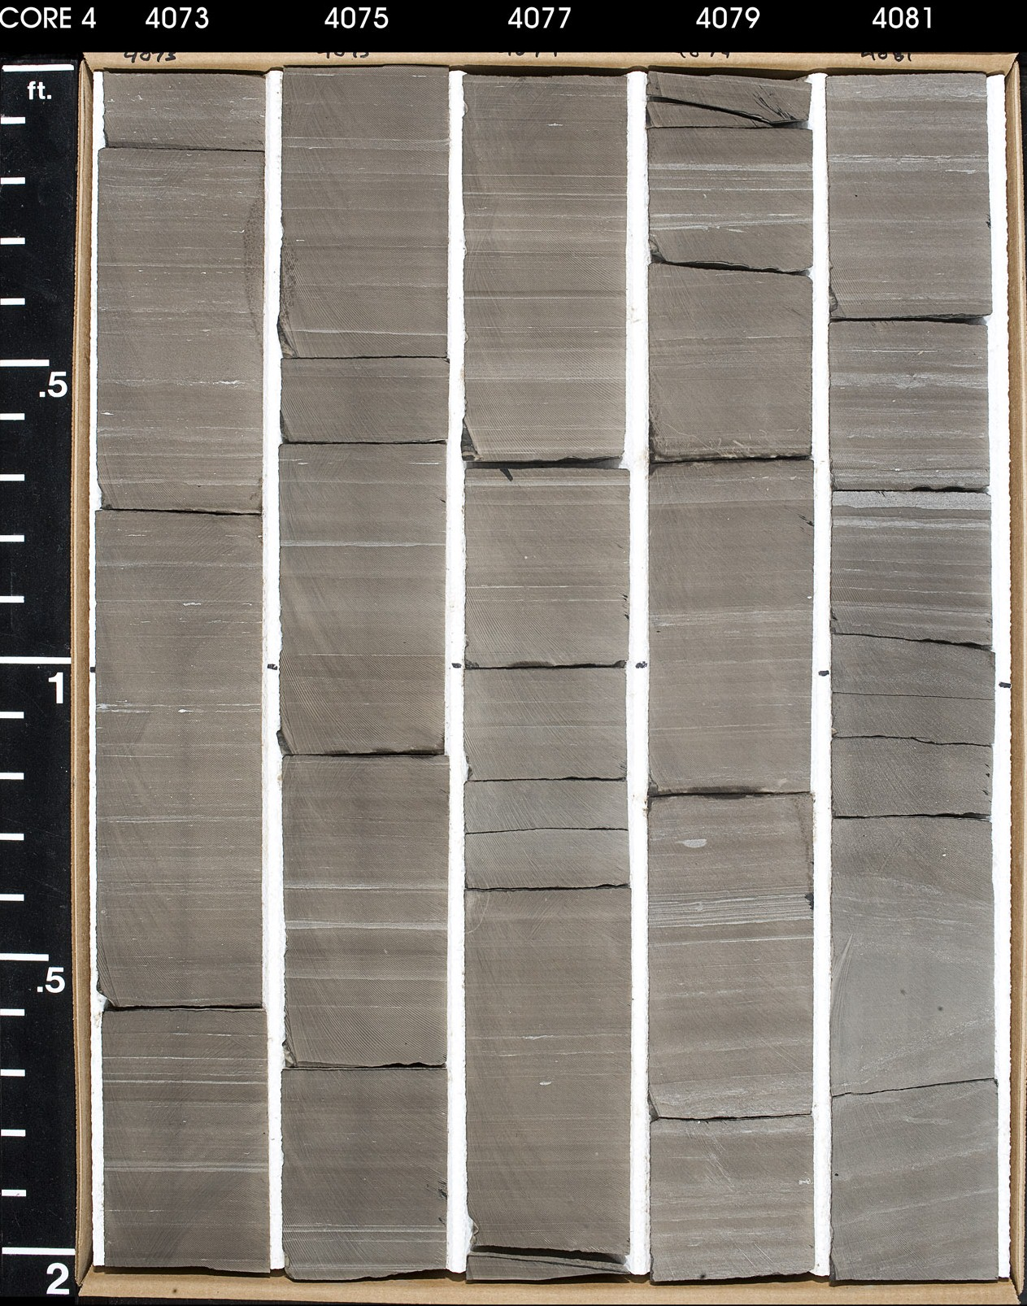
55
2.3
33
3.6
37
3.3
32
3.7
68
2.1
42
2.3
30
4.3
34
2.8
48
3.4
26
3.6

Slide 47
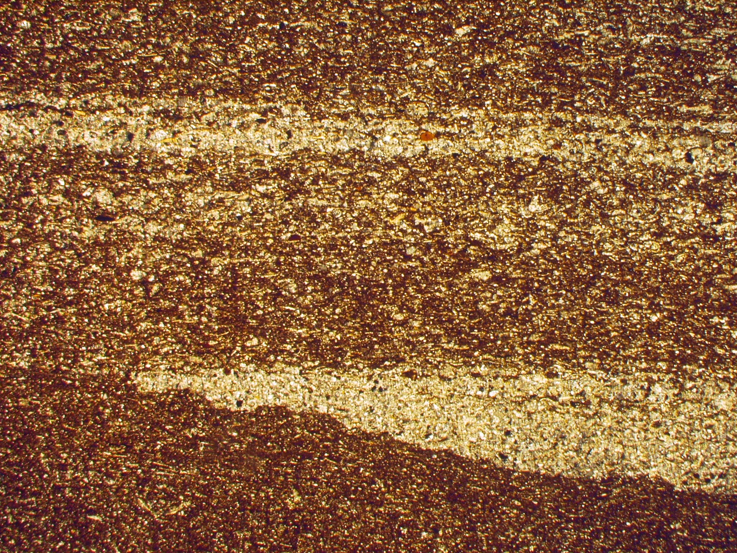
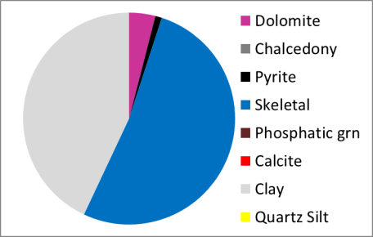
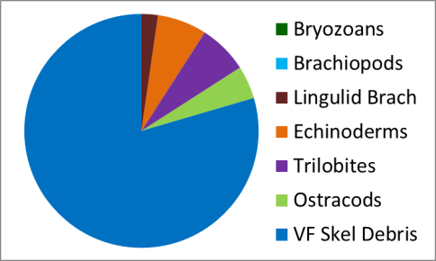
48
3.4
TS
1 mm
4080.2-More carbonate-rich organic-rich shale – scour surface with lenticular bed of skeletal debris – clearly deposited in moving water

Slide 48
Lexington Limestone
Clean limestone at top makes good log marker
Looks like it may have an unconformity near the top
Some very high TOC beds just above and below Limestone – up to 5%
Some

Slide 50
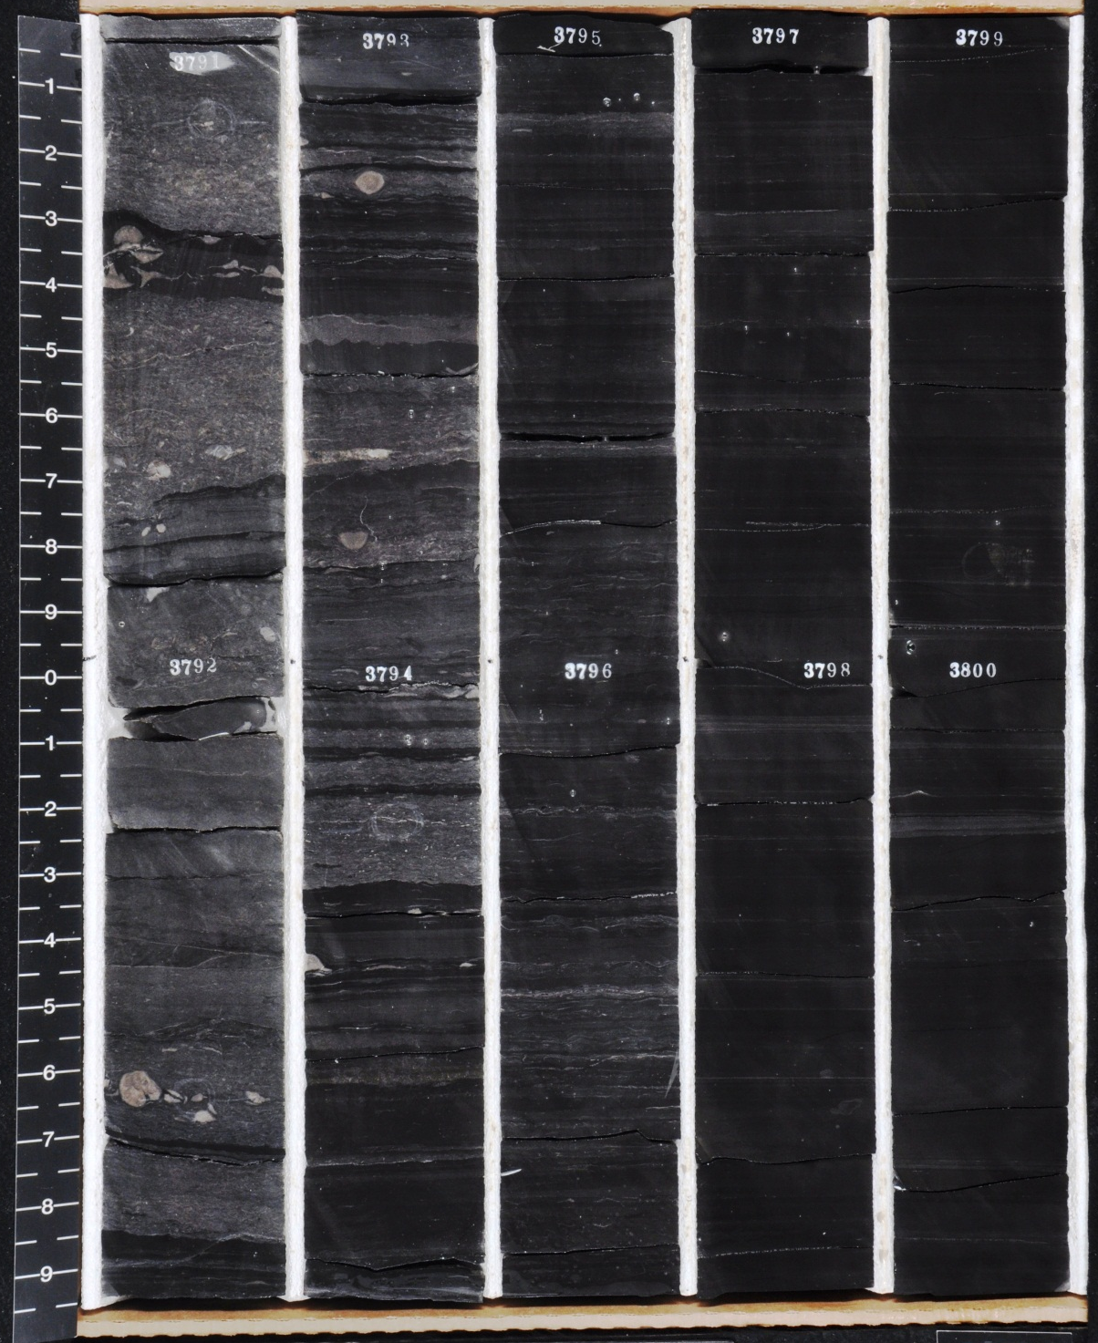

3791
0.1
1.7
2.3
2.7
4.0
Harstine Trust
0.5
3.9
0.2
0.6
0.7
3.2
2.5
3.0
3.1
3801

Slide 51

Unconformity?
This surface may mark an unconformity at the top of the Trenton that can be traced around much of the Basin

Slide 52

80
0.3
66
2.3
35
4.5
57
4.0
72
1.9
60
3.4
60
3.1
84
0.5
43
5.1
69
2.5

Slide 53




71
3.4
TS
1 mm
4125-Ostracods and trilobites in coarse bed overlying scour surface in organic rich argillaceous limestone

Slide 54
Logana Limestone
High TOC zone at base of organic-rich section
TOC up to 5%
High carbonate content average around 75%
Brachiopod rudstone beds common at base
Abundant ostracods in organic-rich facies

Slide 56

64
3.8
67
3.7
84
1.8
2.9
67
4.0
68
3.2
75
3.6
80
2.3
1.9
63
3.3

Slide 57



75
3.6
TS
1 mm
4177.5-Scour surface below ostracod-skeletal grainstone cuts into organic-rich argillaceous limestone

Slide 58
Depositional Environment of Organic-Rich Utica/Point Pleasant
The dominant paradigm for the deposition of the organic-rich Utica and other black shales has been in a very deep, quiet, stratified, permanently anoxic or dysoxic basin
It appears that it may actually have been quite shallow (<50m, probably <30m), with common stormsand possibly more frequent currents (tides?), not stratified and rarely, if ever anoxic

Slide 59

The existing models for the Utica almost all have some kind of permanent stratification with a pycnocline somewhere in the water column that separates water with normal oxygen from oxygen deficient water where organic carbon can be preserved from water where carbonate producing organisms can thrive
Most models for the Utica had it deposited in hundreds of meters of water (some have said >500 m and others have it in >1000m)
These models are all dependent on preservation being the only important factor
From Baird and Brett, 2002

Slide 60


Transgressive Onlap Model
Organic-Rich Mudrock
Conant and Swanson, 1961
Organic-rich Devonian Chattanooga Shale overlies and onlaps an unconformity and is time-equivalent to exposure nearby – reasoned that water was likely less than 30m (100 feet) deep

Slide 61

Utica
Utica
Trenton Formation
Utica
Outcrop Stratigraphy from Mohawk Valley, NY – Some Utica is Trenton-equivalent, some is younger than Trenton – Note that the most organic-rich parts overlie and onlap unconformities

Slide 62
An Alternative Hypothesis
In some vast epeiric seas, some widespread organic-rich argillaceous limestones and shales may have formed in:
  Relatively shallow water (<50m and commonly 0-30m), not >>100 m as some have proposed
  In water that was perhaps seasonally dysoxic, not permanently anoxic, not necessarily stratified
  In moving currents, not stagnant water

Slide 63
Storm Bedding
The presence of abundant storm beds throughout much of the section suggests water that was not that deep
It would also be impossible to maintain any kind of stratification if there were frequent storms
Interpretation: above storm wave base, not stratified

Slide 64

Base Point Pleasant and top of Lexington
Despite the presence of some thicker bedded very clean brachiopod dominated limestone, high TOC occurs above and below
Storm beds throughout – clearly above storm wave base
39
4.7
47
3.8
67
2.4
59
3.8
71
2.6
Top Lexington
53
4.7
69
2.8
58
3.8
81
1.0
63
2.9

Slide 65

3.1
4.1
3.3
2.6
2.0
0.2
3.4
3.6
3.6
3.3
1.6
3.2
1.2
Samples are from the depths above the values

Slide 66

Scour surfaces
Scour surfaces underlie all limestone beds

Slide 67
In Situ Fossils
Brachiopods, trilobites, bryozoans, echinoderms and ostracods all are benthic organisms that lived on the sea floor
The presence of benthic fossils in the organic-rich strata and interbedded with the organic-rich strata suggest that the water conditions were probably never anoxic or if they were it was for very brief periods
Interpretation: Low oxygen at times, probably never anoxic (it may have been anoxic from the sediment-water interface down at times)

Slide 68


3.0
0.5mm
Ostracods and trilobites in calcareous black shale overlie scour surface - 3.0% TOC

Slide 69

2.1
2.6
2.8
2.1
2.7
1.1
2.5
1.2
1.5
2.2
3.1
2.9

Slide 70

Laminations Produced by Moving Bottom Currents
Laminations are common in black shales and are commonly used as evidence of deep quiet deposition as clay settled out of suspension
New research suggests, however, that these laminations may actually form in moving water with flow rates up to 30 cm/s
Organic-matter may have been protected by clay floccules which maintained anoxic microenvironment

Slide 71


Slide 72

Flow rates up to 25 or 30 cm/s
J. Schieber

Slide 73

Internal Cross-Laminae
Flow
In cross-section the layers that constitute clinoforms show low-angle laminae, inclined in downcurrent direction. The latter are compacted foresets of initially water-rich muddy ripples.
J. Schieber
IU Shale Research

Slide 74
Link to Unconformities
Many organic-rich argillaceous limestones and shales both overlie and onlap unconformities, some of which are demonstrably subaerial in origin
This suggests that the water depth cannot have been too deep for many of them (barring icehouse sea level fluctuations)

Slide 75
Thruway Disconformity
Utica
Utica
Trenton Formation
Utica
Knox Unconformity
Outcrop Stratigraphy from Mohawk Valley, NY – Some Utica is Trenton-equivalent, some is younger than Trenton – Note that the most organic-rich parts overlie or are time-equvalent to unconformities

Slide 76

Very old well here with cuttings study

Slide 77

5500 feet of Utica equivalent clastics on downthrown side of fault with only minor organic-rich shale at base

Slide 78

Organic–rich shale
Turbidites, gray shale
This block model shows the organic rich shale forming in relatively shallow water (<50m) on the upthrown side of a major down to the east fault system - the major fault system cut the dilution by siliciclastics coming in from the present day east

Slide 79


NE
SW
Area of Utica organic-rich deposition may have been 10 meters deeper than area of shallow marine limestone deposition
Not organic-rich

Slide 80
Water Depth
The organic-rich Utica onlaps and overlies subaerial unconformities
The true deep water was to the east in the foredeep which is filled with organic-poor turbidites
Almost certainly <50m deep and probably <30 m deep in New York and Ohio

Slide 81
Shallow Seasonal Model
So how does organic matter get preserved in this setting?
A shallow seasonal model was first proposed by Tyson and Pearson, 1991 and is being increasingly adopted for black shales deposited in vast epeiric seas
It may be the best explanation for what we have here

Slide 82



Slide 83


Some organic matter makes its way downward as “marine snow” in “organomineralic aggregates” with clay and fecal pellets (sensu Macquaker et al., 2010)
Organic matter is sticky and may bond with clay floccules and other matter floating in the water column
The increased size and density of the aggregates helps them fall faster to the bottom
Anoxic microenvironments may form within the aggregate, preventing the organic matter from being oxidized, even in the mixed, oxygenated zone
http://sciencebasedlife/marine_snow.jpg
http://ocean.si.edu

Slide 84



Slide 85


Slide 86
Shallow Seasonal Model
There may be extended periods of few algal blooms due to a lack of storms or nutrient input which could lead to colonization of the surface by benthic fauna
During these times the redox boundary may be a few mm below the sediment-water interface but the already deposited OM will still be preserved

Slide 87
Shallow Seasonal Model
This model can explain
  the current laminations which form during the winter storms
  the presence of benthic fauna
  the shallow water depth and link to unconformities
  The apparent increase in TOC in what was probably shallower water (along with lack of dilution)

