Slide 1

Mass wasting

Slide 2
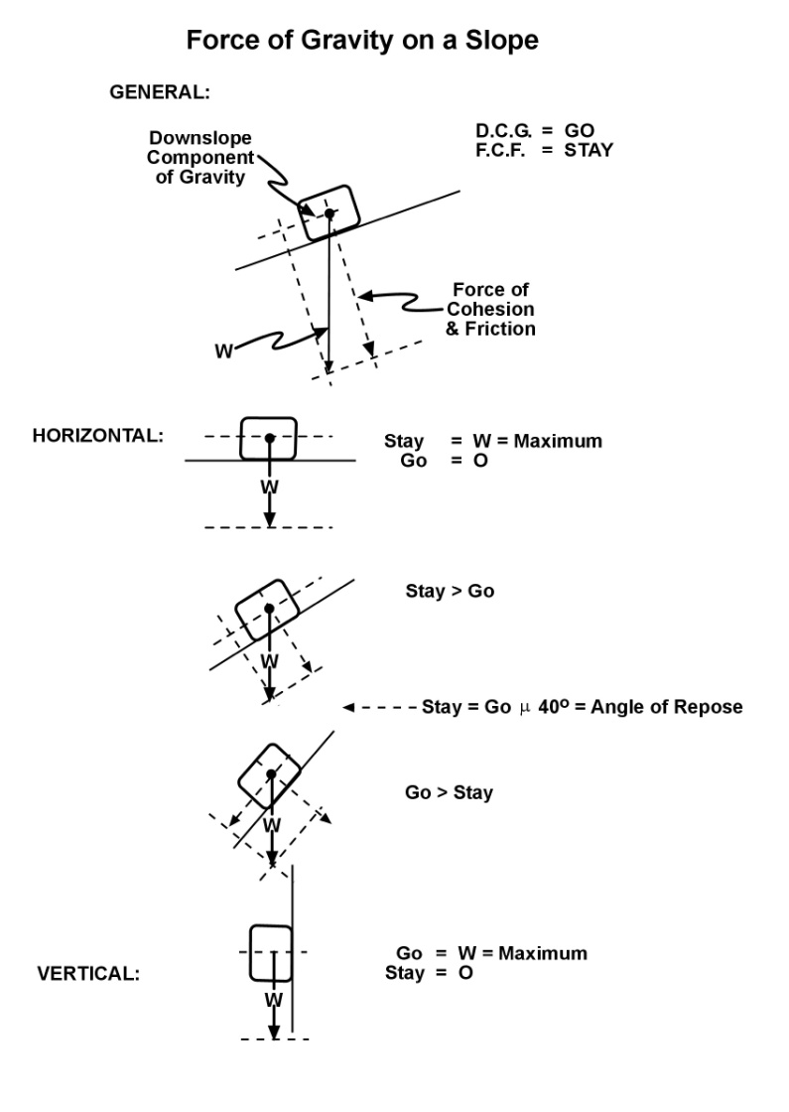
Mechanics of Mass Wasting
An object resting on a horizontal surface will move only when it encounters a force acting parallel to the horizontal surface. The force of gravity operating perpendicular to the horizontal surface will not move the object. However, if an object is resting on a sloping surface, the force of gravity creates two other force vectors. One is the force directed downslope. The second is the force of cohesion and friction which is directed perpendicular to the slope surface. Another way to state this is that, on a sloping surface, gravity has a GO component and a STAY component. The magnitude of the GO and Stay forces can be graphically presented by drawing a parallelogram where the force of gravity is the diagonal and the GO and STAY forces represent the sides parallel and perpendicular to the surface respectively. According to the drawings, at low angles of slope the STAY force is greater than the GO force and the object will not move. However, at high angles of slope where the GO force exceeds the STAY force the object will move downslope. Theoretically at an angle of 45^{O}, the two forces would be equal and in balance. Experiments, however, have shown that when dealing with odd-shaped particles of any size, this balance is actually reached at about 40^{O}, an angle called the angle of repose. The angle of repose is the natural angle achieved when mass wasting event pile up rock debris at the base of a cliff, outcrop, or roadcut.

Slide 3
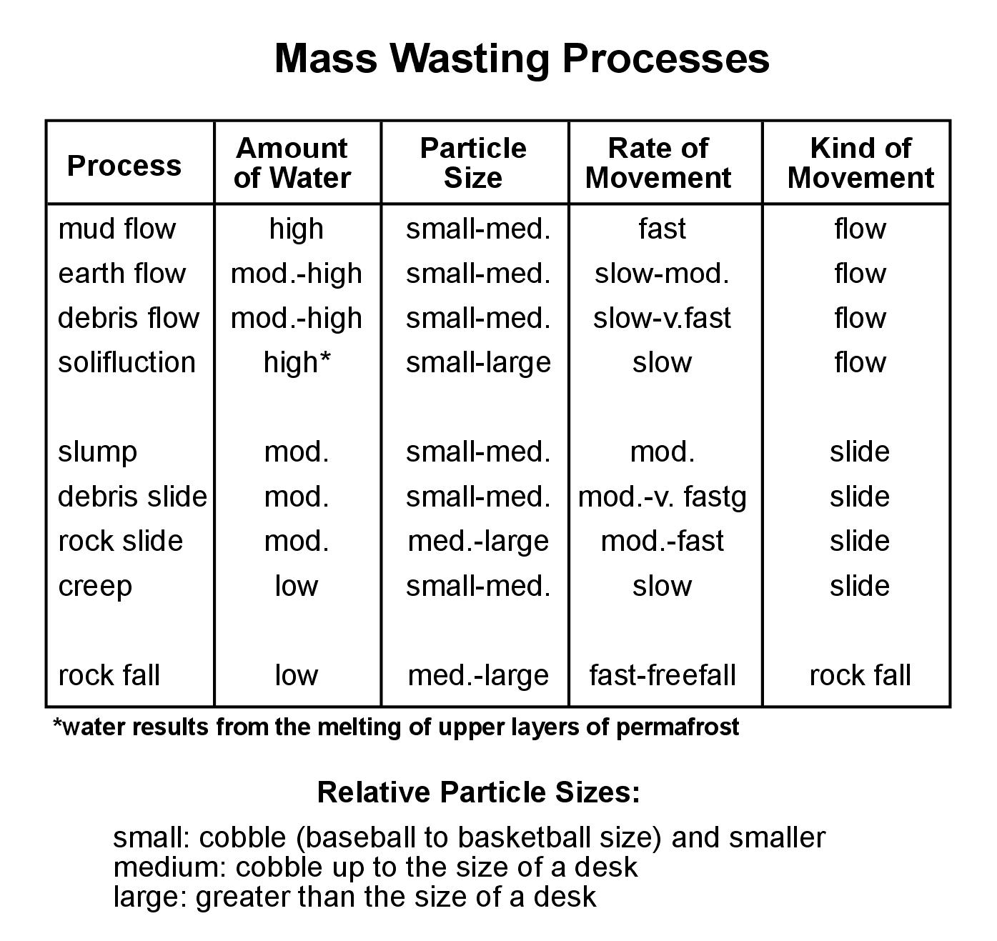
Mass wasting events are given different names based upon the amount of water, particle size, rate of movement, and kind of movement.

