Slide 1
Photographs of West Virginia Outcrops by County
Raleigh
Randolph
Ritchie
Roane
Summers
Tucker
Wood
Pendleton
Putnam
Photos by:
Peter Lessing, Ph.D.
Senior Research Geologist (retired)
West Virginia Geological
and Economic Survey
1997
Click on a photo above to see photo(s) available for a County
Photo Credits

Slide 2
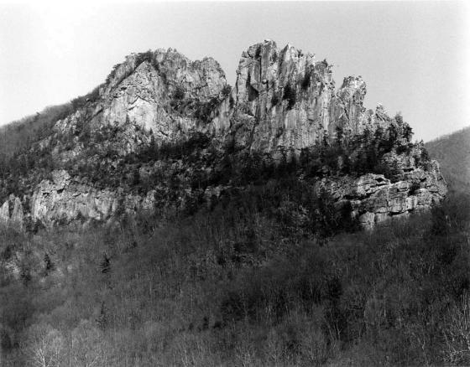
Vertical Tuscarora
County: Pendleton
Quadrangle: Upper Tract
Location Info: See comments
Rock Formation(s): Silurian Tuscarora Sandstone
Strike/Dip (in degrees): N 30 E, dip is vertical
Comments: Seneca Rocks from visitors center area (many climbers on the face and at top). The Tuscarora at this location is approximately 200 feet thick with several faults parallel to bedding.
County List
Next

Slide 3
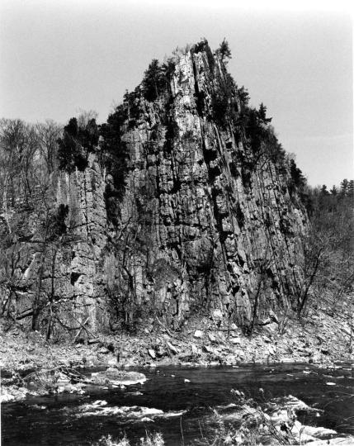
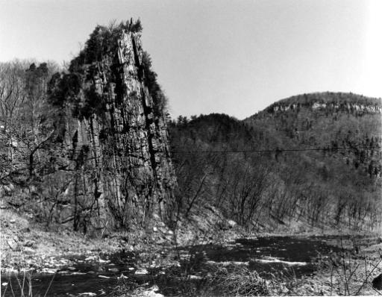
Overturned Devonian
Oriskany Sandstone
County: Pendleton
Quadrangle: Upper Tract
Location Info: Approximately 2 miles northwest of Route 220 on Smoke Hole Road
Rock Formation(s): Devonian Oriskany Sandstone
Strike/Dip (in degrees): Overturned and now dips 80 SE with Devonian Helderberg on southeast side. Strike is N 20 E.
Comments: Also called “Eagle Rocks” and located on Cave Mountain.
From Sign at this Location: “Eagle Rocks. Named for William Eagle, a Revolutionary War soldier who lived nearby. Enlisted at age fifteen, 12-24-1776, he served in the 3rd, 4th, 8th, and 12th, Virginia Regiments, Continental Line, at Valley Forge and Yorktown. Died 1848, and is buried here.” Grave is right behind this sign at Eagle Rocks.
Click on photo above to zoomed view of the fold.
County List
CLOSE
Previous

Slide 4
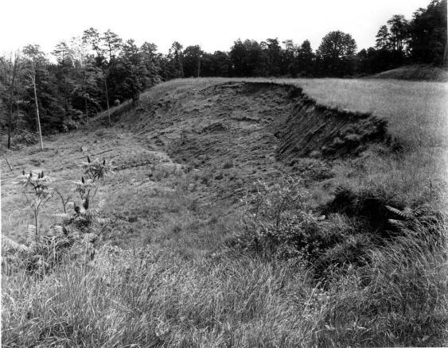
Top of Landslide
County: Putnam
Quadrangle: Bancroft
Location Info: On Route 34, next to Lone Oak Church
Rock Formation(s): Base of Permian Dunkard Group
Strike/Dip (in degrees): None
Comments: This is the top of a landslide showing the crown, scarp, and head. The upper scarp is about 15 feet high and the distance across is about 175-200 feet. Slide is mostly red soil of the Dunkard, which is notoriously unstable.
County List

Slide 5
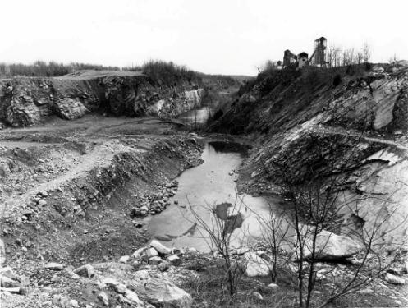
Coal Strip Mine Benches
County: Raleigh
Quadrangle: Arnett
Location Info: 4.2 miles west of Bolt, WV on Route 99.
Rock Formation(s): Pennsylvanian Kanawha Formation
Strike/Dip (in degrees): Horizontal
Comments: Five benches in photo.
County List

Slide 6
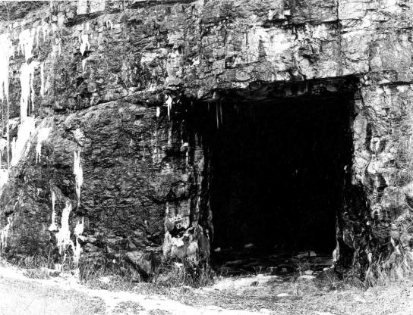
Abandoned Limestone Mine
County: Randolph
Quadrangle: Bowen
Location Info: South side of new Route 33 at Bowden.
Rock Formation(s): Mississippian Greenbrier Limestone
Strike/Dip (in degrees): Nearly horizontal.
Comments: Opening to mine is about 30-40 feet high. There is another opening to the same mine at this same location. Route 33 that was built here disrupted springs that fed Bowden fish hatchery and so, this Corridor H was abandoned and ends at Shavers Fork; another screw up by the WV Highway Dept.
County List

Slide 7
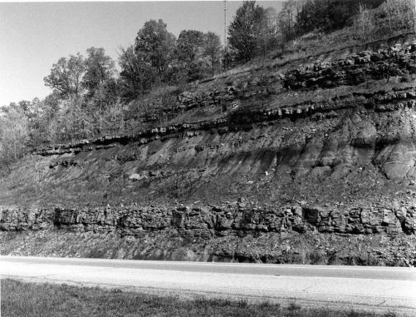
Sandstone and Shale Roadcut
County: Ritchie
Quadrangle: Schultz
Location Info: On Route 50, just E of Bear Run Road and 4.5 miles W of Ellenboro
Rock Formation(s): Permian Dunkard (may be Pennsylvanian)
Strike/Dip (in degrees): Horizontal
Comments: Entire road cut is about 100 feet high. Thick sandstone near base is about 10 feet thick and green on fresh surface. There are thinner sandstones in middle and upper sections. Interlayered shales are red and green. Note different weathering characteristics.
County List

Slide 8
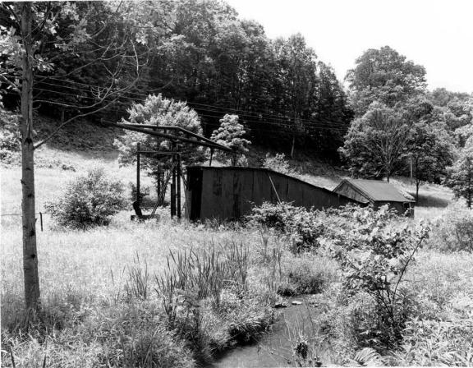
Old Oil Well
County: Roane
Quadrangle: Gay
Location Info: On Route 33, 0.5 miles E of Roane/Jackson line and 2.6 miles W of Peniel
Rock Formation(s): Well is spudded in Permian Dunkard Group
Strike/Dip (in degrees): None in photo, but horizontal
Comments: This oil well is in the Buffalo-Peniel field (number 162) and oil was obtained from the Salt Sand (Lower Pennsylvanian).
County List

Slide 9
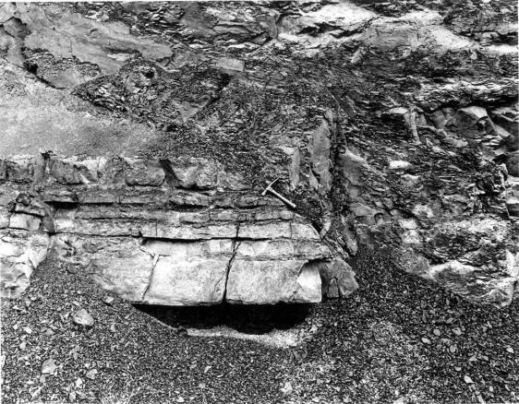
Thrust Fault
County: Summers
Quadrangle: Dawson
Location Info: On I-64 at mile post 147; 0.8 miles west of Summers/Greenbrier County line and 3.5 miles east of Green Sulphur Springs exit.
Rock Formation(s): Mississippian Hinton Formation
Strike/Dip (in degrees): Horizontal
Comments: Hammer handle (about one foot long) is parallel to fault that dips 25 E. Displacement unknown. Right side has moved upwards towards upper left of photo.
County List

Slide 10
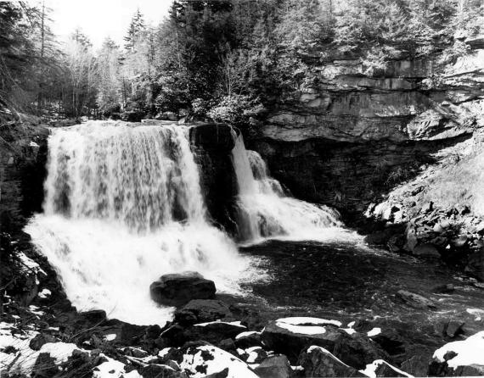
Blackwater Falls
County: Tucker
Quadrangle: Blackwater Falls
Location Info: At Blackwater State Park
Rock Formation(s): Pennsylvanian Conoquesnessing and Homewood Sandstones
Strike/Dip (in degrees): Horizontal
Comments: Several frames from first overlook and from lower walkway. Good photo ops from “Gentle Trail” on other side also. Falls caused by resistant sandstones visible on right.
County List

Slide 11
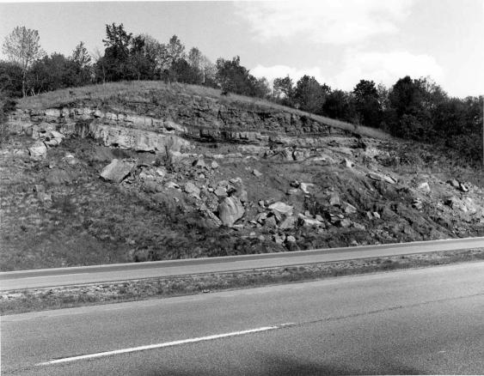
Landslide
County: Wood
Quadrangle: Rockport
Location Info: On I-77, 0.7 miles N of Jackson/Wood County line and 0.7 miles N of mile post 157
Rock Formation(s): Permian Dunkard (may be Pennsylvanian)
Strike/Dip (in degrees): Horizontal
Comments: Large blocks of rock (the size of cars) with associated red shale have fallen to road level. Red shale here has no strength, and when combined with water, it will slide. Sandstone ledges now have no support, so they too tumble down.
County List

